Slide 1
Maximizing Speed and Density of Tiled FPGA Overlays via Partitioning
Charles Eric LaForest
J. Gregory Steffan
University of Toronto
ICFPT 2013

Slide 2
FPGA Overlay Architectures
Layer of abstraction over FPGA
Easier development
Compile software rather than design hardware
Typically a soft-processor
Provides parallelism through “tiling”
Multiple Cores
Multiple Datapaths (Vector Processors)

Slide 3
Scalar Core: Octavo
0
1
2
3
4
5
6
7
8
9
I
CTL0
CTL1
A/B
A/B
ALU0
ALU1
ALU2
ALU3
A soft-processor on Stratix IV
10 stages, 8 threads, 550 MHz in many cases
Highly configurable and customizable
Published at FPGA 2012
“Octavo: an FPGA-Centric Processor Family”

Slide 4
Tiling Datapaths
Attach SIMD Lanes
Copies of the Scalar Datapath
Private data memories
Replicated instruction logic
Pipelined distribution and decoding
Not the critical path!
Intuition: Fmax stays “constant”
Scalar Core
SIMD
SIMD
SIMD
SIMD

Slide 5
Experimental Framework
Quartus 12.1 targeting Stratix IV E230
Test harness to isolate paths to outside
Synthesize for speed
Including full physical synthesis
Maximum Place & Route effort
550 MHz clock target (BRAM Fmax)
Average results over 10 runs
Measure area as equivalent ALMs (eALMs)

Slide 6
Fmax with Increasing SIMD Lanes
Scalar Core
Optimized instruction
logic fan-out!
32 SIMD Lanes

Slide 7
Disabling Duplicate Register Removal
467 MHz
+26% Fmax
370 MHz

Slide 8
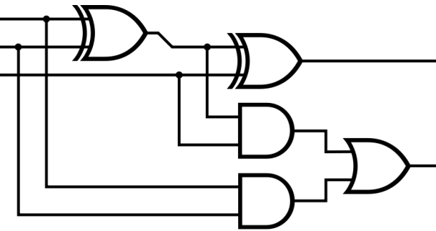
A Better Way: Partitioning
Logical division of a design
Synthesize as separate netlists
Generally, optimizations do not cross partitions
Register retiming
Register de-duplication
Boolean simplification

Slide 9
Partitioning Each SIMD Lane

Slide 10
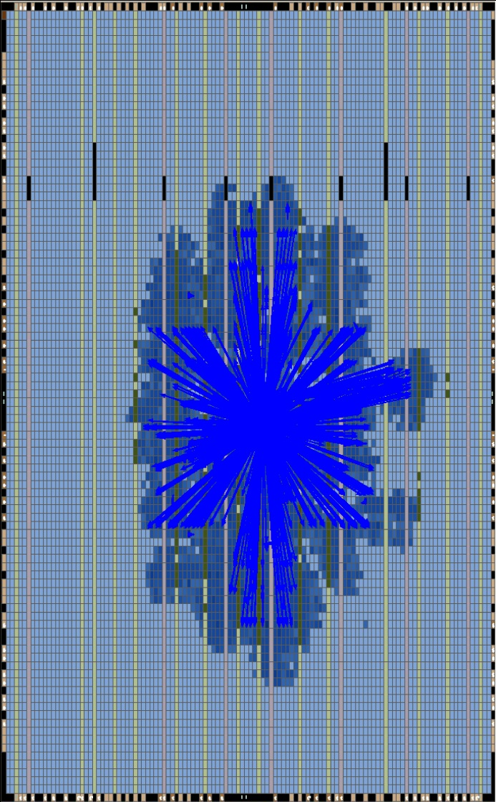
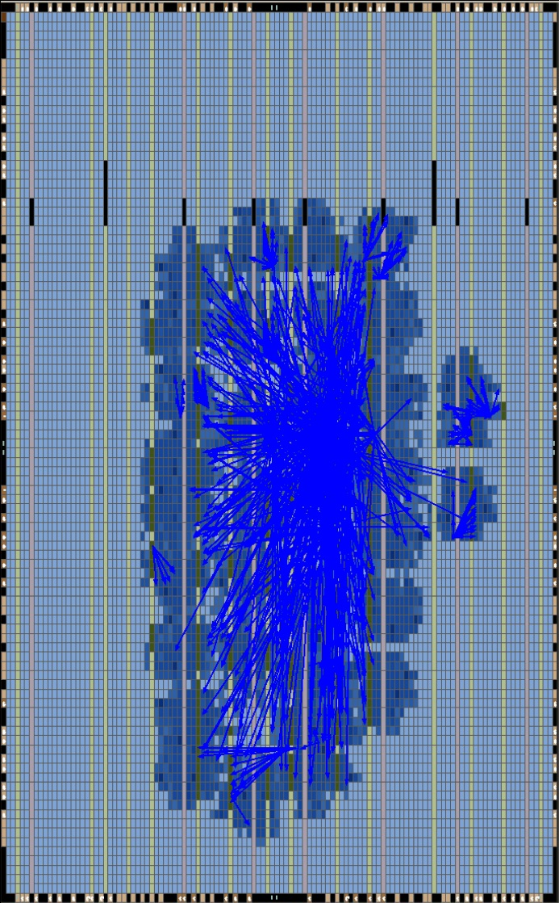
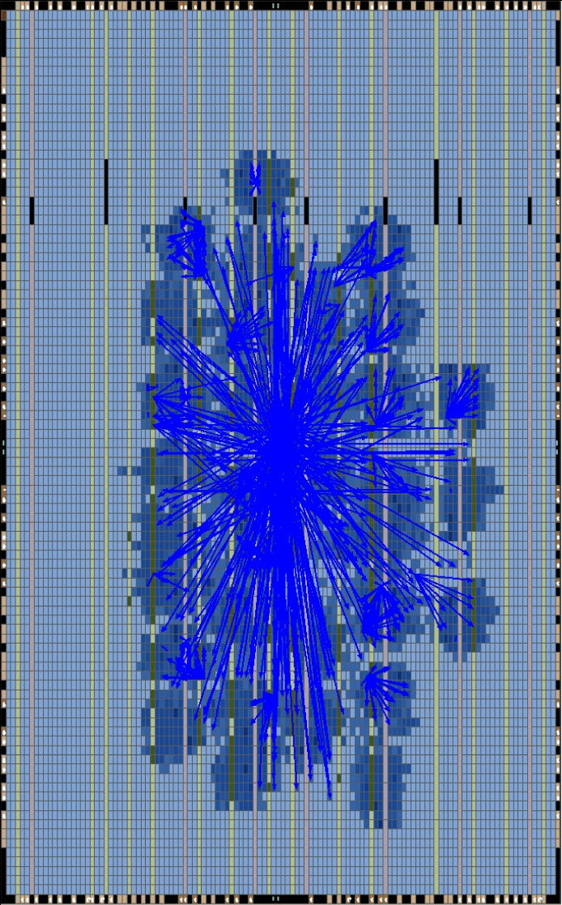
Impact on Critical Paths
32-Lane SIMD Core
Source node fan-out of
top 100 failing paths
Flat
373 MHz
21 Nodes
Duplicate Registers
456 MHz
43 Nodes
Partitioned
489 MHz
64 Nodes

Slide 11
Improving Compute Density
Beneficial optimization
Excessive fan-out

Slide 12
Improving Compute Density
Lost
optimization
Duplicated registers: less excessive fan-out

Slide 13
Improving Compute Density
Lost
optimization
Partitioning: local optimizations!

Slide 14
Area Impact
Partitioned (solid)
Duplicate Registers
(dashed)
(Relative to Flat)

Slide 15
Area Impact
Dup. Registers
+5% area
Partitioning:
+11-14% area

Slide 16
Summary: SIMD Partitioning
Scalar Core with 0 to 32 SIMD Lanes
Tiling datapaths
Replicated instruction logic
Pipelined distribution and decoding in each Lane
Placing each Lane in a Partition
32 Lanes: 372 MHz → 482 MHz (+30%)
Area increase from partitioning: 11-14%
Reflects area of preserved replicated logic
Better to not partition for a few Lanes!
4 lanes or less have better compute density
Local optimizations outweigh increased fanout

Slide 17
Partitioning!? Really!?
Can we get the same results in another way?
“Layering” replicated logic:
Introducing sequential dependency via pipelining
Not about breaking critical paths!
Isolating instances of replicated logic
Prevents optimization of replicated logic
Staggers execution of each layer

Slide 18
Layering a SIMD Core
1 Layer with 4 Lanes
Scalar
SIMD
SIMD
SIMD
SIMD

Slide 19
Layering a SIMD Core
Scalar
SIMD
2 Layers with 2 Lanes
SIMD
SIMD
SIMD

Slide 20
Layering a SIMD Core
Scalar
SIMD
SIMD
4 Layer with 1 Lane
SIMD
SIMD
Staggered SIMD execution!

Slide 21
Layering a SIMD Core
16
32
8
4
2
1
Flat: +65 MHz (+17%)

Slide 22
Layering a SIMD Core
Partitioned: +30 MHz (+6%)
Flat: +65 MHz (+17%)

Slide 23
Replicating Entire Processors
Connect processors in a pipelined Mesh
Entire processors replicated
No critical paths between processors
Intuition: Fmax stays “constant”
Scalar/SIMD
Scalar/SIMD
Scalar/SIMD
Scalar/SIMD
Scalar/SIMD
Scalar/SIMD

Slide 24
Critical Paths of Meshes
Mesh of 102 Cores
Source node fan-out
of top 100 failing paths
Flat
331 MHz
2 nodes
Partitioned
489 MHz
61 nodes

Slide 25
Partitioning Meshes
Mesh of 102 Scalar Cores
Bottleneck: optimized 3-bit counter
Round-robin thread counter in each Scalar Core
No inputs, but identical and synchronized states
Placing each Core in a Partition
Avg. Fmax: 284 MHz → 437 MHz (54%)
Only a 22% Fmax drop over 102x scaling!
Area increase from partitioning: 0.85%
No relation between Fmax and area increases
Mysterious 10-11% area overhead from CAD tool
No significant increase to CAD time!

Slide 26
Summary
Tiled designs contain replicated logic
Forms the critical paths in large tilings
Useless optimizations causing excessive fanout
Becomes significant at higher speeds
Partitioning avoids this problem
Simpler than per-node management
Lower area than disabling duplicate removal
Better performance than sequential dependencies
Benefit scales with the number of tiles
Area increase only proportional to replicated logic
No significant change to total CAD time

Slide 27
Further Work
The CAD tools could automatically…
Detect repeated optimizations across modules
Tag the replicated logic and/or alert the designer
“Restart” optimization
Keep performance and save (some) area
Only if substantial replicated logic area
Partition modules containing replicated logic
Power Analysis of Partitioning
Could go either way…
CAD tool mysteriously adds area when tiling
Main source of density reduction when tiling

Slide 28
Acknowledgements
Funding:
Queen Elizabeth II World Telecom. Congress
Walter C. Sumner Foundation
Altera
NSERC
Computing:
SciNet GPC supercomputer
24 CPU-years of Quartus runs
Altera

Slide 29
Extra Slides

Slide 30
FPGA Overlay Architectures
Layer of abstraction over FPGA
Easier development
Compile software rather than design hardware
Typically a soft-processor
Nios, MicroBlaze (Altera, Xilinx)
iDEA (NTU, Xilinx),
Octavo (UofT, Altera)
Provides parallelism through tiling
Multi-Cores
Vector Processors
VEGAS (UofT)
VENICE (UBC)

Slide 31
Multi-Local Logic
Multiple instances of equivalent logic
Each instance operates locally and identically
Tiling introduces multi-local logic
Different tilings → Different multi-local logic
Connected (SIMD)
Unconnected (Mesh)
CAD tools de-duplicate multi-local logic
Removes redundancy in small circuits
Introduces critical paths in large circuits!
Especially at high speeds
Preserve with different partitioning schemes

Slide 32
Area Impact
Relative to Flat: 1,027 to 25,799 eALMs

Slide 33
Floorplanning a Scalar Core

Slide 34
Floorplanning
Spatial pre-allocation of area
Avoids placement interference
Preserves timing closure
Used to manage large projects
A
B
C
D

Slide 35
Floorplanning a Scalar Core
Floorplan to match logic and routing aspects
Tall, narrow logic blocks, more horizontal wires
Maybe improve compute density
Place a Scalar Core in range of floorplans
Results:
4 to 14% lower compute density!
Harder P&R problem, same hardware
Use only for project management

Slide 36
Floorplanning a Scalar Core
Floorplan to match logic and routing aspects
Tall, narrow logic blocks, more horizontal wires
Maybe improve compute density
Scalar Core in 4x4 to 20x20 LAB floorplans
1 Logic Array Block = 10 ALMs, plus local routing
Needs ~64 LABs minimum to fit
4 to 14% lower compute density!
Harder P&R problem, same hardware
Use only for project management

Slide 37
Floorplanning a Scalar Core
14% lower vs.
no floorplan
9x8 8x9,
but no gain
4% lower
6x12 12x6

Slide 38
Experimental Framework
Quartus 12.1 targeting Stratix IV E230
Design enclosed by test harness
Synthesize for speed
Maximum Place & Route effort
550 MHz clock target (BRAM Fmax)
Average results over 10 runs
Measure area as equivalent ALMs (eALMs)
ALM → two 6-LUTs, two flip-flops, two full-adders
M9K BRAM → 28.7 ALMs
DSP Block → 29.75 ALMs
“Comparing FPGA vs. Custom CMOS and the Impact on Processor Microarchitecture”, Wong, Betz, Rose, FPGA 2011

Slide 39
Partitioning
Logical division of a design
Synthesize as separate netlists
Generally, optimizations do not cross partitions
Register retiming
Register de-duplication
Boolean simplification
A
B

Slide 40
Tiling
Replicating in two dimensions
Multiple copies for parallelism
SIMD: tiled datapaths
MIMD: tiled processors
Scalar Core
SIMD
Scalar/SIMD
Scalar/SIMD
SIMD
SIMD
Scalar/SIMD
Scalar/SIMD
SIMD
Scalar/SIMD
Scalar/SIMD

