Slide 1
Chip-Multiprocessor Caches:
Placement and Management
Andreas Moshovos
University of Toronto/ECE
Short Course, University of Zaragoza, July 2009
Most slides are based on or directly taken from material and slides by the original paper authors

Slide 2
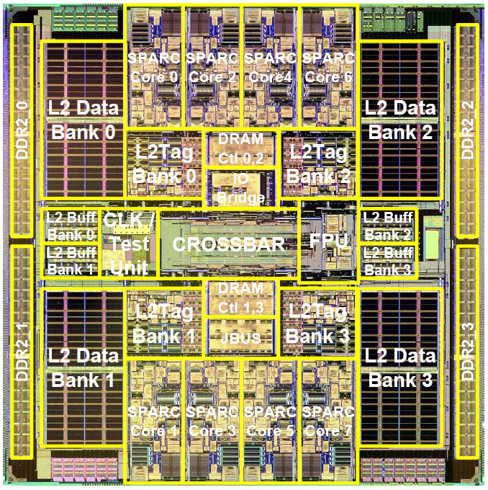
Modern Processors Have Lots of Cores and Large Caches
Sun Niagara T1
From http://jinsatoh.jp/ennui/archives/2006/03/opensparc.html

Slide 3
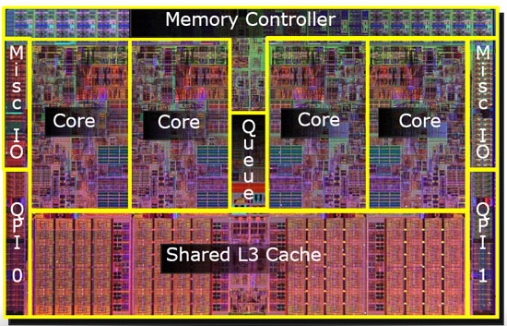
Modern Processors Have Lots of Cores and Large Caches
Intel i7 (Nehalem)
From http://www.legitreviews.com/article/824/1/

Slide 4
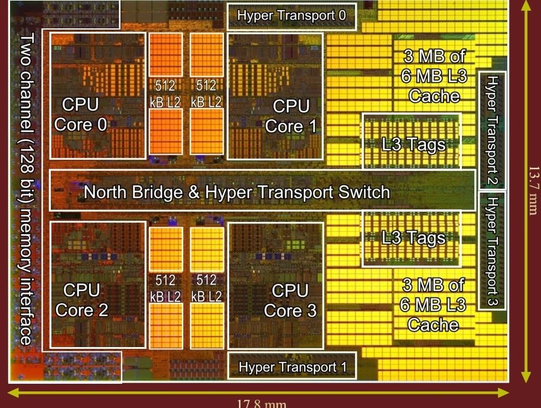
Modern Processors Have Lots of Cores and Large Caches
AMD Shanghai
From http://www.chiparchitect.com

Slide 5
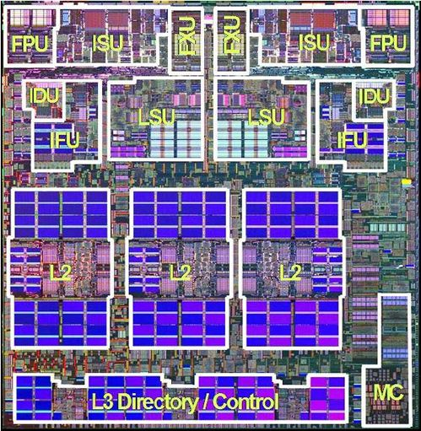
Modern Processors Have Lots of Cores and Large Caches
IBM Power 5
From http://www.theinquirer.net/inquirer/news/1018130/ibms-power5-the-multi-chipped-monster-mcm-revealed

Slide 6
Why?
Helps with Performance and Energy
  Find graph with perfect vs. realistic memory system

Slide 7
What Cache Design Used to be About
Core
L1I
L1D
1-3 cycles / Latency Limited
L2
10-16 cycles / Capacity Limited
Main Memory
> 200 cycles
L2: Worst Latency == Best Latency
Key Decision: What to keep in each cache level

Slide 8
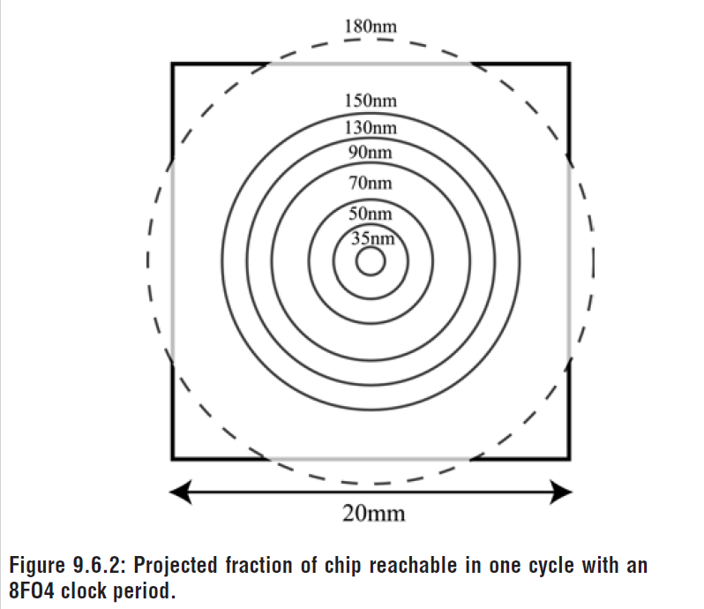
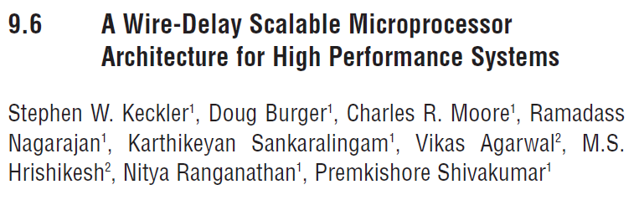
What Has Changed
ISSCC 2003

Slide 9
What Has Changed
Where something is matters
More time for longer distances

Slide 10
NUCA: Non-Uniform Cache Architecture
Core
Tiled Cache
Variable Latency
Closer tiles = Faster
Key Decisions:
  Not only what to cache
  Also where to cache
L1I
L1D
L2
L2
L2
L2
L2
L2
L2
L2
L2
L2
L2
L2
L2
L2
L2
L2

Slide 11
NUCA Overview
Initial Research focused on Uniprocessors
Data Migration Policies
  When to move data among tiles
L-NUCA: Fine-Grained NUCA

Slide 12
Another Development: Chip Multiprocessors
Core
Core
Core
Core
L1I
L1D
L1I
L1D
L1I
L1D
L1I
L1D
L2
Easily utilize on-chip transistors
Naturally exploit thread-level parallelism
Dramatically reduce design complexity
Future CMPs will have more processor cores
Future CMPs will have more cache
Text from Michael Zhang & Krste Asanovic, MIT

Slide 13
Initial Chip Multiprocessor Designs
Layout: “Dance-Hall”
  Core + L1 cache
  L2 cache
Small L1 cache: Very low access latency
Large L2 cache
core
core
core
core
L1$
L1$
L1$
L1$
Intra-Chip Switch
L2
Cache
A 4-node CMP with a large L2 cache
Slide from Michael Zhang & Krste Asanovic, MIT

Slide 14
Chip Multiprocessor w/ Large Caches
Layout: “Dance-Hall”
  Core + L1 cache
  L2 cache
Small L1 cache: Very low access latency
Large L2 cache: Divided into slices to minimize access latency and power usage
core
core
core
core
L1$
L1$
L1$
L1$
Intra-Chip Switch
L2 Slice
L2 Slice
L2 Slice
L2 Slice
L2 Slice
L2 Slice
L2 Slice
L2 Slice
L2 Slice
L2 Slice
L2 Slice
L2 Slice
L2 Slice
L2 Slice
L2 Slice
L2 Slice
L2 Slice
L2 Slice
L2 Slice
L2 Slice
L2 Slice
L2 Slice
L2 Slice
L2 Slice
L2 Slice
L2 Slice
L2 Slice
L2 Slice
L2 Slice
L2 Slice
L2 Slice
L2 Slice
A 4-node CMP with a large L2 cache
Slide from Michael Zhang & Krste Asanovic, MIT

Slide 15
Chip Multiprocessors + NUCA
Current: Caches are designed with (long) uniform access latency for the worst case:
  Best Latency == Worst Latency
Future: Must design with non-uniform access latencies depending on the on-die location of the data:
  Best Latency << Worst Latency
Challenge: How to minimize average cache access latency:
  Average Latency → Best Latency
core
core
core
core
L1$
L1$
L1$
L1$
Intra-Chip Switch
L2 Slice
L2 Slice
L2 Slice
L2 Slice
L2 Slice
L2 Slice
L2 Slice
L2 Slice
L2 Slice
L2 Slice
L2 Slice
L2 Slice
L2 Slice
L2 Slice
L2 Slice
L2 Slice
L2 Slice
L2 Slice
L2 Slice
L2 Slice
L2 Slice
L2 Slice
L2 Slice
L2 Slice
L2 Slice
L2 Slice
L2 Slice
L2 Slice
L2 Slice
L2 Slice
L2 Slice
L2 Slice
A 4-node CMP with a large L2 cache
Slide from Michael Zhang & Krste Asanovic, MIT

Slide 16
Tiled Chip Multiprocessors
Switch
Tiled CMPs for Scalability
  Minimal redesign effort
  Use directory-based protocol for scalability
Managing the L2s to minimize the effective access latency
  Keep data close to the requestors
  Keep data on-chip
core
L1$
L2$
Slice
Data
L2$
Slice
Tag
c
L1
SW
c
L1
SW
c
L1
SW
c
L1
SW
L2$
Data
L2$
Tag
L2$
Data
L2$
Tag
L2$
Data
L2$
Tag
L2$
Data
L2$
Tag
c
L1
SW
c
L1
SW
c
L1
SW
c
L1
SW
L2$
Data
L2$
Tag
L2$
Data
L2$
Tag
L2$
Data
L2$
Tag
L2$
Data
L2$
Tag
c
L1
SW
c
L1
SW
c
L1
SW
c
L1
SW
L2$
Data
L2$
Tag
L2$
Data
L2$
Tag
L2$
Data
L2$
Tag
L2$
Data
L2$
Tag
c
L1
SW
c
L1
SW
c
L1
SW
c
L1
SW
L2$
Data
L2$
Tag
L2$
Data
L2$
Tag
L2$
Data
L2$
Tag
L2$
Data
L2$
Tag
Slide from Michael Zhang & Krste Asanovic, MIT

Slide 17
Option #1: Private Caches
Core
Core
Core
Core
L1I
L1D
L1I
L1D
L1I
L1D
L1I
L1D
L2
L2
L2
L2
Main Memory
+ Low Latency
- Fixed allocation

Slide 18
Option #2: Shared Caches
Core
Core
Core
Core
L1I
L1D
L1I
L1D
L1I
L1D
L1I
L1D
L2
L2
L2
L2
Main Memory
Higher, variable latency
One Core can use all of the cache

Slide 19
Data Cache Management for CMP Caches
Get the bets of both worlds
  Low Latency of Private Caches
  Capacity Adaptability of Shared Caches

Slide 20
  NUCA: A Non-Uniform Cache Access Architecture for Wire-Delay Dominated On-Chip Caches
  Changkyu Kim, D.C. Burger, and S.W. Keckler,
  10th International Conference on Architectural Support for Programming Languages and Operating Systems (ASPLOS-X), October, 2002.

Slide 21
NUCA: Non-Uniform Cache Architecture
Tiled Cache
Variable Latency
Closer tiles = Faster
Key Decisions:
  Not only what to cache
  Also where to cache
Interconnect
  Dedicated busses
  Mesh better
Static Mapping
Dynamic Mapping
  Better but more complex
  Migrate data
Core
L1I
L1D
L2
L2
L2
L2
L2
L2
L2
L2
L2
L2
L2
L2
L2
L2
L2
L2

Slide 22
Distance Associativity for High-Performance Non-Uniform Cache Architectures
Zeshan Chishti, Michael D Powell, and T. N. Vijaykumar
36th Annual International Symposium on Microarchitecture (MICRO), December 2003.
Slides mostly directly from their conference presentation

Slide 23
Problem with NUCA
Couples Distance Placement with Way Placement
NuRapid:
  Distance Associativity
Centralized Tags
  Extra pointer to Bank
  Achieves 7% overall processor E-D savings
Core
L1I
L1D
fastest
L2
L2
Way 1
fast
L2
L2
Way 2
slow
L2
L2
Way 3
slowest
L2
L2
Way 4

Slide 24
Light NUCA: a proposal for bridging the inter-cache latency gap
Darío Suárez ¹, Teresa Monreal ¹, Fernando Vallejo ², Ramón Beivide ², and Victor Viñals ¹
¹ Universidad de Zaragoza and ² Universidad de Cantabria

Slide 25
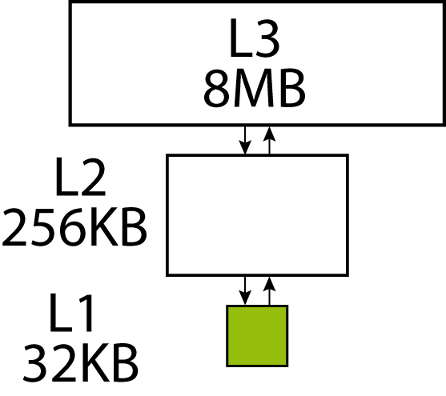
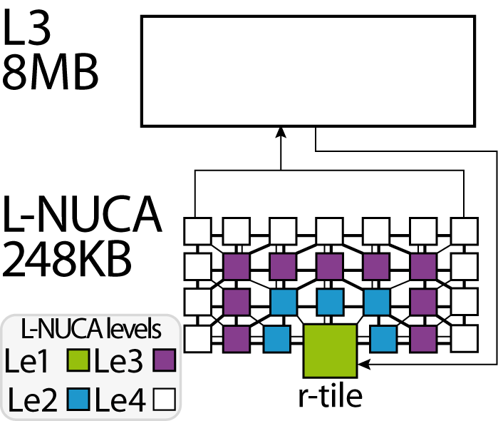
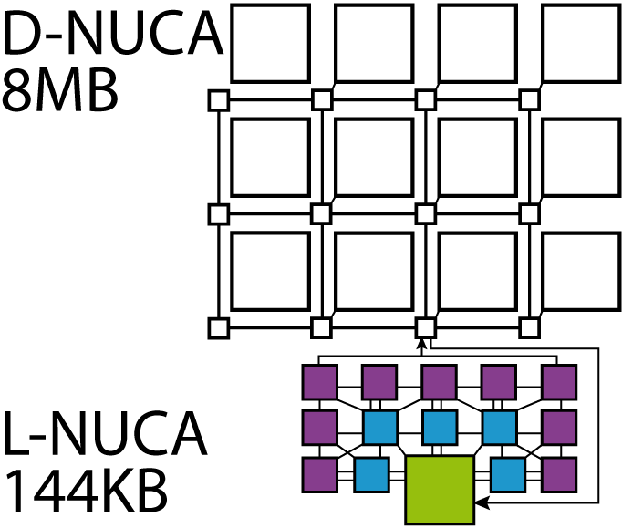
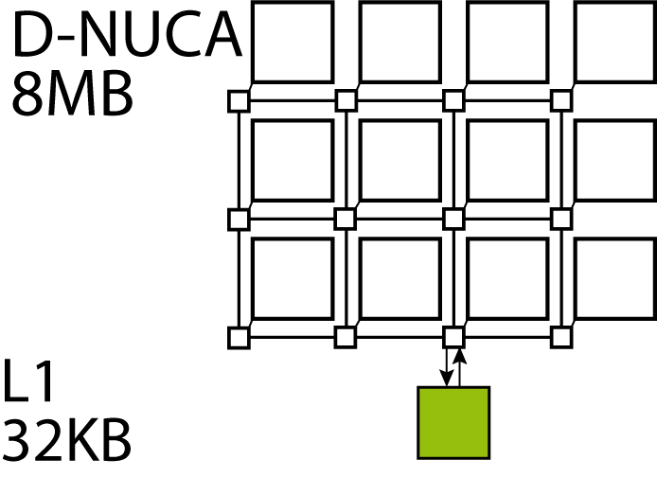
L-NUCA: A Fine-Grained NUCA
3-level conventional cache vs. L-NUCA and L3
D-NUCA vs. L-NUCA and D-NUCA

Slide 26
Managing Wire Delay in Large CMP Caches
Bradford M. Beckmann and David A. Wood
Multifacet Project
University of Wisconsin-Madison
MICRO 2004
12/8/04

Slide 27
Managing Wire Delay in Large CMP Caches
Managing wire delay in shared CMP caches
Three techniques extended to CMPs
    On-chip Strided Prefetching
      Scientific workloads: 10% average reduction
      Commercial workloads: 3% average reduction
    Cache Block Migration (e.g. D-NUCA)
      Block sharing limits average reduction to 3%
      Dependence on difficult to implement smart search
    On-chip Transmission Lines (e.g. TLC)
      Reduce runtime by 8% on average
      Bandwidth contention accounts for 26% of L2 hit latency
Combining techniques
    Potentially alleviates isolated deficiencies
      Up to 19% reduction vs. baseline
    Implementation complexity
D-NUCA search technique for CMPs
  Do it in steps

Slide 28
Where do Blocks Migrate to?
Scientific Workload:
Block migration successfully separates
the data sets
Commercial Workload:
Most Accesses go in the middle

Slide 29
A NUCA Substrate for Flexible CMP Cache Sharing
Jaehyuk Huh, Changkyu Kim †, Hazim Shafi, Lixin Zhang§,
Doug Burger , Stephen W. Keckler †
Int’l Conference on Supercomputing, June 2005
§Austin Research Laboratory IBM Research Division | †Dept. of Computer Sciences The University of Texas at Austin

Slide 30
What is the best Sharing Degree? Dynamic Migration?
Core
Determining sharing degree
  Miss rates vs. hit latencies
Latency management for increasing wire delay
  Static mapping (S-NUCA) and dynamic mapping (D-NUCA)
Best sharing degree is 4
Dynamic migration
  Does not seem to be worthwhile in the context of this study
  Searching problem is still yet to be solved
L1 prefetching
  7 % performance improvement (S-NUCA)
  Decrease the best sharing degree slightly
Per-line sharing degrees provide the benefit of both high and low sharing degree
L1I
L1D
L2
L2
L2
L2
L2
L2
L2
L2
L2
L2
L2
L2
L2
L2
L2
L2
  Sharing Degree (SD):
  number of processors in a shared L2

Slide 31
Victim Replication: Maximizing Capacity while Hiding Wire Delay in Tiled Chip Multiprocessors
Michael Zhang & Krste Asanovic
Computer Architecture Group
MIT CSAIL
Int’l Conference on Computer Architecture, June 2005
Slides mostly directly from the author’s presentation

Slide 32
Victim Replication: A Variant of the Shared Design
Switch
Switch
core
L1$
core
L1$
Implementation: Based on the shared design
Get for free:
  L1 Cache: Replicates shared data locally for fastest access latency
L2 Cache: Replicates the L1 capacity victims → Victim Replication
Shared
L2$
Data
L2$
Tag
DIR
Shared
L2$
Data
L2$
Tag
DIR
Sharer i
Sharer j
Switch
core
L1$
Shared
L2$
Data
L2$
Tag
DIR
Home Node

Slide 33
Optimizing Replication, Communication, and
Capacity Allocation in CMPs
Z. Chishti, M. D. Powell, and T. N. Vijaykumar
Proceedings of the 32nd International Symposium on Computer Architecture, June 2005.
Slides mostly by the paper authors and by Siddhesh Mhambrey’s course presentation CSE520

Slide 34
CMP-NuRAPID: Novel Mechanisms
Controlled Replication
  Avoid copies for some read-only shared data
In-Situ Communication
  Use fast on-chip communication to avoid coherence miss of read-write-shared data
Capacity Stealing
  Allow a core to steal another core’s unused capacity
Hybrid cache
  Private Tag Array and Shared Data Array
  CMP-NuRAPID(Non-Uniform access with Replacement and Placement using Distance associativity)
  Local, larger tags
Performance
  CMP-NuRAPID improves performance by 13% over a shared cache and 8% over a private cache for three commercial multithreaded workloads
  Three novel mechanisms to exploit the changes in Latency-Capacity tradeoff

Slide 35
Cooperative Caching for
Chip Multiprocessors
Jichuan Chang and Guri Sohi
Int’l Conference on Computer Architecture, June 2006

Slide 36
CC: Three Techniques
Don’t go off-chip if on-chip (clean) data exist
  Existing protocols do that for dirty data only
    Why? When clean-shared have to decide who responds
    No significant benefit in SMPs → CMPs protocols are build on SMP protocols
Control Replication
  Evict singlets only when no invalid or replicates exist
  “Spill” an evicted singlet into a peer cache
Approximate global-LRU replacement
  First become the LRU entry in the local cache
  Set as MRU if spilled into a peer cache
  Later become LRU entry again: evict globally
  1-chance forwarding (1-Fwd)
    Blocks can only be spilled once if not reused

Slide 37
Cooperative Caching
Two probabilities to help make decisions
  Cooperation probability: Prefer singlets over replicates?
    When replacing within a set
      Use probability to select whether a singlet can be evicted or not
    control replication
  Spill probability: Spill a singlet victim?
    If a singlet was evicted should it be replicated?
    throttle spilling
No method for selecting this probability is proposed

Slide 38
Managing Distributed, Shared L2 Caches through
OS-Level Page Allocation
Sangyeun Cho and Lei Jin
Dept. of Computer Science
University of Pittsburgh
Int’l Symposium on Microarchitecture, 2006

Slide 39
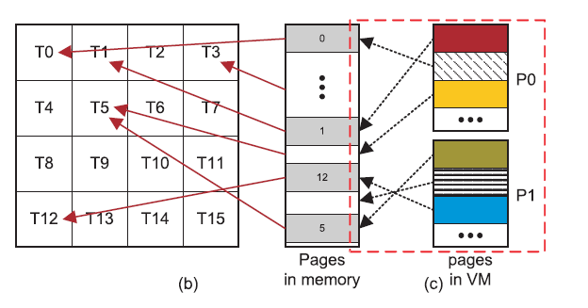
Page-Level Mapping
The OS has control of where a page maps to

Slide 40
OS Controlled Placement – Potential Benefits
Performance management:
  Proximity-aware data mapping
Power management:
  Usage-aware slice shut-off
Reliability management
  On-demand isolation
On each page allocation, consider
  Data proximity
  Cache pressure
  e.g., Profitability function P = f(M, L, P, Q, C)
    M: miss rates
    L: network link status
    P: current page allocation status
    Q: QoS requirements
    C: cache configuration

Slide 41
OS Controlled Placement
Hardware Support:
  Region-Table
  Cache Pressure Tracking:
    # of actively accessed pages per slice
    Approximation → power-, resource-efficient structure
Results on OS-directed:
  Private
  Clustered

Slide 42
ASR: Adaptive Selective Replication for CMP Caches
Brad Beckmann, Mike Marty, and David Wood
Multifacet Project
University of Wisconsin-Madison
Int’l Symposium on Microarchitecture, 2006
12/13/06

Slide 43
Adaptive Selective Replication
Sharing, Locality, Capacity Characterization of Workloads
  Replicate only Shared read-only data
  Read-write: little locality → written and read a few times
  Single Requestor: little locality
Adaptive Selective Replication: ASR
  Dynamically monitor workload behavior
  Adapt the L2 cache to workload demand
  Up to 12% improvement vs. previous proposals
Mechanisms for estimating Cost/Benefit of less/more replication
Dynamically adjust replication probability
  Several replication prob. levels
Use probability to “randomly” replicate blocks

Slide 44
An Adaptive Shared/Private NUCA Cache Partitioning Scheme for Chip Multiprocessors
Haakon Dybdahl & Per Stenstrom
Int’l Conference on High-Performance Computer Architecture, Feb 2007

Slide 45
Adjust the Size of the Shared Partition in Each Local Cache
Divide ways in Shared and Private
  Dynamically adjust the # of shared ways
Decrease? → Loss: How many more misses will occur?
Increase? → Gain: How many more hits?
Every 2K misses adjust ways according to gain and loss
No massive evictions or copying to adjust ways
  Replacement algorithm takes care of way adjustment lazily
Demonstrated for multiprogrammed workloads

Slide 46
Dynamic Spill-Receive for Robust High-Performance Caching in CMPs
Moinuddin K. Qureshi
T. J. Watson Research Center, Yorktown Heights, NY

Slide 47
Cache Line Spilling
Spill evicted line from one cache to neighbor cache
- Co-operative caching (CC) [ Chang+ ISCA’06]
Spill
Cache A
Cache B
Cache C
Cache D
Problem with CC:
Performance depends on the parameter (spill probability)
All caches spill as well as receive ➔ Limited improvement
  Spilling helps only if application demands it
  Receiving lines hurts if cache does not have spare capacity
Goal:
Robust High-Performance Capacity Sharing with Negligible Overhead

Slide 48
Spill-Receive Architecture
Each Cache is either a Spiller or Receiver but not both
- Lines from spiller cache are spilled to one of the receivers
- Evicted lines from receiver cache are discarded
Spill
Cache A
Cache B
Cache C
Cache D
S/R =1
(Spiller cache)
S/R =0
(Receiver cache)
S/R =1
(Spiller cache)
S/R =0
(Receiver cache)
Dynamic Spill Receive (DSR) → Adapt to Application Demands
Dynamically decide whether a cache should be a Spill or a Receive one
Set Dueling: A few sampling sets follow one or the other policy
Periodically select the best and use for the rest
Underlying Assumption: The behavior of a few sets is reasonably representative of that of all sets

Slide 49
PageNUCA:
Selected Policies for Page-grain Locality Management in Large Shared CMP Caches
Mainak Chaudhuri, IIT Kanpur
Int’l Conference on High-Performance Computer Architecture, 2009
Some slides from the author’s conference talk

Slide 50
PageNUCA
Most Pages accessed by a single core and multiple times
  That core may change over time
  Migrate page close to that core
Fully hardwired solution composed of four central algorithms
  When to migrate a page
  Where to migrate a candidate page
  How to locate a cache block belonging to a migrated page
  How the physical data transfer takes place
Shared pages: minimize average latency
Solo pages: move close to core
Dynamic migration better than first-touch: 12.6%
  Multiprogrammed workloads

Slide 51
Dynamic Hardware-Assisted Software-Controlled Page Placement to Manage Capacity Allocation and Sharing within Caches
Manu Awasthi, Kshitij Sudan, Rajeev Balasubramonian, John Carter
University of Utah
Int’l Conference on High-Performance Computer Architecture, 2009

Slide 52
Conclusions
Last Level cache management at page granularity
  Previous work: First-touch
Salient features
  A combined hardware-software approach with low overheads
    Main Overhead : TT → page translation for all pages currently cached
  Use of page colors and shadow addresses for
    Cache capacity management
    Reducing wire delays
    Optimal placement of cache lines.
  Allows for fine-grained partition of caches.
Up to 20% improvements for multi-programmed, 8% for multi-threaded workloads

Slide 53
R-NUCA: Data Placement in Distributed Shared Caches
Nikos Hardavellas, M. Ferdman, B. Falsafi, and A. Ailamaki
Int’l Conference on Computer Architecture, June 2009
Slides from the authors and by Jason Zebchuk, U. of Toronto

Slide 54


R-NUCA
OS enforced replication at the page level
Private Data Sees This
Shared Data Sees This
Private L2
Private L2
Private L2
Private L2
Shared L2
Core
Core
Core
Core
Core
Core
Core
Core
L2 cluster
L2 cluster
Instructions
See This
Core
Core
Core
Core

Slide 55
  NUCA: A Non-Uniform Cache Access Architecture for Wire-Delay Dominated On-Chip Caches
  Changkyu Kim, D.C. Burger, and S.W. Keckler,
  10th International Conference on Architectural Support for Programming Languages and Operating Systems (ASPLOS-X), October, 2002.
Some material from slides by Prof. Hsien-Hsin S. Lee ECE, GTech

Slide 56
Conventional – Monolithic Cache
UCA: Uniform Access Cache
UCA
Best Latency = Worst Latency
  Time to access the farthest possible bank

Slide 57
UCA Design
Partitioned in Banks
Sub-bank
Data Bus
Bank
Predecoder
Address Bus
Sense
amplifier
Tag Array
Wordline driver
and decoder
Conceptually a single address and a single data bus
  Pipelining can increase throughput
See CACTI tool:
  http://www.hpl.hp.com/research/cacti/
  http://quid.hpl.hp.com:9081/cacti/

Slide 58
Experimental Methodology
SPEC CPU 2000
Sim-Alpha
CACTI
8 FO4 cycle time
132 cycles to main memory
Skip and execute a sample
Technology Nodes
  130nm, 100nm, 70nm, 50nm

Slide 59
UCA Scaling – 130nm to 50nm
Relative Latency and Performance Degrade as Technology Improves

Slide 60
UCA Discussion
Loaded Latency: Contention
  Bank
  Channel
    Bank may be free but path to it is not

Slide 61
Multi-Level Cache
Conventional Hierarchy
L3
L2
Common Usage:
  Serial-Access for Energy and Bandwidth Reduction
This paper:
  Parallel Access
  Prove that even then their design is better

Slide 62
ML-UCA Evaluation
Better than UCA
Performance Saturates at 70nm
No benefit from larger cache at 50nm

Slide 63
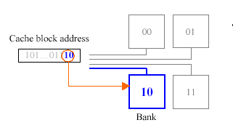
S-NUCA-1
Static NUCA with per bank set busses
Sub-bank
Bank
Data Bus
Address Bus
Tag
Set
Offset
Bank Set
Use private per bank set channel
Each bank has its distinct access latency
A given address maps to a given bank set
  Lower bits of block address

Slide 64
S-NUCA-1
How fast can we initiate requests?
  If c = scheduler delay
Conservative /Realistic:
  Bank + 2 x interconnect + c
Aggressive / Unrealistic:
  Bank + c
What is the optimal number of bank sets?
  Exhaustive evaluation of all options
  Which gives the highest IPC
Bank
Data Bus
Address Bus

Slide 65
S-NUCA-1 Latency Variability
Variability increases for finer technologies
Number of banks does not increase beyond 4M
  Overhead of additional channels
  Banks become larger and slower

Slide 66
S-NUCA-1 Loaded Latency
Better than ML-UCA

Slide 67
S-NUCA-1: IPC Performance
Per bank channels become an overhead
Prevent finer partitioning @70nm or smaller

Slide 68
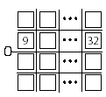
S-NUCA2
Use a 2-D Mesh P2P interconnect
Tag Array
Bank
Switch
Data bus
Predecoder
Wordline driver
and decoder
Wire overhead much lower:
  S1: 20.9% vs. S2: 5.9% at 50nm and 32banks
Reduces contention
128-bit bi-directional links

Slide 69
S-NUCA2 vs. S-NUCA1 Unloaded Latency
Hmm
S-NUCA2 almost always better

Slide 70
S-NUCA2 vs. S-NUCA-1 IPC Performance
S2 better than S1

Slide 71
Dynamic NUCA
Processor Core
fast
tag
data
way 0
way 1
. . .
...
...
slow
way n-2
way n-1
d-group
Data can dynamically migrate
Move frequently used cache lines closer to CPU
One way of each set in fast d-group; compete within set
Cache blocks “screened” for fast placement
Part of slide from Zeshan Chishti, Michael D Powell, and T. N. Vijaykumar

Slide 72
Dynamic NUCA – Mapping #1
Where can a block map to?
bank
8 bank sets
one set
way 0
way 1
way 2
way 3
Simple Mapping
All 4 ways of each bank set need to be searched
Farther bank sets → longer access

Slide 73
Dynamic NUCA – Mapping #2
bank
8 bank sets
one set
way 0
way 1
way 2
way 3
Fair Mapping
Average access times across all bank sets are equal

Slide 74
Dynamic NUCA – Mapping #3
bank
8 bank sets
way 0
way 1
way 2
way 3
Shared Mapping
Sharing the closest banks → every set has some fast storage
If n bank sets share a bank then all banks must be n-way set associative

Slide 75
Dynamic NUCA - Searching
Where is a block?
Incremental Search
  Search in order
Multicast
  Search all of them in parallel
Partitioned Multicast
  Search groups of them in parallel
way 0
way 1
way 2
way 3

Slide 76
D-NUCA – Smart Search
Tags are distributed
  May search many banks before finding a block
  Farthest bank determines miss determination latency
Solution: Centralized Partial Tags
  Keep a few bits of all tags (e.g., 6) at the cache controller
  If no match → Bank doesn’t have the block
  If match → Must access the bank to find out
Partial Tags → R.E. Kessler, R. Jooss, A. Lebeck, and M.D. Hill. Inexpensive
implementations of set-associativity. In Proceedings of
the 16th Annual International Symposium on Computer Architecture,
pages 131–139, May 1989.

Slide 77
Partial Tags / Smart Search Policies
SS-Performance:
  Partial Tags and Banks accessed in parallel
  Early Miss Determination
  Go to main memory if no match
  Reduces latency for misses
SS-Energy:
  Partial Tags first
  Banks only on potential match
  Saves energy
  Increases Delay

Slide 78
Migration
Want data that will be accessed to be close
Use LRU?
  Bad idea: must shift all others
LRU
MRU
Generational Promotion
  Move to next bank
  Swap with another block

Slide 79
Initial Placement
Where to place a new block coming from memory?
Closest Bank?
  May force another important block to move away
Farthest Bank?
  Takes several accesses before block comes close

Slide 80
Victim Handling
A new block must replace an older block victim
What happens to the victim?
Zero Copy
  Get’s dropped completely
One Copy
  Moved away to a slower bank (next bank)

Slide 81
DN-Best
DN-BEST
  Shared Mapping
  SS Energy
    Balance performance and access account/energy
    Maximum performance is 3% higher
  Insert at tail
    Insert at head → reduces avg. latency but increases misses
  Promote on hit
    No major differences with other polices

Slide 82
Baseline D-NUCA
Simple Mapping
Multicast Search
One-Bank Promotion on Hit
Replace from the slowest bank
bank
8 bank sets
one set
way 0
way 1
way 2
way 3

Slide 83
D-NUCA Unloaded Latency

Slide 84
IPC Performance: DNUCA vs. S-NUCA2 vs. ML-UCA

Slide 85
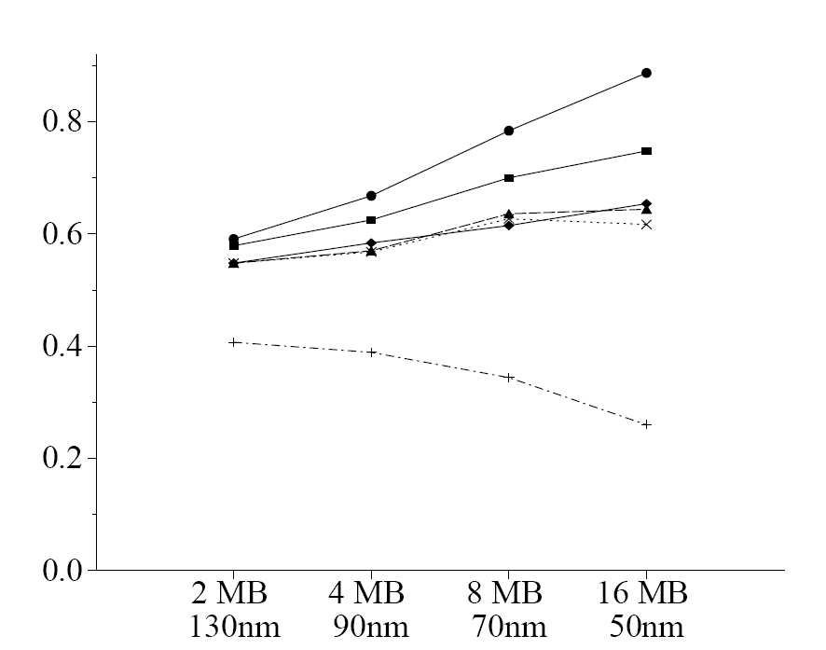
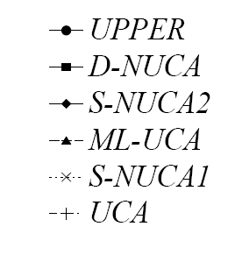

Performance Comparison
UPPER = all hits are
in the closest bank
3 cycle latency
D-NUCA and S-NUCA2 scale well
D-NUCA outperforms all other designs
ML-UCA saturates – UCA Degrades

Slide 86
Distance Associativity for High-Performance Non-Uniform Cache Architectures
Zeshan Chishti, Michael D Powell, and T. N. Vijaykumar
36th Annual International Symposium on Microarchitecture (MICRO), December 2003.
Slides mostly directly from the authors’ conference presentation

Slide 87
Motivation
Large Cache Design
L2/L3 growing (e.g., 3 MB in Itanium II)
Wire-delay becoming dominant in access time
Conventional large-cache
Many subarrays => wide range of access times
Uniform cache access => access-time of slowest subarray
Oblivious to access-frequency of data
Want often-accessed data faster: improve access time

Slide 88
Previous work: NUCA (ASPLOS ’02)
Pioneered Non-Uniform Cache Architecture
Access time: Divides cache into many distance-groups
D-group closer to core => faster access time
Data Mapping: conventional
Set determined by block index; each set has n-ways
Within a set, place frequently-accessed data in fast d-group
Place blocks in farthest way; bubble closer if needed

Slide 89
D-NUCA
Processor core
fast
tag
data
way 0
way 1
. . .
...
...
slow
way n-2
way n-1
d-group
One way of each set in fast d-group; compete within set
Cache blocks “screened” for fast placement

Slide 90
D-NUCA
Processor core
fast
tag
data
way 0
way 1
. . .
...
...
slow
way n-2
way n-1
d-group
One way of each set in fast d-group; compete within set
Cache blocks “screened” for fast placement

Slide 91
D-NUCA
Processor core
fast
tag
data
way 0
way 1
. . .
...
...
slow
way n-2
way n-1
d-group
One way of each set in fast d-group; compete within set
Cache blocks “screened” for fast placement

Slide 92
D-NUCA
Processor core
fast
tag
data
way 0
way 1
. . .
...
...
slow
way n-2
way n-1
d-group
One way of each set in fast d-group; compete within set
Cache blocks “screened” for fast placement

Slide 93
D-NUCA
Processor core
fast
tag
way 0
way 1
. . .
...
...
slow
way n-2
way n-1
d-group
One way of each set in fast d-group; compete within set
Cache blocks “screened” for fast placement

Slide 94
D-NUCA
Processor core
fast
tag
data
way 0
way 1
. . .
...
...
slow
way n-2
way n-1
d-group
Want to change restriction; more flexible data-placement

Slide 95
NUCA
Artificial coupling between s-a way # and d-group
Only one way in each set can be in fastest d-group
  Hot sets have > 1 frequently-accessed way
  Hot sets can place only one way in fastest d-group
Swapping of blocks is bandwidth- and energy-hungry
D-NUCA uses a switched network for fast swaps

Slide 96
Common Large-cache Techniques
Sequential Tag-Data: e.g., Alpha 21164 L2, Itanium II L3
Access tag first, and then access only matching data
Saves energy compared to parallel access
Data Layout: Itanium II L3
Spread a block over many subarrays (e.g., 135 in Itanium II)
For area efficiency and hard- and soft-error tolerance
These issues are important for large caches

Slide 97
Contributions
Key observation:
sequential tag-data => indirection through tag array
Data may be located anywhere
Distance Associativity:
Decouple tag and data => flexible mapping for sets
Any # of ways of a hot set can be in fastest d-group
NuRAPID cache: Non-uniform access with Replacement And Placement usIng Distance associativity
Benefits:
More accesses to faster d-groups
Fewer swaps => less energy, less bandwidth
But:
More tags + pointers are needed

Slide 98
Outline
Overview
NuRAPID Mapping and Placement
NuRAPID Replacement
NuRAPID layout
Results
Conclusion

Slide 99
NuRAPID Mapping and Placement
Distance-Associative Mapping:
decouple tag from data using forward pointer
Tag access returns forward pointer, data location
Placement: data block can be placed anywhere
Initially place all data in fastest d-group
Small risk of displacing often-accessed block

Slide 100
NuRAPID Mapping; Placing a block
Tag array
Data Arrays
frame #
0
1
k
fast
set #
Way-0
Way-(n-1)
A
d-group 0
0
1
2
3
A_{tag},grp₀,frm₁
...
0
1
k
d-group 1
forward pointer
0
1
k
All blocks initially placed in fastest d-group
d-group 2
slow

Slide 101
NuRAPID: Hot set can be in fast d-group
Tag array
Data Arrays
frame #
0
1
k
fast
set #
Way-0
Way-(n-1)
A
d-group 0
B
0
1
2
3
A_{tag},grp₀,frm₁
B_{tag},grp₀,frm_{k}
...
0
1
k
d-group 1
0
1
k
Multiple blocks from one set in same d-group
d-group 2
slow

Slide 102
NuRAPID: Unrestricted placement
Tag array
Data Arrays
frame #
0
1
k
fast
set #
Way-0
Way-(n-1)
A
d-group 0
B
0
1
2
3
A_{tag},grp₀,frm₁
B_{tag},grp₀,frm_{k}
...
0
1
k
D
d-group 1
C_{tag},grp₂,frm₀
D_{tag},grp₁,frm₁
0
1
k
C
No coupling between tag and data mapping
d-group 2
slow

Slide 103
Outline
Overview
NuRAPID Mapping and Placement
NuRAPID Replacement
NuRAPID layout
Results
Conclusion

Slide 104
NuRAPID Replacement
Two forms of replacement:
Data Replacement: Like conventional
  Evicts blocks from cache due to tag-array limits
Distance Replacement: Moving blocks among d-groups
  Determines which block to demote from a d-group
  Decoupled from data replacement
  No blocks evicted
    Blocks are swapped

Slide 105
NuRAPID: Replacement
Tag array
Data Arrays
frame #
0
1
k
fast
set #
Way-0
Way-(n-1)
B
d-group 0
0
1
...
Z_{tag},grp₁,frm_{k}
B_{tag},grp₀,frm₁
0
1
k
d-group 1
Place new block, A, in set 0.
Space must be created in the tag set:
Data-Replace Z
Z may not be in the target d-group
Z
0
1
k
d-group 2
slow

Slide 106
NuRAPID: Replacement
Tag array
Data Arrays
frame #
0
1
k
fast
set #
Way-0
Way-(n-1)
B
d-group 0
0
1
...
empty
B_{tag},grp₀,frm₁
0
1
k
d-group 1
Place new block, A, in set 0.
Data-Replace Z
empty
0
1
k
d-group 2
slow

Slide 107
NuRAPID: Replacement
reverse pointer
Tag array
Data Arrays
frame #
0
1
k
fast
set #
Way-0
Way-(n-1)
B, set₁ way₀
d-group 0
0
1
...
A_{tag}
B_{tag},grp₀,frm₁
0
1
k
d-group 1
Place A_{tag}, in set 0.
Must create an empty data block
B is selected to demote. Use reverse-pointer to locate B_{tag}
empty
0
1
k
d-group 2
slow

Slide 108
NuRAPID: Replacement
Tag array
Data Arrays
frame #
0
1
k
fast
set #
Way-0
Way-(n-1)
empty
d-group 0
0
1
...
A_{tag}
B_{tag},grp₁,frm_{k}
0
1
k
d-group 1
B is demoted to empty frame. B_{tag} updated
There was an empty frame because Z was evicted
This may not always be the case
B, set₁ way₀
0
1
k
d-group 2
slow

Slide 109
NuRAPID: Replacement
Tag array
Data Arrays
frame #
0
1
k
fast
set #
Way-0
Way-(n-1)
A, set₀ way_{n-1}
d-group 0
0
1
...
A_{tag},grp₀,frm₁
B_{tag},grp₁,frm_{k}
0
1
k
d-group 1
A is placed in d-group 0
pointers updated
B, set₁ way₀
0
1
k
d-group 2
slow

Slide 110
Replacement details
Always empty block for demotion for dist.-replacement
May require multiple demotions to find it
Example showed only demotion
Block could get stuck in slow d-group
Solution: Promote upon access (see paper)
How to choose block for demotion?
Ideal: LRU-group
LRU hard. We show random OK (see paper)
  Promotions fix errors made by random

Slide 111
Outline
Overview
NuRAPID Mapping and Placement
NuRAPID Replacement
NuRAPID layout
Results
Conclusion

Slide 112
Layout: small vs. large d-groups
Key: Conventional caches spread block over subarrays
+ Splits the “decoding” into the address decoder and muxes at the output of the subarrays
e.g., 5-to-1 decoder + 2 2-to-1 muxes better than 10-to-1 decoder
?? 9-to-1 decoder ??
+ more flexibility to deal with defects
+ more tolerant to transient errors
Non-uniform cache: can spread over only one d-group
  So all bits in a block have same access time
Small d-groups (e.g., 64KB of 4 16-KB subarrays)
Fine granularity of access times
Blocks spread over few subarrays
Large d-groups (e.g., 2 MB of 128 16-KB subarrays)
Coarse granularity of access times
Blocks spread over many subarrays
Large d-groups superior for spreading data

Slide 113
Outline
Overview
NuRAPID Mapping and Placement
NuRAPID Replacement
NuRAPID layout
Results
Conclusion

Slide 114
Methodology
64 KB, 2-way L1s. 8 MSHRs on d-cache
NuRAPID: 8 MB, 8-way, 1-port, no banking
4 d-groups (14-, 18-, 36-, 44- cycles)
8 d-groups (12-, 19-, 20-, . . . 49- cycles) shown in paper
Compare to:
BASE:
  1 MB, 8-way L2 (11-cycles) + 8-MB, 8-way L3 (43-cycles)
8 MB, 16-way D-NUCA (4 – 31 cycles)
  Multi-banked, infinite-bandwidth interconnect

Slide 115
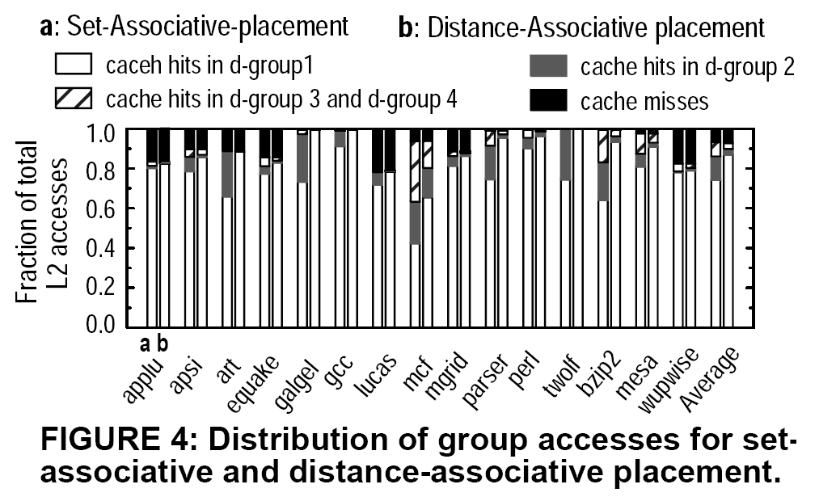
Results
SA vs. DA placement (paper figure 4)
As high
As possible

Slide 116
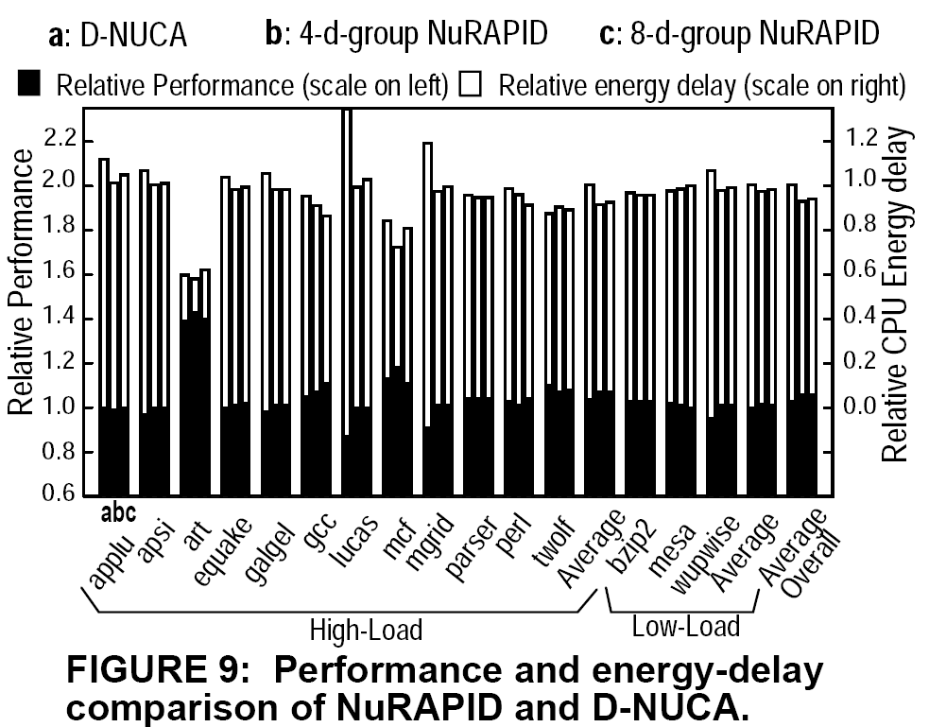
Results
3.0% better than D-NUCA and up to 15% better

Slide 117
Conclusions
NuRAPID
  leverage seq. tag-data
  flexible placement, replacement for non-uniform cache
  Achieves 7% overall processor E-D savings
over conventional cache, D-NUCA
  Reduces L2 energy by 77% over D-NUCA
NuRAPID an important design for wire-delay dominated caches

Slide 118
Managing Wire Delay in Large CMP Caches
Bradford M. Beckmann and David A. Wood
Multifacet Project
University of Wisconsin-Madison
MICRO 2004

Slide 119
Overview
Managing wire delay in shared CMP caches
Three techniques extended to CMPs
    On-chip Strided Prefetching (not in talk – see paper)
      Scientific workloads: 10% average reduction
      Commercial workloads: 3% average reduction
    Cache Block Migration (e.g. D-NUCA)
      Block sharing limits average reduction to 3%
      Dependence on difficult to implement smart search
    On-chip Transmission Lines (e.g. TLC)
      Reduce runtime by 8% on average
      Bandwidth contention accounts for 26% of L2 hit latency
Combining techniques
    Potentially alleviates isolated deficiencies
      Up to 19% reduction vs. baseline
    Implementation complexity

Slide 120
Baseline: CMP-SNUCA
L1
I $
L1
I $
CPU 2
CPU 3
L1
D $
L1
D $
CPU 4
L1
I $
L1
D $
L1
D $
L1
I $
CPU 1
CPU 5
L1
I $
L1
D $
L1
D $
L1
I $
CPU 0
L1
D $
L1
D $
CPU 7
CPU 6
L1
I $
L1
I $

Slide 121
Outline
Global interconnect and CMP trends
Latency Management Techniques
Evaluation
  Methodology
  Block Migration: CMP-DNUCA
  Transmission Lines: CMP-TLC
  Combination: CMP-Hybrid

Slide 122
Block Migration: CMP-DNUCA
L1
I $
L1
I $
CPU 2
CPU 3
L1
D $
L1
D $
CPU 4
A
B
L1
I $
L1
D $
L1
D $
L1
I $
CPU 1
CPU 5
L1
I $
L1
D $
B
A
L1
D $
L1
I $
CPU 0
L1
D $
L1
D $
CPU 7
CPU 6
L1
I $
L1
I $

Slide 123
On-chip Transmission Lines
Similar to contemporary off-chip communication
Provides a different latency / bandwidth tradeoff
Wires behave more “transmission-line” like as frequency increases
  Utilize transmission line qualities to our advantage
  No repeaters – route directly over large structures
  ~10x lower latency across long distances
Limitations
  Requires thick wires and dielectric spacing
  Increases manufacturing cost
See “TLC: Transmission Line Caches” Beckman, Wood, MICRO’03

Slide 124
RC vs. TL Communication
Conventional Global RC Wire
Voltage
Voltage
Vt
Distance
Driver
Receiver
On-chip Transmission Line
Voltage
Voltage
Vt
Distance
Driver
Receiver

Slide 125
RC Wire vs. TL Design
Conventional Global RC Wire
~0.375 mm
RC delay dominated
On-chip Transmission Line
~10 mm
LC delay dominated
Driver
Receiver
Notes:
Many RC wire segments separated by intermediate latches and repeaters
Single LC (inductive – capacitance) product over a distance of approximately 10 mm
We assumed here voltage mode signaling
Termination with a digital tuned driver resistance

Slide 126
On-chip Transmission Lines
Why now? → 2010 technology
  Relative RC delay ↑
  Improve latency by 10x or more
What are their limitations?
  Require thick wires and dielectric spacing
  Increase wafer cost
Presents a different Latency/Bandwidth Tradeoff
Notes:
Wires behave more “transmission line like” as frequency increases
Let’s use these transmission line qualities to our advantage
Technology provides a lower-k dielectric

Slide 127
Latency Comparison

Slide 128
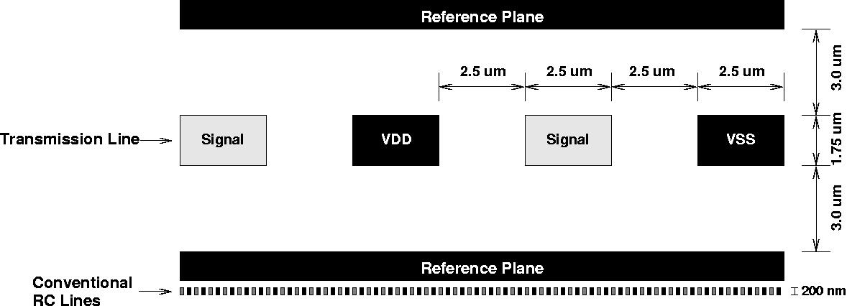
Bandwidth Comparison
2 transmission line signals
50 conventional signals
Key observation
Transmission lines – route over large structures
Conventional wires – substrate area & vias for repeaters
Notes:
This is a cross-sectional view
Shielding and reference planes provide noise isolation and low-loss return paths
Key observation is conventional interconnect requires repeaters
hence vias and intermediate repeaters

Slide 129
Transmission Lines: CMP-TLC
L1
I $
L1
I $
CPU 3
CPU 4
L1
D $
L1
D $
L1
I $
L1
I $
CPU 2
CPU 5
16
8-byte
links
L1
D $
L1
D $
L1
I $
L1
I $
CPU 1
CPU 6
L1
D $
L1
D $
L1
I $
L1
I $
CPU 0
CPU 7
L1
D $
L1
D $

Slide 130
Combination: CMP-Hybrid
L1
I $
L1
I $
CPU 2
CPU 3
L1
D $
L1
D $
CPU 4
L1
I $
L1
D $
L1
D $
L1
I $
CPU 1
8
32-byte
links
CPU 5
L1
I $
L1
D $
L1
D $
L1
I $
CPU 0
L1
D $
L1
D $
CPU 7
CPU 6
L1
I $
L1
I $

Slide 131
Outline
Global interconnect and CMP trends
Latency Management Techniques
Evaluation
  Methodology
  Block Migration: CMP-DNUCA
  Transmission Lines: CMP-TLC
  Combination: CMP-Hybrid

Slide 132
Methodology
Full system simulation
  Simics
  Timing model extensions
    Out-of-order processor
    Memory system
Workloads
  Commercial
    apache, jbb, otlp, zeus
  Scientific
    Splash: barnes & ocean
    SpecOMP: apsi & fma3d

Slide 133
System Parameters
Memory System |  | Dynamically Scheduled Processor
L1 I & D caches | 64 KB, 2-way, 3 cycles | Clock frequency | 10 GHz
Unified L2 cache | 16 MB, 256x64 KB, 16-way, 6 cycle bank access | Reorder buffer / scheduler | 128 / 64 entries
L1 / L2 cache block size | 64 Bytes | Pipeline width | 4-wide fetch & issue
Memory latency | 260 cycles | Pipeline stages | 30
Memory bandwidth | 320 GB/s | Direct branch predictor | 3.5 KB YAGS
Memory size | 4 GB of DRAM | Return address stack | 64 entries
Outstanding memory request / CPU | 16 | Indirect branch predictor | 256 entries (cascaded)

Slide 134
Outline
Global interconnect and CMP trends
Latency Management Techniques
Evaluation
  Methodology
  Block Migration: CMP-DNUCA
  Transmission Lines: CMP-TLC
  Combination: CMP-Hybrid

Slide 135
CMP-DNUCA: Organization
CPU 2
CPU 3
CPU 4
Bankclusters
CPU 1
Local
Inter.
Center
CPU 5
CPU 0
CPU 7
CPU 6

Slide 136
Hit Distribution: Grayscale Shading
CPU 2
CPU 3
Greater %
of L2 Hits
CPU 4
CPU 1
CPU 5
CPU 0
CPU 7
CPU 6

Slide 137
CMP-DNUCA: Migration
Migration policy
  Gradual movement
  Increases local hits and reduces distant hits
other
bankclusters
my center
bankcluster
my inter.
bankcluster
my local
bankcluster

Slide 138
CMP-DNUCA: Hit Distribution Ocean per CPU
CPU 0
CPU 1
CPU 2
CPU 3
CPU 4
CPU 5
CPU 6
CPU 7

Slide 139
CMP-DNUCA: Hit Distribution Ocean all CPUs
Block migration successfully separates the data sets

Slide 140
CMP-DNUCA: Hit Distribution OLTP all CPUs

Slide 141
CMP-DNUCA: Hit Distribution OLTP per CPU
CPU 0
CPU 1
CPU 2
CPU 3
CPU 4
CPU 5
CPU 6
CPU 7
Hit Clustering: Most L2 hits satisfied by the center banks

Slide 142
CMP-DNUCA: Search
Search policy
  Uniprocessor DNUCA solution: partial tags
    Quick summary of the L2 tag state at the CPU
    No known practical implementation for CMPs
      Size impact of multiple partial tags
      Coherence between block migrations and partial tag state
  CMP-DNUCA solution: two-phase search
    1st phase: CPU’s local, inter., & 4 center banks
    2nd phase: remaining 10 banks
    Slow 2nd phase hits and L2 misses

Slide 143
CMP-DNUCA: L2 Hit Latency

Slide 144
CMP-DNUCA Summary
Limited success
  Ocean successfully splits
    Regular scientific workload – little sharing
  OLTP congregates in the center
    Commercial workload – significant sharing
Smart search mechanism
  Necessary for performance improvement
  No known implementations
  Upper bound – perfect search

Slide 145
Outline
Global interconnect and CMP trends
Latency Management Techniques
Evaluation
  Methodology
  Block Migration: CMP-DNUCA
  Transmission Lines: CMP-TLC
  Combination: CMP-Hybrid

Slide 146
L2 Hit Latency
Bars Labeled
D: CMP-DNUCA
T: CMP-TLC
H: CMP-Hybrid

Slide 147
Overall Performance
Transmission lines improve L2 hit and L2 miss latency

Slide 148
Conclusions
Individual Latency Management Techniques
  Strided Prefetching: subset of misses
  Cache Block Migration: sharing impedes migration
  On-chip Transmission Lines: limited bandwidth
Combination: CMP-Hybrid
  Potentially alleviates bottlenecks
  Disadvantages
    Relies on smart-search mechanism
    Manufacturing cost of transmission lines

Slide 149
Recap
Initial NUCA designs → Uniprocessors
  NUCA:
    Centralized Partial Tag Array
  NuRAPID:
    Decouples Tag and Data Placement
    More overhead
  L-NUCA
    Fine-Grain NUCA close to the core
  Beckman & Wood:
    Move Data Close to User
    Two-Phase Multicast Search
    Gradual Migration
    Scientific: Data mostly “private” → move close / fast
    Commercial: Data mostly “shared” → moves in the center / “slow”

Slide 150
Recap – NUCAs for CMPs
Beckman & Wood:
  Move Data Close to User
  Two-Phase Multicast Search
  Gradual Migration
  Scientific: Data mostly “private” → move close / fast
  Commercial: Data mostly “shared” → moves in the center / “slow”
CMP-NuRapid:
  Per core, L2 tag array
    Area overhead
    Tag coherence

Slide 151
A NUCA Substrate for Flexible CMP Cache Sharing
Jaehyuk Huh, Changkyu Kim †, Hazim Shafi, Lixin Zhang§,
Doug Burger , Stephen W. Keckler †
Int’l Conference on Supercomputing, June 2005
§Austin Research Laboratory IBM Research Division | †Dept. of Computer Sciences The University of Texas at Austin

Slide 152
Challenges in CMP L2 Caches
  Private L2 (SD = 1)
  + Small but fast L2 caches
  - More replicated cache blocks
  - Can not share cache capacity
  - Slow remote L2 accesses
P0
P1
P2
P3
P4
P5
P6
P7
I
D
I
D
I
D
I
D
I
D
I
D
I
D
I
D
L2
Completely Shared L2
L2 Caches for CMPs ?
L2
L2
L2
L2
L2
L2
L2
Partially
Shared L2
Partially
Shared L2
L2 Coherence Mechanism
L2
L2
L2
L2
L2
L2
L2
L2
Partially
Shared L2
Partially
Shared L2
  Completely Shared L2 (SD=16)
  + No replicated cache blocks
  + Dynamic capacity sharing
  - Large but slow caches
I
D
I
D
I
D
I
D
I
D
I
D
I
D
I
D
P15
P14
P13
P12
P11
P10
P9
P8
P0
P0
P0
P0
P0
P0
P0
P0
  Partially Shared L2
What is the best sharing degree (SD) ?
  Does granularity affect? (per-application and per-line)
  The effect of increasing wire delay
  Do latency managing techniques affect?

Slide 153
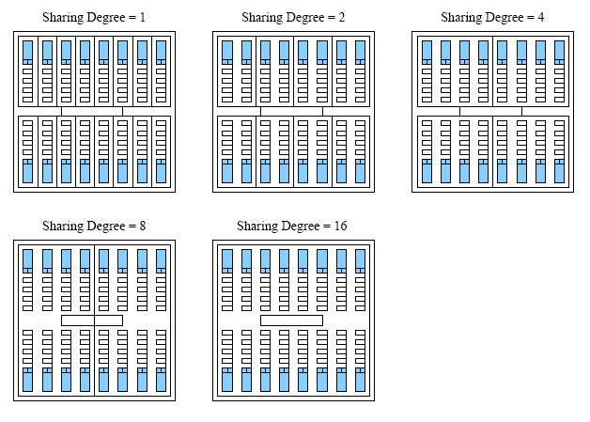
Sharing Degree

Slide 154
Outline
Design space
  Varying sharing degrees
  NUCA caches
  L1 prefetching
MP-NUCA design
Lookup mechanism for dynamic mapping
Results
Conclusion

Slide 155
Sharing Degree Effect Explained
Latency Shorter: Smaller Sharing Degree
  Each partition is smaller
Hit Rate higher: Larger Sharing Degree
  Larger partitions means more capacity
Inter-processor communication: Larger Sharing Degree
  Through the shared cache
L1 Coherence more Expensive: Larger Sharing Degree
  More L1’s share an L2 Partition
L2 Coherence more expensive: Smaller Sharing Degree
  More L2 partitions

Slide 156
Design Space
Determining sharing degree
  Sharing Degree (SD): number of processors in a shared L2
  Miss rates vs. hit latencies
  Sharing differentiation: per-application and per-line
    Private vs. Shared data
    Divide address space into shared and private
Latency management for increasing wire delay
  Static mapping (S-NUCA) and dynamic mapping (D-NUCA)
  D-NUCA : move frequently accessed blocks closer to processors
  Complexity vs. performance
The effect of L1 prefetching on sharing degree
  Simple strided prefetching
  Hide long L2 hit latencies

Slide 157
Sharing Differentiation
Private Blocks
  Lower sharing degree better
  Reduced latency
  Caching efficiency maintained
    No one else will have cached it anyhow
Shared Blocks
  Higher sharing degree better
  Reduces the number of copies
Sharing Differentiation
  Address Space into Shared and Private
  Assign Different Sharing Degrees

Slide 158
Flexible NUCA Substrate
D-NUCA 2D
D-NUCA 1D
P0
P1
P2
P3
P4
P5
P6
P7
S-NUCA
I
D
I
D
I
D
I
D
I
D
I
D
I
D
I
D
P4
P4
P4
P5
P5
P5
P6
P6
P6
P7
P7
P7
Dynamic mapping
Dynamic mapping
I
I
I
D
D
D
I
I
I
D
D
D
I
I
I
D
D
D
I
I
I
D
D
D
L2 Banks
Directory for
L2 coherence
Static mapping
Static mapping
Dynamic mapping
I
D
I
D
I
D
I
D
I
D
I
D
I
D
I
D
How to find a block?
P15
P14
P13
P12
P11
P10
P9
P8
P0
P0
P0
P0
P0
P0
P0
P0
Support SD=1, 2, 4, 8, and 16
Bank-based non-uniform caches, supporting multiple sharing degrees
Directory-based coherence
  L1 coherence : sharing vectors embedded in L2 tags
  L2 coherence : on-chip directory
DNUCA-1D:
block → one column
DNUCA-2D:
block → any column
Higher associativity

Slide 159
Lookup Mechanism
Use partial-tags [Kessler et al. ISCA 1989]
Searching problem in shared D-NUCA
  Centralized tags : multi-hop latencies from processors to tags
  Fully replicated tags : huge area overheads and complexity
Distributed partial tags: partial-tag fragment for each column
Broadcast lookups of partial tags can occur in D-NUCA 2D
D-NUCA
P0
P1
P2
P3
I
D
I
D
I
D
I
D
Partial tag fragments

Slide 160
Methodology
MP-sauce: MP-SimpleScalar + SimOS-PPC
Benchmarks: commercial applications and SPLASH 2
Simulated system configuration
  16 processors, 4 way out-of-order + 32KB I/D L1
  16 X 16 bank array, 64KB, 16-way, 5 cycle bank access latency
  1 cycle hop latency
  260 cycle memory latency, 360 GB/s bandwidth
Simulation parameters
Sharing degree (SD) | 1, 2, 4, 8, and 16
Mapping policies | S-NUCA, D-NUCA-1D, and D- NUCA-2D
D-NUCA search | distributed partial tags and perfect search
L1 prefetching | stride prefetching (positive/negative unit and non-unit stride)

Slide 161
Sharing Degree
L1 miss latencies with S-NUCA (SD=1, 2, 4, 8, and 16)
Hit latency increases significantly beyond SD=4
The best shared degrees: 2 or 4

Slide 162
D-NUCA: Reducing Latencies
NUCA hit latencies with SD=1 to 16
D-NUCA 2D perfect reduces hit latencies by 30%
Searching overheads are significant in both 1D and 2D D-NUCAs
D-NUCAs with
perfect search
Perfect search →
Auto-magically go to the right
block
Hit latency != performance

Slide 163
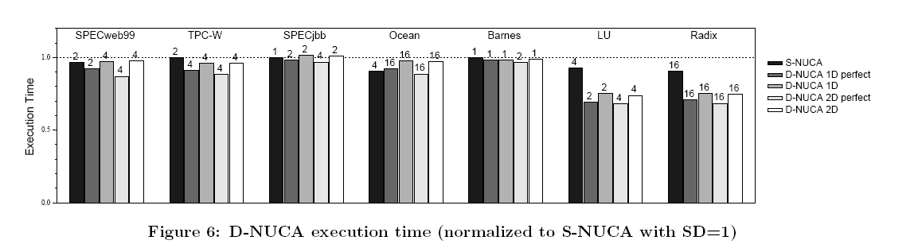
S-NUCA vs. D-NUCA
D-NUCA improves performance but not as much with realistic searching
The best SD may be different compared to S-NUCA

Slide 164
S-NUCA vs. D-NUCA
Fixed best: fixed shared degree for all applications
Variable best: per-application best sharing degree
D-NUCA has marginal performance improvement due to the searching overhead
Per-app. sharing degrees improved D-NUCA more than S-NUCA
What is the base? Are the bars comparable?

Slide 165
Per-line Sharing Degree
Per-line sharing degree: different sharing degrees for different classes of cache blocks
Private vs. shared sharing degrees
  Private : place private blocks in close banks
  Shared : reduce replication
Approximate evaluation
  Per-line sharing degree is effective for two applications (6-7% speedups)
  Best combination: private SD= 1 or 2 and shared SD = 16

Slide 166
Conclusion
Best sharing degree is 4
Dynamic migration
  Does not change the best sharing degree
  Does not seem to be worthwhile in the context of this study
  Searching problem is still yet to be solved
  High design complexity and energy consumption
L1 prefetching
  7 % performance improvement (S-NUCA)
  Decrease the best sharing degree slightly
Per-line sharing degrees provide the benefit of both high and low sharing degree

Slide 167
Victim Replication: Maximizing Capacity while Hiding Wire Delay in Tiled Chip Multiprocessors
Michael Zhang & Krste Asanovic
Computer Architecture Group
MIT CSAIL
Int’l Conference on Computer Architecture, 2005
Slides mostly directly from the author’s presentation

Slide 168
Current Research on NUCAs
core
core
core
core
Targeting uniprocessor machines
Data Migration: Intelligently place data such that the active working set resides in cache slices closest to the processor
  D-NUCA [ASPLOS-X, 2002]
  NuRAPID [MICRO-37, 2004]
L1$
L1$
L1$
L1$
Intra-Chip Switch

Slide 169
Data Migration does not Work Well with CMPs
Problem: The unique copy of the data cannot be close to all of its sharers
Behavior: Over time, shared data migrates to a location equidistant to all sharers
  Beckmann & Wood [MICRO-36, 2004]
core
core
core
core
L1$
L1$
L1$
L1$
Intra-Chip Switch
Intra-Chip Switch
L1$
L1$
L1$
L1$
core
core
core
core

Slide 170
This Talk: Tiled CMPs w/ Directory Coherence
Switch
Tiled CMPs for Scalability
  Minimal redesign effort
  Use directory-based protocol for scalability
Managing the L2s to minimize the effective access latency
  Keep data close to the requestors
  Keep data on-chip
Two baseline L2 cache designs
  Each tile has own private L2
  All tiles share a single distributed L2
core
L1$
L2$
Slice
Data
L2$
Slice
Tag
c
L1
SW
c
L1
SW
c
L1
SW
c
L1
SW
L2$
Data
L2$
Tag
L2$
Data
L2$
Tag
L2$
Data
L2$
Tag
L2$
Data
L2$
Tag
c
L1
SW
c
L1
SW
c
L1
SW
c
L1
SW
L2$
Data
L2$
Tag
L2$
Data
L2$
Tag
L2$
Data
L2$
Tag
L2$
Data
L2$
Tag
c
L1
SW
c
L1
SW
c
L1
SW
c
L1
SW
L2$
Data
L2$
Tag
L2$
Data
L2$
Tag
L2$
Data
L2$
Tag
L2$
Data
L2$
Tag
c
L1
SW
c
L1
SW
c
L1
SW
c
L1
SW
L2$
Data
L2$
Tag
L2$
Data
L2$
Tag
L2$
Data
L2$
Tag
L2$
Data
L2$
Tag

Slide 171
Private L2 Design Provides Low Hit Latency
Switch
Switch
The local L2 slice is used as a private L2 cache for the tile
  Shared data is duplicated in the L2 of each sharer
  Coherence must be kept among all sharers at the L2 level
On an L2 miss:
  Data not on-chip
  Data available in the private L2 cache of another chip
core
L1$
core
L1$
Private
L2$
Data
L2$
Tag
DIR
Private
L2$
Data
L2$
Tag
DIR
Sharer i
Sharer j

Slide 172
Private L2 Design Provides Low Hit Latency
Switch
Switch
The local L2 slice is used as a private L2 cache for the tile
  Shared data is duplicated in the L2 of each sharer
  Coherence must be kept among all sharers at the L2 level
On an L2 miss:
  Data not on-chip
  Data available in the private L2 cache of another tile (cache-to-cache reply-forwarding)
core
L1$
core
L1$
Private
L2$
Data
L2$
Tag
DIR
Private
L2$
Data
L2$
Tag
DIR
Requestor
Owner/Sharer
Switch
core
L1$
Private
L2$
Data
L2$
Tag
DIR
Off-chip
Access
Home Node
statically determined by address

Slide 173
Private L2 Design Provides Low Hit Latency
Switch
Characteristics:
  Low hit latency to resident L2 data
  Duplication reduces on-chip capacity
Works well for benchmarks with working sets that fits into the local L2 capacity
core
L1$
Private
L2$
Data
L2$
Tag
DIR
c
L1
SW
c
L1
SW
c
L1
SW
c
L1
SW
Private
L2
Dir
Private
L2
Dir
Private
L2
Dir
Private
L2
Dir
c
L1
SW
c
L1
SW
c
L1
SW
c
L1
SW
Private
L2
Dir
Private
L2
Dir
Private
L2
Dir
Private
L2
Dir
c
L1
SW
c
L1
SW
c
L1
SW
c
L1
SW
Private
L2
Dir
Private
L2
Dir
Private
L2
Dir
Private
L2
Dir
c
L1
SW
c
L1
SW
c
L1
SW
c
L1
SW
Private
L2
Dir
Private
L2
Dir
Private
L2
Dir
Private
L2
Dir

Slide 174
Shared L2 Design Provides Maximum Capacity
Switch
Switch
All L2 slices on-chip form a distributed shared L2, backing up all L1s
  No duplication, data kept in a unique L2 location
  Coherence must be kept among all sharers at the L1 level
On an L2 miss:
  Data not in L2
  Coherence miss (cache-to-cache reply-forwarding)
core
L1$
core
L1$
Shared
L2$
Data
L2$
Tag
DIR
Shared
L2$
Data
L2$
Tag
DIR
Requestor
Owner/Sharer
Switch
core
L1$
Shared
L2$
Data
L2$
Tag
DIR
Off-chip
Access
Home Node
statically determined by address

Slide 175
Shared L2 Design Provides Maximum Capacity
Switch
Characteristics:
  Maximizes on-chip capacity
  Long/non-uniform latency to L2 data
Works well for benchmarks with larger working sets to minimize expensive off-chip accesses
core
L1$
Shared
L2$
Data
L2$
Tag
DIR
c
L1
SW
c
L1
SW
c
L1
SW
c
L1
SW
Shared
L2
Dir
Shared
L2
Dir
Shared
L2
Dir
Shared
L2
Dir
c
L1
SW
c
L1
SW
c
L1
SW
c
L1
SW
Shared
L2
Dir
Shared
L2
Dir
Shared
L2
Dir
Shared
L2
Dir
c
L1
SW
c
L1
SW
c
L1
SW
c
L1
SW
Shared
L2
Dir
Shared
L2
Dir
Shared
L2
Dir
Shared
L2
Dir
c
L1
SW
c
L1
SW
c
L1
SW
c
L1
SW
Shared
L2
Dir
Shared
L2
Dir
Shared
L2
Dir
Shared
L2
Dir

Slide 176
Victim Replication:
A Hybrid Combining the Advantages
of Private and Shared Designs
Private design characteristics:
  Low L2 hit latency to resident L2 data
  Reduced L2 capacity
Shared design characteristics:
  Long/non-uniform L2 hit latency
  Maximum L2 capacity

Slide 177
Victim Replication
A Hybrid Combining the Advantages
of Private and Shared Designs
Shared design characteristics:
  Long/non-uniform L2 hit latency
  Maximum L2 capacity
Private design characteristics:
  Low L2 hit latency to resident L2 data
  Reduced L2 capacity
Victim Replication: Provides low hit latency while keeping the working set on-chip

Slide 178
Victim Replication: A Variant of the Shared Design
Switch
Switch
core
L1$
core
L1$
Implementation: Based on the shared design
L1 Cache: Replicates shared data locally for fastest access latency
L2 Cache: Replicates the L1 capacity victims → Victim Replication
Shared
L2$
Data
L2$
Tag
DIR
Shared
L2$
Data
L2$
Tag
DIR
Sharer i
Sharer j
Switch
core
L1$
Shared
L2$
Data
L2$
Tag
DIR
Home Node

Slide 179
The Local Tile Replicates the L1 Victim During Eviction
Switch
Switch
core
L1$
core
L1$
Replicas: L1 capacity victims stored in the Local L2 slice
Why? Reused in the near future with fast access latency
Which way in the target set to use to hold the replica?
Shared
L2$
Data
L2$
Tag
DIR
Shared
L2$
Data
L2$
Tag
DIR
Sharer i
Sharer j
Switch
core
L1$
Shared
L2$
Data
L2$
Tag
DIR
Home Node

Slide 180
The Replica should NOT Evict More Useful Cache Blocks from the L2 Cache
Switch
Switch
core
L1$
core
L1$
Replica is NOT always made
Shared
L2$
Data
L2$
Tag
DIR
Shared
L2$
Data
L2$
Tag
DIR
Invalid blocks
Home blocks w/o sharers
Existing replicas
Home blocks w/ sharers
Sharer i
Sharer j
Switch
core
L1$
Never evict actively shared home blocks in favor of a replica
Shared
L2$
Data
L2$
Tag
DIR
Home Node

Slide 181
Victim Replication Dynamically Divides the Local L2 Slice into Private & Shared Partitions
Switch
Switch
core
L1$
core
L1$
Private
L2$
L2$
Tag
DIR
Shared
L2$
L2$
Tag
DIR
Victim Replication dynamically creates a large local private, victim cache for the local L1 cache
Private Design
Shared Design
Switch
core
L1$
L2$
Tag
DIR
Shared L2$
Private L2$
(filled w/ L1 victims)
Victim Replication

Slide 182
Experimental Setup
Processor Model: Bochs
  Full-system x86 emulator running Linux 2.4.24
  8-way SMP with single in-order issue cores
All latencies normalized to one 24-F04 clock cycle
  Primary caches reachable in one cycle
Cache/Memory Model
  4x2 Mesh with 3 Cycle near-neighbor latency
  L1I$ & L1D$: 16KB each, 16-Way, 1-Cycle, Pseudo-LRU
  L2$: 1MB, 16-Way, 6-Cycle, Random
  Off-chip Memory: 256 Cycles
Worst-case cross chip contention-free latency is 30 cycles
Applications
Linux 2.4.24
c
L1
S
c
L1
S
L2
D
L2
D
c
L1
S
c
L1
S
L2
D
L2
D
c
L1
S
c
L1
S
L2
D
L2
D
c
L1
S
c
L1
S
L2
D
L2
D
DRAM
Notes:
OK. Hopefully by now I’ve at least got you thinking that “ok. This maaaaay work”. And let’s move on to the evaluation part of the talk. And also in my opinion, more interesting part. Before that though, we have to first get through some mandatory slides about the system setup.
So for the processor model, … read off.
As for the cache and memory model. We have developed a detailed simulator in-house that models the cache and memory hierarchy of the CMP. The protocol used is the four state MESI.
One problem we faced while evaluating the scheme is the long running time of the benchmarks. So to make the ISCA deadline, we needed to do something about it. Thanks to the SMART group at CMU, we extended their work in statistical sampling to multiprocessors and cut down and simulation time. Another problem we faced was system variation, especially in combination with sampling. So we decided to run each benchmark 10 times and saw that variation is small compared to the results.

Slide 183
The Plan for Results
Three configurations evaluated:
  Private L2 design → L2P
  Shared L2 design → L2S
  Victim replication → L2VR
Three suites of workloads used:
  Multi-threaded workloads
  Single-threaded workloads
  Multi-programmed workloads
Results show Victim Replication’s Performance Robustness
Notes:
OK now time for results and here is the plan. We first present the results for multi-threaded benchmarks. Then we move on to single-threaded benchmarks as a special case of multi-threaded benchmarks. Lastly we will present some multi-programmed benchmarks. Note that the multi-programmed results are not in the paper as we obtained them after the cam-ready deadline. The main result shown here is the average data fetch latency experienced by a processor in 24-FO4 cycles.

Slide 184



Multithreaded Workloads
8 NASA Advanced Parallel Benchmarks:
  Scientific (computational fluid dynamics)
  OpenMP (loop iterations in parallel)
  Fortran: ifort –v8 –O2 –openmp
2 OS benchmarks
  dbench: (Samba) several clients making file-centric system calls
  apache: web server with several clients (via loopback interface)
  C: gcc 2.96
1 AI benchmark: Cilk checkers
  spawn/sync primitives: dynamic thread creation/scheduling
  Cilk: gcc 2.96, Cilk 5.3.2
Notes:
We have a good mix of benchmarks
Read off

Slide 185
Average Access Latency
Their working set fits in the private L2
Notes:
The three metrics are shown in the figures. Please do not pay attention to the details of the results on this slide as I will talk about them in detail later. II just want to introduce what they are. First thing to notice is that the performance of L2VC is always slightly better than L2S but worse than L2VR. Thus we ignore L2VC from the rest of the discussion. The data access breakdown shows how a cache access is serviced, either by a hit in the L1, or a hit in the Local L2, or a hit in the non-local L2, or from Memory. The off-chip miss rate is the same as the off-chip memory accesses in the data access breakdown diagram, just that it is magnified here for ease of reading.

Slide 186
Average Access Latency
Working set >> all of L2s combined
Lower latency of L2P dominates – no capacity advantage for L2S
Notes:
The three metrics are shown in the figures. Please do not pay attention to the details of the results on this slide as I will talk about them in detail later. II just want to introduce what they are. First thing to notice is that the performance of L2VC is always slightly better than L2S but worse than L2VR. Thus we ignore L2VC from the rest of the discussion. The data access breakdown shows how a cache access is serviced, either by a hit in the L1, or a hit in the Local L2, or a hit in the non-local L2, or from Memory. The off-chip miss rate is the same as the off-chip memory accesses in the data access breakdown diagram, just that it is magnified here for ease of reading.

Slide 187
Average Access Latency
Working set fits in L2
Higher miss rate with L2P than L2S
Still lower latency of L2P dominates since miss rate is relatively low
Notes:
The three metrics are shown in the figures. Please do not pay attention to the details of the results on this slide as I will talk about them in detail later. II just want to introduce what they are. First thing to notice is that the performance of L2VC is always slightly better than L2S but worse than L2VR. Thus we ignore L2VC from the rest of the discussion. The data access breakdown shows how a cache access is serviced, either by a hit in the L1, or a hit in the Local L2, or a hit in the non-local L2, or from Memory. The off-chip miss rate is the same as the off-chip memory accesses in the data access breakdown diagram, just that it is magnified here for ease of reading.

Slide 188
Average Access Latency
Much lower L2 miss rate with L2S
L2S not that much better than L2P
Notes:
The three metrics are shown in the figures. Please do not pay attention to the details of the results on this slide as I will talk about them in detail later. II just want to introduce what they are. First thing to notice is that the performance of L2VC is always slightly better than L2S but worse than L2VR. Thus we ignore L2VC from the rest of the discussion. The data access breakdown shows how a cache access is serviced, either by a hit in the L1, or a hit in the Local L2, or a hit in the non-local L2, or from Memory. The off-chip miss rate is the same as the off-chip memory accesses in the data access breakdown diagram, just that it is magnified here for ease of reading.

Slide 189
Average Access Latency
Working set fits on local L2 slice
Uses thread migration a lot
With L2P most accesses are to remote L2 slices after thread migration
Notes:
The three metrics are shown in the figures. Please do not pay attention to the details of the results on this slide as I will talk about them in detail later. II just want to introduce what they are. First thing to notice is that the performance of L2VC is always slightly better than L2S but worse than L2VR. Thus we ignore L2VC from the rest of the discussion. The data access breakdown shows how a cache access is serviced, either by a hit in the L1, or a hit in the Local L2, or a hit in the non-local L2, or from Memory. The off-chip miss rate is the same as the off-chip memory accesses in the data access breakdown diagram, just that it is magnified here for ease of reading.

Slide 190
Average Access Latency, with Victim Replication
 | BT | CG | EP | FT | IS | LU | MG | SP | apache | dbench | checkers

Slide 191
Average Access Latency, with Victim Replication
 | BT | CG | EP | FT | IS | LU | MG | SP | apache | dbench | checkers
1st | L2VR | L2P | L2VR | L2P | Tied | L2P | L2VR | L2P | L2P | L2P | L2VR
2nd | L2P 0.1% | L2VR 32.0% | L2S 18.5% | L2VR 3.5% | Tied | L2VR 4.5% | L2S 17.5% | L2VR 2.5% | L2VR 3.6% | L2VR 2.1% | L2S 14.4%
3rd | L2S 12.2% | L2S 111% | L2P 51.6% | L2S 21.5% | Tied | L2S 40.3% | L2P 35.0% | L2S 22.4% | L2S 23.0% | L2S 11.5% | L2P 29.7%

Slide 192
FT: Private Best When Working Set Fits in Local L2 Slice
The large capacity of the shared design is not utilized as shared and private designs have similar off-chip miss rates
The short access latency of the private design yields better performance
Victim replication mimics the private design by creating replicas, with performance within 5%
Why L2VR worse than L2P?
  Must first miss bring in L1 and then replicate
Average Data
Access Latency
Access
Breakdown
Off-chip misses
Not Good …
Hits in Non-Local L2
O.K.
Hits in Local L2
Very Good
Hits in L1
Best
L2P
L2S
L2VR
L2P
L2S
L2VR

Slide 193
CG: Large Number of L2 Hits Magnifies Latency Advantage of Private Design
Average Data
Access Latency
Access
Breakdown
The latency advantage of the private design is magnified by the large number of L1 misses that hits in L2 (>9%)
Victim replication edges out shared design with replicas, by falls short of the private design
Off-chip misses
Hits in Non-Local L2
Hits in Local L2
Hits in L1
L2P
L2S
L2VR
L2P
L2S
L2VR

Slide 194
MG: VR Best When Working Set Does not Fit in Local L2
Average Data
Access Latency
Access
Breakdown
The capacity advantage of the shared design yields many fewer off-chip misses
The latency advantage of the private design is offset by costly off-chip accesses
Victim replication is even better than shared design by creating replicas to reduce access latency
Off-chip misses
Hits in Non-Local L2
Hits in Local L2
Hits in L1
L2P
L2S
L2VR
L2P
L2S
L2VR

Slide 195
Checkers: Thread Migration → Many Cache-Cache Transfers
Average Data
Access Latency
Access
Breakdown
Virtually no off-chip accesses
Most of hits in the private design come from more expensive cache-to-cache transfers
Victim replication is even better than shared design by creating replicas to reduce access latency
Off-chip misses
Hits in Non-Local L2
Hits in Local L2
Hits in L1
L2P
L2S
L2VR
L2P
L2S
L2VR

Slide 196
Victim Replication Adapts to the Phases of the Execution
CG
FT
% of replica in cache
0
5.0 Billion Instrs
0
6.6 Billion Instrs
Each graph shows the percentage of replicas in the L2 caches averaged across all 8 caches
Notes:
VR has two important properties I hope you can take away. First is that VR is an adaptive algorithm that adapt to the phases of the benchmarks. Shown here are two time-varying graphs of the percentage of victim replicas in the cache. This is the average of all 8 caches. On the left is CG, you clearly observe the two phases, and on the right is FT, where you observe the repetition.
Second is that the size of the “victim cache” is very large, usually on the order of 100 MB, which is much larger than the conventional victim cache in hardware.

Slide 197
Single-Threaded Benchmarks
Switch
SpecINT2000 are used as Single-Threaded benchmarks
  Intel C compiler version 8.0.055
Victim replication automatically turns the cache hierarchy into three levels with respect to the node hosting the active thread
Active
Thread
L1$
Shared
L2$
Data
L2$
Tag
DIR
c
L1
SW
c
L1
SW
c
L1
SW
c
L1
SW
Shared
L2
Dir
Shared
L2
Dir
Shared
L2
Dir
Shared
L2
Dir
c
L1
SW
c
L1
SW
c
L1
SW
c
L1
SW
Shared
L2
Dir
Shared
L2
Dir
Shared
L2
Dir
Shared
L2
Dir
c
L1
SW
c
L1
SW
c
L1
SW
c
L1
SW
Shared
L2
Dir
Shared
L2
Dir
Shared
L2
Dir
Shared
L2
Dir
c
L1
SW
c
L1
SW
c
L1
SW
c
L1
SW
Shared
L2
Dir
Shared
L2
Dir
Shared
L2
Dir
Shared
L2
Dir

Slide 198
Single-Threaded Benchmarks
Switch
SpecINT2000 are used as Single-Threaded benchmarks
  Intel C compiler version 8.0.055
Victim replication automatically turns the cache hierarchy into three levels with respect to the node hosting the active thread
  Level 1: L1 cache
  Level 2: All remote L2 slices
  “Level 1.5”: The local L2 slice acts as a large private victim cache which holds data used by the active thread
Active
Thread
L1$
Mostly
Replica
Data
L2$
Tag
DIR
c
L1
SW
c
L1
SW
c
L1
SW
T
L1
SW
Shared
L2
Dir
Shared
L2
Dir
Shared
L2
Dir
L1.5
with
replicas
Dir
c
L1
SW
c
L1
SW
c
L1
SW
c
L1
SW
Shared
L2
Dir
Shared
L2
Dir
Shared
L2
Dir
Shared
L2
Dir
c
L1
SW
c
L1
SW
c
L1
SW
c
L1
SW
Shared
L2
Dir
Shared
L2
Dir
Shared
L2
Dir
Shared
L2
Dir
c
L1
SW
c
L1
SW
c
L1
SW
c
L1
SW
Shared
L2
Dir
Shared
L2
Dir
Shared
L2
Dir
Shared
L2
Dir

Slide 199
Three Level Caching
bzip
mcf
Thread running
on one tile
% of replica in cache
Thread moving
between two tiles
0
3.8 Billion Instrs
0
1.7 Billion Instrs
Each graph shows the percentage of replicas in the L2 caches for each of the 8 caches

Slide 200
Single-Threaded Benchmarks
Average Data Access Latency
Victim replication is the best policy in 11 out of 12 benchmarks with an average saving of 23% over shared design and 6% over private design

Slide 201
Multi-Programmed Workloads
Average Data Access Latency
Created using SpecINTs, each with 8 different programs chosen at random
1st : Private design, always the best
2nd : Victim replication, performance within 7% of private design
3rd : Shared design, performance within 27% of private design
Notes:
For multi-programmed benchmarks. You’d expect that the result lie somewhere between multi-threaded and single-threaded benchmarks, and they indeed do. And on average savings is 19% over L2S.

Slide 202
Concluding Remarks
Victim Replication is
Simple: Requires little modification from a shared L2 design
Scalable: Scales well to CMPs with large number of nodes by using a directory-based cache coherence protocol
Robust: Works well for a wide range of workloads
  Single-threaded
  Multi-threaded
  Multi-programmed

Slide 203
Optimizing Replication, Communication, and
Capacity Allocation in CMPs
Z. Chishti, M. D. Powell, and T. N. Vijaykumar
Proceedings of the 32nd International Symposium on Computer Architecture, June 2005.
Slides mostly by the paper authors and by Siddhesh Mhambrey’s course presentation CSE520

Slide 204
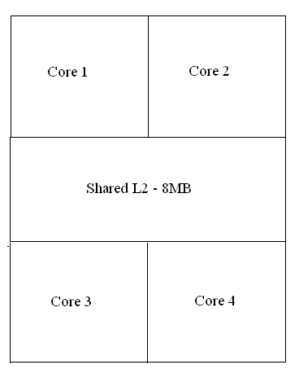
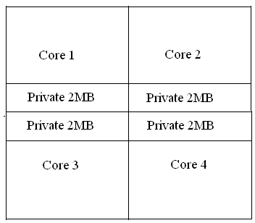
Cache Organization
Goal:
  Utilize Capacity Effectively- Reduce capacity misses
  Mitigate Increased Latencies- Keep wire delays small
Shared
  High Capacity but increased latency
Private
  Low Latency but limited capacity
Neither private nor shared caches achieve both goals

Slide 205
CMP-NuRAPID: Novel Mechanisms
Controlled Replication
  Avoid copies for some read-only shared data
In-Situ Communication
  Use fast on-chip communication to avoid coherence miss of read-write-shared data
Capacity Stealing
  Allow a core to steal another core’s unused capacity
Hybrid cache
  Private Tag Array and Shared Data Array
  CMP-NuRAPID(Non-Uniform access with Replacement and Placement using Distance associativity)
Performance
  CMP-NuRAPID improves performance by 13% over a shared cache and 8% over a private cache for three commercial multithreaded workloads
  Three novel mechanisms to exploit the changes in Latency-Capacity tradeoff

Slide 206
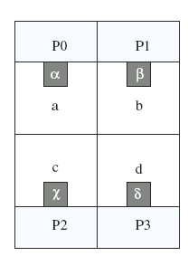
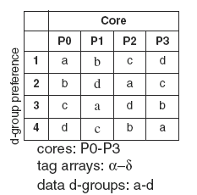
CMP-NuRAPID
Non-Uniform Access and Distance Associativity
  Caches divided into d-groups
  D-group preference
  Staggered
4-core CMP with CMP-NuRAPID

Slide 207
CMP-NuRapid Tag and Data Arrays
Data
Array
d-group 0
d-group 1
d-group 2
d-group 3
Crossbar or other interconnect
Tag 0
Tag 1
Tag 2
Tag 3
P0
P1
P2
P3
Bus
Memory
Tag arrays snoop on a bus to maintain coherence

Slide 208
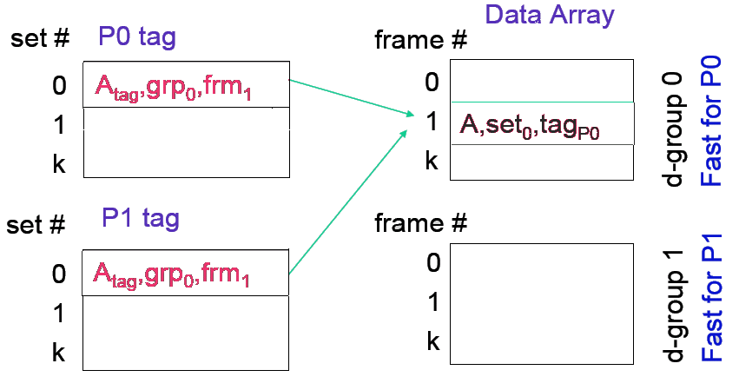
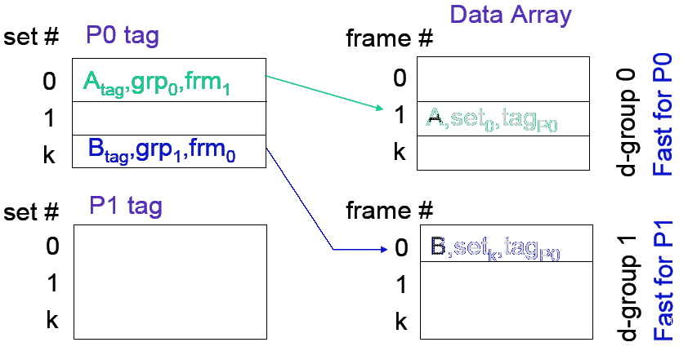
CMP-NuRAPID Organization
Private Tag Array
Shared Data Array
Leverages forward and reverse pointers
Single copy of block shared by multiple tags
Data for one core in different d-groups
Extra Level of Indirection for novel mechanisms

Slide 209
Mechanisms
Controlled Replication
In-Situ Communication
Capacity Stealing

Slide 210
Controlled Replication Example
Data Arrays
set #
P0 tag
frame #
0
1
k
A_{tag},grp₀,frm₁
0
1
k
A,set₀,tag_{P0}
d-group 0
set #
P1 tag
frame #
0
1
k
0
1
k
d-group 1
P0 has a clean block A in its tag and d-group 0

Slide 211
Controlled Replication Example (cntd.)
First access points to the same copy
No replica is made
Data Arrays
set #
P0 tag
frame #
0
1
k
A_{tag},grp₀,frm₁
0
1
k
A,set₀,tag_{P0}
d-group 0
set #
P1 tag
frame #
0
1
k
A_{tag},grp₀,frm₁
0
1
k
d-group 1
P1 misses on a read to A
P1’s tag gets a pointer to A in d-group 0

Slide 212
Controlled Replication Example (cntd.)
Second access makes a copy
Data that is reused is reused multiple times
Data Arrays
set #
P0 tag
frame #
0
1
k
A_{tag},grp₀,frm₁
0
1
k
A,set₀,tag_{P0}
d-group 0
set #
P1 tag
frame #
0
1
k
A_{tag},grp₁,frm_{k}
0
1
k
d-group 1
A,set₀,tag_{P1}
P1 reads A again
P1 replicates A in its closest d-group 1
Increases Effective Capacity

Slide 213
Shared Copies - Backpointer
Data Arrays
set #
P0 tag
frame #
0
1
k
A_{tag},grp₀,frm₁
0
1
k
A,set₀,tag_{P0}
d-group 0
set #
P1 tag
frame #
0
1
k
A_{tag},grp₀,frm₁
0
1
k
d-group 1
Only P0 can replace A

Slide 214
Mechanisms
Controlled Replication
In-Situ Communication
Capacity Stealing

Slide 215
In-Situ Communication
Core
Core
Core
Core
L1I
L1D
L1I
L1D
L1I
L1D
L1I
L1D
L2
L2
L2
L2
Write to Shared Data

Slide 216
In-Situ Communication
Core
Core
Core
Core
L1I
L1D
L1I
L1D
L1I
L1D
L1I
L1D
L2
L2
L2
L2
Write to Shared Data
  Invalidate all other copies

Slide 217
In-Situ Communication
Core
Core
Core
Core
L1I
L1D
L1I
L1D
L1I
L1D
L1I
L1D
L2
L2
L2
L2
Write to Shared Data
  Invalidate all other copies
  Write new value on own copy

Slide 218
In-Situ Communication
Core
Core
Core
Core
L1I
L1D
L1I
L1D
L1I
L1D
L1I
L1D
L2
L2
L2
L2
Write to Shared Data
  Invalidate all other copies
  Write new value on own copy
  Readers read on-demand
Communication & Coherence
Overhead

Slide 219
In-Situ Communication
Core
Core
Core
Core
L1I
L1D
L1I
L1D
L1I
L1D
L1I
L1D
L2
L2
L2
L2
Write to Shared Data
  Update All Copies
  Waste When Current Readers don’t need the value anymore
Communication & Coherence
Overhead

Slide 220
In-Situ Communication
Core
Core
Core
Core
L1I
L1D
L1I
L1D
L1I
L1D
L1I
L1D
L2
L2
L2
L2
Only one copy
Writer Updates the copy
Readers read it directly
Lower Communication and Coherence Overheads

Slide 221
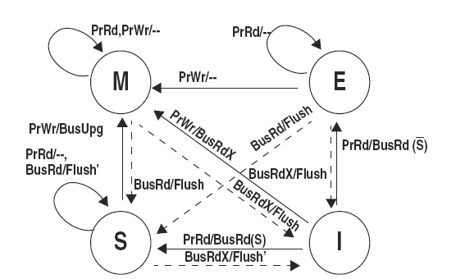
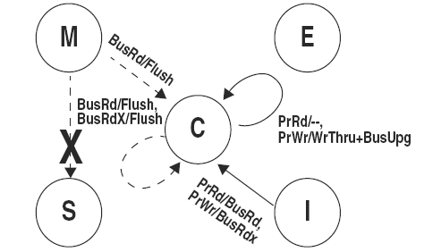
In-Situ Communication
Enforce single copy of read-write shared block in L2 and keep the block in communication (C) state
Requires change in the coherence protocol
Replace M to S transition by M to C transition
Fast communication with capacity savings
Notes:
Whenever there is a write in the shared state, the copy of the block in the sharers is invalidated and the writer has the modified copy. On a subsequent read, the reader incurs the penalty of a coherence miss to obtain data from writer and makes new copy in its private cache. This implies slow access. Idea is that each write is read more than once. In C state, writer writes the copy and reader in C state reads it without incurring a miss.

Slide 222
Mechanisms
Controlled Replication
In-Situ Communication
Capacity Stealing

Slide 223
Capacity Stealing
Demotion:
  Demote less frequently used data to un-used frames in d-groups closer to core with less capacity demands.
Promotion:
  if tag hit occurs on a block in farther d-group promote it
Data for one core in different d-groups
Use of unused capacity in a neighboring core

Slide 224
Placement and Promotion
Private Blocks (E)
Initially:
  In the closest d-group
Hit in private data not in closest d-group
  Promote to closets d-group
Shared Blocks
Rules for Controller Replication and In-Situ Communication apply
Never Demoted

Slide 225
Demotion and Replacement
Data Replacement
  Similar to conventional caches
  Occurs on cache misses
  Data is evicted
Distance Replacement
  Unique to NuRAPID
  Occurs on demotion
  Only data moves

Slide 226
Data Replacement
A block in the same cache set as the cache miss
Order of preference
  Invalid
    No cost
  Private
    Only one core needs the replaced block
  Shared
    Multiple cores may need the replaced block
LRU within each category
Replacing an invalid block or a block in the farthest d-group creates only space for the tag
  Need to find space for the data as well

Slide 227
Data Replacement
Private block in farthest d-group
  Evicted
  Space created for data in the farthest d-group
Shared
  Only tag evicted
  Data stays there
  No space for data
  Only the backpointer-referenced core can replace these
Invalid
  No space for data
Multiple demotions may be needed
  Stop at some d-group at random and evict

Slide 228
Methodology
Full-system simulation of 4-core CMP using Simics
CMP NuRAPID: 8 MB, 8-way
4 d-groups,1-port for each tag array and data d-group
Compare to
  Private 2 MB, 8-way, 1-port per core
  CMP-SNUCA: Shared with non-uniform-access, no replication

Slide 229
Performance: Multithreaded Workloads
a: CMP-SNUCA b: Private c: CMP NuRAPID d: Ideal
Performance relative to shared
a b c d
oltp
apache
specjbb
Average
Ideal: capacity of shared, latency of private
CMP NuRAPID: Within 3% of ideal cache on average

Slide 230
Performance: Multiprogrammed Workloads
a: CMP-SNUCA b: Private c: CMP NuRAPID
Performance relative to shared
a b c
MIX1
MIX2
MIX3
MIX4
Average
CMP NuRAPID outperforms shared, private, and CMP-SNUCA

Slide 231
Access distribution: Multiprogrammed workloads
Cache Hits
Cache Misses
a: Shared/CMP-SNUCA b: Private c: CMP NuRAPID
Fraction of total accesses
a b c
a b c
MIX1
MIX2
MIX3
MIX4
Average
CMP NuRAPID: 93% hits to closest d-group
CMP-NuRAPID vs Private: 11- vs 10-cycle average hit latency

Slide 232
Summary

Slide 233
Conclusions
CMPs change the Latency Capacity tradeoff
Controlled Replication, In-Situ Communication and Capacity Stealing are novel mechanisms to exploit the change in the Latency-Capacity tradeoff
CMP-NuRAPID is a hybrid cache that uses incorporates the novel mechanisms
For commercial multi-threaded workloads– 13% better than shared, 8% better than private
For multi-programmed workloads– 28% better than shared, 8% better than private

Slide 234
Cooperative Caching for
Chip Multiprocessors
Jichuan Chang and Guri Sohi
Int’l Conference on Computer Architecture, June 2006

Slide 235
Yet Another Hybrid CMP Cache - Why?
Private cache based design
  Lower latency and per-cache associativity
  Lower cross-chip bandwidth requirement
  Self-contained for resource management
  Easier to support QoS, fairness, and priority
Need a unified framework
  Manage the aggregate on-chip cache resources
  Can be adopted by different coherence protocols

Slide 236
CMP Cooperative Caching
Form an aggregate global cache via cooperative private caches
  Use private caches to attract data for fast reuse
  Share capacity through cooperative policies
  Throttle cooperation to find an optimal sharing point
Inspired by cooperative
file/web caches
  Similar latency tradeoff
  Similar algorithms
P
P
L1I
L1D
L1I
L1D
L2
L2
Network
L2
L2
L1I
L1D
L1I
L1D
P
P

Slide 237
Outline
Introduction
CMP Cooperative Caching
Hardware Implementation
Performance Evaluation
Conclusion

Slide 238
Policies to Reduce Off-chip Accesses
Cooperation policies for capacity sharing
  (1) Cache-to-cache transfers of clean data
  (2) Replication-aware replacement
  (3) Global replacement of inactive data
Implemented by two unified techniques
  Policies enforced by cache replacement/placement
  Information/data exchange supported by modifying the coherence protocol

Slide 239
Policy (1) - Make use of all on-chip data
Don’t go off-chip if on-chip (clean) data exist
  Existing protocols do that for dirty data only
    Why? When clean-shared have to decide who responds
    In SMPs no significant benefit to doing that
Beneficial and practical for CMPs
  Peer cache is much closer than next-level storage
  Affordable implementations of “clean ownership”
Important for all workloads
  Multi-threaded: (mostly) read-only shared data
  Single-threaded: spill into peer caches for later reuse

Slide 240
Policy (2) – Control replication
Intuition – increase # of unique on-chip data
  SINGLETS
Latency/capacity tradeoff
  Evict singlets only when no invalid or replicates exist
    If all singlets pick LRU
  Modify the default cache replacement policy
“Spill” an evicted singlet into a peer cache
  Can further reduce on-chip replication
  Which cache? Choose at Random

Slide 241
Policy (3) - Global cache management
Approximate global-LRU replacement
  Combine global spill/reuse history with local LRU
Identify and replace globally inactive data
  First become the LRU entry in the local cache
  Set as MRU if spilled into a peer cache
  Later become LRU entry again: evict globally
1-chance forwarding (1-Fwd)
  Blocks can only be spilled once if not reused

Slide 242
1-Chance Forwarding
Keep Recirculation Count with each block
Initially RC = 0
When evicting a singlet w/ RC = 0
  Set it’s RC to 1
When evicting:
  RC--
  If RC = 0 discard
If block is touched
  RC = 0
  Give it another chance

Slide 243
Cooperation Throttling
Why throttling?
  Further tradeoff between capacity/latency
Two probabilities to help make decisions
  Cooperation probability: Prefer singlets over replicates?
    control replication
  Spill probability: Spill a singlet victim?
    throttle spilling
Shared
Private
CC 100%
Cooperative Caching
CC 0%
Policy (1)

Slide 244
Outline
Introduction
CMP Cooperative Caching
Hardware Implementation
Performance Evaluation
Conclusion

Slide 245
Hardware Implementation
Requirements
  Information: singlet, spill/reuse history
  Cache replacement policy
  Coherence protocol: clean owner and spilling
Can modify an existing implementation
Proposed implementation
  Central Coherence Engine (CCE)
  On-chip directory by duplicating tag arrays

Slide 246
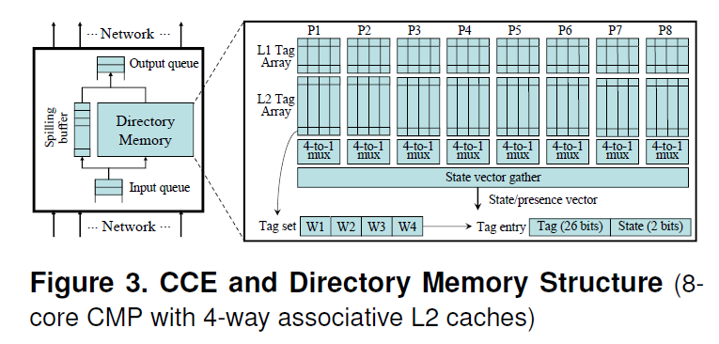
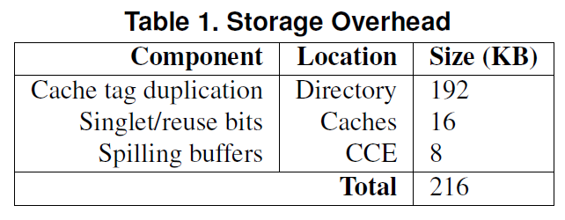
Duplicate Tag Directory
2.3% of total

Slide 247
Information and Data Exchange
Singlet information
  Directory detects and notifies the block owner
Sharing of clean data
  PUTS: notify directory of clean data replacement
  Directory sends forward request to the first sharer
Spilling
  Currently implemented as a 2-step data transfer
  Can be implemented as recipient-issued prefetch

Slide 248
Outline
Introduction
CMP Cooperative Caching
Hardware Implementation
Performance Evaluation
Conclusion

Slide 249
Performance Evaluation
Full system simulator
  Modified GEMS Ruby to simulate memory hierarchy
  Simics MAI-based OoO processor simulator
Workloads
  Multithreaded commercial benchmarks (8-core)
    OLTP, Apache, JBB, Zeus
  Multiprogrammed SPEC2000 benchmarks (4-core)
    4 heterogeneous, 2 homogeneous
Private / shared / cooperative schemes
  Same total capacity/associativity

Slide 250
Multithreaded Workloads - Throughput
CC throttling - 0%, 30%, 70% and 100%
  Same for spill and replication policy
Ideal – Shared cache with local bank latency

Slide 251
Multithreaded Workloads - Avg. Latency
Low off-chip miss rate
High hit ratio to local L2
Lower bandwidth needed than a shared cache

Slide 252
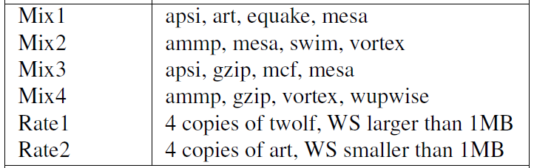
Multiprogrammed Workloads
CC = 100%
Off-chip
Off-chip
Remote L2
Remote L2
Local L2
Local L2
L1
L1

Slide 253
Comparison with Victim Replication
Normalized Performance
SPECOMP
Single-
threaded

Slide 254
Conclusion
CMP cooperative caching
  Exploit benefits of private cache based design
  Capacity sharing through explicit cooperation
  Cache replacement/placement policies
  for replication control and global management
  Robust performance improvement

Slide 255
Managing Distributed, Shared L2 Caches through
OS-Level Page Allocation
Sangyeun Cho and Lei Jin
Dept. of Computer Science
University of Pittsburgh
Int’l Symposium on Microarchitecture, 2006

Slide 256
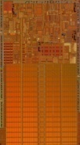
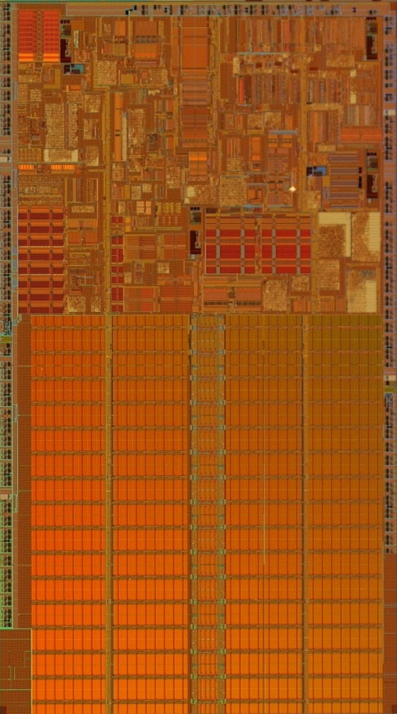
Private caching
3. Access directory
 short hit latency (always local)
 high on-chip miss rate
long miss resolution time
complex coherence enforcement
L1 miss
L2 access
  Hit
  Miss
Access directory
  A copy on chip
  Global miss
1. L1 miss
2. L2 access

Slide 257
OS-Level Data Placement
Placing “flexibility” as the top design consideration
OS-level data to L2 cache mapping
  Simple hardware based on shared caching
  Efficient mapping maintenance at page granularity
Demonstrating the impact using different policies

Slide 258
Talk roadmap
Data mapping, a key property
Flexible page-level mapping
  Goals
  Architectural support
  OS design issues
Management policies
Conclusion and future works

Slide 259
Data mapping, the key
Data mapping = deciding data location (i.e., cache slice)
Private caching
  Data mapping determined by program location
  Mapping created at miss time
  No explicit control
Shared caching
  Data mapping determined by address
    slice number = (block address) % (N_{slice})
  Mapping is static
  Cache block installation at miss time
  No explicit control
  (Run-time can impact location within slice)
Mapping granularity = block

Slide 260
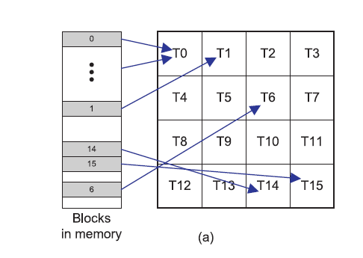
Block-Level Mapping
Used in Shared Caches

Slide 261
Page-Level Mapping
The OS has control of where a page maps to
  Page-level interleaving across cache slices

Slide 262
Goal 1: performance management
◻ Proximity-aware data mapping

Slide 263
Goal 2: power management
0
0
0
0
0
0
0
0
0
0
0
0
◻ Usage-aware cache shut-off

Slide 264
Goal 3: reliability management
X
X
◻ On-demand cache isolation

Slide 265
Goal 4: QoS management
◻ Contract-based cache allocation

Slide 266
Architectural support
page_num
offset
Slice = Collection of Banks
Managed as a unit
Method 1: “bit selection”
slice_num = (page_num) % (N_{slice})
other bits
slice_num
offset
Method 2: “region table”
regionx_low ≤ page_num ≤ regionx_high
L1 miss
data address
region0_low
region0_high
slice_num0
reg_table
region1_low
region1_high
slice_num1
Method 3: “page table (TLB)”
page_num «–» slice_num
TLB
vpage_num0
ppage_num0
slice_num0
vpage_num1
ppage_num1
slice_num1
◻ Simple hardware support enough
◻ Combined scheme feasible

Slide 267
Some OS design issues
Congruence group CG(i)
  Set of physical pages mapped to slice i
  A free list for each i ⇒ multiple free lists
On each page allocation, consider
  Data proximity
  Cache pressure
  e.g., Profitability function P = f(M, L, P, Q, C)
    M: miss rates
    L: network link status
    P: current page allocation status
    Q: QoS requirements
    C: cache configuration
Impact on process scheduling
Leverage existing frameworks
  Page coloring – multiple free lists
  NUMA OS – process scheduling & page allocation

Slide 268
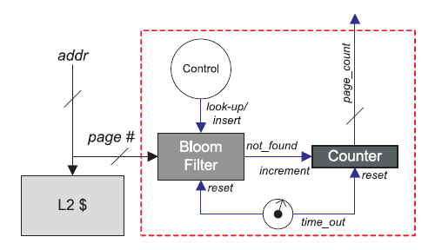
Tracking Cache Pressure
A program’s time-varying working set
Approximated by the number of actively accessed pages
Divided by the cache size
Use a Bloom filter to approximate that
  Empty the filter
  If miss, count++ and insert

Slide 269
Working example
Profitability Function:
Program
0
1
2
3
5
5
◻ Static vs. dynamic mapping
◻ Program information (e.g., profile)
Proper run-time monitoring needed
4
5
6
7
P(4) = 0.9
P(6) = 0.8
P(5) = 0.7
…
P(1) = 0.95
P(6) = 0.9
P(4) = 0.8
…
5
5
8
9
10
11
4
1
12
13
14
15
6

Slide 270
Simulating private caching
For a page requested from a program running on core i, map the page to cache slice i
SPEC2k INT
SPEC2k FP
private caching
OS-based
L2 cache latency (cycles)
L2 cache slice size
◻ Simulating private caching is simple
◻ Similar or better performance

Slide 271
Simulating shared caching
For a page requested from a program running on core i, map the page to all cache slices (round-robin, random, …)
SPEC2k INT
SPEC2k FP
129
106
OS
shared
L2 cache latency (cycles)
L2 cache slice size
◻ Simulating shared caching is simple
Mostly similar behavior/performance

Slide 272
Clustered Sharing
Mid-way between Shared and Private
0
1
2
3
4
5
6
7
8
9
10
11
12
13
14
15

Slide 273
Simulating clustered caching
For a page requested from a program running on core of group j, map the page to any cache slice within group (round-robin, random, …)
private
shared
OS
Relative performance (time⁻¹)
4 cores used; 512kB cache slice
◻ Simulating clustered caching is simple
Lower miss traffic than private
Lower on-chip traffic than shared

Slide 274
Conclusion
“Flexibility” will become important in future multicores
  Many shared resources
  Allows us to implement high-level policies
OS-level page-granularity data-to-slice mapping
  Low hardware overhead
  Flexible
Several management policies studied
  Mimicking private/shared/clustered caching straightforward
  Performance-improving schemes

Slide 275
Future works
Dynamic mapping schemes
  Performance
  Power
Performance monitoring techniques
  Hardware-based
  Software-based
Data migration and replication support

Slide 276
ASR: Adaptive Selective Replication for CMP Caches
Brad Beckmann†, Mike Marty, and David Wood
Multifacet Project
University of Wisconsin-Madison
Int’l Symposium on Microarchitecture, 2006
12/13/06
† currently at Microsoft

Slide 277
Introduction
Previous hybrid proposals
  Cooperative Caching, CMP-NuRapid
    Private L2 caches / restrict replication
  Victim Replication
    Shared L2 caches / allow replication
  Achieve fast access and high capacity
    Under certain workloads & system configurations
    Utilize static rules
  Non-adaptive
    E.g., CC w/ 100% (minimum replication)
      Apache performance improves by 13%
      Apsi performance degrades by 27%

Slide 278
Adaptive Selective Replication
Adaptive Selective Replication: ASR
  Dynamically monitor workload behavior
  Adapt the L2 cache to workload demand
  Up to 12% improvement vs. previous proposals
Estimates
  Cost of replication
    Extra misses
      Hits in LRU
  Benefit of replication
    Lower hit latency
      Hits in remote caches

Slide 279
Outline
Introduction
Understanding L2 Replication
  Benefit
  Cost
  Key Observation
  Solution
ASR: Adaptive Selective Replication
Evaluation
Beckmann, Marty, & Wood
ASR: Adaptive Selective Replication for CMP Caches
279
Notes:
279

Slide 280
Understanding L2 Replication
Three L2 block sharing types
  Single requestor
    All requests by a single processor
  Shared read only
    Read only requests by multiple processors
  Shared read-write
    Read and write requests by multiple processors
Profile L2 blocks during their on-chip lifetime
  8 processor CMP
  16 MB shared L2 cache
  64-byte block size

Slide 281
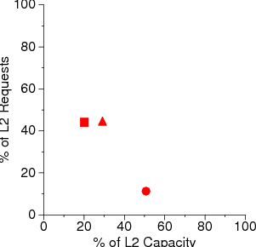
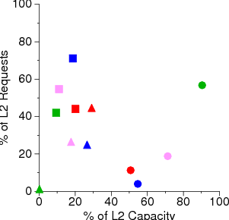
Understanding L2 Replication
High Locality
Low Locality
Apache
Jbb
Oltp
Mid Locality
Zeus
Shared Read-only
Shared Read-write
Single Requestor

Slide 282
Understanding L2 Replication
Shared read-only replication
  High-Locality
  Can reduce latency
  Small static fraction → minimal impact on capacity if replicated
  Degree of sharing can be large → must control replication to avoid capacity overload
Shared read-write
  Little locality
  Data is read only a few times and then updated
  Not a good idea to replicate
Single Requestor
  No point in replicating
  Low locality as well
Focus on replicating Shared Read-Only

Slide 283
Understanding L2 Replication: Benefit
The more we replicate the closer the data can be to the accessing core
Hence the lower the latency
L2 Hit Cycles
Replication Capacity

Slide 284
Understanding L2 Replication: Cost
The more we replicate the lower the effective cache capacity
Hence we get more cache misses
L2 Miss Cycles
Replication Capacity

Slide 285
Understanding L2 Replication: Key Observation
Top 3% of Shared Read-only blocks satisfy
70% of Shared Read-only requests
Replicate Frequently
Requested Blocks First
L2 Hit Cycles
Replication Capacity
Beckmann, Marty, & Wood
ASR: Adaptive Selective Replication for CMP Caches
285
Notes:
285

Slide 286
Understanding L2 Replication: Solution
Total
Cycle
Curve
Property of Workload
Cache Interaction
Not Fixed ⇒
Must Adapt
Optimal
Total Cycles
Replication Capacity

Slide 287
Outline
Wires and CMP caches
Understanding L2 Replication
ASR: Adaptive Selective Replication
  SPR: Selective Probabilistic Replication
  Monitoring and adapting to workload behavior
Evaluation

Slide 288
SPR: Selective Probabilistic Replication
Mechanism for Selective Replication
Replicate on L1 eviction
  Use token coherence
    No need for centralized directory (CC) or home node (victim)
  Relax L2 inclusion property
    L2 evictions do not force L1 evictions
    Non-exclusive cache hierarchy
  Ring Writebacks
    L1 Writebacks passed clockwise between private L2 caches
    Merge with other existing L2 copies
Probabilistically choose between
  Local writeback ⇒ allow replication
  Ring writeback ⇒ disallow replication
  Always writeback if block already in local L2
Replicates frequently requested blocks

Slide 289

SPR: Selective Probabilistic Replication
L1
I $
Private
L2
Private
L2
L1
I $
CPU 3
CPU 4
L1
D $
L1
D $
L1
I $
Private
L2
Private
L2
L1
I $
CPU 2
CPU 5
L1
D $
L1
D $
L1
I $
Private
L2
Private
L2
L1
I $
CPU 1
CPU 6
L1
D $
L1
D $
L1
I $
Private
L2
Private
L2
L1
I $
CPU 0
CPU 7
L1
D $
L1
D $

Slide 290
SPR: Selective Probabilistic Replication
How do we choose the probability of replication?
Replication Level | 0 | 1 | 2 | 3 | 4 | 5
Prob. of Replication | 0 | 1/64 | 1/16 | 1/4 | 1/2 | 1
Current
Level
Replication
Capacity
0
1
2
3
4
5
Replication Levels

Slide 291
Implementing ASR
Four mechanisms estimate deltas
  Decrease-in-replication Benefit
  Increase-in-replication Benefit
  Decrease-in-replication Cost
  Increase-in-replication Cost
Triggering a cost-benefit analysis
Four counters → measuring cycle differences

Slide 292
ASR: Decrease-in-replication Benefit
L2 Hit Cycles
lower level
current level
Replication Capacity

Slide 293
ASR: Decrease-in-replication Benefit
Goal
  Determine replication benefit decrease of the next lower level
  Local hits that would be remote hits
Mechanism
  Current Replica Bit
    Per L2 cache block
    Set for replications of the current level
    Not set for replications of lower level
  Current replica hits would be remote hits with next lower level
Overhead
  1-bit x 256 K L2 blocks = 32 KB

Slide 294
ASR: Increase-in-replication Benefit
L2 Hit Cycles
current level
higher level
Replication Capacity

Slide 295
ASR: Increase-in-replication Benefit
Goal
  Determine replication benefit increase of the next higher level
  Blocks not replicated that would have been replicated
Mechanism
  Next Level Hit Buffers (NLHBs)
    8-bit partial tag buffer
    Store replicas of the next higher when not replicated
  NLHB hits would be local L2 hits with next higher level
Overhead
  8-bits x 16 K entries x 8 processors = 128 KB

Slide 296
ASR: Decrease-in-replication Cost
L2 Miss Cycles
lower level
current level
Replication Capacity

Slide 297
ASR: Decrease-in-replication Cost
Goal
  Determine replication cost decrease of the next lower level
  Would be hits in lower level, evicted due to replication in this level
Mechanism
  Victim Tag Buffers (VTBs)
    16-bit partial tags
    Store recently evicted blocks of current replication level
  VTB hits would be on-chip hits with next lower level
Overhead
  16-bits x 1 K entry x 8 processors = 16 KB

Slide 298
ASR: Increase-in-replication Cost
L2 Miss Cycles
current level
higher level
Replication Capacity

Slide 299
ASR: Increase-in-replication Cost
Goal
  Determine replication cost increase of the next higher level
  Would be evicted due to replication at next level
Mechanism
  Goal: track the 1K LRU blocks → too expensive
  Way and Set counters [Suh et al. HPCA 2002]
    Identify soon-to-be-evicted blocks
    16-way pseudo LRU
    256 set groups
  On-chip hits that would be off-chip with next higher level
Overhead
  255-bit pseudo LRU tree x 8 processors = 255 B
Overall storage overhead: 212 KB or 1.2% of total storage

Slide 300
Estimating LRU position
Counters per way and per set
  Ways x Sets x Processors → too expensive
To reduce cost they maintain a pseudo-LRU ordering of set groups
  256 set-groups
  Maintain way counters per group
  Pseudo-LRU tree
How are these updated?

Slide 301
ASR: Triggering a Cost-Benefit Analysis
Goal
  Dynamically adapt to workload behavior
  Avoid unnecessary replication level changes
Mechanism
  Evaluation trigger
    Local replications or NLHB allocations exceed 1K
  Replication change
    Four consecutive evaluations in the same direction

Slide 302
ASR: Adaptive Algorithm
Decrease in Replication Benefit vs.
Increase in Replication Cost
  Whether we should decrease replication
Decrease in Replication Cost vs.
Increase in Replication Benefit
  Whether we should increase replication
Decrease in Replication Cost → Would be hits in lower level, evicted due to replication
Increase in Replication Benefit → Blocks not replicated that would have been replicated
Decrease in Replication Benefit → Local hits that would be remote hits if lower
Increase in Replication Cost → Would be evicted due to replication at next level

Slide 303
ASR: Adaptive Algorithm
 | Decrease in Replication Cost > Increase in Replication Benefit | Decrease in Replication Cost < Increase in Replication Benefit
Decrease in Replication Benefit > Increase in Replication Cost | Go in direction with greater value | Increase Replication
Decrease in Replication Benefit < Increase in Replication Cost | Decrease Replication | Do Nothing
Decrease in Replication Cost → Would be hits in lower level, evicted due to replication
Increase in Replication Benefit → Blocks not replicated that would have been replicated
Decrease in Replication Benefit → Local hits that would be remote hits if lower
Increase in Replication Cost → Would be evicted due to replication at next level

Slide 304
Outline
Wires and CMP caches
Understanding L2 Replication
ASR: Adaptive Selective Replication
Evaluation
Beckmann, Marty, & Wood
ASR: Adaptive Selective Replication for CMP Caches
Notes:
304

Slide 305
Methodology
Full system simulation
  Simics
  Wisconsin’s GEMS Timing Simulator
    Out-of-order processor
    Memory system
Workloads
  Commercial
    apache, jbb, otlp, zeus
  Scientific (see paper)
    SpecOMP: apsi & art
    Splash: barnes & ocean

Slide 306
System Parameters
[ 8 core CMP, 45 nm technology ]
Memory System |  | Dynamically Scheduled Processor
L1 I & D caches | 64 KB, 4-way, 3 cycles | Clock frequency | 5.0 GHz
Unified L2 cache | 16 MB, 16-way | Reorder buffer / scheduler | 128 / 64 entries
L1 / L2 prefetching | Unit & Non-unit strided prefetcher (similar Power4) | Pipeline width | 4-wide fetch & issue
Memory latency | 500 cycles | Pipeline stages | 30
Memory bandwidth | 50 GB/s | Direct branch predictor | 3.5 KB YAGS
Memory size | 4 GB of DRAM | Return address stack | 64 entries
Outstanding memory request / CPU | 16 | Indirect branch predictor | 256 entries (cascaded)

Slide 307
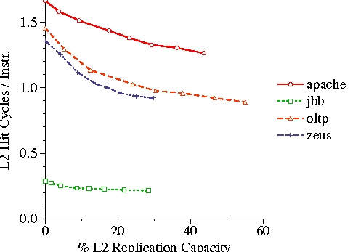
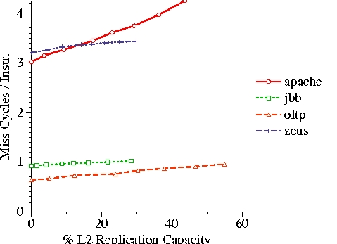
Replication Benefit, Cost, & Effectiveness Curves
Benefit
Cost

Slide 308
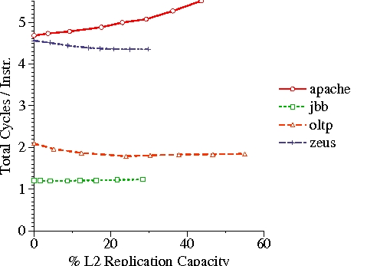
Replication Benefit, Cost, & Effectiveness Curves
Effectiveness

Slide 309
Comparison of Replication Policies
SPR ⇒ multiple possible policies
Evaluated 4 shared read-only replication policies
  VR: Victim Replication
    Previously proposed [Zhang ISCA 05]
    Disallow replicas to evict shared owner blocks
  NR: CMP-NuRapid
    Previously proposed [Chishti ISCA 05]
    Replicate upon the second request
  CC: Cooperative Caching
    Previously proposed [Chang ISCA 06]
    Replace replicas first
    Spill singlets to remote caches
    Tunable parameter 100%, 70%, 30%, 0%
  ASR: Adaptive Selective Replication
    Our proposal
    Monitor and adjust to workload demand
Lack
Dynamic
Adaptation

Slide 310
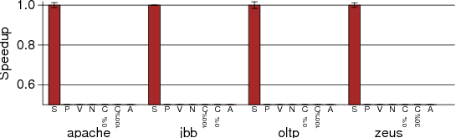
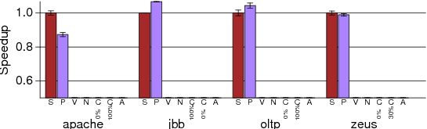
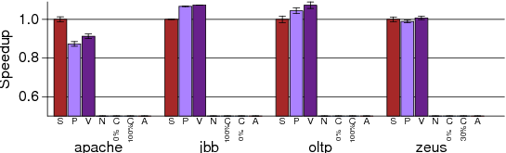
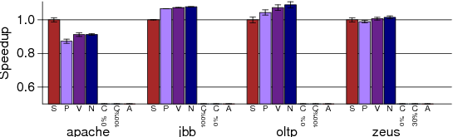
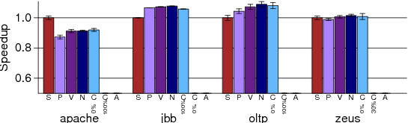
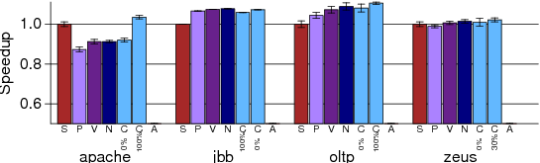
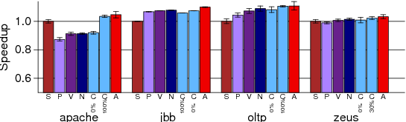
ASR: Performance
S: CMP-Shared
P: CMP-Private
V: SPR-VR
N: SPR-NR
C: SPR-CC
A: SPR-ASR

Slide 311
Conclusions
CMP Cache Replication
  No replications ⇒ conservers capacity
  All replications ⇒ reduces on-chip latency
  Previous hybrid proposals
    Work well for certain criteria
    Non-adaptive
Adaptive Selective Replication
  Probabilistic policy favors frequently requested blocks
  Dynamically monitor replication benefit & cost
  Replicate benefit > cost
  Improves performance up to 12% vs. previous schemes

Slide 312
An Adaptive Shared/Private NUCA Cache Partitioning Scheme for Chip Multiprocessors
Haakon Dybdahl & Per Stenstrom
Int’l Conference on High-Performance Computer Architecture, Feb 2007

Slide 313
The Problem with Previous Approaches
Uncontrolled Replication
  A replicated block evicts another block at random
  This results in Polution
Goal of this work:
  Develop an adaptive replication method
How will replication be controlled?
  Adjust the portion of the cache that can be used for replicas
The paper shows that the proposed method is better than:
  Private
  Shared
  Controlled Replication
Only Multi-Program workloads considered
  The authors argue that the technique should work for parallel workloads as well

Slide 314
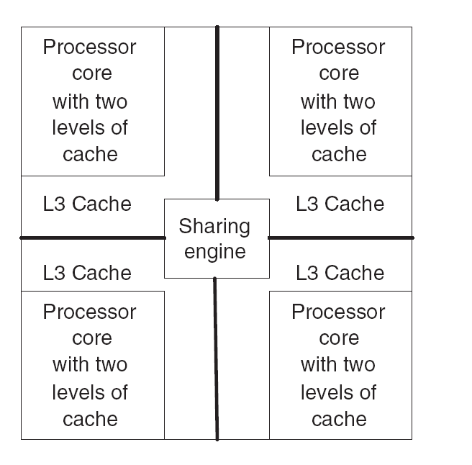
Baseline Architecture
Local and remote partitions
Sharing engine controls replication

Slide 315
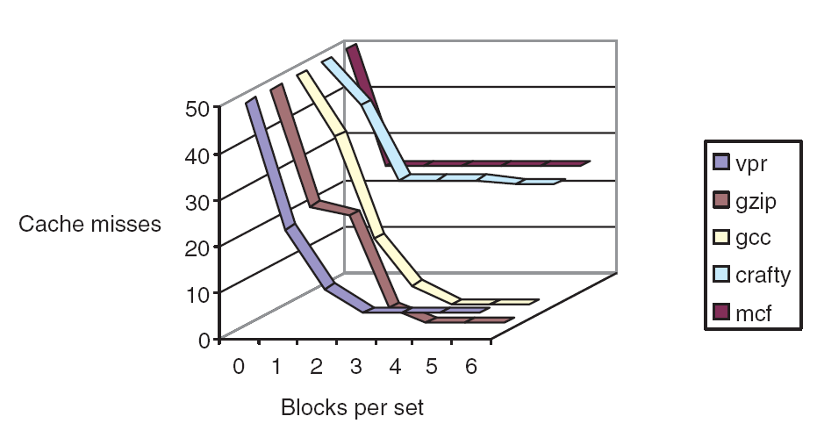
Motivation
→ ways
Some programs do well with few ways
Some require more ways

Slide 316
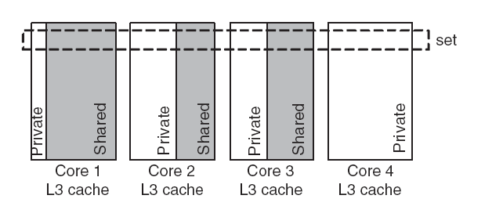
Private vs. Shared Partitions
Adjust the number of ways:
  Private ways
  Replica ways → can be used by all processors
Private ways only available to local processor
Goal is to minimize the total number of misses
  Size of private partition
  The number of blocks in the shared partition

Slide 317
Sharing Engine
Three components
  Estimation of private/shared “sizes”
  A method for sharing the cache
  A replacement policy for the shared cache space

Slide 318
Estimating the size of Private/Shared Partitions
Keep several counters
Should we decrease the number of ways?
  Count the number of hits to the LRU block in each set
  How many more misses will occur?
Should we increase the number of ways?
  Keep shadow tags → remember last evicted block
  Hit in shadow tag → increment the counter
  How many more hits will occur?
Every 2K misses:
  Look at the counters
  Gain: Core with max more ways
  Loss: Core with min less ways
  If Gain > Loss → Adjust ways give more ways to first core
Start with 75% private and 25% shared

Slide 319
Structures
Core ID with every block
  Used eventually in Shadow Tags
A counter per core
  Max blocks per set → how many ways it can use
Another two counters per block
  Hits in Shadow tags
    Estimate Gain of increasing ways
  Hits in LRU block
    Estimate Loss of decreasing ways

Slide 320
Management of Partitions
Private partition
  Only accessed by the local core
  LRU
Shared partition
  Can contain blocks from any core
  Replacement algorithm tries to adjust size according to the current partition size
To adjust the shared partition ways only the counter is changed
  Block evictions or introductions are done gradually

Slide 321
Cache Hit in Private Portion
All blocks involved are from the private partition
  Simply use LRU
  Nothing else is needed

Slide 322
Cache hit in neighboring cache
This means first we had a miss in the local private partition
Then all other caches are searched in parallel
The cache block is moved to the local cache
  The LRU block in the private portion is moved to the neighboring cache
  There it is set as the MRU block in the shared portion
Local
Remote
LRU
Local
Remote
MRU
MRU

Slide 323
Cache miss
Get from memory
Place as MRU in private portion
  Move LRU block to shared portion of the local cache
  A block from the shared portion needs to be evicted
Eviction Algorithm
  Scan in LRU order
    If the owning Core has too many blocks in the set evict
  If no block found LRU goes
How can a Core have too many blocks?
  Because we adjust the max number of blocks per set
  The above algorithm gradually enforces this adjustment

Slide 324

Methodology
Extended Simplescalar
SPEC CPU 2000

Slide 325

Classification of applications
Which care about L2 misses?

Slide 326

Compared to Shared and Private
Running different mixes of four benchmarks

Slide 327
Conclusions
Adapt the number of ways
Estimate the Gain and Loss per core of increasing the number of ways
Adjustment happens gradually via the shared portion replacement algorithm
Compared to private: 13% faster
Compared to shared: 5%

Slide 328
Dynamic Spill-Receive for Robust High-Performance Caching in CMPs
Moinuddin K. Qureshi
T. J. Watson Research Center, Yorktown Heights, NY

Slide 329
Background: Private Caches on CMP
Private caches avoid the need for shared interconnect
++ fast latency, tiled design, performance isolation
CACHE A
CACHE B
CACHE C
CACHE D
Memory
Core A
I$
D$
Core B
I$
D$
Core D
Core C
I$
D$
I$
D$
Problem: When one core needs more cache and other core
has spare cache, private-cache CMPs cannot share capacity

Slide 330
Cache Line Spilling
Spill evicted line from one cache to neighbor cache
- Co-operative caching (CC) [ Chang+ ISCA’06]
Spill
Cache A
Cache B
Cache C
Cache D
Problem with CC:
Performance depends on the parameter (spill probability)
All caches spill as well as receive ➔ Limited improvement
  Spilling helps only if application demands it
  Receiving lines hurts if cache does not have spare capacity
Goal:
Robust High-Performance Capacity Sharing with Negligible Overhead

Slide 331
Spill-Receive Architecture
Each Cache is either a Spiller or Receiver but not both
- Lines from spiller cache are spilled to one of the receivers
- Evicted lines from receiver cache are discarded
Spill
Cache A
Cache B
Cache C
Cache D
S/R =1
(Spiller cache)
S/R =0
(Receiver cache)
S/R =1
(Spiller cache)
S/R =0
(Receiver cache)
What is the best N-bit binary string that maximizes the performance of Spill Receive Architecture ➔
Dynamic Spill Receive (DSR) → Adapt to Application Demands

Slide 332

“Giver” & “Taker” Applications
Some applications
  Benefit from more cache → Takers
  Do not benefit from more cache → Givers
If all Givers → Private cache works well
If mix → Spilling helps
#ways

Slide 333
Where is a block?
First check the “local” bank
Then “snoop” all other caches
Then go to memory

Slide 334
Dynamic Spill-Receive via “Set Dueling”
    Divide the cache in three:
      Spiller sets
      Receiver sets
      Follower sets (winner of spiller, receiver)
    n-bit PSEL counter
    misses to spiller-sets: PSEL--
    misses to receiver-set: PSEL++
    MSB of PSEL decides policy for Follower sets:
      MSB = 0, Use spill
      MSB = 1, Use receive
Spiller-sets
miss
-
PSEL
Receiver-sets
+
miss
Follower Sets
MSB = 0?
YES
No
Use Recv
Use spill
monitor ➔ choose ➔ apply
(using a single counter)

Slide 335
Dynamic Spill-Receive Architecture
Cache A
Cache B
Cache C
Cache D
Set X
AlwaysSpill
AlwaysRecv
Set Y
Miss in Set X
in any cache
-
PSEL A
PSEL B
PSEL C
PSEL D
Miss in Set Y
in any cache
+
Decides policy for all sets of Cache A (except X and Y)

Slide 336
Outline
Background
Dynamic Spill Receive Architecture
Performance Evaluation
Quality-of-Service
Summary

Slide 337
Experimental Setup
  Baseline Study:
    4-core CMP with in-order cores
    Private Cache Hierarchy: 16KB L1, 1MB L2
    10 cycle latency for local hits, 40 cycles for remote hits
  Benchmarks:
    6 benchmarks that have extra cache: “Givers” (G)
    6 benchmarks that benefit from more cache: “Takers” (T)
    All 4-thread combinations of 12 benchmarks: 495 total
    Five types of workloads:
G4T0
G3T1
G2T2
G1T3
G0T4

Slide 338
Performance Metrics
Three metrics for performance:
Throughput
➔ perf = IPC₁ + IPC₂
➔can be unfair to low-IPC application
Weighted Speedup
➔ perf = IPC₁/SingleIPC₁ + IPC₂/SingleIPC₂
➔ correlates with reduction in execution time
Hmean-fairness ➔ perf = hmean(IPC₁/SingleIPC₁, IPC₂/SingleIPC₂) ➔ balances fairness and performance

Slide 339
Results for Throughput
G4T0 → Need more capacity for all apps → still DASR helps
No significant degradation of performance for some workloads
On average, DSR improves throughput by 18%, co-operative caching by 7%
DSR provides 90% of the benefit of knowing the best decisions a priori
* DSA implemented with 32 dedicated sets and 10 bit PSEL counters

Slide 340

S-Curve
Throughput Improvement

Slide 341
Results for Weighted Speedup
On average, DSR improves weighted speedup by 13%

Slide 342
Results for Hmean Fairness
On average, DSR improves Hmean Fairness from 0.58 to 0.78

Slide 343
DSR vs. Faster Shared Cache
DSR (with 40 cycle extra for remote hits) performs similar to
shared cache with zero latency overhead and crossbar interconnect

Slide 344
Scalability of DSR
DSR improves average throughput by 19% for both systems
(No performance degradation for any of the workloads)

Slide 345
Outline
Background
Dynamic Spill Receive Architecture
Performance Evaluation
Quality-of-Service
Summary

Slide 346


Quality of Service with DSR
For 1 % of the 495x4 =1980 apps, DSR causes IPC loss of > 5%
In some cases, important to ensure that performance does not
degrade compared to dedicated private cache ➔ QoS
Estimate Misses with vs. without DSR
DSR can ensure QoS: change PSEL counters by weight of miss:
ΔMiss = MissesWithDSR – MissesWithoutDSR
ΔCyclesWithDSR = AvgMemLatency · ΔMiss
Calculate weight every 4M cycles. Needs 3 counters per core
Estimated by Spiller Sets

Slide 347
QoS DSR Hardware
4-byte cycle counter
  Shared by all cores
Per Core/Cache:
  3 bytes for Misses in Spiller Sets
  3 bytes for Miss in DSR
  1 byte for QoSPenaltyFactor
    6.2 fixed-point
  12 bits for PSEL
    10.2 fixed-point
10 bytes per core
On overflow of cycle counter
  Halve all other counters

Slide 348
IPC of QoS-Aware DSR
For Category: G0T4
IPC Normalized To NoSpill
IPC curves for other categories almost overlap for the two schemes.
Avg. throughput improvement across all 495 workloads similar (17.5% vs. 18%)

Slide 349
Summary
  The Problem:
  Need efficient capacity sharing in CMPs with private cache
  Solution: Dynamic Spill-Receive (DSR)
  1. Provides High Performance by Capacity Sharing
  - On average 18% in throughput (36% on hmean fairness)
  2. Requires Low Design Overhead
  - < 2 bytes of HW require per core in the system
  3. Scales to Large Number of Cores
  - Evaluated 16-cores in our study
  4. Maintains performance isolation of private caches
  - Easy to ensure QoS while retaining performance

Slide 350
DSR vs. TADIP

Slide 351
PageNUCA:
Selected Policies for Page-grain Locality Management in Large Shared CMP Caches
Mainak Chaudhuri, IIT Kanpur
Int’l Conference on High-Performance Computer Architecture, 2009
Some slides from the author’s conference talk

Slide 352
Baseline System
Manage data placement at the Page Level
Memory
control
B0
B1
B2
B3
B4
B5
B6
B7
L2 bank
L2 bank
control
C0
C1
C2
C3
Ring
C4
C5
C6
C7
Core w/
L1$
B8
B9
B10
B11
B12
B13
B14
B15

Slide 353
Page-Interleaved Cache
Data is interleaved at the page level
Page allocation determines where data goes on-chip
pages
0
B0
B1
B2
B3
B4
B5
B6
B7
0
1
3
1
16
3
C0
C1
C2
C3
15
C4
C5
C6
C7
16
B8
B9
B10
B11
B12
B13
B14
B15
15

Slide 354
Preliminaries: Baseline mapping
Virtual address to physical address mapping is demand-based L2 cache-aware bin-hopping
  Good for reducing L2 cache conflicts
An L2 cache block is found in a unique bank at any point in time
  Home bank maintains the directory entry of each block in the bank as an extended state
  Home bank may change as a block migrates
  Replication not explored in this work

Slide 355
Preliminaries: Baseline mapping
Physical address to home bank mapping is page-interleaved
  Home bank number bits are located right next to the page offset bits
Private L1 caches are kept coherent via a home-based MESI directory protocol
  Every L1 cache request is forwarded to the home bank first for consulting the directory entry
  The cache hierarchy maintains inclusion

Slide 356
Preliminaries: Observations
Fraction of all pages or L2$ accesses
1.0
>= 32
[16, 31]
[8, 15]
0.8
[1, 7]
Solo pages
0.6
Access
coverage
0.4
0.2
0
Barnes
Matrix
Equake
FFTW
Ocean
Radix
Every 100K references
Given a time window:
Most pages are accessed by one core and multiple times

Slide 357
Dynamic Page Migration
Fully hardwired solution composed of four central algorithms
  When to migrate a page
  Where to migrate a candidate page
  How to locate a cache block belonging to a migrated page
  How the physical data transfer takes place

Slide 358
#1: When to Migrate
Keep the following access counts per page:
  Max & core ID
  Second Max & core ID
  Access count since last, new sharer introduced
Maintain two empirically derived threadholds
  T1 = 9 → for max and second max
  T2 = 29 → for new sharer
Two modes based on DIFF = MAX - SecondMAX
  DIFF < T1 → No, single dominant accessing core
    Shared mode:
      Migrate when AC of last sharer > T2
      New sharer dominate
  DIFF >= T1 → One core dominates the access count
    Solo Mode:
      Migrate when the dominant core is distant

Slide 359

#2: Where to Migrate to
Find a destination bank of migration
Find an appropriate “region” in the destination bank for holding the migrated page
Many different pages map to the same bank
Pick one

Slide 360
#2: Migration – Destination Bank
Sharer Mode:
  Minimize the average access latency
  Assuming all accessing cores equally important
  Proximity ROM:
    Sharing vector → four banks that have lower average latency
      Scalability? Coarse-grain vectors using clusters of nodes
      Pick the bank with the least load
      Load = # pages mapped to the bank
Solo Mode:
  Four local banks
  Pick the bank with the least load

Slide 361

#2: Migration – Which Physical Page to Map to?
PACT: Page Access Counter Table
One entry per page
  Maintains the information needed by PageNUCA
Ideally all pages have PACT entries
  In practice some may not due to conflict misses

Slide 362
#2: Migration – Which Physical Page to Map to?
First find an appropriate set of pages
  Look for an invalid PACT entry
    Maintain a bit vector for the sets
If no invalid entry exists
  Select a Non-MRU Set
  Pick the LRU entry
Generate a Physical Address outside the range of installed physical memory
  To avoid potential conflicts with other pages
When a PACT entry is evicted
  The corresponding page is swapped with the new page
One more thing … before describing the actual migration
MRU

Slide 363

Physical Addresses: PageNUCA vs. OS
OS Only
OS & PageNUCA
PageNUCA
Uses PAs to change
the mapping of pages
to banks
OS Only
OS Only
Dl1Map: OS PA → PageNUCA PA
FL2Map: OS PA → PageNUCA PA
IL2MAP: PageNUCA PA → OS PA
The rest of the system is oblivious to Page NUCA
  It still uses the PAs assigned by the OS
  Only the L2 sees the PageNUCA PAs

Slide 364
Physical Addresses: PageNUCA vs. OS
OS Only
OS & PageNUCA
PageNUCA
Uses PAs to change
the mapping of pages
to banks
OS Only
OS Only
Invariant:
  Given page p is mapped to page q
  FL2Map(p) → q
    This is at the home node of p
  IL2Map(q) → p
    This is at the home node of q

Slide 365
Physical Addresses: PageNUCA vs. OS
OS Only
OS & PageNUCA
PageNUCA
Uses PAs to change
the mapping of pages
to banks
OS Only
OS Only
L1Map:
  Fill on TLB Miss
  On migration notify all relevant L1Maps
    Nodes that had entries for the page being migrated
  On miss:
    Go to FL2Map in the home node

Slide 366
#3: Migration Protocol
Want to migrate S in place of D: Swap S and D
S
D
Source
Bank
Dest
Bank
S
iL2
s
D
iL2
d
PageNUCA PA
OS PA
First convert the PageNUCA PAs into OS Pas
Eventually we want
  s → D & d → S

Slide 367
#3: Migration Protocol
Want to migrate S in place of D: Swap S and D
S
D
Source
Bank
Dest
Bank
S
iL2
D
iL2
d
s
Home(s)
Bank
Home(d)
Bank
fL2
fL2
s
D
d
S
Update home Forward L2 maps
  s maps now to D and d maps to S
Swap Inverse Maps at the current banks

Slide 368
#3: Migration Protocol
Want to migrate S in place of D: Swap S and D
D
S
Source
Bank
Dest
Bank
S
iL2
D
iL2
d
s
Home(s)
Bank
Home(d)
Bank
fL2
fL2
s
D
d
S
Lock the two banks
  Swap the data pages
Finally, notify all L1 maps of the change and unlock the banks

Slide 369
How to locate a cache block in L2$
On-core translation of OS PA to L2 CA (showing the L1 data cache misses only)
Offset
L1 Data
Cache
dTLB
OS PA
LSQ
VPN
PPN
One-to-one
Filled on dTLB miss
Miss
Exercised by all
L1 to L2 transactions
dL1
Map
L2 CA
Ring
OS PPN to L2 PPN
Core outbound

Slide 370
How to locate a cache block in L2$
Uncore translation between OS PA and L2 CA
Offset
OS
PA
L2 Cache
Bank
Forward
L2Map
L2 CA
L2 CA
(RING)
Ring
MC
OS PPN
L2 PPN
L2 PPN
Miss
Inverse
L2Map
PACT
MC
Mig.?
Hit
OS PPN
Ring
Refill/Ext.

Slide 371
Other techniques
Block-grain migration is modeled as a special case of page-grain migration where the grain is a single L2 cache block
  The per-core L1Map is now a replica of the forward L2Map so that an L1 cache miss request can be routed to the correct bank
  The forward and inverse L2Maps get bigger (same organization as the L2 cache)
OS-assisted static techniques
  First touch: assign VA to PA mapping such that the PA is local to the first touch core
  Application-directed: one-time best possible page-to-core affinity hint before the parallel section starts

Slide 372
Simulation environment
Single-node CMP with eight OOO cores
  Private L1 caches: 32KB 4-way LRU
  Shared L2 cache: 1MB 16-way LRU banks, 16 banks distributed over a bidirectional ring
  Round-trip L2 cache hit latency from L1 cache: maximum 20 ns, minimum 7.5 ns (local access), mean 13.75 ns (assumes uniform access distribution) [65 nm process, M5 for ring with optimally placed repeaters]
  Off-die DRAM latency: 70 ns row miss, 30 ns row hit

Slide 373
Storage overhead
Page-grain: 848.1 KB (4.8% of total L2 cache storage)
Block-grain: 6776 KB (28.5%)
  Per-core L1Maps are the largest contributors
Idealized block-grain with only one shared L1Map: 2520 KB (12.9%)
  Difficult to develop a floorplan

Slide 374
Performance comparison: Multi-Threaded
Normalized cycles (lower is better)
18.7%
22.5%
1.1
Perfect
1.46
1.69
App.-dir.
Lock placement
First touch
1.0
Block
Page
0.9
0.8
0.7
0.6
Barnes
Matrix
Equake
FFTW
Ocean
Radix
gmean

Slide 375
Performance comparison: Multi-Program
Normalized avg. cycles (lower is better)
1.1
Perfect
Spill effect
12.6%
15.2%
First touch
1.0
Block
Page
0.9
0.8
0.7
0.6
MIX1
MIX2
MIX3
MIX4
MIX5
MIX6
MIX7
MIX8
gmean

Slide 376
L1 cache prefetching
Impact of a 16 read/write stream stride prefetcher per core
  L1 Pref. Page Mig. Both
  ShMem 14.5% 18.7% 25.1%
  MProg 4.8% 12.6% 13.0%
Complementary for the most part for multi-threaded apps
Page Migration dominates for multi-programmed workloads

Slide 377
Dynamic Hardware-Assisted Software-Controlled Page Placement to Manage Capacity Allocation and Sharing within Caches
Manu Awasthi, Kshitij Sudan, Rajeev Balasubramonian, John Carter
University of Utah
Int’l Conference on High-Performance Computer Architecture, 2009

Slide 378
Executive Summary
Last Level cache management at page granularity
Salient features
  A combined hardware-software approach with low overheads
  Use of page colors and shadow addresses for
    Cache capacity management
    Reducing wire delays
    Optimal placement of cache lines
  Allows for fine-grained partition of caches.

Slide 379
Baseline System
Core 1
Core 2
Also applicable to other NUCA layouts
Intercon
Core/L1 $
Cache Bank
Core 4
Core 3
Router

Slide 380
Existing techniques
S-NUCA :Static mapping of address/cache lines to banks (distribute sets among banks)
  Simple, no overheads. Always know where your data is!
  Data could be mapped far off!

Slide 381
S-NUCA Drawback
Core 1
Core 2
Increased Wire Delays!!
Core 4
Core 3

Slide 382
Existing techniques
S-NUCA :Static mapping of address/cache lines to banks (distribute sets among banks)
  Simple, no overheads. Always know where your data is!
  Data could be mapped far off!
D-NUCA (distribute ways across banks)
  Data can be close by
  But, you don’t know where. High overheads of search mechanisms!!

Slide 383
D-NUCA Drawback
Core 1
Core 2
Costly search Mechanisms!
Core 4
Core 3

Slide 384
A New Approach
Page Based Mapping
  Cho et. al (MICRO ‘06)
  S-NUCA/D-NUCA benefits
Basic Idea –
  Page granularity for data movement/mapping
  System software (OS) responsible for mapping data closer to computation
  Also handles extra capacity requests
Exploit page colors!

Slide 385
Page Colors
Physical Address – Two Views
The Cache View
Cache Tag
Cache Index
Offset
The OS View
Physical Page #
Page Offset

Slide 386
Page Colors
Page Color
Cache Tag
Cache Index
Offset
Intersecting bits of Cache Index and Physical Page Number
Can Decide which set a cache line goes to
Physical Page #
Page Offset
Bottomline : VPN to PPN assignments can be manipulated to redirect cache line placements!

Slide 387
The Page Coloring Approach
Page Colors can decide the set (bank) assigned to a cache line
Can solve a 3-pronged multi-core data problem
  Localize private data
  Capacity management in Last Level Caches
  Optimally place shared data (Centre of Gravity)
All with minimal overhead! (unlike D-NUCA)

Slide 388
Prior Work : Drawbacks
Implement a first-touch mapping only
  Is that decision always correct?
  High cost of DRAM copying for moving pages
No attempt for intelligent placement of shared pages (multi-threaded apps)
Completely dependent on OS for mapping

Slide 389
Would like to..
Find a sweet spot
Retain
  No-search benefit of S-NUCA
  Data proximity of D-NUCA
  Allow for capacity management
  Centre-of-Gravity placement of shared data
Allow for runtime remapping of pages (cache lines) without DRAM copying

Slide 390
Lookups – Normal Operation
CPU
Virtual Addr : A
TLB
A → Physical Addr : B
L1 $
Miss!
B
Miss!
DRAM
B
L2 $

Slide 391
Lookups – New Addressing
CPU
Virtual Addr : A
TLB
A → Physical Addr : B → New Addr : B1
L1 $
Miss!
B1
Miss!
DRAM
B1→ B
L2 $

Slide 392
Shadow Addresses
SB
Physical Page Number
PT
OPC
Page Offset
Unused Address Space (Shadow) Bits
Original Page Color (OPC)
Physical Tag (PT)

Slide 393
Shadow Addresses
SB
PT
OPC
Page Offset
Find a New Page Color (NPC)
Replace OPC with NPC
SB
PT
NPC
Page Offset
Store OPC in Shadow Bits
Cache
Lookups
SB
OPC
PT
NPC
Page Offset
Off-Chip, Regular Addressing
SB
PT
OPC
Page Offset

Slide 394
More Implementation Details
New Page Color (NPC) bits stored in TLB
Re-coloring
  Just have to change NPC and make that visible
    Just like OPC→NPC conversion!
Re-coloring page => TLB shootdown!
Moving pages :
  Dirty lines : have to write back – overhead!
  Warming up new locations in caches!

Slide 395
The Catch!
Virt Addr VA
Virt Addr VA
TLB
Eviction
VPN
PPN
NPC
VPN
PPN
NPC
TLB Miss!!
Translation Table (TT)
PA1
VPN
PPN
NPC
PROC ID
TT Hit!

Slide 396
Advantages
Low overhead : Area, power, access times!
  Except TT
Lesser OS involvement
  No need to mess with OS’s page mapping strategy
Mapping (and re-mapping) possible
Retains S-NUCA and D-NUCA benefits, without D-NUCA overheads

Slide 397
Application 1 – Wire Delays
Core 1
Core 2
Address PA
Longer Physical Distance => Increased Delay!
Core 4
Core 3

Slide 398
Application 1 – Wire Delays
Core 1
Core 2
Address PA
Remap
Address PA1
Decreased Wire Delays!
Core 4
Core 3

Slide 399
Application 2 – Capacity Partitioning
Shared vs. Private Last Level Caches
  Both have pros and cons
  Best solution : partition caches at runtime
Proposal
  Start off with equal capacity for each core
    Divide available colors equally among all
    Color distribution by physical proximity
  As and when required, steal colors from someone else

Slide 400
Application 2 – Capacity Partitioning
1. Need more Capacity
Core 1
Core 2
2. Decide on a Color from Donor
Proposed-Color-Steal
3. Map New, Incoming pages of Acceptor to Stolen Color
Core 4
Core 3

Slide 401
How to Choose Donor Colors?
Factors to consider
  Physical distance of donor color bank to acceptor
  Usage of color
For each donor color i we calculate suitability
The best suitable color is chosen as donor
Done every epoch (1000,000 cycles)
color_suitability_{i} = α x distance_{i} + β x usage_{i}

Slide 402
Are first touch decisions always correct?
Core 1
Core 2
1. Increased Miss Rates!! Must Decrease Load!
2. Choose Re-map Color
3. Migrate pages from Loaded bank to new bank
Proposed-Color-Steal-Migrate
Core 4
Core 3

Slide 403
Application 3 : Managing Shared Data
Optimal placement of shared lines/pages can reduce average access time
  Move lines to Centre of Gravity (CoG)
But,
  Sharing pattern not known apriori
  Naïve movement may cause un-necessary overhead

Slide 404
Page Migration
Core 1
Core 2
No bank pressure consideration : Proposed-CoG
Both bank pressure and wire delay considered : Proposed-Pressure-CoG
Cache Lines (Page) shared by cores 1 and 2
Core 4
Core 3

Slide 405
Overheads
Hardware
  TLB Additions
    Power and Area – negligible (CACTI 6.0)
  Translation Table
OS daemon runtime overhead
  Runs program to find suitable color
  Small program, infrequent runs
  TLB Shootdowns
    Pessimistic estimate : 1% runtime overhead
Re-coloring : Dirty line flushing

Slide 406
Results
SIMICS with g-cache
Spec2k6, BioBench, PARSEC and Splash 2
CACTI 6.0 for cache access times and overheads
4 and 8 cores
16 KB/4 way L1 Instruction and Data $
Multi-banked (16 banks) S-NUCA L2, 4x4 grid
2 MB/8-way (4 cores), 4 MB/8-way (8-cores) L2

Slide 407
Multi-Programmed Workloads
Acceptors and Donors
Acceptors
Donors

Slide 408
Multi-Programmed Workloads
Potential for 41% Improvement

Slide 409
Multi-Programmed Workloads
3 Workload Mixes – 4 Cores : 2, 3 and 4 Acceptors

Slide 410
Conclusions
Last Level cache management at page granularity
Salient features
  A combined hardware-software approach with low overheads
    Main Overhead : TT
  Use of page colors and shadow addresses for
    Cache capacity management
    Reducing wire delays
    Optimal placement of cache lines.
  Allows for fine-grained partition of caches.
Upto 20% improvements for multi-programmed, 8% for multi-threaded workloads

Slide 411
R-NUCA: Data Placement in Distributed Shared Caches
Nikos Hardavellas, M. Ferdman, B. Falsafi, and A. Ailamaki
Int’l Conference on Computer Architecture, June 2009
Slides from the authors and by Jason Zebchuk, U. of Toronto

Slide 412
Prior Work
Several proposals for CMP cache management
  ASR, cooperative caching, victim replication,
  CMP-NuRapid, D-NUCA
...but suffer from shortcomings
  complex, high-latency lookup/coherence
  don’t scale
  lower effective cache capacity
  optimize only for subset of accesses
We need:
Simple, scalable mechanism for fast access to all data

Slide 413
Our Proposal: Reactive NUCA
Cache accesses can be classified at run-time
  Each class amenable to different placement
Per-class block placement
  Simple, scalable, transparent
  No need for HW coherence mechanisms at LLC
  Avg. speedup of 6% & 14% over shared & private
    Up to 32% speedup
    -5% on avg. from ideal cache organization
Rotational Interleaving
  Data replication and fast single-probe lookup

Slide 414
Outline
Introduction
Access Classification and Block Placement
Reactive NUCA Mechanisms
Evaluation
Conclusion

Slide 415
Terminology: Data Types
core
core
core
core
core
Read
or
Write
Read
Read
Read
Write
L2
L2
L2
Private
Shared
Read-Only
Shared
Read-Write

Slide 416
Conventional Multicore Caches
Shared
Private
core
core
core
core
core
core
core
core
L2
L2
L2
L2
L2
L2
L2
L2
core
core
core
core
core
core
core
core
L2
L2
L2
L2
dir
L2
L2
L2
Addr-interleave blocks
High effective capacity
Slow access
Each block cached locally
Fast access (local)
Low capacity (replicas)
Coherence: via indirection
(distributed directory)
We want: high capacity (shared) + fast access (priv.)

Slide 417
Where to Place the Data?
Close to where they are used!
Accessed by single core: migrate locally
Accessed by many cores: replicate (?)
  If read-only, replication is OK
  If read-write, coherence a problem
    Low reuse: evenly distribute across sharers
read-write
share
migrate
read-only
replicate
sharers#

Slide 418
Methodology
Flexus: Full-system cycle-accurate timing simulation
Workloads
OLTP: TPC-C 3.0 100 WH
  IBM DB2 v8
  Oracle 10g
DSS: TPC-H Qry 6, 8, 13
  IBM DB2 v8
SPECweb99 on Apache 2.0
Multiprogammed: Spec2K
Scientific: em3d
Model Parameters
Tiled, LLC = L2
Server/Scientific wrkld.
  16-cores, 1MB/core
Multi-programmed wrkld.
  8-cores, 3MB/core
OoO, 2GHz, 96-entry ROB
Folded 2D-torus
  2-cycle router
  1-cycle link
45ns memory

Slide 419
Cache Access Classification Example
Each bubble: cache blocks shared by x cores
Size of bubble proportional to % L2 accesses
y axis: % blocks in bubble that are read-write
% RW Blocks in Bubble

Slide 420
Cache Access Clustering
share (addr-interleave)
R/W
share
migrate
% RW Blocks in Bubble
% RW Blocks in Bubble
R/O
replicate
sharers#
migrate
locally
Server Apps
Scientific/MP Apps
replicate
Accesses naturally form 3 clusters

Slide 421

Classification: Scientific Workloads
Scientific mostly read-only or read-write with few sharers or none

Slide 422
Private Data
Private data should be private
  Shouldn’t require complex coherence mechanisms
  Should only be in local L2 slice - fast access
More private data than local L2 can hold?
  For server workloads, all cores have similar cache pressure, no reason to spill private data to other L2s
  Multiprogrammed workloads have unequal pressure ... ?

Slide 423
Shared Data
Most shared data is Read/Write, not Read Only
Most accesses are 1st or 2nd access following a write
  Little benefit to migrating/replicating data closer to one core or another
Migrating/Replicating data requires coherence overhead
Shared data should have 1 copy in L2 cache
Notes:
In other CMP-NUCA papers, shared data generally moved to the middle because it was accessed by all cores.

Slide 424
Instructions
scientific and multiprogrammed -> instructions fit in L1 cache
server workloads: large footprint, shared by all cores
instructions are (mostly) read only
access latency VERY important
Ideal solution: little/no coherence overhead (Rd only), multiple copies (to reduce latency), but not replicated at every core (waste capacity).

Slide 425
Summary
Avoid coherence mechanisms (for last level cache)
Place data based on classification:
  Private data -> local L2 slice
  Shared data -> fixed location on-chip (ie. shared cache)
  Instructions -> replicated in multiple groups

Slide 426

Groups?
Indexing and Rotational Interleaving
clusters centered at each node
4-node clusters, all members only 1 hop away
up to 4 copies on chip, always within 1-hop of any node, distributed across all tiles

Slide 427
Visual Summary
Private Data Sees This
Shared Data Sees This
Private L2
Private L2
Private L2
Private L2
Shared L2
Core
Core
Core
Core
Core
Core
Core
Core
L2 cluster
L2 cluster
Instructions
See This
Core
Core
Core
Core

Slide 428
Coherence: No Need for HW Mechanisms at LLC
Reactive NUCA placement guarantee
  Each R/W datum in unique & known location
Shared data: addr-interleave
Private data: local slice
core
core
core
core
core
core
core
core
L2
L2
L2
L2
L2
L2
L2
L2
core
core
core
core
core
core
core
core
L2
L2
L2
L2
L2
L2
L2
L2
Fast access, eliminates HW overhead

Slide 429
Evaluation
ASR (A)
Shared (S)
R-NUCA (R)
Ideal (I)
Delivers robust performance across workloads
  Shared: same for Web, DSS; 17% for OLTP, MIX
  Private: 17% for OLTP, Web, DSS; same for MIX

Slide 430
Conclusions
Reactive NUCA: near-optimal block placement
and replication in distributed caches
Cache accesses can be classified at run-time
  Each class amenable to different placement
Reactive NUCA: placement of each class
  Simple, scalable, low-overhead, transparent
  Obviates HW coherence mechanisms for LLC
Rotational Interleaving
  Replication + fast lookup (neighbors, single probe)
Robust performance across server workloads
  Near-optimal placement (-5% avg. from ideal)

