Slide 1
Introduction to CUDA Programming
CUDA Programming Introduction
Andreas Moshovos
Winter 2009
Some slides/material from:
UIUC course by Wen-Mei Hwu and David Kirk
UCSB course by Andrea Di Blas
Universitat Jena by Waqar Saleem
NVIDIA by Simon Green
CUDA By Example Book, David Weller, http://developer.nvidia.com/content/cuda-example-introduction-general-purpose-gpu-programming-0

Slide 2
Some things are naturally parallel

Slide 3
Sequential Execution Model
int a[N]; // N is large
for (i =0; i < N; i++)
a[i] = a[i] * fade;
Flow of control / Thread
One instruction at the time
Optimizations possible at the machine level
time

Slide 4
Data Parallel Execution Model / SIMD
int a[N]; // N is large
for all elements do in parallel
a[i] = a[i] * fade;
time
This has been tried before: ILLIAC III, UIUC, 1966
http://ieeexplore.ieee.org/xpls/abs_all.jsp?arnumber=4038028&tag=1
http://ed-thelen.org/comp-hist/vs-illiac-iv.html

Slide 5
Single Program Multiple Data / SPMD
int a[N]; // N is large
for all elements do in parallel
if (a[i] > threshold) a[i]*= fade;
time
Code is statically identical across all threads
Execution path may differ
The model used in today’s Graphics Processors

Slide 6
Programmer’s view
GPU as a co-processor (CPU data is from 2008 – matches our lab machines)
CPU
GPU
3GB/s – 8GB.s
177.4GB/sec
Memory
6.4GB/sec – 31.92GB/sec
8B per transfer
GPU Memory
1GB on our systems
GTX480 characteristics
Top of the line in 2010
Key Suppliers: Nvidia and AMD

Slide 7
Execution Timeline
CPU / Host
GPU / Device
1. Copy to GPU mem
2. Launch GPU Kernel
2’. Synchronize with GPU
3. Copy from GPU mem
time

Slide 8
Programmer’s view
First create data on CPU memory
CPU
GPU
Memory
GPU Memory

Slide 9
Programmer’s view
Then Copy to GPU
CPU
GPU
Memory
GPU Memory

Slide 10
Programmer’s view
GPU starts computation → runs a kernel
CPU can also continue
CPU
GPU
Memory
GPU Memory

Slide 11
Programmer’s view
CPU and GPU Synchronize
CPU
GPU
Memory
GPU Memory

Slide 12
Per Kernel Computation Partitioning
Computation Grid: 2D Case
Threads within a block can communicate/synchronize
Run on the same multiprocessor
Threads across blocks can’t communicate
Shouldn’t touch each others data
Behavior undefined
thread
Block

Slide 13
Per Kernel Computation Partitioning
Computation Grid: 2D Case
One thread can process multiple data elements
Other mappings are possible and often desirable
More on this when we talk about how to optimize for performance
thread
Block

Slide 14
Fade example
Each thread will process one pixel
for all elements do in parallel
a[i] = a[i] * fade;

Slide 15
Code Skeleton
CPU:
Initialize image from file
Allocate IN and OUT buffers on GPU
Copy image to
Launch GPU kernel
Reads IN
Produces OUT
Copy Out back to CPU
Write image to a file
GPU:
Launch a thread per pixel

Slide 16
GPU Kernel pseudo-code
__global__ void fade (unsigned char *in, unsigned char *out, float f, int xmax, int ymax)
{
unsigned int v = in[x][y];
v = v * f;
if (v > 255) v = 255;
out[x][y] = v;
}
This is the program for one thread
It processes one pixel

Slide 17
How does a thread know which pixel to process?
blockDim.x
gridDim.x
threadIdx.x
blockDim.y
blockIdx.y
blockIdx.x
threadIdx.y
gridDim.y

Slide 18
gridDim.x = 7, gridDim.y = 6
How many blocks per dimension

Slide 19
blockDim
blockDim.x= 7, blockDim.y = 7
How many threads in a block per dimension

Slide 20
blockIdx
blockIdx = coordinates of block in the grid
blockIdx.x = 2, blockIdx.y = 3
blockIdx.x = 5, blockIdx.y = 1
(0,0)

Slide 21
threadIdx
threadIdx = coordinates of thread in the block
threadidx.x= 2, threadIdx.y = 3
threadIdx.x = 5, threadIdx.y = 4
(0,0)

Slide 22
How does a thread know which pixel to process?
blockDim.x
gridDim.x
threadIdx.x
blockDim.y
blockIdx.y
blockIdx.x
threadIdx.y
gridDim.y
x = blockIdx.x * blockDim.x + threadIdx.x
y = blockIdx.y * blockDim.y + threadIdx.y

Slide 23
GPU Kernel pseudo-code
__global__ void fade (unsigned char *in, unsigned char *out, float f, int xmax, int ymax)
{
int x = blockDim.x * blockIdx.x + threadIdx.x;
int y = blockDim.y * blockIdx.y + threadIdx.y;
unsigned int v = in[x][y];
v = v * f;
if (v > 255) v = 255;
out[x][y] = v;
}

Slide 24
GPU Kernel pseudo-code w/ limits
__global__ void fade (unsigned char *in, unsigned char *out, float f, int xmax, int ymax)
{
int x = blockDim.x * blockIdx.x + threadIdx.x;
int y = blockDim.y * blockIdx.y + threadIdx.y
if ( (x >= xmax) || (y>= ymax) ) return;
unsigned int v = in[x][y];
v = v * f;
if (v > 255) v = 255;
out[x][y] = v;
}

Slide 25
Convert to a unidimensional array
__global__ void fade (unsigned char *in, unsigned char *out, float f, int xmax, int ymax)
{
int x = blockDim.x * blockIdx.x + threadIdx.x;
int y = blockDim.y * blockIdx.y + threadIdx.y
int offset = y * (blockDim.x * gridDim.x) + x;
if ( (x >= xmax) || (y>= ymax) ) return;
unsigned int v = in[offset];
v = v * f;
if (v > 255) v = 255;
out[offset] = v;
}

Slide 26
PPM images
typedef struct ppm_t {
unsigned char *rgb;
unsigned int x, y, d;
} ppm_t;
P3
1024 768
255
255 0 0 255 0 0 255 255 0 0 0 255 …
Every pixel has three values RGB

Slide 27
Main program
int
main( int argc, char** argv)
{
ppm_t *image = ppmread ("Untitled.ppm");
float f = 1.5;
int pixels = image->x * image->y * 3;
int threads = 256;
int blocks = (pixels / threads) +
((pixels % threads) ? 1: 0);

Slide 28
Main Program contd.
cudaMalloc ((void**) &din, pixels);
cudaMalloc ((void**) &dout, pixels);
cudaMemcpy (din, image->rgb, pixels, cudaMemcpyHostToDevice) ;
fade <<<blocks, threads>>> (din, dout, f, pixels);
cudaMemcpy (image->rgb, dout, pixels, cudaMemcpyDeviceToHost) ;

Slide 29
Main Program contd.
ppmwrite ("out.ppm", image);
ppmfree (image);
cudaFree(din);
cudaFree(dout);

Slide 30
Fade Kernel
__global__ void fade (unsigned char *in, unsigned char *out, float f, int pixels)
{
int xIndex = blockIdx.x * blockDim.x + threadIdx.x;
if (xIndex >= pixels) return;
unsigned char *t = in + xIndex;
unsigned int v = *t;
v = v * f;
if (v > 255) v = 255;
t = out + xIndex;
*t = v;
}

Slide 31
Execution order?
Not defined
Threads may run:
All in parallel
One after the other
Any other order
On GPU hardware they run in groups of 32
This is called a WARP
WARPS: threads 0-31, 32-63, …
No order defined among WARPS

Slide 32
Drawing a fractal

Slide 33
Drawing a Fractal
Julia Set
Compute:
Where Z is a complex number
Z belongs in the set if the function remains bounded
If the function grows toward infinity, Z is not in the set

Slide 34
CPU Julia Kernel
void kernel (unsigned char *image) {
for (int y=0; y<DIM; y++) {
for (int x=0; x<DIM; x++) {
int offset = (x + y * DIM) * 3;
int juliaValue = julia ( x, y );
image[offset + 0] = 255 * juliaValue;
image[offset + 1] = 0;
image[offset + 2] = 0;
}
}
}

Slide 35
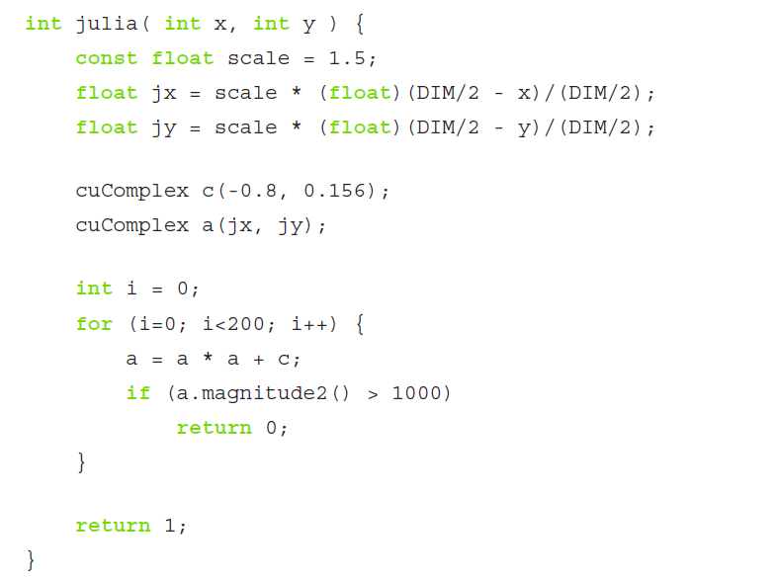
Julia Function

Slide 36
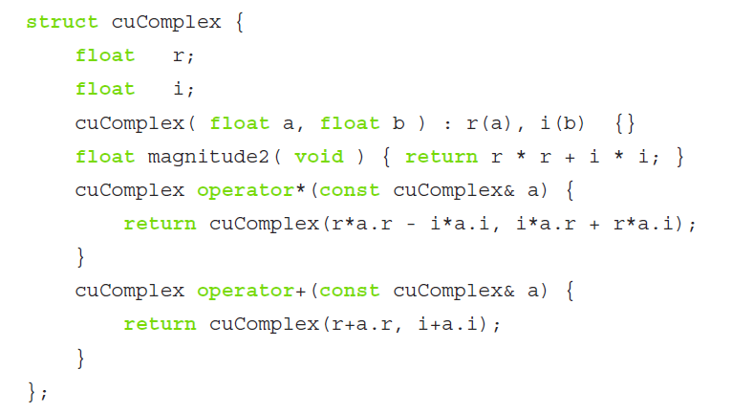
Complex Numbers

Slide 37
GPU Kernel
__global__ void kernel( unsigned char *ptr ) {
int x = blockIdx.x * blockDim.x + threadIdx.x;
int y = blockIdx.y * blockDim.y + threadIdx.y;
int offset = (x + y * gridDim.x * blockDim.x) * 3;
// now calculate the value at that position
int juliaValue = julia( x, y );
ptr[offset + 0] = 255 * juliaValue;
ptr[offset + 1] = 0;
ptr[offset + 2] = 0;
}

Slide 38
Julia function
__device__ __host__int julia( int x, int y ) {
const float scale = 1.5;
float jx = scale * (float)(DIM/2 - x)/(DIM/2);
float jy = scale * (float)(DIM/2 - y)/(DIM/2);
cuComplex c(-0.8, 0.156);
cuComplex a(jx, jy);
int i = 0;
for (i=0; i<200; i++) {
a = a * a + c;
if (a.magnitude2() > 1000)
return 0;
}
return 1;
}

Slide 39
Complex numbers
struct cuComplex {
float r;
float i;
__device__ cuComplex( float a, float b ) : r(a), i(b) {}
__device__ float magnitude2( void ) {
return r * r + i * i;
}
__device__ cuComplex operator*(const cuComplex& a) {
return cuComplex(r*a.r - i*a.i, i*a.r + r*a.i);
}
__device__ cuComplex operator+(const cuComplex& a) {
return cuComplex(r+a.r, i+a.i);
}
};

Slide 40
Main program
int main( void ) {
ppm_t *image = ppmalloc (DIM, DIM, 255);
int pixels = image->x * image->y * 3;
unsigned char *dout;
cudaMalloc( (void**)&dout, pixels );
dim3 grid(DIM/16,DIM/16);
dim3 block(16,16);
kernel <<<grid, block>>> ( dout );
cudaMemcpy ( image->rgb, dout, pixels, cudaMemcpyDeviceToHost );
ppmwrite ("out.ppm", image);
cudaFree (dout );
ppmfree (image);
}

Slide 41
How to set the CUDA environment
ug51.eecg.toronto.edu through ug75
Will be posting instructions on my website
www.eecg.toronto.edu/~moshovos/CUDAsummer12

