Slide 1
Operating Systems ECE344
Lecture 10: Scheduling
Ding Yuan
Notes:
Question: java thread?

Slide 2
Scheduling Overview
In discussing process management and synchronization, we talked about context switching among processes/threads on the ready queue
But we have glossed over the details of exactly which thread is chosen from the ready queue
Making this decision is called scheduling

Slide 3
Scheduling problem
Which process (thread) to run, for how long
We’ll refer to schedulable entities as jobs (standard usage) – could be processes, threads, people, etc.

Slide 4
When to schedule?
A new job starts
The running job exits
The running job is blocked
I/O interrupt (some processes will be ready)
Timer interrupt
Every 10 milliseconds (Linux 2.4)
Every 1 millisecond (Linux 2.6)
Why is the change?

Slide 5
Performance Criteria
Throughput: # of jobs that complete in unit time
Turnaround time (also called elapse time)
Amount of time to the return of the complete output of a process from the time it entered
Waiting time
amount of time process has been waiting in ready queue
Meeting deadlines: avoid bad consequences

Slide 6
Different Systems, Different Focuses
Interactive Systems (e.g., our PC)
Minimize response time
Batch Systems (e.g., billing, accounts receivable, accounts payable, etc.)
Max throughput, max CPU utilization
Real-time system (e.g., airplane)
Priority, meeting deadlines
Example: on airplane, Flight Control has strictly higher priority than Environmental Control

Slide 7
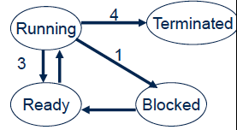
Preemptive vs. Non-preemptive
Non-preemptive scheduling
The running process keeps the CPU until it voluntarily gives up the CPU
Process exits
Switch to blocked state
1 and 4 only (no 3 unless
calls yield)
Preemptive scheduling
The running process can be interrupted and must release the CPU

Slide 8
Scheduling Algorithms
First Come First Serve (FCFS)
Short Job First (SJF)
Priority Scheduling
Round Robin
Multi-Queue & Multi-Level Feedback
Earliest Deadline First Scheduling
Batch
Systems
Interactive
Systems
Real-time
Systems

Slide 9
Priority Scheduling
Each job is assigned a priority
FCFS within each priority level
Select highest priority job over lower ones
Rationale: higher priority jobs are more mission-critical
Example: movie player vs. send email
Real life analogy?
Boarding at airports
Problems:
May not give the best Average Waiting Time
indefinite blocking or starving a process

Slide 10
Set Priority
Two approaches
Static (for systems with well-known and regular application behaviors)
Dynamic (otherwise)
Priority may be based on:
Importance
Percentage of CPU time used in last X hours
Should a job have higher priority if it used more CPU in the past? Why?

Slide 11
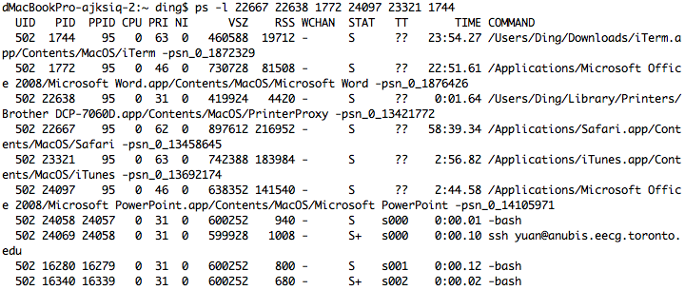
Priority in Unix

Slide 12
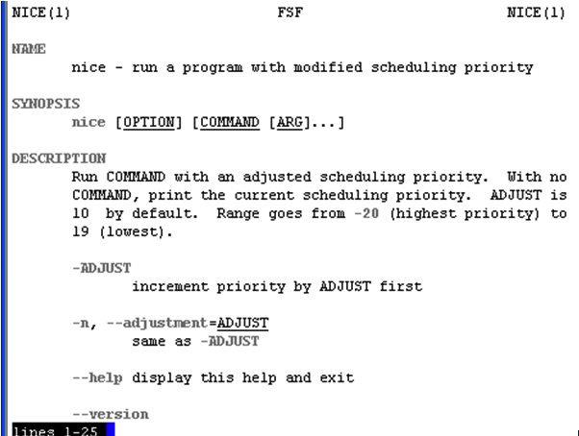
Nobody wants to Be “nice” on Unix

Slide 13
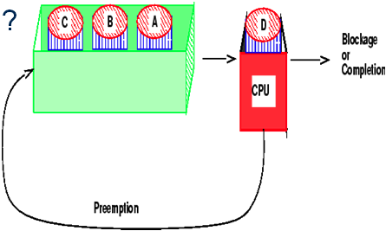
Round-robin
One of the oldest, simplest, most commonly used scheduling algorithm
Select process/thread from ready queue in a round-robin fashion (take turns)
Problem:
Do not consider priority
Context switch overhead

Slide 14
Time Quantum
Time slice too large
FIFO behavior
Poor response time
Time slice too small
Too many context switches (overheads)
Inefficient CPU utilization
Heuristics: 70-80% of jobs block within time-slice
Typical time-slice: 5 – 100 ms
Wait: isn’t timer-interrupt frequency 1ms on Linux 2.6?

Slide 15
Combining Algorithms
Scheduling algorithms can be combined
Have multiple queues
Use a different algorithm for each queue
Move processes among queues
Example: Multiple-level feedback queues (MLFQ)
Multiple queues representing different job types
Interactive, CPU-bound, batch, etc.
Queues have priorities
Jobs can move among queues based upon execution history
Feedback: switch from interactive to CPU-bound behavior

Slide 16
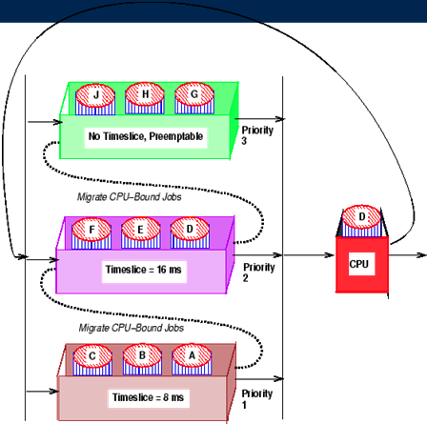
Example

Slide 17
Unix Scheduler
The Unix scheduler uses a MLFQ
~170 priority levels
Priority scheduling across queues, RR within a queue
The process with the highest priority always runs
Processes with the same priority are scheduled RR
Processes dynamically change priority
Increases over time if process blocks before end of quantum
Decreases over time if process uses entire quantum

Slide 18
Unix Scheduler
priority value = nice + base + (recent CPU usage/2)
The lower the value, the higher the priority
nice --- static priority [-20, 20], default 0
base --- a constant (60 in Unix)
recent CPU usage is also called CPU decay = (last value + CPU count used by this process) / 2

Slide 19
Process A
Process B
Process C
priority
recent CPU
priority
recent CPU
priority
recent CPU
60
0
1
..
60
60
0
60
0
timer int.
Context
switch
75
30
60
0
1
..
60
60
0
Context
switch
67.5
15
75
30
60
0
1
..
60
Context
switch
63.75
7.5
8
9
..
67
67.5
15
75
30

Slide 20
Motivation of Unix Scheduler
The idea behind the Unix scheduler is to reward interactive processes over CPU hogs
Interactive processes (shell, editor, etc.) typically run using short CPU bursts
They do not finish quantum before waiting for more input
Want to minimize response time
Time from keystroke (putting process on ready queue) to executing keystroke handler (process running)
Don’t want editor to wait until CPU hog finishes quantum
This policy delays execution of CPU-bound jobs
But that’s ok

Slide 21
Scheduling Algorithms
First Come First Serve (FCFS)
Short Job First (SJF)
Priority Scheduling
Round Robin
Multi-Queue & Multi-Level Feedback
Earliest Deadline First Scheduling
Batch
Systems
Interactive
Systems
Real-time
Systems

Slide 22
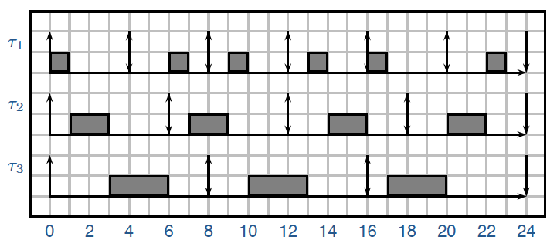
Earlieas Deadline First (EDF)
Each job has an arrival time and a deadline to finish
Real life analogy?
Always pick the job with the earliest deadline to run
Optimal algorithm (provable): if the jobs can be scheduled (by any algorithm) to all meet the deadline, EDF is one of such schedules

Slide 23
Scheduling Summary
Scheduler (dispatcher) is the module that gets invoked when a context switch needs to happen
Scheduling algorithm determines which process runs, where processes are placed on queues
Many potential goals of scheduling algorithms
Utilization, throughput, wait time, response time, etc.
Various algorithms to meet these goals
FCFS/FIFO, SJF, Priority, RR
Can combine algorithms
Multiple-level feedback queues
Unix example

