Slide 1
Designing Modern
Web-Scale Applications
Ashvin Goel
Electrical and Computer Engineering
University of Toronto
ECE 1724, Winter 2020

Slide 2
Topics
Overview of the course
Class format
Introduction to the course

Slide 3
My Research Background
Systems software
  Operating systems
  Storage systems
  Dependable systems
  Distributed systems
Recent focus
  Distributed storage systems
  Big data analytics
  Course reflects this focus

Slide 4
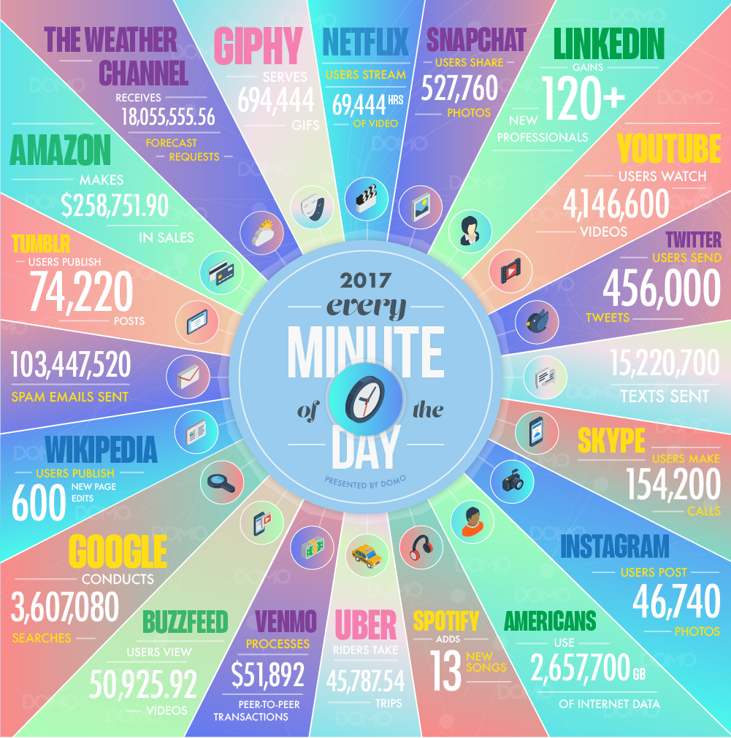
What are Web-Scale Apps?
Applications that are
hosted in massive-scale
computing infrastructures
such as data centers
Used by millions of
geographically distributed
users
  Via web browsers,
  mobile clients, etc.
Produce, store, consume massive amounts of data
  Scale is hard to comprehend

Slide 5
Focus of Course
Web-scale applications are large scale systems
  They require massive infrastructure for storing their data and for their computation needs
Course focuses on
  Infrastructure needed for web-scale applications
  Big data computation models and analytics
Core concerns
  Efficiency, scalability, availability, reliability, consistency, programmability, flexibility

Slide 6
Key Issues
How to store data at scale
How to serve data with low latency
How to index and analyze data at scale
  Unstructured and structured data
  Streaming data
  Graph data
  Model training data
Notes:
unstructured: e.g., web pages
structured: e.g., key-values, database tabular data

Slide 7
Course Goals
Understand challenges in designing systems and infrastructure for web-scale applications
Understand the design of data storage systems
Understand the design of data analytics applications
Gain experience with system development with a large software project

Slide 8
Relation to Other Courses
ECE1779: Intro to cloud computing teaches you to be a cloud application developer
  Use Microsoft Azure, Google App Engine, Amazon AWS Lambda, etc.
  Lots of jobs available
ECE1724: This course teaches you to be the cloud provider’s application developer
  Understand the design of the provider’s infrastructure
  Use it to design big data applications
  In-demand jobs
Notes:
similarly, we discuss machine learning systems but not learning models

Slide 9
Industrial Relevance
Many papers in the reading list are from industry
  GFS, MapReduce, Bigtable, Borg, Millwheel, Pregel, TensorFlow (Google)
  Dynamo (Amazon)
  Spark (Databricks)
  Storm (Twitter)
Similarly, for optional reading list
  Azure (Microsoft)
Notes:
many of these papers are seminal, have had major impact

Slide 10
Course Prerequisites
Distributed systems
Operating systems
Preferably taken courses in database systems, networking
Developed large software project
  Languages like Java, C++

Slide 11
Main Topics
Consensus and coordination
Distributed data stores
Data parallel frameworks
Scheduling and resource management
Stream processing
Graph processing and mining
Machine learning systems

Slide 12
Class Format

Slide 13
Overview
Class website available from my home page
  http://www.eecg.toronto.edu/~ashvin
Sign up for class by joining Piazza
  Instructions available from class website
Seminar style course
  Reading before class, presentation, discussion
No assignments
Project, presentation
No quizzes or final exams

Slide 14
Reading and Discussion
Advanced
Background in distributed systems, databases, OS, networking
At least 2 papers per week
  Unless marked optional, all papers are required reading
Will take about 4-6 hours per week
Allows discussion in class
It will show if you don't do the reading …

Slide 15
Presentation
You can reuse any available slides
Things to think about for your presentation
  What problem does the paper solve?
    Are these real/current problems? Why haven’t they been solved?
  What are the main challenges in solving the problem?
  How do the authors address these challenges?
  What are the main contributions of the paper?
  How do the authors show they have solved the problem?
  What improvements are possible?

Slide 16
Discussion
For discussion, you must prepare five questions
  One slide for each question
  Then one slide for each of your answers
  That is a total of 10 slides at the end of the presentation
  The order is Q1, A1, Q2, A2,…,Q5, A5
Detailed instructions on website
Please follow carefully
  E.g., make sure you number slides!
  Fonts should be reasonably large (>24)
  Follow this style

Slide 17
Choosing A Paper
First-come, first served
Pick 2 papers you will present from website
Send a message on Piazza
Make sure that your choice is not taken

Slide 18
Assignments
There will be no assignments in this course

Slide 19
Project
Choose a project based on topics covered
Sample topics will be posted on website
Options
  Implement and evaluate a system
  Evaluate existing system
  Write a research paper
Write up your work
  8-10 pages
Present your work

Slide 20
Grading Policy
Class presentation: 30%
Class project: 50%
  Description: 5%
  Mid-term report: 10%
  Final report: 35%
Class participation: 20%

