Slide 1
Cluster Storage Systems
- A Quick Overview
Ashvin Goel
Electrical and Computer Engineering
University of Toronto
ECE 1724, Winter 2021

Slide 2
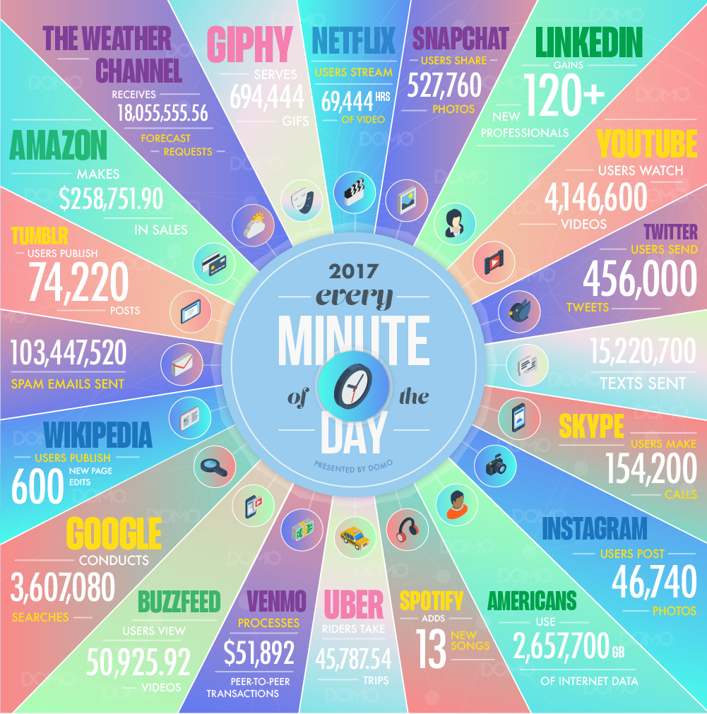
Web-Scale Apps
Applications that are
hosted in massive-scale
computing infrastructures
such as data centers
Used by millions of
geographically distributed
users
  Via web browsers,
  mobile clients, etc.
Produce, store, consume massive amounts of data
  Scale is hard to comprehend

Slide 3
Storage Systems
For the next few weeks, we focus on massive scale storage systems
Today, cluster scale storage
Next week, strongly consistent storage
Following week, wide area storage

Slide 4
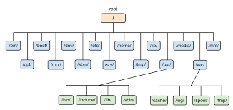
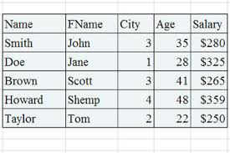
Type of Storage Systems
File systems for
unstructured data
Databases for
unstructured data

Slide 5
Scalable File Systems
Requirements
  Bulk storage
  High throughput
  Scalable
  Fault tolerant
Key idea for scaling: separate metadata and data operations
  Metadata is smaller, requires strong consistency for correct file system operation
  Data is much larger, requires high throughput

Slide 6
GFS: Key Design Ideas
Goal: use a cluster of machines to provide a scalable storage pool
Metadata server
  Use single node for ensuring metadata consistency
  Replicate operation logs for fault tolerance
  Avoid performing any data operations
Data servers
  Shard files across multiple servers
  Provide weak data consistency guarantees, applications need to handle inconsistencies
  Use primary-backup replication for fault tolerance

Slide 7
GFS: Pros, Cons
Pros
  Can handle massive data and massive objects scalably
  Works well for large sequential reads/writes
  Simple, robust reliability model
Cons
  Metadata server can be bottleneck, single point of failure
    Sharding the namespace, replicating the server is feasible
  Weak consistency guarantees
    Linearizability for single chunk writes (not for cross-chunk writes)
    Stale chunk reads possible
    Duplicate and inconsistent data can be read
  Small reads, overwrites are expensive

Slide 8
Questions to Keep in Mind
Which file system X have we seen until now?
What are the differences between GFS and X?
When should you use X and when GFS?
Is there any synergy between the two?
How does GFS provide fault tolerance?
What fault tolerance method(s) Y have we seen?
What are the differences between GFS and Y?
Notes:
We are talking about Zookeeper. Note that Zookeeper doesn’t scale well and is typically used for small files.
Often applications need to use two file systems: GFS-like FS for bulk data, and Zookeeper for configuration management, coordination, failure sensing. GFS-like FS could itself use Zookeeper for its own configuration, etc.

Slide 9
Scalable Databases
Requirements
  Bulk storage
  High throughput
  Scalable
  Fault tolerant
  Structured data
  Random accesses
  Low latency
  “Some” consistency

Slide 10
Bigtable: Key Design Ideas
Goal: use a cluster of machines to provide a scalable, shared-nothing database
Master server
  Use single node for locating data servers, and for database schema operations (create table, column families, etc.)
  Use a coordination server for leader election, configuration management, storing location information, schema metadata
  Avoid performing any data operations
Data servers
  …

Slide 11
Bigtable: Key Design Ideas
Goal: use a cluster of machines to provide a scalable, shared-nothing database
Master server
  …
Data servers
  Fine-grained sharding of table data across servers
  Provide low latency access by using read and write optimized data structures
  Use multi-versioning for concurrent access
  Use GFS for storage and replication
  Co-located with GFS servers for locality
Notes:
The sharding is fine grained. One can split a large cell value into multiple values in different column families, and thus shard the value.

Slide 12
Bigtable: Pros, Cons
Pros
  Can handle massive data and massive objects scalably
  Supports low-latency access for small data sizes
  Supports tables with thousands of columns efficiently
  Allows applications to ensure data locality
Cons
  Weak consistency model (row-level atomic updates)
    Generally sufficient for many applications
  Very large objects cause significant write amplification
  Time series data, e.g., logs organized by time-stamps can cause write hotspots

Slide 13
Questions to Keep in Mind
Bigtable is called a NoSQL database today. What is a NoSQL database?
What are the differences between a NoSQL database and a traditional database?
What are the most significant differences between GFS and Bigtable?
Notes:
NoSQL databases:
- provide horizontal scaling, i.e., if you buy more machines, their performance will scale. more appropriate for big data workloads.
- provide weak consistency (BASE): Basically Available Soft state Eventually consistency
RDBMS:
- provide vertical scaling, i.e., if you buy a faster machine, e.g., with more cores, their performance will scale. more appropriate for transactional workloads.
- provide strong consistency (ACID): Atomicity, Consistency, Isolation, Durability
GFS:
- Stores data as flat files
- Optimized for sequential access to large files
- Optimized for write-once, read-many accesses
Bigtable:
Stores data as key-values in columnal fashion
Supports low-latency access (often single disk access) for key-value in large data set

