Slide 1
Transactions - A Quick Overview
Ashvin Goel
Electrical and Computer Engineering University of Toronto
ECE 1724, Winter 2021
These slides are adapted from Michael Freedman & Wyatt Lloyd’s course on Distributed Systems

Slide 2
Transactions
A unit of work that may perform multiple operations (e.g., reads and writes) on multiple items (e.g., A, B)
transfer(A, B):
begin_tx
a ← read(A)
if a < 10 then
abort_tx
else
write(A, a−10)
b ← read(B)
write(B, b+10)
commit_tx
sum(A, B):
begin_tx
a ← read(A)
b ← read(B)
print a + b
commit_tx

Slide 3
Transaction Properties: ACID
Atomicity: transaction executes completely or not at all
E.g.: transfer(A,B) either commits or makes no changes
Consistency: transaction moves database from one consistent state to another
E.g.: avoids database corruption
Isolation: operations in the transaction appear to happen together
E.g., sum(A,B) does not read intermediate update by transfer(A, B)
Durability: transactions that commit are not lost, even on failure

Slide 4
Isolation
Goal: operations in the transaction appear to happen together
Serial execution
All operations in a transaction are executed before another transaction is run, ensures isolation
Problem: poor performance, no concurrency possible
Concurrent execution
Transactions are executed concurrently by interleaving the their operations, provides good performance
Problem: certain interleavings of operations break isolation

Slide 5
Serializability
A schedule for a set of transactions is an ordering of the operations performed by those transactions
A schedule is serializable if it is equivalent to some serial schedule
A serializable schedule provides isolation
i.e., ensures that the operations in a transaction appear to happen together in some serial order

Slide 6
Schedules
transfer: r_{A} w_{A} r_{B} w_{B} ©
sum: r_{A} r_{B} ©
Serializable
transfer: r_{A} w_{A} r_{B} w_{B} ©
sum: r_{A} r_{B} ©
Serializable
transfer: r_{A} w_{A} r_{B} w_{B} ©
sum: r_{A} r_{B} ©
Non-Serializable
transfer: r_{A} w_{A} r_{B} w_{B} ©
sum: r_{A} r_{B} ©
Serializable
Notes:
intuitively, read-write, write-read, write-write conflicts between operations needs to occur in the same order as some serial order (this is what makes the two schedules equivalent). in case 3, sum(ra) occurs after transfer(wa) but sum(rb) occurs before transfer(wb), which is why this schedule is not serializable.

Slide 7
Linearizability vs. Serializability
Linearizability: a guarantee about single operations on single objects
Writes are ordered
Once write completes, all reads that begin later should reflect that write
Serializability: a guarantee about multiple operations (transactions) on multiple objects
Transactions appear to execute in some serial order
Doesn’t impose real-time constraints
Strict serializability: intuitively serializability + linearizability
Notes:
Until now, the papers we have discussed (e.g., GFS and Bigtable) aimed to provide linearizability. For example, GFS ensures linearizability for chunks and Bigtable ensures linearizability for a single row. Today, we are discussing paper that provide a serializability guarantees.

Slide 8
Implementing Serializability with Locking
Locks maintained for each data item
Lock types
Shared: Need to acquire before reading object
Exclusive: Need to acquire before writing object
 | Shared (S) | Exclusive (X)
Shared (S) | Yes | No
Exclusive (X) | No | No
Notes:
Concurrent execution can violate serializability. We need to control concurrent execution to ensure serializability, and so an implementation of isolation is also called concurrency control.

Slide 9
Two-Phase Locking (2PL)
2PL rule: Once a transaction has released a lock it is not allowed to obtain any other locks
Growing phase: transaction acquires locks
Shrinking phase: transaction releases locks
In practice:
Growing phase is the entire transaction
Shrinking phase is during commit

Slide 10
2PL Schedules
transfer: r_{A} w_{A} r_{B} w_{B} ©
sum: r_{A} r_{B} ©
Serializable,
Allowed
transfer: r_{A} w_{A} r_{B} w_{B} ©
sum: r_{A} r_{B} ©
Non-Serializable,
Not allowed
transfer: r_{A} w_{A} r_{B} w_{B} ©
sum: r_{A} r_{B} ©
Serializable,
Allowed
transfer: r_{A} w_{A} r_{B} w_{B} ©
sum: r_{A} r_{B} ©
Serializable,
Not allowed

Slide 11
Issues with 2PL
What do we do if a lock is unavailable?
Give up immediately (abort)?
Wait forever?
Waiting for a lock can result in deadlock
Transfer has A locked, waiting on B
Sum has B locked, waiting on A
Assuming A and B are interchanged in the original transaction code
Many ways to detect and handle deadlocks

Slide 12
Distributed Transactions
Data is partitioned (sharded) across nodes
Transaction accesses data from multiple nodes
transfer(A, B):
begin_tx
a ← read(A)
if a < 10 then
abort_tx
else
write(A, a−10)
b ← read(B)
write(B, b+10)
commit_tx
A
B
Participant nodes:
all nodes that hold
transaction data
Coordinator node:
runs transaction code
Notes:
Until now we have talked about transactions and concurrency control on a single node.
coordinator node can be a participant as well.

Slide 13
Atomic Commit
Atomic: All or nothing
Either all participants do something (commit) or no participant does anything (abort)
Common use: commit a transaction that updates data on different shards

Slide 14
Two-Phase Commit
Phase 1
Coordinator sends Prepare requests to all participants
Each participant votes yes or no
Sends yes vote or no vote back to coordinator
Typically acquires locks if they vote yes (for 2PL)
Coordinator inspects all votes
If all yes, then commit
If any no, then abort
Phase 2
Coordinator sends Commit or Abort to all participants
If commit, each participant commits changes
Each participant releases locks (for 2PL)
Each participant sends an Ack back to the coordinator
Notes:
Common reasons to abort:
Cannot acquire required lock
No memory or disk space available to do write
Transaction constraint fails (e.g., a < 10)

Slide 15
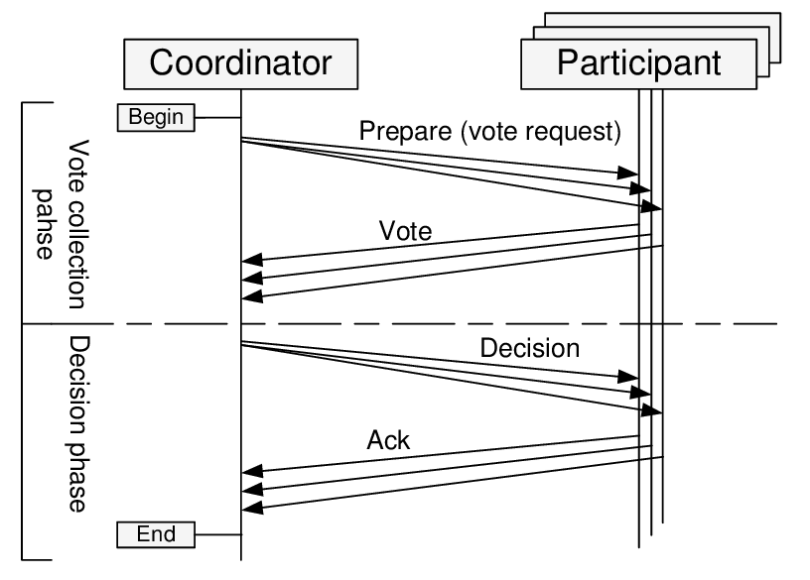
Two-Phase Commit

Slide 16
Distributed Transactions and Replication
Replication Dimension
A-F
A-F
A-F
Sharding Dimension
G-L
G-L
G-L
M-R
M-R
M-R
S-Z
S-Z
S-Z

Slide 17
Sharding, Replication, Atomic Commit
Replication (e.g., primary-backup, RAFT) is about doing the same thing in multiple places, primarily to provide fault tolerance
Sharding is about doing different things in multiple places for scalability
Atomic commit is about doing different things in multiple places together (all or nothing)

Slide 18
Motivation for Today’s Papers
Two-Phase Commit makes distributed transactions very expensive
Requires two additional round trips in addition to the read and write requests made to participants
Locks are held from the time reads and writes are performed until the end of the two-phase commit
Any other transactions waiting on locks are also delayed

Slide 19
Key Idea
Limit the power of transactions to enable scaling distributed transactions

Slide 20
Sinfonia
Sinfonia: proposes mini-transactions
Performs the entire transaction within the commit protocol
Reduces messages, locking times
Requires
Read/write sets of transactions before transaction execution
Any conditions that cause abort to be checkable within commit protocol
All writes to depend on the condition above

Slide 21
Calvin
Calvin: proposes deterministic concurrency control
Establishes serial order of transactions before transaction execution
Avoids the need for 2 phase commit due to concurrency control related aborts
Transaction constraint related aborts still require atomic commit
Makes it much cheaper to perform replication
Input replication rather than output replication
Requires
Read/write sets of transactions before transaction execution
Batching of transactions for concurrency
Accurate prefetching of data for good performance

