Slide 1
Wide Area Storage Systems - A Quick Overview
Ashvin Goel
Electrical and Computer Engineering University of Toronto
ECE 1724, Winter 2021

Slide 2
Storage Systems
We have seen GFS and Bigtable
GFS is a cluster-scale, file system
Bigtable is a cluster-scale, multi-dimensional key-value store
Both provide scalability and high availability for cluster-scale applications
We have seen Sinfonia and Calvin
Both provide strong consistency guarantees at cluster scale
However, modern web-scale applications are used by millions of geographically distributed users

Slide 3
Problem
One data center can’t solve it all
Servicing data centers requires turning them off
Serving power, cooling systems, backbone routers, data center management systems
Diurnal load patterns
Too much load during the day, too little during the night
Geographically separated users
Too much latency for cross-continent operations
Cross-continent links are expensive

Slide 4
Solution
Within a region: 3-5 data centers located within 10-100 miles apart
Improves availability – a data center can be turned off
Across regions: build data centers based on user demand
Helps with diurnal load patterns
Reduces latency
Improves availability, disaster recovery

Slide 5
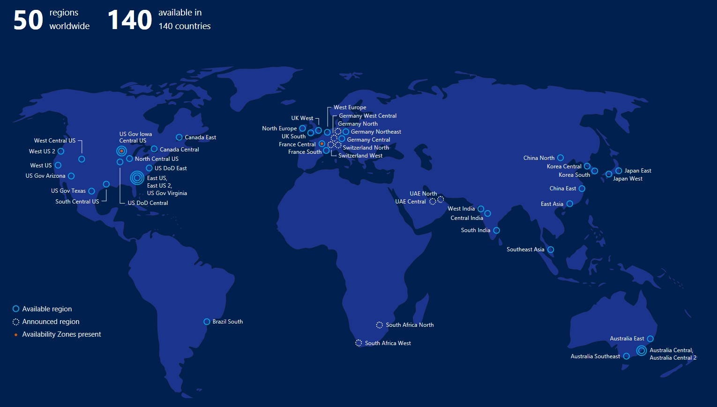
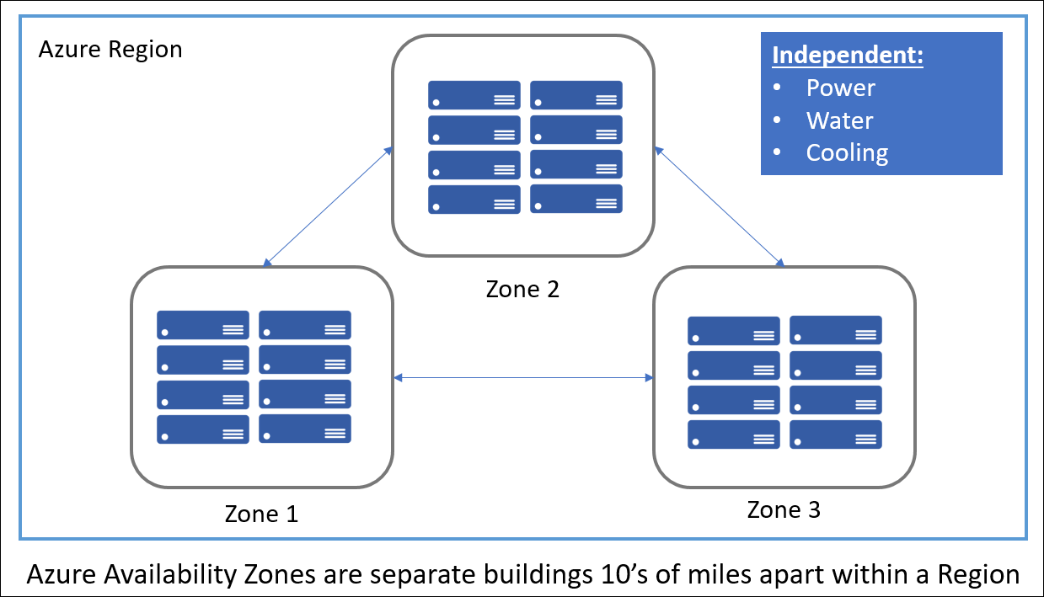
Microsoft
Azure
Notes:
50 regions worldwide. Each region has three data centers located 10’s of miles apart.

Slide 6
Consistency (Once Again)

Slide 7
Single or Multi-Object Accesses
Single object access
Think of key-value stores
get(key), put(key, value) operations
Involves accessing one shard (partition)
Multi-object access
Think transactions and databases
Each transaction accesses multiple rows
Involves accessing one or more shards (partitions)

Slide 8
Consistency Hierarchy
Strict Serializability
Linearizability
Serializability
Sequential consistency
Causal consistency
Eventual consistency

Slide 9
Understanding Single-Object Access Consistency
Eventual consistency
All replicas execute operations in any order
Assuming updates stop, replicated data will eventually become consistent
Sequential consistency
All replicas execute operations in some total order
Operations act as if they occurred (instantaneously) in some sequential order (consistent with program order)
Linearizability
All replicas execute operations in some total order, while preserving real-time ordering
Operations act as if they occurred (instaneously) at some point in between invocation & response (consistent with program order)
Notes:
real-time ordering: If operation A completes before operation B begins in real time, then A is ordered before B

Slide 10
Understanding Multi-Object Access Consistency
Serializability
The outcome of executing transactions (e.g., resulting state) is equivalent to the outcome of its transactions executed sequentially without interleaving
Strict serializability
Informally: Serializability + Linearizability

Slide 11
Consistency Hierarchy
Strict Serializability
(Spanner, wide area)
Linearizability
(Raft, GFS, Bigtable)
Serializability
(Sinfonia, Calvin)
Sequential consistency
Causal consistency
Eventual consistency
(Dynamo, wide area)
Notes:
GFS: linearizability for chunks
Bigtable: linearizability for single rows

Slide 12
Questions to Keep in Mind
We are discussing Dynamo and Spanner today
How does each system provide the consistency property it says it does?
What is the impact on availability, performance?
What are the key similarities and differences in their design?

Slide 13
Dynamo (vs Bigtable)
Dynamo targets applications that require
Only key/value access
Not the rich tabular and columnar format in Bigtable, why?
High availability where updates are not rejected
Always writeable data store even in the wake of network partitions or server failures, why?
High availability leads to a unique design
Dynamo is leaderless, eventually consistent system
No single metadata server (master) for locating data, or a single primary replica (leader) for replicating data, as in Bigtable
Notes:
... they argue that any other format would limit scaling although this might just be an implementation issue
… customer is always right … Andy Jassy, CEO of Amazon, was the chief of AWS. AWS/dynamo formed the seed of cloud computing. In 2020, 63% of Amazon’s revenue was derived from AWS (roughly 15B), even though more people have never heard of AWS.

Slide 14
Dynamo Key Design Ideas
All storage nodes are identical (symmetric)
Use consistent hashing for partitioning, replicating data
All nodes know locations of all data and their replicas
Updates can be applied to replicas in any order
Apply updates to quorum, not all replicas
Create "temporary" replicas, if required
Use quorum reads for best-effort consistent reads
Applications resolve conflicting updates
Use gossiping and eventual consistency
For handling 1) replicas that have diverged due to node failures, 2) membership changes, i.e., node joins/leaves
Notes:
all nodes know: this is why no master is needed for locating data and their replicas
updates in any order: this is why they don't need to have a single primary replica
membership changes: all nodes need to know the nodes in the dynamo ring and the key ranges stored by each node in the ring

Slide 15
Spanner (vs BigTable)
Spanner is a globally distributed (multi datacenter) and replicated storage system
In each data center, the design uses Bigtable style deployment
Spanner supports
Multi-row transactions with complex schemas (e.g., foreign keys) and SQL interface
Provide strong consistency (strict serializability) in the presence of wide-area replication
Unlike Sinfonia and Calvin, they support general-purpose transactions
These properties ease app development
Notes:
general purpose txns: a transaction doesn’t specify the reads and writes it will perform before it starts the transaction, although for read-only transactions, they require knowing the partitions that will be accessed by the transaction before the transaction starts.

Slide 16
Spanner Deployment
Several geographically-distributed datacenters (zones)
100-1000s of servers per zone
100-1000s of shards per server
Each shard replicated via Paxos for fault-tolerance
Replicas groups (e.g., 3 replicas) can cross data centers
Use strict two-phase locking and two-phase commit for read-write transactions, ensuring strict serializability
Paper claims that they provide external consistency (same as strict serializability)
So what problem are they solving?

Slide 17
Fast Read-Only Transactions
Reads are dominant (1000:1 rw ratio)
Spanner provides lock-free reads while ensuring strict serializability
Reads don't acquire locks and thus don't block writers
Writers don't block reads in the past
Reads are consistent, i.e., read latest committed version
Note that reads may block (snapshot reads are non-blocking)
How can you ensure consistent reads without locking?

Slide 18
Multi-versioning and Timestamps
Lock-free reads can be performed by keeping multiple immutable versions of data
Write creates a new immutable version whose timestamp is that of the write's transaction
A snapshot read at a timestamp returns the value of the most recent version prior to that timestamp
Read doesn’t block writes
Problem: reader and writer timestamps need to be synchronized to ensure that reads are consistent

Slide 19
Assume Times are Synchronized
Assign all read-write transactions a wall-clock commit time
All shards track how up-to-date they are (Tsafe)
All transactions with timestamp < Tsafe have committed
Lock-free read-only transactions (basic idea)
Assign timestamp s = current time
wait until s < Tsafe
Read data as of s
Unfortunately, times are not synchronized

Slide 20
Timestamp Problem
Say a person issues transaction T1 at Z1
T1 writes A at Z1, B at Z2
Then person issues transaction T2 at Z2
T2 reads B at Z2
Person expects that T2 will read B is 2
Z1
T1 w(A=1)
Z2
T1 w(B=2)
T2 r(B)

Slide 21
Timestamp Problem
But what if Z2 is running much behind Z1?
T1 assigns timestamp based on Z1, e.g., 10
T2 assigns timestamp based on Z2, e.g., 8
Then, T2 reads previous version of B!
Z1
T1 w(A=1, ts = 10)
Z2
T1 w(B=2, ts = 10)
T2 r(B, ts = 8)

Slide 22
TrueTime
Spanner provides a time API called TrueTime that provides bounded error
Uses this bounded error to ensure lock-free consistent reads
Allows reads for replicated data with a single round trip of communication

