Slide 1
Designing Modern Web-Scale Applications
Ashvin Goel
Electrical and Computer Engineering University of Toronto
ECE 1724, Winter 2020

Slide 2
Topics
Overview of the course
Class format
Introduction to the course

Slide 3
My Research Background
Systems software
Operating systems
Storage systems
Dependable systems
Distributed systems
Recent focus
Distributed storage systems
Big data analytics
Course reflects this focus

Slide 4
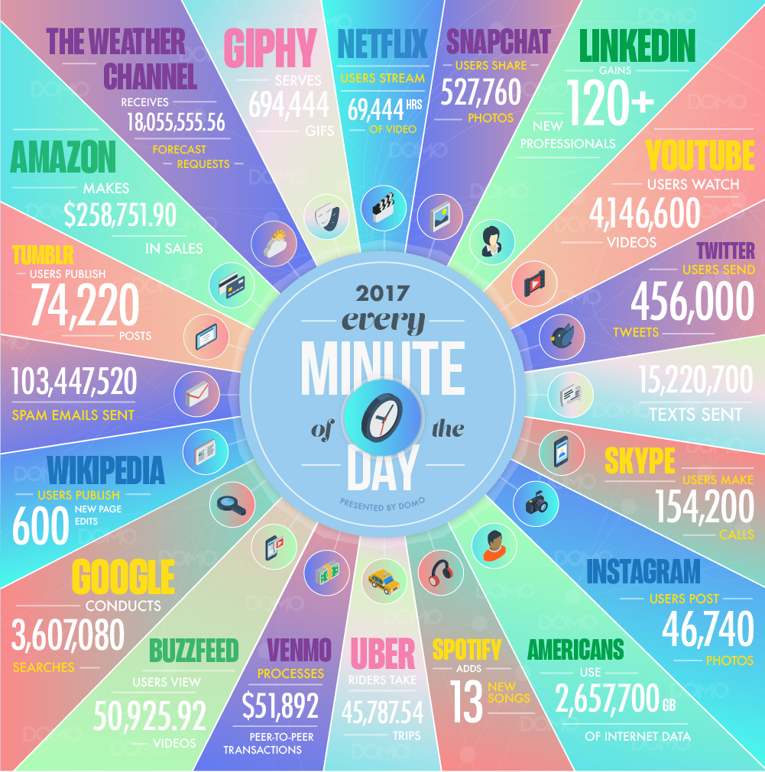
What are Web-Scale Apps?
Applications that are hosted in massive-scale computing infrastructures such as data centers
Used by millions of geographically distributed users
Via web browsers, mobile clients, etc.
Produce, store, consume massive amounts of data
Scale is hard to comprehend

Slide 5
Focus of Course
Web-scale applications are large scale systems
They require massive infrastructure for storing their data and for their computation needs
Course focuses on
Infrastructure needed for web-scale applications
Big data computation models and analytics
Core concerns
Efficiency, scalability, availability, reliability, consistency, programmability, flexibility

Slide 6
Key Issues
How to store data at scale
How to serve data with low latency
How to index and analyze data at scale
Unstructured and structured data
Streaming data
Graph data
Model training data
Notes:
unstructured: e.g., web pages
structured: e.g., key-values, database tabular data

Slide 7
Course Goals
Understand challenges in designing systems and infrastructure for web-scale applications
Understand the design of data storage systems
Understand the design of data analytics applications
Gain experience with system development with a large software project

Slide 8
Relation to Other Courses
ECE1779: Intro to cloud computing teaches you to be a cloud application developer
Use Microsoft Azure, Google App Engine, Amazon AWS Lambda, etc.
Lots of jobs available
ECE1724: This course teaches you to be the cloud provider’s application developer
Understand the design of the provider’s infrastructure
Use it to design big data applications
In-demand jobs
Notes:
similarly, we discuss machine learning systems but not learning models

Slide 9
Industrial Relevance
Many papers in the reading list are from industry
GFS, MapReduce, Bigtable, Spanner, Twine, Millwheel, Pregel, TensorFlow (Google)
Dynamo (Amazon)
Spark, Spark Streaming (Databricks)
Zookeeper (Yahoo)
Similarly, for optional reading list
Chubby, Omega, Borg (Google)
Azure, Apollo, Quincy (Microsoft)
Storm (Twitter)
Akkio, Flighttracker, SVE (Facebook)
Notes:
many of these papers are seminal, have had major impact

Slide 10
Course Prerequisites
Distributed systems
Operating systems
Preferably taken courses in database systems, networking
Developed large software project
Languages like Java, C++

Slide 11
Main Topics
Consensus and coordination
Distributed data stores
Data parallel frameworks
Scheduling and resource management
Stream processing
Graph processing and mining
Machine learning systems

Slide 12
Class Format

Slide 13
Overview
Class website available from my home page
http://www.eecg.toronto.edu/~ashvin
Sign up for class by joining Piazza
Please send all messages there (instead of emailing me)
You can send private messages to me as well
Seminar style course
Reading before class, presentation, discussion
No assignments
Project, presentation
No quizzes or final exams
Notes:
Instructions available for joinining Piazza are available from class website

Slide 14
Reading and Discussion
Advanced
Background in distributed systems, databases, OS, networking
At least 2 papers per week
Unless marked optional, all papers are required reading
Will take about 4-6 hours per week
Allows discussion in class
It will show if you don't do the reading …

Slide 15
Choosing Papers For Presentation
Each student will present 1 or 2 papers in class
Pick 2 required reading papers from website:
Check Piazza to make sure that your choice is not taken
Send a Piazza message with your two papper choices
I will assign the paper to you by updating the website
If all papers have been taken:
Send a Piazza message letting me know, don’t stress!
Please send a Piazza message if you have been assigned a paper and then you plan to drop the course …
Notes:
If you plan to drop the course, please be kind and let me know ASAP, so I can reassign the paper(s) you are presenting.

Slide 16
Making Your Presentation
You can reuse any available slides
Things to think about for your presentation
What problem does the paper solve?
Are these real/current problems? Why haven’t they been solved?
What are the main challenges in solving the problem?
How do the authors address these challenges?
What are the main contributions of the paper?
How do the authors show they have solved the problem?
What improvements are possible?

Slide 17
Discussion Questions
For discussion, you must prepare five questions
One slide for each question
Then one slide for each of your answers
That is a total of 10 slides at the end of the presentation
The order is Q1, A1, Q2, A2,…,Q5, A5
Detailed instructions on website
Please follow carefully
E.g., make sure you number slides!
Fonts should be reasonably large (>24)
Follow this style

Slide 18
Assignments
There will be no assignments in this course

Slide 19
Project
Choose a project based on topics covered
Sample topics will be posted on website
Options
Implement and evaluate a system
Evaluate existing system
Write a research paper
Write up your work
8-10 pages
Present your work

Slide 20
Grading Policy
Class presentation: 30%
Feedback during presentation, mark at end of term
Class project: 50%
Description: 5%
Mid-term report: 10%
Final report: 35%
Feedback and mark in each report
Class participation: 20%
No direct feedback, mark at end of term
Notes:
This is a discussion-oriented seminar course in which we discuss both seminal and recent research papers. I expect class participation, and this is reflected in 20% of the course grade being assigned to participation.
If you never speak or participate in class, I have no idea whether you have read the required readings or are following the lecture or discussion. In that case, you can expect a low score for participation.
If you do not turn on your video on Zoom, it is hard to know whether you are participating in class. Given the way Zoom works, even if you speak, it is sometimes hard to determine who is speaking. In that case, you can expect a zero to low score for participation. If you are concerned about privacy, Zoom has an option for a virtual background, which you can turn on. With a virtual background, only your face is visible.
Please mark your attendance on Zoom by sending a message on chat after I join the meeting.

