Slide 1
Introduction TO Designing Modern
Web-Scale Applications
Ashvin Goel
University of Toronto
These slides are lightly modified versions of slides from Prof. Ken Birman’s course on Cloud Computing

Slide 2

How did today’s Cloud evolve?
Prior to ~2005, we had “data centers designed for high availability”.
Amazon had especially large ones, to serve its web requests
This is all before the AWS cloud model
The real goal was just to support online shopping
Their system wasn’t very reliable and the core problem was scaling
Like a theoretical complexity growth issue
Amazon’s computers were overloaded and often crashed
Notes:
2005 was really the year when scalable database solutions hit their limits. This happened in all sorts of very horrible ways, if you were working at one of these companies that year.
It wasn’t fun, and it was a pretty direct proof that the things we were sure we knew how to do… just weren’t right.

Slide 3
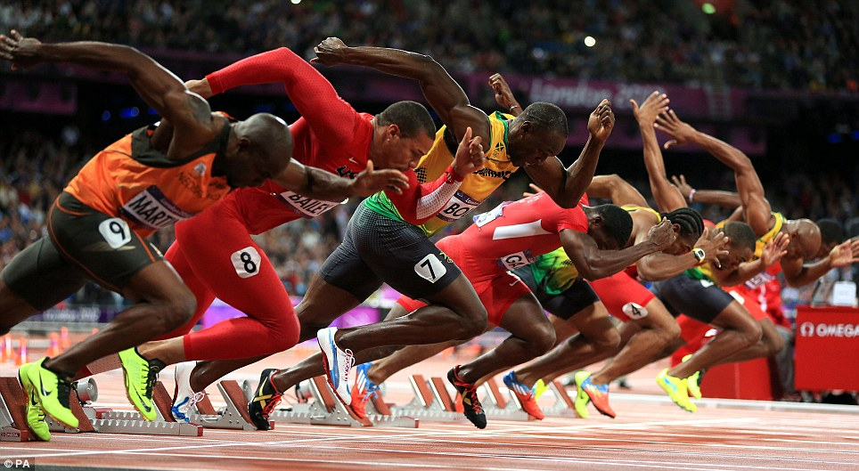
Yahoo Experiment
A sprint to render your web page!
At Yahoo, they tried an “alpha/beta” experiment
Customers who saw fast web page rendering (below 100ms) were happy
For every 100ms delay, purchase rates noticeably dropped
Speed at scale determines revenue, and revenue shapes technology: an arms race to speed up the cloud
Notes:
One really obvious symptom of overload is that everything got slow. But meanwhile, people realized that speed is an absolute must-have requirement

Slide 4
Starting around 2006, Amazon led in reinventing data center computing
Amazon reorganized their whole approach:
Requests arrived at a “first tier” of very lightweight servers.
These dispatched work requests on a message bus or queue.
The requests were selected by “micro-services” running in elastic pools.
One web request might involve tens or hundreds of μ-services!
They also began to guess at your next action and precompute what they would probably need to answer your next query or link click.
Notes:
Led to a reinvention of the cloud. Amazon was first to do this right, and it made Jeff Bezos the wealthiest man in the world.
The list is just a few things that mattered.

Slide 5
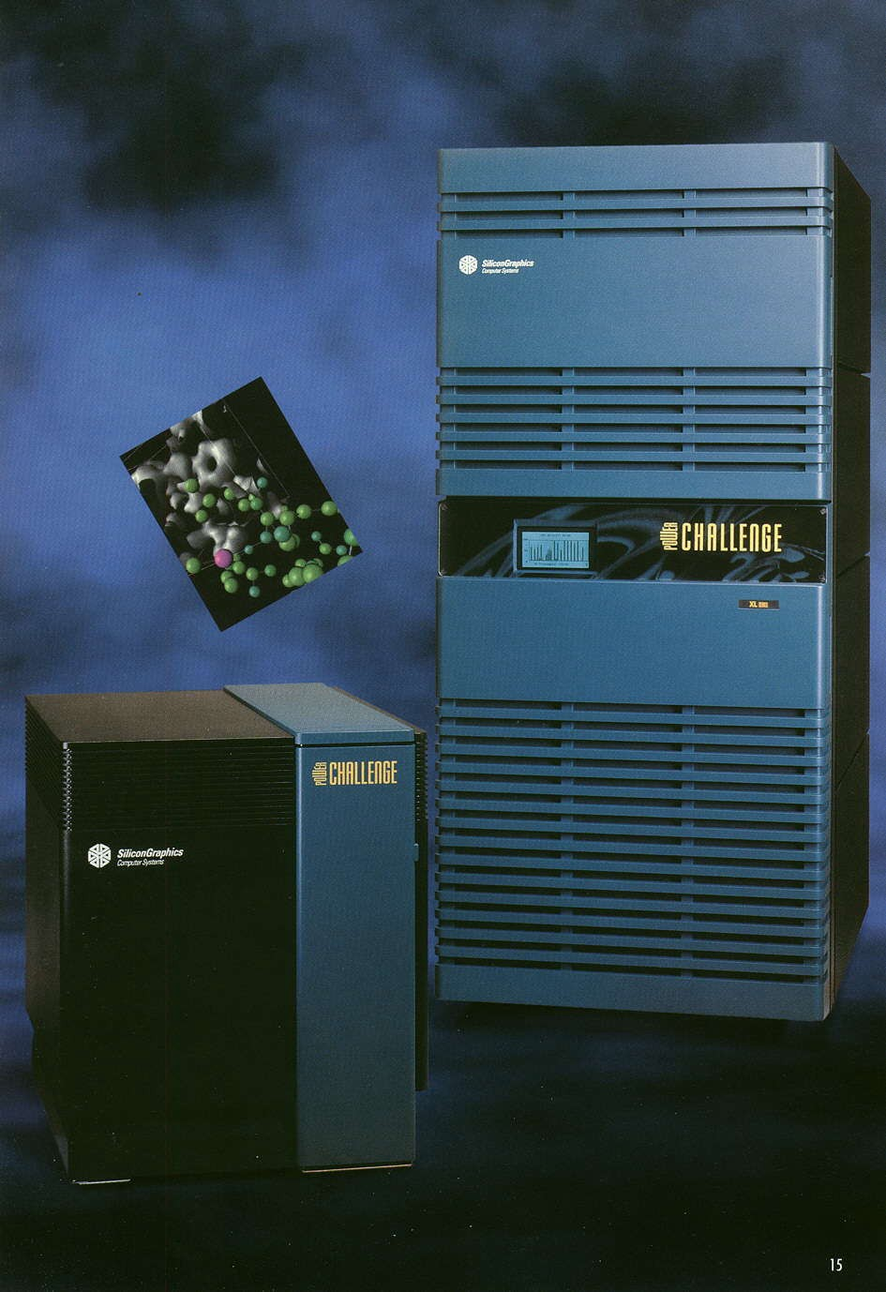

Old Approach (2005)
Product List
Image Database
Internet routing was
pretty static, except
for load balancing
Web Server
built the page… in Seattle
Computers were mostly desktops
Billing and Account Info
Databases held the real
product inventory
Notes:
Oracle used to sell us systems like this. They are called “three tier” but this picture combines tiers 1 and 2 (tier 1 is the web page server, tier 2 is the application that uses SQL to access databases holding the product list, images and account information. Tier 3 is the database itself, shown on the right. In effect tier 2 is a library used by tier 1.

Slide 6

New Approach (2008)
Product List
Routed to nearest
datacenter, one of many
Image Database
Web Server built the page… ten miles from the users
Computers became lightweight, yet faster
Billing and Account Info
Databases held the real
product inventory
Notes:
People using eCommerce web sites were a tiny bit happier once their service at least came from a nearby data center. So there was pressure to have a lot of websites spread close to the concentrations of users. Companies like Amazon were snapping up warehouses and building like crazy.

Slide 7

New Approach (2008)
Product List
Routed to nearest
datacenter, one of many
Image Database
Web Server built the page… ten miles from the users
Computers became lightweight, yet faster
Backup routing options
Billing and Account Info
Databases held the real
product inventory
More and more mobile apps
Notes:
One advantage of georeplication is that you have fallback options if your local system is overloaded or something is faulty. Fewer timeout issues….
But meanwhile the number of people accessing these sites was also soaring, so even as they solved one kind of problem they just saw a next one.

Slide 8

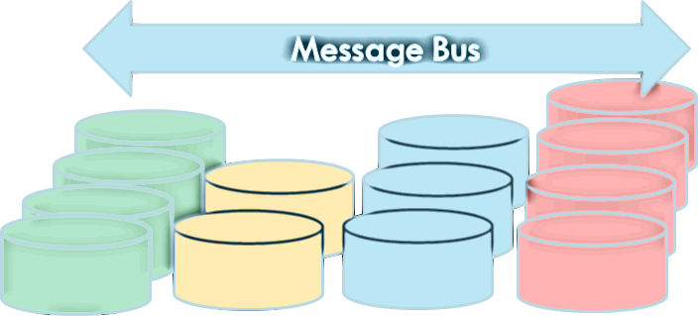
New Approach (2008)
Message Bus
Routed to nearest
datacenter, one of many
Web Server becomes simpler and does less of the real work
Racks of highly parallel workers do much of the data fetching and processing, ideally ahead of need… The old databases are split into smaller and highly parallel services.
Desktops with
snappier response
GeoReplication
More and more mobile apps
Notes:
Amazon was first to move to a “micro services” model in which the initial goal was just to be as parallel as possible.
By now, in 2021, the model is more baked in and has additional interesting aspects, such as use of very specialized hardware accelerators to make these microservices ultra cost-effective and fast. So what started as just a way to do things in parallel gradually expanded into a whole new way of computing with mixtures of hardware and software.
And of course, big, big, big precomputed databases and indices and other stuff to give us a performance boost by just “looking up the answer” because the cloud anticipated the question and figured out today’s answer a few hours ago…

Slide 9
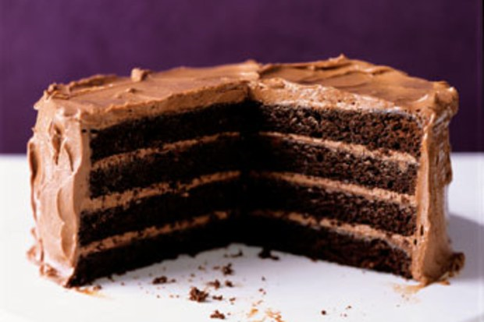
Tier one / Tier Two
We often talk about the cloud as a “multi-tier” environment.
Tier one: programs that generate the web page you see.
Tier two: services that support tier one.
Notes:
There are a lot of layers but we tend to just talk about tiers 1, 2 and the back end. It would be confusing to have some concept of precisely what tier 3 should mean.
Honestly, this tier thing is fading and not a good term to use. But everyone agrees that tier 1 is the outermost layer of the actual datacenter.
“Cloud edge” is the new confusing term. Nobody agrees on whether this is outside the cloud entirely (like sensors), or a point of presence cloud (like a little cluster of machines near those sensors), or just a new name for tier 1.
In Azure the edge tends to be “outside” the data center, but is still a cluster running Microsoft-supplied software (like when you run Windows on your laptop). Azure IoT Edge would run on your cluster, but in your home or office or farm, or in a truck your company drives to its customer sites.
Then Azure uses the term “Azure Intelligent IoT Edge” for the new tier 1, which contains services like the key-value storage mentioned here.

Slide 10
Today’s Cloud
Tier one runs on very lightweight servers:
They use very small amounts of computer memory
They don’t need a lot of compute power either
They have limited needs for storage, or network I/O
Tier two μ-Services specialize in various aspects of the content delivered to the end-user. They may run on somewhat “beefier” computers.
Notes:
The little mu symbol means “micro” as in “micro-services”

Slide 11
End-to-end Microservices (from Christina Delimitrou)
Social Network
Notes:
In this course, we will first focus on the caching and storage layers, and then discuss the application layer.

Slide 12
End-to-end Microservices (from Christina Delimitrou)
Media Service

Slide 13
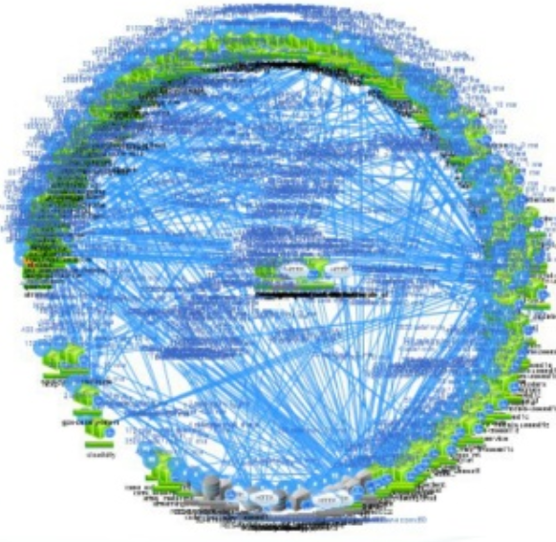
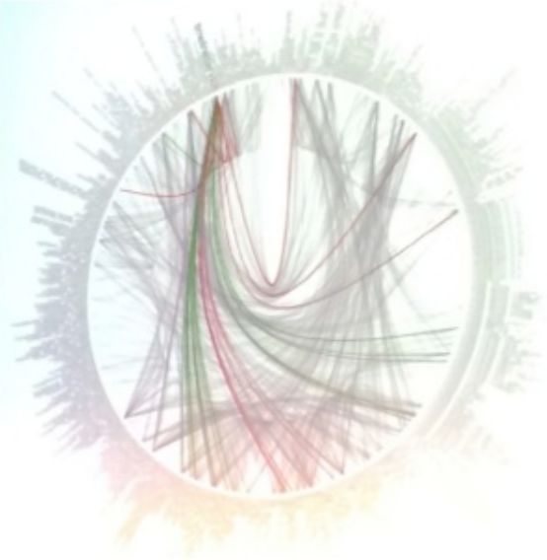
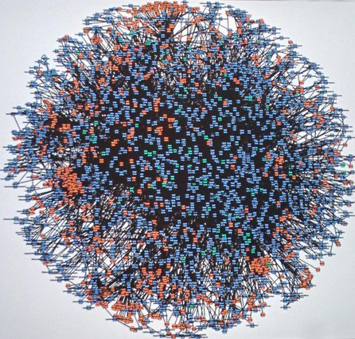
Microservices Visualized
Netflix
Twitter
Amazon
Notes:
Dots on the circle are microservices, links are communication links between the services

Slide 14
Each microservice is a parallel “pool”!
Every one of those little nodes is itself a small elastic pool of processes
A microservice (μ-service) is a kind of program designed so that the data center can run one instance… or many instances, “elastically”, to deal with dynamically varying demand.
The idea here is that any instance can handle any request equally well, so there is no need for very careful “routing” of specific requests to specific instances. This lets the data center adapt to changing loads easily!
Notes:
Load really can vary significantly over different periods and so the need for elasticity is critical, and is perhaps one of the key defining features of cloud computing

Slide 15
These pools are managed automatically
In Azure, for example, there is a tool called the “App Service”
The App Service manages a big collection of compute resources in the cloud. Developers can install your own services in it (as “containers”). Configuration files tell it when to launch them for you, automatically.
Among the features is a way for it to watch the queue of requests and automatically add instances or shut instances down to match loads.

Slide 16
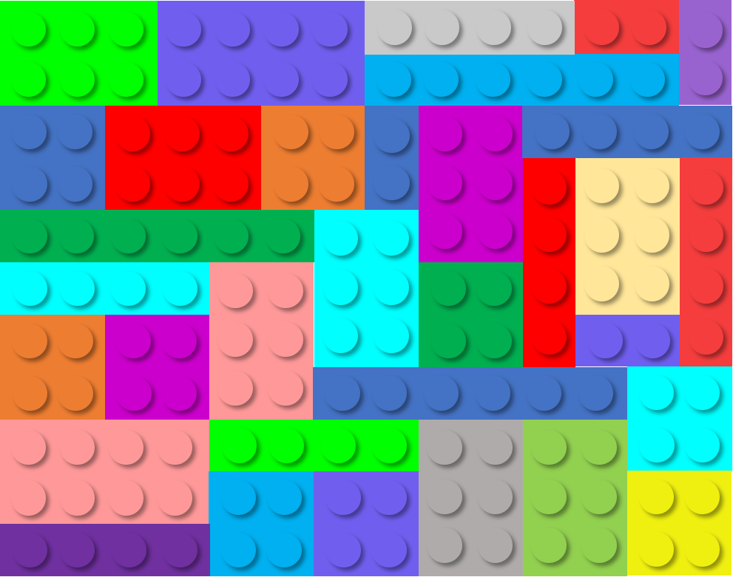

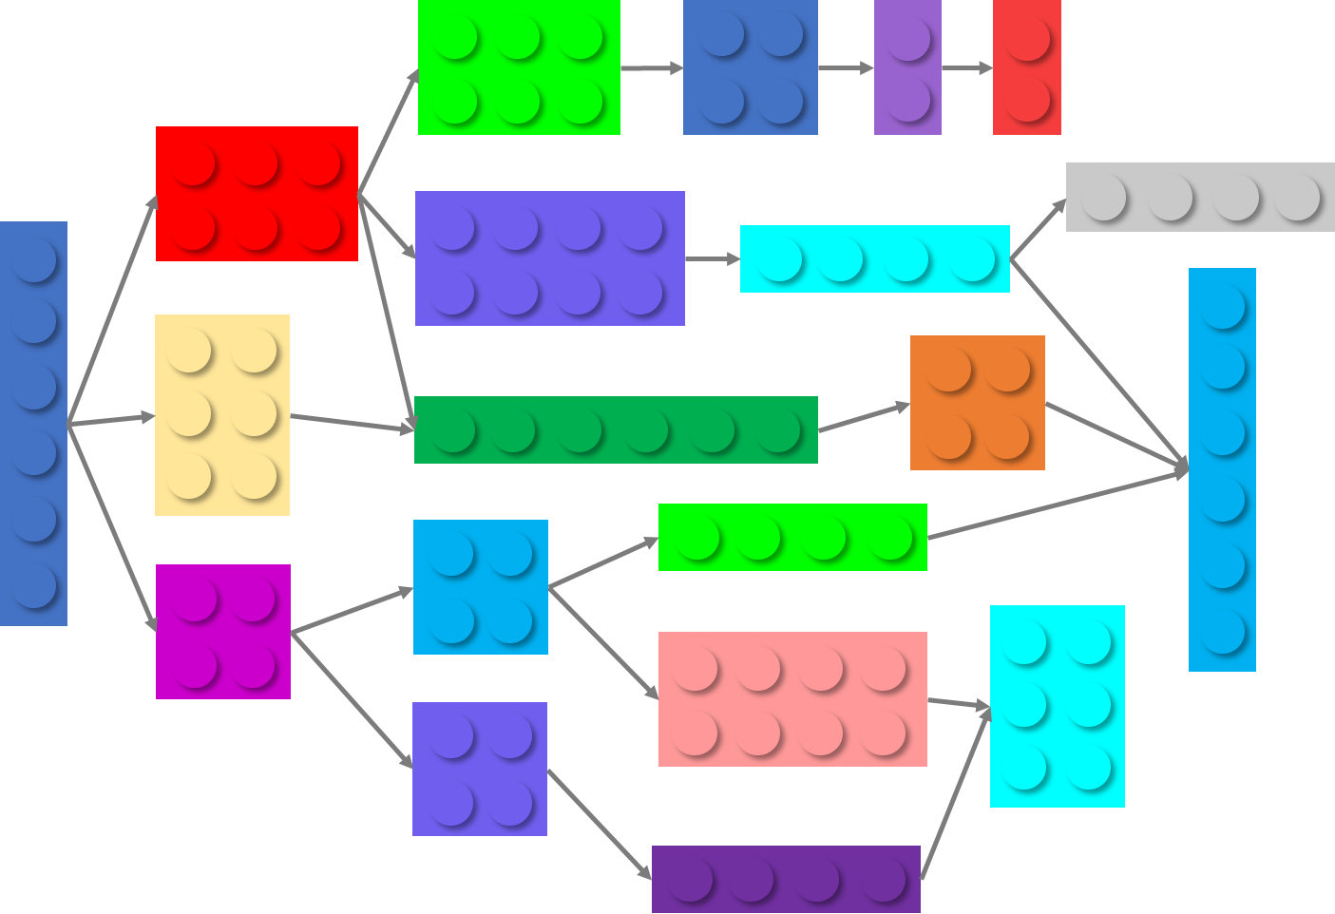





Motivation for μ-services (Delimitrou)
Advantages of μ-services:
  Modular → easier to understand
  Speed of development & deployment
  On-demand provisioning, elasticity
  Language/framework heterogeneity
recommender
photos
posts
recommender
ads
posts
webserver
webserver
ads
databases
photos
databases

Slide 17
Questions about Data
All the microservices access data, cache data, update data, replicate data
Can we ensure that data is accessed consistently, even in the presence of failures?
Solution: use a single BIG database, replicate it for fault tolerance

Slide 18
Single big service performs poorly… why?
Until 2005 “one server” was able to scale and keep up, like for Amazon’s shopping cart. A 2005 server often ran on a small cluster with, perhaps, 2-16 machines in the cluster.
This worked well.
But suddenly, as the cloud grew, this form of scaling broke. Companies threw unlimited money at the issue but critical services like databases still became hopelessly overloaded and crashed or fell far behind.

Slide 19

Jim Gray’s Famous Paper
At Microsoft, Jim Gray anticipated this as early as 1996.
He and colleagues wrote a wonderful paper from their insights:
Basic message: divide and conquer is really the only option.
Jim Gray
(Jan 1944 – Jan 2007)
The dangers of replication and a solution. Jim Gray, Pat Helland, Patrick O'Neil, and Dennis Shasha. 1996. In Proceedings of the 1996 ACM SIGMOD Conference.
Notes:
In fact, almost nothing scaled. Jim studied this and tried to understand root causes.

Slide 20
How their paper approached it
The paper uses a “chalkboard analysis” to think about scaling for a system that behaves like a database.
It could be an actual database like SQL Server or Oracle
But their “model” also covered any other storage layer where you want
strong guarantees of data consistency.
Mostly they talk about a single replicated storage instance, but look
at structured versions too.
Notes:
Even with a pencil and paper analysis, he and his colleagues identified a huge issue!

Slide 21
The core issue
The paper assumes that your goal is some form of lock-based consistency, which they model as database serializability
So applications will be using read locks, and write locks, and because we want to accommodate more and more load by adding more servers, the work spreads over the pool of servers.
This is a very common way to think about servers of all kinds.
Notes:
He posed his analysis as an asymptotic cost question, like in an algorithms class where you study complexity. But here we have more moving parts.

Slide 22
Their setup, as a picture
Applications using the database: client processes
During the run, T concurrent requests are issued. Here, 3 are running right now, but T could be much larger.
The database
Notes:
The model starts with clients talking to a database. There are T transactions that need to run. They won’t run all at the same time, of course. Here, three are active.

Slide 23
Their Basic setup, as a picture
Applications using the database: client processes
During the run, T concurrent requests are issued. Here, 3 are running right now, but T could be much larger.
Server 1
Server 2
Server N
For scalability, the number of servers (N) can be increased
Notes:
And there are N servers. We want to have N x the capacity, so the goal is to scale well and be able to throw more servers at the problem if the system overloads.

Slide 24
What should be The goals?
A scalable system needs to be able to handle “more T’s” by adding to N
Instead, they found that the work the servers must do increases non-linearly with T
Worse, with an even split of work, deadlocks occur as N^{3,} causing feedback (because the reissued transactions get done more than once).
Example: if 3 servers (N=3) could do 1000 TPS, with 5 servers the rate might drop to 300 TPS, purely because of deadlocks forcing abort/retry.

Slide 25
Why do services slow down at scale?
The paper pointed to several main issues:
Lock contention. The more concurrent tasks, the more likely that they
will try to access the same object and wait for locks.
Abort. Many consistency mechanisms have some form of optimistic
behavior built in. Now and then, they must back out and retry. Deadlock
also causes abort/retry sequences.
The paper actually explores multiple options for structuring the data, but ends up with similar negative conclusions except in one specific situation.
Notes:
Basically, you see higher and higher rates of transactions banging into each other and either waiting (which can be slow), or deadlocking (which causes a rollback), or in some “optimistic” scenarios, aborting.
The rate of growth of overhead is a polynomial, like the number of servers or the number of transactions raised to an exponent like 2 or 3.
Now this may sound very database-specific but in fact the same issues arise in any consistent cloud service because Jim’s model was so general it could apply even if you have never thought about databases in your life!

Slide 26
What Was that one good option?
Back in 1996, they concluded that you are forced to shard the database into a large set of much smaller databases, with distinct data in each. Jim set out to do this for a massive database of astronomy data.
By the time he died in 2007, Jim had shown that for every problem he ran into, it was possible to devise a sharded solution in which transactions only touched a single shard at a time.
In 1996, it wasn’t clear that every important service could be sharded. By the 2007 period, Jim had made the case that in fact, this is feasible!
Notes:
Jim is arguing for a form of consistent replication in which the replicas definitely follow the identical histories. There are many terms for this, and we will see some later – state machine replication is perhaps the most general one.
Transactional databases with replicated shards work EXACTLY this way. The terminology may sound different but the ideas are the same.
But one thing to realize is that in Jim’s world we often have long transactions that do many things and end with a 2-phase commit. In the cloud, updates that perform just a single operation on a single shard would be far more common, like an event handler fetching some data, modifying it, and writing it back.

Slide 27
Sharding: This works… but carefully
A transaction
A read or write to some (key,value) tuple. Here, Hash(key)%K=1
A shard with 2 replicas handling Hash(key)%K=2
Sharded storage
μ-service with 2 servers per shard
K shards
We will often see this kind of picture.

Slide 28
Sharding: This works… but carefully
Each transaction accesses just one shard
Storage
μ-service
If a transaction does all its work at just one shard, never needing to access two or more, then no locks or 2-phase commit are required. This scales very well.

Slide 29
Sharding fails for arbitrary transactions
These transactions read and write multiple shards and need atomicity.
Storage
μ-service
Transactions that touch multiple shards need locks and 2-phase commit.
Jim Gray’s analysis applies: as we scale this case up, performance collapses.
Notes:
we will discuss this later when we discuss transactional storage.

Slide 30
Example: A μ-service for caching
Let’s look closely at the concept of caching as it arises in a cloud, and at how we can make such a service elastic.
This is just one example, but in fact is a great example because key-value data structures are very common in the cloud.
Notes:
So let’s look at how companies like Facebook use elastic caching to cache binary large objects: blobs.

Slide 31




Accessing Sharded Storage
Key=Birman
Value=
Hash(“Birman”)%100000
Each machine has a set of (key,value) tuples stored in a local “Map” or perhaps on NVMe
In effect, two levels of hashing!
Notes:
two levels of hashing: first hash to machine, second hash within machine.
This is how a distributed cache might be implemented. This example caches data items in a single process (each blue circle is one process on some server), so it won’t tolerate failures: if a single cache element were to get shut down for some reason, we would lose the associated shard – a portion of the cache would go cold.
At FB, even a brief glitch can put back-end services under load spikes, so actually they compute the likely frequency of such events. Only a few would happen per day. Yet this is occurring at massive scale, and even a few per day may be enough that you wouldn’t want that frequency of cache failures.

Slide 32
Many systems use a second copy as a backup, for higher availability
Key=“Ken”
Value=
Hash(“Ken”)%100000
These two machines both store a copy of the (key,value) tuple in a local “Map” or perhaps on NVMe
Notes:
So one possible answer is to replicate the server handling each shard. Here we have two replicas per shard. In fact this model is common. Sharding with two replicas is very common, and sometimes for especially critical data we might have three copies. Even more would be used if we had a hot spot and wanted to spread the load, but not all key-value sharding solutions have that degree of sophistication.
If the management layer understands the fault-tolerance model and replication pattern, it can avoid shutting down both replicas simultaneously. So the owners of the FB cache would need to understand the management subsystem and configure it appropriately. Then their cache implementation would need to include a replication mechanism.
These aren’t such easy steps, which is one reason people tend to use existing μ-services rather than casually building their own: they could certainly implement a key-value cache, but would have way more trouble adding all these features needed in really serious deployments.

Slide 33
Terminology
This is called a “key value store” (KVS) or a “distributed hash table” (DHT)
A distributed KVS contains shards or partitions of data, and each shard may be replicated
Notes:
On this question of hashing: In cloud computing, most companies favor SHA-256 (followed by a simple modulus operation) because SHA-256 is fast to compute but also very random looking. Not all hashing methods are good at really spreading data around in a uniform way.
Even so, people worry about hot spots. A common mistake is to imagine that random hashing somehow eliminates them, but random fluctuations in placement could cause a hot spot. Or some key might simply be far more popular than other keys, so that even with an even distribution of items we get a skewed load pattern.
One solution is to have 2N servers but maybe 8N shards, so each server ends up owning 4 “mini-shards”. This way if some shards host popular keys or something, the odds of being an unlucky server with an unfair load are a bit lower.

Slide 34
Elasticity Adds a Further dimension
If we expect changing patterns of load, the cache may need a way to dynamically change the pattern of sharding.
Since a cache “works” even if empty, we could simply shut it down and restart with some other number of servers and some other sharding policy. But cold caches perform very badly.
Instead, we would ideally “shuffle” data.

Slide 35
Elastic shuffle
Perhaps we initially had data spread over 4 shards.
We could drop down to 2 shards during low-load periods. Of course half our items (hopefully, less popular ones) are dropped.
Shard A
Shard B
Shard C
Shard D
Notes:
Elasticity forces us to think about what happens if the key-value sharded service needs to drop down from say 8 members to 4 or 2, perhaps at night.
This would be useful because the cloud could borrow the machines it frees up for other uses, like recomputing indices or product recommendations.

Slide 36
Elastic shuffle
Here, we shuffle data to map from 4 shards down to 2.
Shard A
Shard B
Shard C
Shard D
Shard A’
Shard B’
… later, we could shuffle it again to elastically expand the cache.
Notes:
A really high-quality μ-service cache would understand the elasticity event and would make deliberate choices of which cached items to retain in the new set of shards.

Slide 37
But how would other services know?
How can applications that use the cache find out that the pattern just changed?
Typically, big data centers have a management infrastructure that owns this kind of information and keeps it in files (lists of the processes currently in the cache, and the parameters needed to compute the shard mapping).
If the layout changes, applications are told to reread the configuration. Later we will learn about one tool for this (Zookeeper).
Notes:
OK, your program wants to do a “get” operation. Fine, a library implements it. But how does the library realize we just changed the server membership and sharding rule?
Systems like Azure and AWS use a service called Zookeeper for this.
We will learn about Zookeeper later but it would hold a file containing the μ-service members and also the policy. When changing the list, it would automatically notify current applications using the policy, and they would reread the list.
Things like this make the μ-service harder to implement, but more effective in real production use.

Slide 38
Typical KV Store API?
The so-called MemCached API was the first widely popular example.
Today there are many important KV stores (MemCached, Dynamo DB, BigTable, Cassandra, and the list just goes on and on).
All support some form of (key,value) put, get, and (most) offer watch.
Some hide these basic operations behind file system APIs, or “computer-to-computer email” APIs (publish-subscribe or queuing), or database APIs.
Notes:
Get and put work as you would expect.
The watch API will notify you if an item is updated. Maybe not so useful for a blob service, but in other situations watch can be very valuable.

Slide 39
Questions about CONSISTENCY
Data sharding helps scaling the database
But strong consistency can still cause a bottleneck, and limit availability
What about weaker consistency?
The tasks have some kind of read-only data, computed “last night”.
They can also enqueue update tasks for offline processing.
The tasks might also guess at the effect of the updates, but the offline
version will “win” if a conflict occurs.
Notes:
strong consistency makes it easier to write applications because it guarantees that reads return the latest write. the problem is that the caches may be inconsistent with storage, or replicas in replicated storage may become inconsistent. for example, if one replica is up-to-date, while another isn’t, then reads cannot read from the stale replica, which limits availability.
read-only data: perhaps stale but better than no data
enqueue updates: again, allow updates, rather than disallow under partitioning

Slide 40

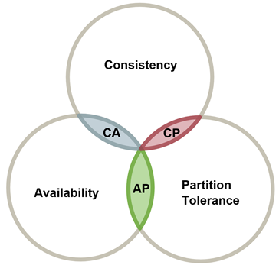
In the cloud, not every subsystem needs the strongest guarantees
At Berkeley, Eric Brewer captured this insight with a “theorem”
CAP stands for “Consistency, Availability and Partition Tolerance”
Basically, Eric argues that:
The theoretically “best” solution often brings heavy costs.
Consistency is one example: conflicting database updates can be forced into
an agreed order, but this takes time and involves node-node dialog (hence ¬P).
Remember that to earn the most money, you need the fastest possible responses.
Eric concluded that this means you might have to relax consistency: CAP.
Notes:
Eric has retired but was a leader in rejecting prior assumptions early in the cloud period. His view (and he was right) was that too much of distributed computing was dominated by theory people who missed the real message, back in 2005. And that real message was about speed.
So he proposed a theory of his own: a theory that “consistency is incompatible with speed”. His theory is not really valid, if carefully studied using formal methods. Yet even if it wasn’t always true, CAP is a great rule of thumb.
Basically, he said to cache everything and to accept weaker forms of consistency. This is not what you learn in a ugrad DB course. But his point was that if this is your goal, you often can build correct and very fast solutions that use cached data and that are behaving sensibly even if that data might be stale. As such, the end-users won’t feel as if the cloud has broken in any sense. Eric’s folk theorem opened people’s eyes to this truth.

Slide 41
Definitions (Slightly informal!)
Consistency: The system responds using the most current values (updates). Conflicting updates are performed in some system-selected order by all replicas. Queries thus will see a “single system” and will be up to date.
Availability: The system is rapidly responsive, and will self-repair if some single component fails, restoring normal functionality asap. Of course fault-tolerance isn’t always possible: if too many components fail all at once, availability is lost.
Partition Tolerant: A data center can have network issues, or entire services can be down. Yet as seen from outside, the cloud should continue to respond even if its first-tier services are temporarily unable to talk to some inner services they would normally depend upon.

Slide 42
Eric Brewer’s Cap Theorem
Relax consistency (C),
Gain faster response (A).
Generate responses even when unable to talk to
back-end servers (P).
Notes:
Later we will look closely at C and will discover that we can have consistency with high performance, but that it demands a whole different style of application design.

Slide 43

BASE Methodology
BASE ≡ “CAP in practice”
Invented at eBay, adopted by Amazon and others
Basic Availability, Soft State and Eventual Consistency
“Use CAP. You can clean up later.”
How BASE works: cache data but don’t worry about cache entries getting stale (hey, they were valid a little while ago).
Notes:
Basic availability implies a focus on continuous system availability despite network failures and tolerance to temporary inconsistency.
Soft state refers to state that is used for efficiency and can be regenerated. It may change due to eventual consistency.
Eventual consistency means that if no further updates are made to a given updated database item for long enough period of time , all users will eventually see the same value for the updated item.
soft state and eventual consistency help with recovery from failures, network partitions.
BASE is similar in style: a set of rules for leading you to CAP-based solutions for the cloud (but not the IoT cloud: this is the e-commerce web site kind of cloud) in which things just work well even though caches full of stale data are used whenever possible.
As an example, BASE would help you realize that product photos rarely change, so you can probably cache photos of products and not check for staleness and just let them expire “naturally”, or maybe after six weeks. Sure, sometimes a product photo does change and you are showing the old model. But you avoid all that cache refresh traffic and in the big picture, that wins a lot, and the staleness rarely bites back.
Anyhow, BASE doesn’t say to always use stale caches. It says think about whether you really need cache coherent data at this point, and don’t ask for it if you don’t need it.” BASE is a step-by-step methodology with steps like that, for building correct code that minimizes its use of locking or coherent caching or other consistency mechanisms.

Slide 44
Today’s Cloud is a CAP+BASE “world”
By and large, cloud systems try to manage with weak consistency.
Notes:
The problem is that IoT may need much more consistency!

Slide 45
Please join class on PIAZZA and choose papers at http://www.eecg.toronto.edu/~ashvin
Thanks!

