Slide 1
Cluster Storage Systems
- A Quick Overview
Ashvin Goel
Electrical and Computer Engineering
University of Toronto
ECE 1724

Slide 2
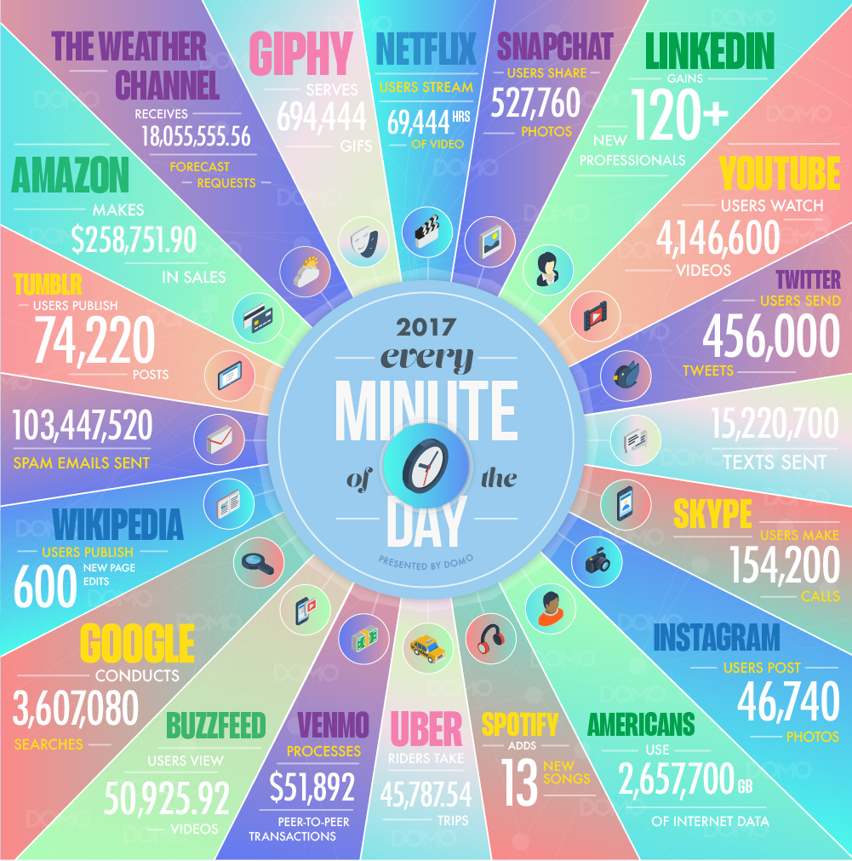
Web-Scale Apps
Applications that are
hosted in massive-scale
computing infrastructures
such as data centers
Used by millions of
geographically distributed
users
  Via web browsers,
  mobile clients, etc.
Produce, store, consume massive amounts of data
  Scale is hard to comprehend

Slide 3
Storage Systems
For the next few weeks, we focus on massive scale storage systems
Today, cluster scale storage
Next week, strongly consistent storage
Following week, wide area storage

Slide 4
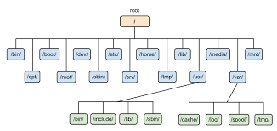
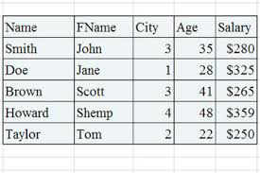
Type of Storage Systems
File systems for
unstructured data
Databases for
unstructured data

Slide 5
Scalable File Systems
Requirements
  Bulk storage
  High throughput
  Scalable
  Fault tolerant
Key idea for scaling: separate metadata and data operations
  Metadata is smaller, requires strong consistency for correct file system operation
  Data is much larger, requires high throughput

Slide 6
GFS: Key Design Ideas
Goal: use a cluster of machines to provide a scalable storage pool
Metadata server
  Use single node for ensuring metadata consistency
  Manage replication (replica placement, load balancing, etc.)
  Replicate operation logs for fault tolerance
  Avoid performing any data operations
Data servers
  Shard files across multiple servers
  Support file appends efficiently
  Provide weak data consistency guarantees
Notes:
data servers: weak consistency: applications need to handle inconsistencies

Slide 7
GFS: Pros, Cons
Pros
  Can handle massive data and massive objects scalably
  Works well for large sequential reads/writes
  Simple, robust reliability model
Cons
  Metadata server can be bottleneck, single point of failure
    Sharding the namespace, replicating the server is feasible
  Weak consistency guarantees
    Linearizability for single chunk writes (not for cross-chunk writes)
    Stale chunk reads possible
    Duplicate and inconsistent data can be read
  Small reads, overwrites are expensive

Slide 8
Questions to Keep in Mind
Which file system X have we seen until now?
  What are the differences between GFS and X?
  When should you use X and when GFS?
  Is there any synergy between the two?
How does GFS provide fault tolerance?
  What fault tolerance method(s) Y have we seen?
  What are the similarities/differences between GFS’s fault tolerance method and Y?
What are the consistency guarantees provided by GFS?
  Why provide these guarantees?
Notes:
We are talking about Zookeeper. Note that Zookeeper doesn’t scale well and is typically used for small files.
Often applications need to use two file systems: GFS-like FS for bulk data, and Zookeeper for configuration management, coordination, failure sensing. GFS-like FS could itself use Zookeeper for its own configuration, etc.
fault tolerance: both master and data servers use primary-backup replication for fault tolerance
master replicates operation logs, which are applied on a backup
data/chunk servers replicate blocks to the replicas
however, there are two differences in the way replication is performed compared to zookeeper, which also performs primary-backup replication
replication is performed to all replicas before an answer is returned rather than using majority consensus
primary is chosen by an external entity rather than by majority consensus. for the master, there is an assumption that some other server can detect master failures. for chunk servers, the master decides the primary

Slide 9
Scalable Databases
Requirements
  Bulk storage
  High throughput
  Scalable
  Fault tolerant
  Structured data, data locality
  Random accesses
  Low latency
  “Some” consistency
Notes:
data locality: allow clients to reason about the locality properties of the data represented in the underlying storage (e.g., using key names)

Slide 10
Bigtable: Key Design Ideas
Goal: use a cluster of machines to provide a scalable, shared-nothing database
Master server
  Use single node for locating data servers, and for database schema operations (create table, column families, etc.)
  Use a coordination server for leader election, configuration management, storing location information, schema metadata
  Avoids performing any data operations
Data servers …

Slide 11
Bigtable: Key Design Ideas
Goal: use a cluster of machines to provide a scalable, shared-nothing database
Master server …
Data servers
  Flexible row format (unbounded number of columns)
  Fine-grained sharding of tables (in row ranges) across servers
  Provide low latency access by using read and write optimized data structure (LSM store)
  Use multi-versioning for concurrent access
  Use GFS for storage and replication
  Co-located with GFS servers for locality
Notes:
flexible row format: One can split a large cell value into multiple values in different column families.
Within a column family, each row contains:
[row key, column (column family:column qualifier), timestamp]
On a query, data is returned in sorted order, first by the row key, then by column family, followed by column qualifier, and finally timestamp (sorted in reverse, so newest records are returned first).
The sharding is fine grained in row ranges, called a tablet. however, each row is guaranteed to be located on one server (+replicas)

Slide 12
Cloud-Scale Storage Requirements
Modern web applications need to support both
  Fast indexed reads, scan operations (search)
  High-throughput updates (inserts)

Slide 13
Storage Options
Sorted array
  search: O(log(n))
  insert, very slow: O(n)
Tree structures, e.g., Btrees
  search: O(log(n))
  insert: O(log(n))
Log
  search, very slow: O(n)
  insert: O(1)

Slide 14
Write-Optimized Storage
Tree structures, e.g., Btrees
  search: O(log(n))
  insert: O(log(n))
Log
  search, very slow: O(n)
  insert: O(1)
Can we design a structure that improves on the insert performance of Btrees, without sacrificing on search?

Slide 15
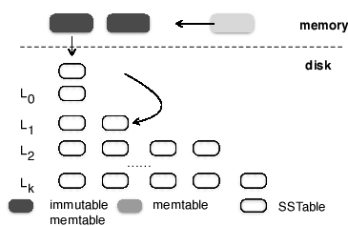
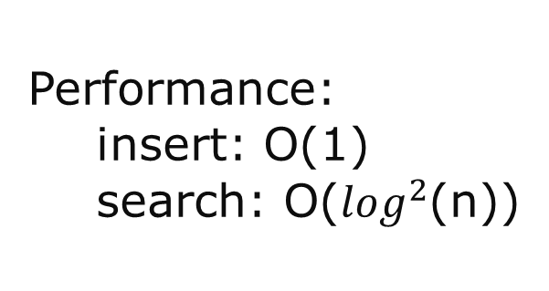
Log-Structured Merge (LSM) Trees
Combine logging with a tree
Write: All data (key, value) is initially written to an in-memory table called memtable
Log: memtable is periodically written sequentially to an on-disk table called sstable
Merge: sstable is periodically merged into a sorted tree of sstables using immutable operations
Performance:
  insert: O(1)
  search: O($\log^{2}$(n))
Notes:
logging: this is not write-ahead log

Slide 16
Bigtable: Pros, Cons
Pros
  Can handle massive data and massive objects scalably
  Supports low-latency access for small data sizes
  Supports tables with thousands of columns efficiently
  Allows applications to ensure data locality
Cons
  Weak consistency model (row-level atomic updates)
    Generally sufficient for many applications
  Very large objects cause significant write amplification
  Time series data, e.g., logs organized by time-stamps can cause write hotspots

Slide 17
Questions to Keep in Mind
Bigtable is called a NoSQL database
  What are the differences between a NoSQL database and a traditional database?
  What are the benefits of NoSQL databases?
What are the most significant differences between GFS and Bigtable?
  In terms of workloads
  In terms of system architecture
Notes:
NoSQL databases (hbase derived from bigtable):
- schema free
- provide horizontal scaling, i.e., if you buy more machines, their performance will scale. more appropriate for big data workloads.
- emphasis on high availability, provide weak consistency (BASE): Basically Available Soft state Eventually consistency
RDBMS:
- rigid schema
- support joins, transactions, typed columns, etc.
- provide vertical scaling, i.e., if you buy a faster machine, e.g., with more cores, their performance will scale. more appropriate for transactional workloads.
- provide strong consistency (ACID): Atomicity, Consistency, Isolation, Durability
GFS:
- Stores data as flat files
- Optimized for sequential access to large files
- Optimized for write-once, read-many accesses
Bigtable:
Stores data as key-values in columnal fashion
Supports low-latency access (often single disk access) for key-value in large data set
Architecture
GFS uses a single master with primary-backup replication
Bigtable uses a single master as well but the master's data is kept replicated in a paxos-based coordinator server (chubby). for example, chubby is used to track active master (which was done by an external server in GFS). similarly, chubby is used to store table schemas

