Slide 1
Transactions - A Quick Overview
Ashvin Goel
Electrical and Computer Engineering University of Toronto
ECE 1724
These slides are adapted from Michael Freedman & Wyatt Lloyd’s course on Distributed Systems
Notes:
In previous class, we looked at cluster storage systems, GFS (file system) and Bigtable (database) that provided weak consistency. Today, we will look at systems that provide strong consistency and provide support for transactions. We will consider the differences between the systems discussed last week and this week at the end of these slides.

Slide 2
Transactions
A unit of work that may perform multiple operations (e.g., reads and writes) on multiple items (e.g., A, B)
transfer(A, B):
begin_tx
a ← read(A)
if a < 10 then
abort_tx
else
write(A, a−10)
b ← read(B)
write(B, b+10)
commit_tx
sum(A, B):
begin_tx
a ← read(A)
b ← read(B)
print a + b
commit_tx
Notes:
transfer is a read-write txn, sum is a read-only txn.

Slide 3
Transaction Properties: ACID
Atomicity: transaction executes completely or not at all
E.g.: transfer(A,B) either commits or makes no changes
Consistency: transaction moves database from one consistent state to another
E.g.: avoids database corruption
Isolation: operations in the transaction appear to happen together
E.g., sum(A,B) does not read intermediate updates by transfer(A, B)
Durability: transactions that commit are not lost, even on failure

Slide 4
Isolation
Goal: operations in the transaction appear to happen together
Serial execution
All operations in a transaction are executed before another transaction is run, ensures isolation
Problem: poor performance, no concurrency possible
Concurrent execution
Transactions are executed concurrently by interleaving the their operations, provides good performance
Problem: certain interleavings of operations may break isolation, need to avoid them

Slide 5
Serializability
A schedule for a set of transactions is an ordering of the operations (reads, writes) performed by those transactions
A schedule is serializable if it is equivalent to some serial schedule
A serializable schedule provides isolation
i.e., ensures that the operations in a transaction appear to happen together in some serial order (even if they don’t)

Slide 6
Schedules
transfer: r_{A} w_{A} r_{B} w_{B} ©
sum: r_{A} r_{B} ©
Serializable
transfer: r_{A} w_{A} r_{B} w_{B} ©
sum: r_{A} r_{B} ©
Serializable
transfer: r_{A} w_{A} r_{B} w_{B} ©
sum: r_{A} r_{B} ©
Non-Serializable
transfer: r_{A} w_{A} r_{B} w_{B} ©
sum: r_{A} r_{B} ©
Serializable
Notes:
intuitively, read-write, write-read, write-write conflicts between operations need to occur in the same order as some serial order (this is what makes the two schedules equivalent). in case 3, ra in sum occurs after wa in transfer but rb in sum occurs before wb in transfer, which is why this schedule is not serializable.

Slide 7
Linearizability vs. Serializability
Linearizability: a guarantee about single operations on single objects
Writes are ordered
Once write completes, all reads that begin later (in real-time order) should reflect that write
Serializability: a guarantee about multiple operations (transactions) on multiple objects
Transactions appear to execute in some serial order
Doesn’t impose any real-time constraints
Strict serializability: intuitively serializability + linearizability
Notes:
Until now, the papers we have discussed (e.g., GFS and Bigtable) aimed to provide linearizability. For example, GFS ensures linearizability for chunks and Bigtable ensures linearizability for a single row. Today, we are discussing paper that provide serializability guarantees.

Slide 8
Implementing Serializability with Locking
Concurrent execution can violate serializability
We need to control concurrent execution to ensure serializability, and so an implementation of isolation is also called concurrency control
Traditionally, locking is used for concurrency control
Two types of locks maintained for each data item
Shared: Need to acquire before reading object
Exclusive: Need to acquire before writing object
 | Shared (S) | Exclusive (X)
Shared (S) | Yes | No
Exclusive (X) | No | No

Slide 9
Two-Phase Locking (2PL)
2PL rule: Once a transaction has released a lock it is not allowed to obtain any other locks
Growing phase: transaction acquires locks
Shrinking phase: transaction releases locks
In practice:
Growing phase is the entire transaction
Shrinking phase is during commit

Slide 10
2PL Schedules
transfer: r_{A} w_{A} r_{B} w_{B} ©
sum: r_{A} r_{B} ©
Serializable,
Allowed
transfer: r_{A} w_{A} r_{B} w_{B} ©
sum: r_{A} r_{B} ©
Non-Serializable,
Not allowed
transfer: r_{A} w_{A} r_{B} w_{B} ©
sum: r_{A} r_{B} ©
Serializable,
Allowed
transfer: r_{A} w_{A} r_{B} w_{B} ©
sum: r_{A} r_{B} ©
Serializable,
Not allowed

Slide 11
Issues with 2PL
What do we do if a lock is unavailable?
Give up immediately (abort)?
Wait forever?
Waiting for a lock can result in deadlock
Transfer has A locked, waits on B
Sum has B locked, waits on A
Assuming order A and B are interchanged in the sum() code
Many ways to detect and handle deadlocks

Slide 12
Distributed Transactions
Data is partitioned (sharded) across nodes
Transaction accesses data from multiple nodes
transfer(A, B):
begin_tx
a ← read(A)
if a < 10 then
abort_tx
else
write(A, a−10)
b ← read(B)
write(B, b+10)
commit_tx
A
B
Participant nodes:
all nodes that hold
transaction data
Coordinator node:
runs transaction code
Notes:
Until now we have talked about transactions and concurrency control on a single node.
coordinator node can be a participant as well.

Slide 13
Atomic Commit
Problem: Participant node may not be able to complete its operation
Cannot acquire required lock (e.g., deadlock)
No memory or disk space available to do write
Transaction constraint fails (e.g., a < 10)
Atomic: All or nothing
Either all participants do something (commit) or no participant does anything (abort)
Common use: commit a distributed transaction that updates data on different shards

Slide 14
Two-Phase Commit
Phase 1
Coordinator sends Prepare requests to all participants
Each participant votes yes or no
Sends yes vote or no vote back to coordinator
Typically acquires locks if they vote yes (for 2PL)
Coordinator inspects all votes
If all yes, then commit
If any no, then abort
Phase 2
Coordinator sends Commit or Abort to all participants
If commit, each participant commits changes
Each participant releases locks (for 2PL)
Each participant sends an Ack back to the coordinator

Slide 15
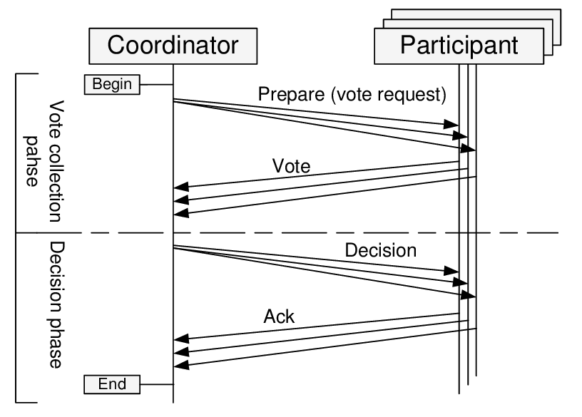
Two-Phase Commit

Slide 16
Distributed Transactions and Replication
Replication Dimension
A-F
A-F
A-F
Sharding Dimension
G-L
G-L
G-L
M-R
M-R
M-R
S-Z
S-Z
S-Z

Slide 17
Replication, Sharding, Atomic Commit
Replication (e.g., primary-backup, consensus in RAFT) is about doing the same thing in multiple places, primarily to provide fault tolerance
Sharding is about doing different things in multiple places for scalability
Atomic commit is about doing different things in multiple places together (all or nothing)
Notes:
We will see today and later that replication is often combined with distributed transactions and atomic commit.
What is the difference between consensus and atomic commit? Roughly speaking, according to the “Relationship between Atomic Commitment and Consensus problems”, consensus is about reaching the same decision among non-faulty (correct) processes, while atomic commit is about reaching the same decision among all (correct or faulty) processes. Consensus makes sense for replication because if a replica fails, we can still access the data from the non-failing replicas. Atomic commit is required for distributed transactions because they are operating on different shards and so all shards need to agree or else the shards may become inconsistent.
from the Unifying Consensus and Atomic Commitment for Effective Cloud Data Management paper:
The gold standard for atomically committing executing distributed transactions is two phase commit (2PC). But 2PC is a blocking protocol even in the presence of mere site failures, which led to the three phase commit protocol (3PC) that is nonblocking in the presence of crash failures. But the general version of 3PC is still blocking in the presence of certain types of partitioning failures.

Slide 18
Motivation for Today’s Papers
Distributed transactions very expensive due to two-phase commit
Requires two additional round trips in addition to the read and write requests made to participants
Locks are held from the time reads and writes are performed until the end of the two-phase commit
Any other transactions waiting on locks are also delayed

Slide 19
Key Idea
Limit the power of transactions to enable scaling distributed transactions

Slide 20
Sinfonia
Sinfonia: proposes mini-transactions
Performs the entire transaction within the commit protocol
Reduces messages, locking times
Requires
Read/write sets of transactions before transaction execution
Any conditions that cause abort to be checkable within commit protocol
All writes must depend on the conditions above
Complications
Coordinator runs on application node and is not trusted
Txn:
if (C == v)
update W;
update X;
Is this supported?
Notes:
read/write sets: in the transfer(a,b) and sum(a,b) transactions, the read write set is known before these transactions execute. however, this is not always the case.
Coordinator runs on application node: this complicates recovery and garbage collection because information such as whether a mini-transaction has committed or not is kept at the participants and it needs to be learnt by all (rather than being kept at the coordinator, as in 2 phase commit)

Slide 21
Calvin
Calvin: proposes deterministic concurrency control
Establishes serial order of transactions before transaction execution
Avoids the need for 2 phase commit for atomic commit
Makes it much cheaper to perform replication
Requires
Read/write sets of transactions before transaction execution
Deterministic program logic for handling failure/replication
Complications
Batching of transactions for concurrency
Accurate prefetching of data for good performance
Notes:
Establishes serial order of transactions before transaction execution: this can limit concurrency since transaction serial ordering cannot be changed at runtime
cheap to perform replication: Input replication rather than output replication
we will compare sinfonia and calvin later.

