Slide 1

Re-examining Instruction Reuse in Pre-execution Approaches
By
Sonya R. Wolff
Prof. Ronald D. Barnes
June 5, 2011

Slide 2
Processor Stalls
Instruction Dependences
  Compiler Optimization
  Dynamic Scheduling
Branch Instructions
  Branch Predictors
Memory Accesses
  Caches
  Non-Blocking Caches
  Cache Prefetchers
  Pre-Execution

Slide 3
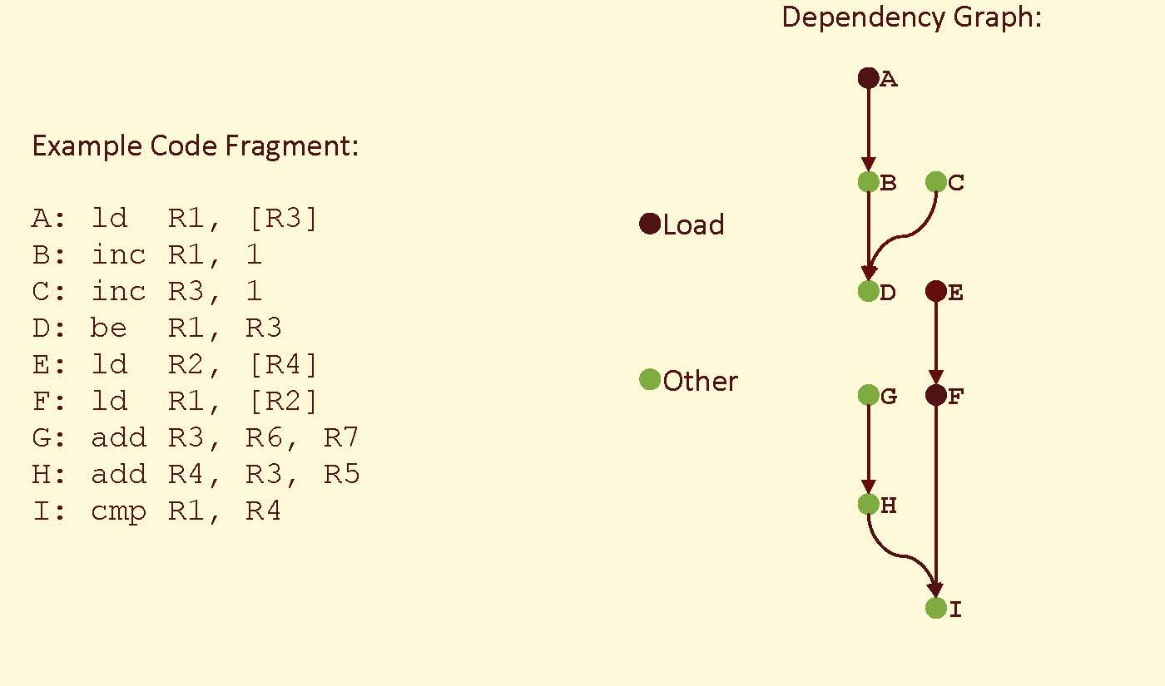
Code Example

Slide 4
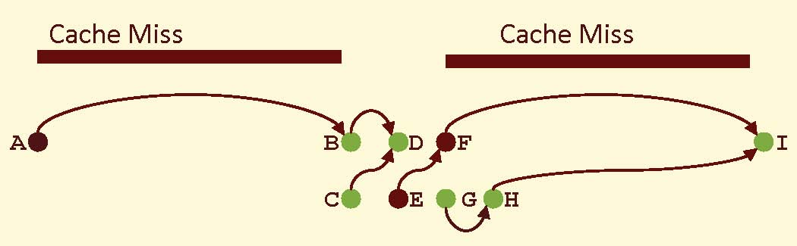
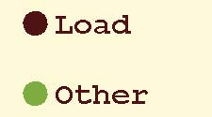
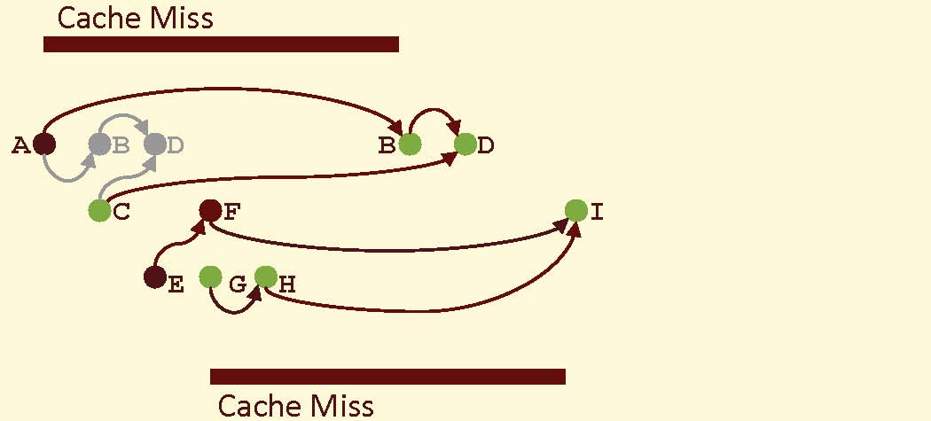
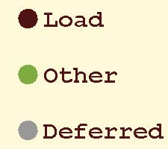
What is Pre-Execution?
In-Order
Pre-Execution

Slide 5
Pre-Execution Techniques
Out-of-Order Execution
Run Ahead Execution
  Run Ahead [Dundas1997], [Multu2003]
  Continuous Flow Pipelines [Srinivasan2004, Hilton2009]
  Two-Pass Pipelining [Barnes2006]
  Dual-Core Execution [Zhou2005]
  Multi-Pass Pipelining [Barnes2006]
  Rock’s Execute Ahead [Chaudhry2002]

Slide 6
Run Ahead Execution
In-Order and Out-of-Order Pipeline Designs
Two Modes of Operation
  Normal Mode: Pipeline functions in traditional manner
  Run-Ahead Mode: Instructions are retired without altering the machine state.
Run-Ahead Entry on Very Long Latency Memory Operations
Upon Run-Ahead Exit, Program Counter Set to Instruction After the Run-Ahead Entry Point.
Instruction Results from Run-Ahead Mode Not Reused During Normal Mode Operation

Slide 7
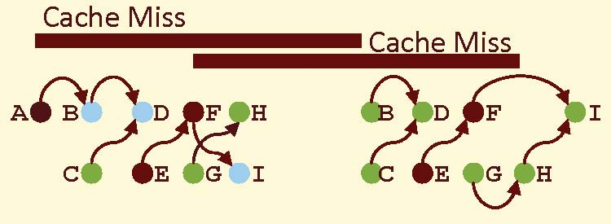
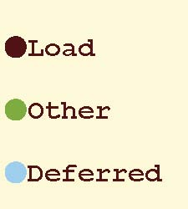
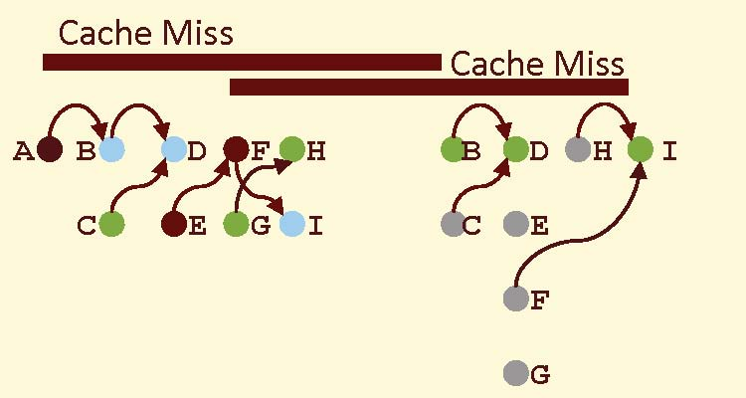
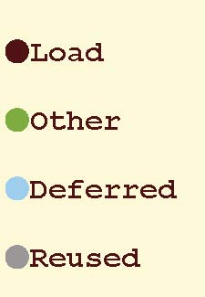
What is Reuse?
Run Ahead
Run Ahead with Reuse

Slide 8
Instruction Reuse Questions
Previously Shown to be Ineffective for Out-of-Order Processors [Multu2005]
Why is reuse ineffective for out-of-order?
Is reuse ineffective for in-order operations?
If effective for in-order operations, what cause the behavioral differences?
How does pipeline variations affect reuse in run-ahead pipelines?

Slide 9
Simulation Setup
Two Processor Models: In-Order and Out-of-Order
8-wide Instruction Fetch and Issue
L1 Cache: 64KB, 2 cycle, 4 loads per cycle
L2 Cache: 1 MB, 10 cycle, 1 load per cycle
Memory: 500 latency, 4:1 bus freq. ratio
Simulations
  SPEC CPU2006 benchmarks (reference inputs)
  Compiled for x86, 64-bit
  250 million instructions simulations
  25 million warm-up period
  Region chosen for statistical relevance [Sherwood2002]

Slide 10
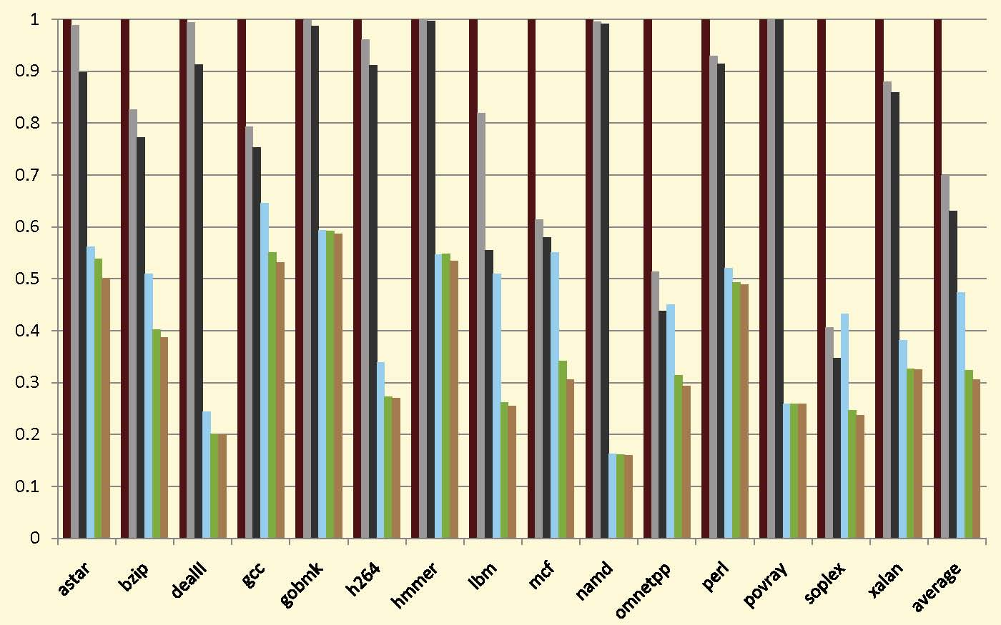
Normalized Cycles
(Normalized to In-Order)

Slide 11

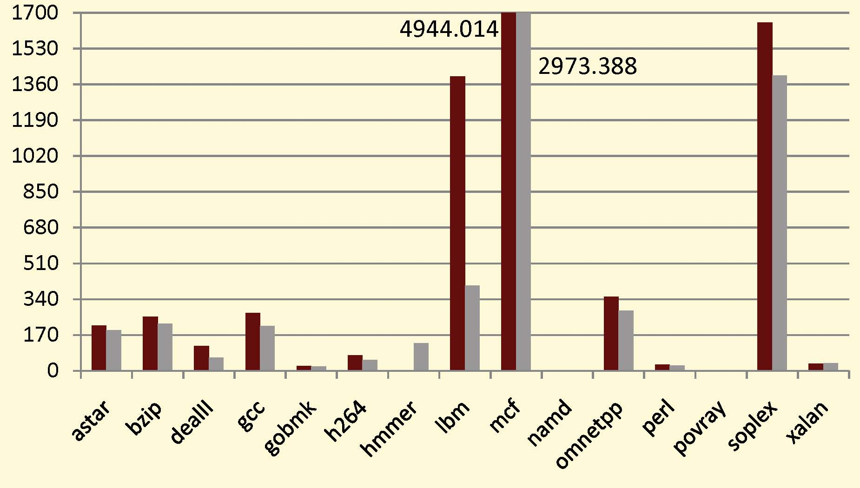
Run Ahead Entries
(Values in 1000)

Slide 12
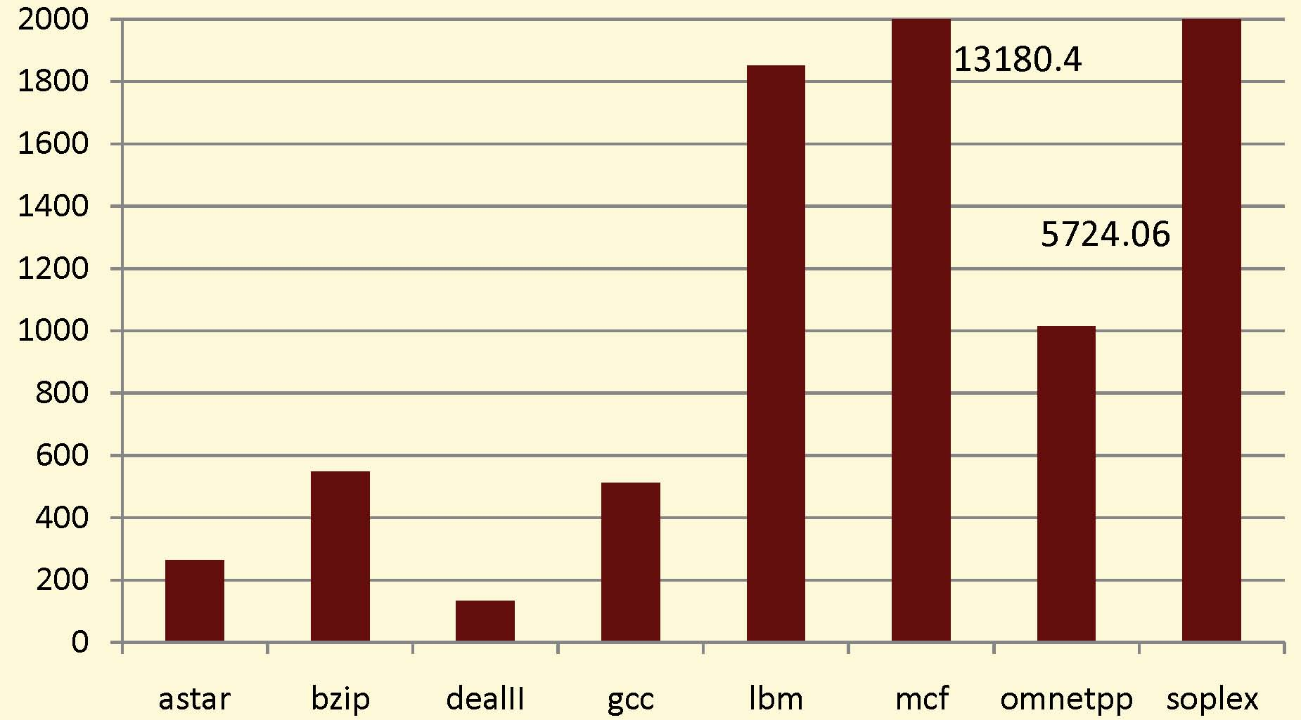
In-Order L2 Cache Misses
(Values in 1000)

Slide 13
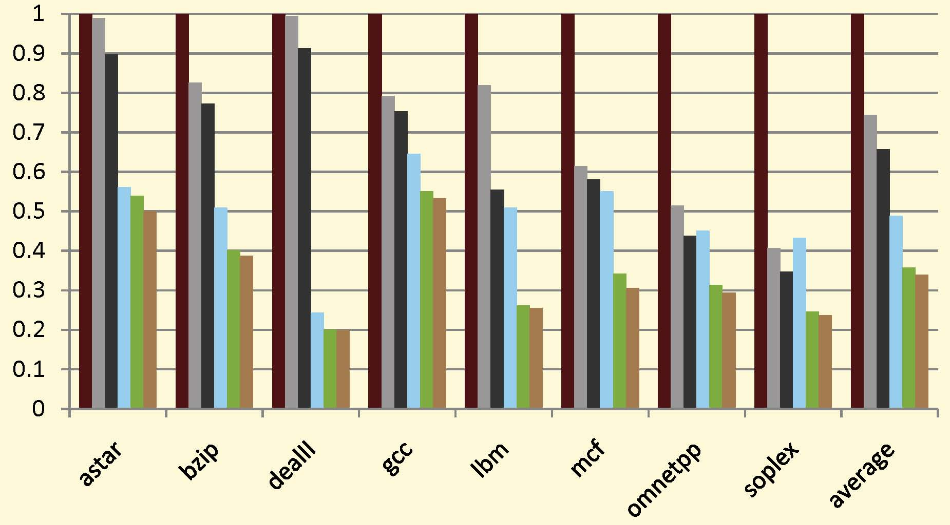
Normalized Cycles
(Normalized to In-Order)

Slide 14
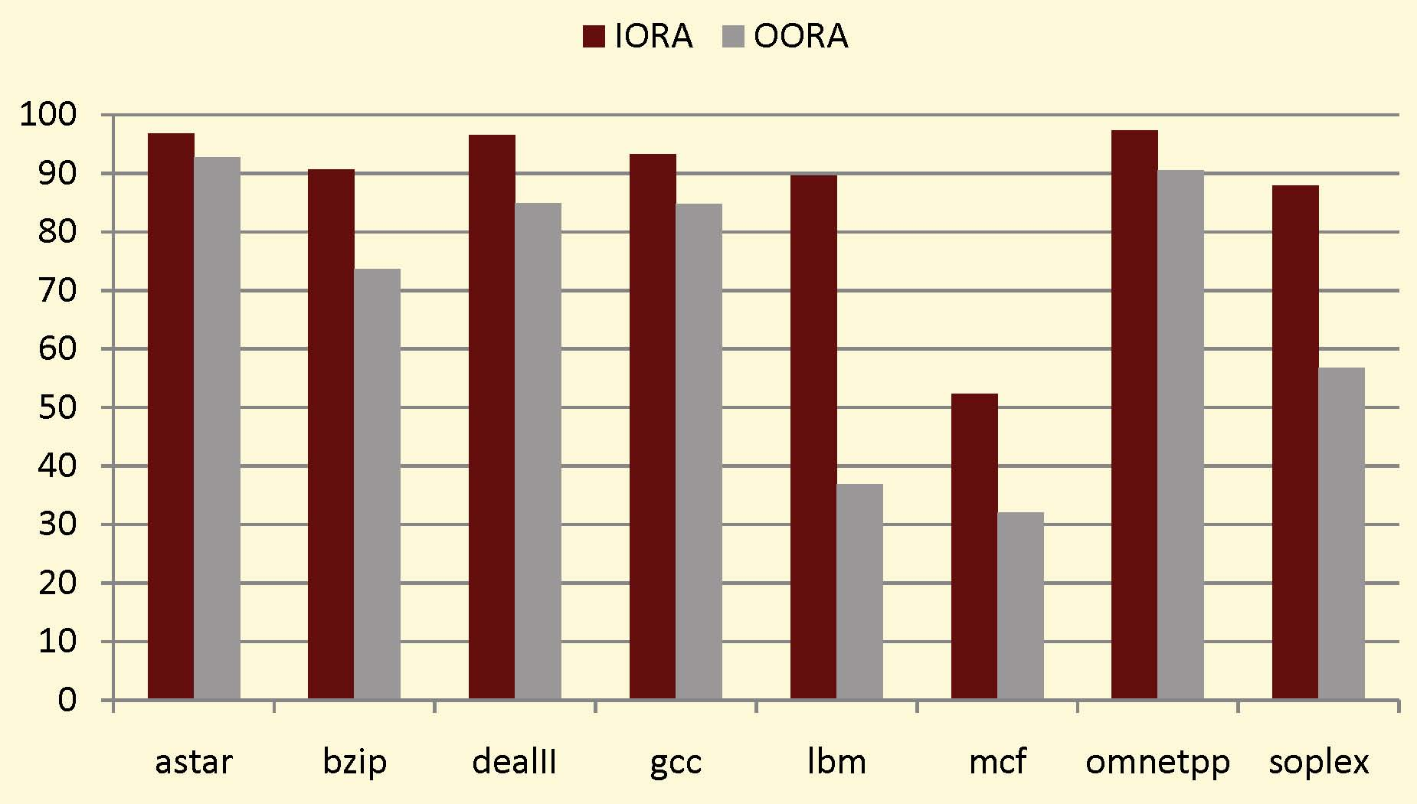
Percentage Clean Memory Accesses

Slide 15
Summary of Reuse Results
Out-of-Order Reuse vs. Run Ahead Only
  Average: 1.03 X
  Maximum (mcf): 1.12 X
  Reduced Set: 1.05 X
In-Order Reuse vs. Run Ahead Only
  Average: 1.09 X
  Maximum (lbm): 1.47 X
  Reduced Set: 1.14 X

Slide 16
In-Order
Run Ahead
Run Ahead with Reuse

Slide 17
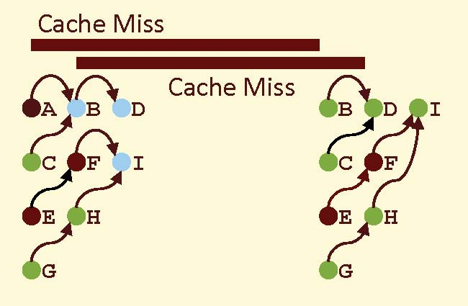
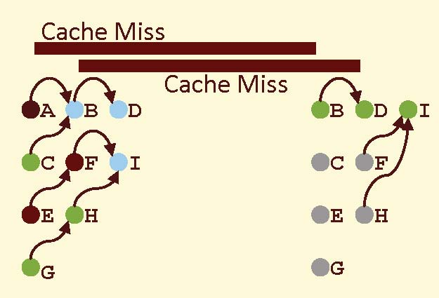
Out-of-Order
Run Ahead
Run Ahead with Reuse

Slide 18
Variations and Expectations
Main Memory Latency (1000, 500, 100)
  Reduction in Run-Ahead Benefit for Lower Latency
  Convergence of In-Order and Out-of-Order
  Increase in Reuse Benefit for Higher Latency
Fetch and Issue (8, 4, 3, and 2 Width)
  Increase Benefit for Reuse with Smaller Issue
  Convergence of In-Order and Out-of-Order

Slide 19
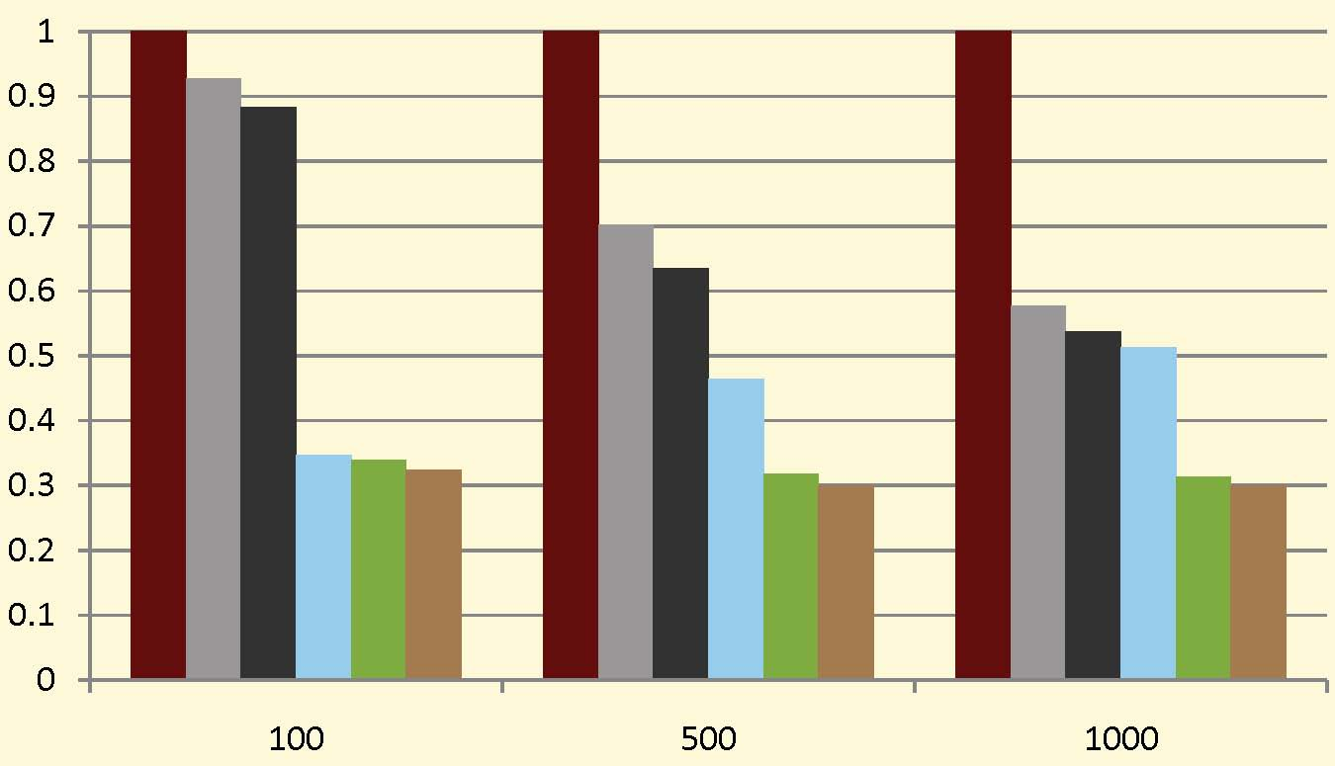
Variations on Memory Latency
(Normalized to In-Order for Each Latency)

Slide 20
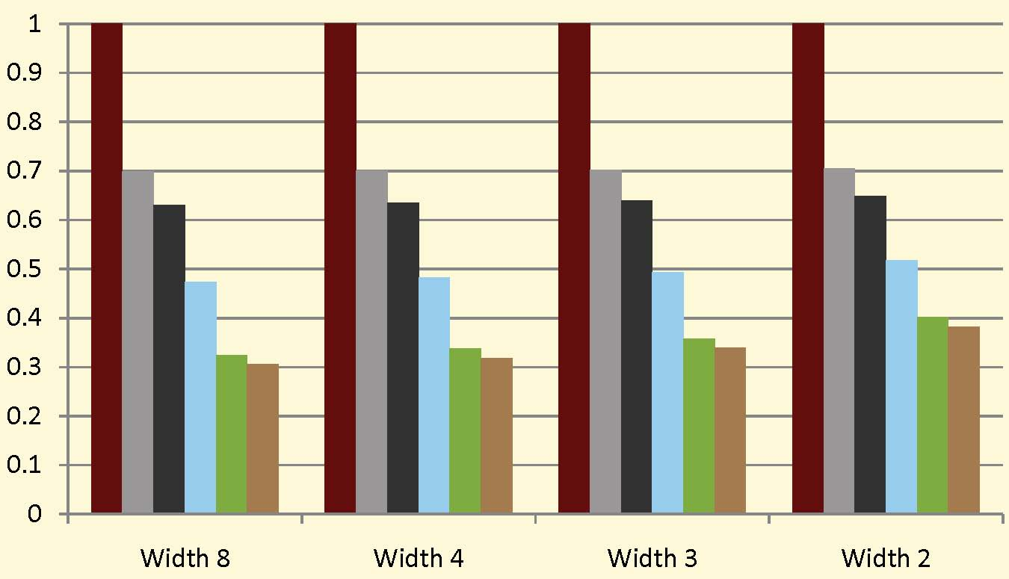
Variations on Issue Width
(Normalized to In-Order to Each Issue Width)

Slide 21
Conclusion
Pre-Execution is a Highly Effective Way to Deal with Long Latency Memory Accesses
Reuse of Run Ahead Results Provides Little to No Speedup for Out-of-Order Pipelines
  Average Speedup = 1.03 X
  Maximum Speedup = 1.12 X (MCF)
Reuse of Run Ahead Results Provides Speedup for In-Order Pipelines
  Average Speedup = 1.09 X
  Maximum Speedup = 1.47 X (LBM)

Slide 22
Additional Slides

Slide 23

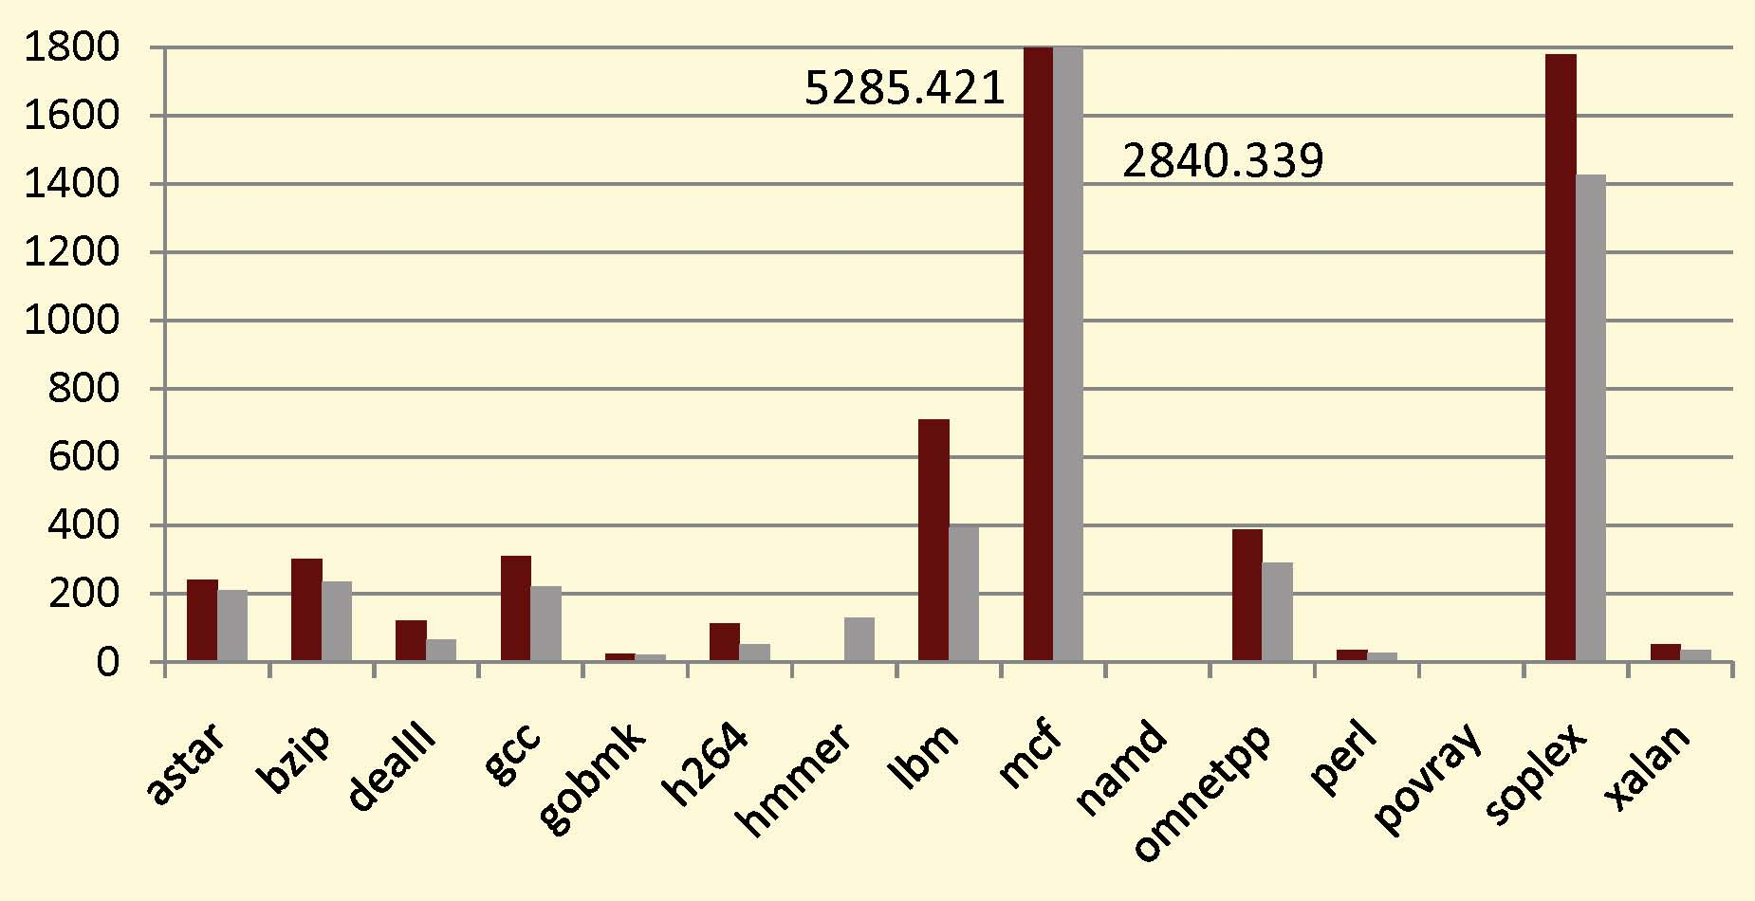
Run Ahead Entries
(Values in 1000)

Slide 24
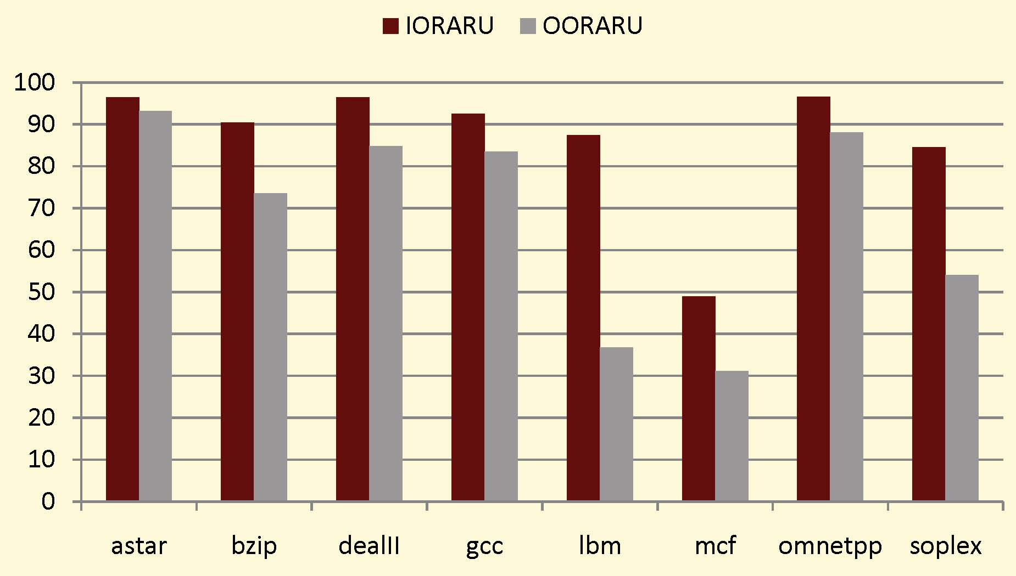
Percentage Clean Memory Accesses

Slide 25
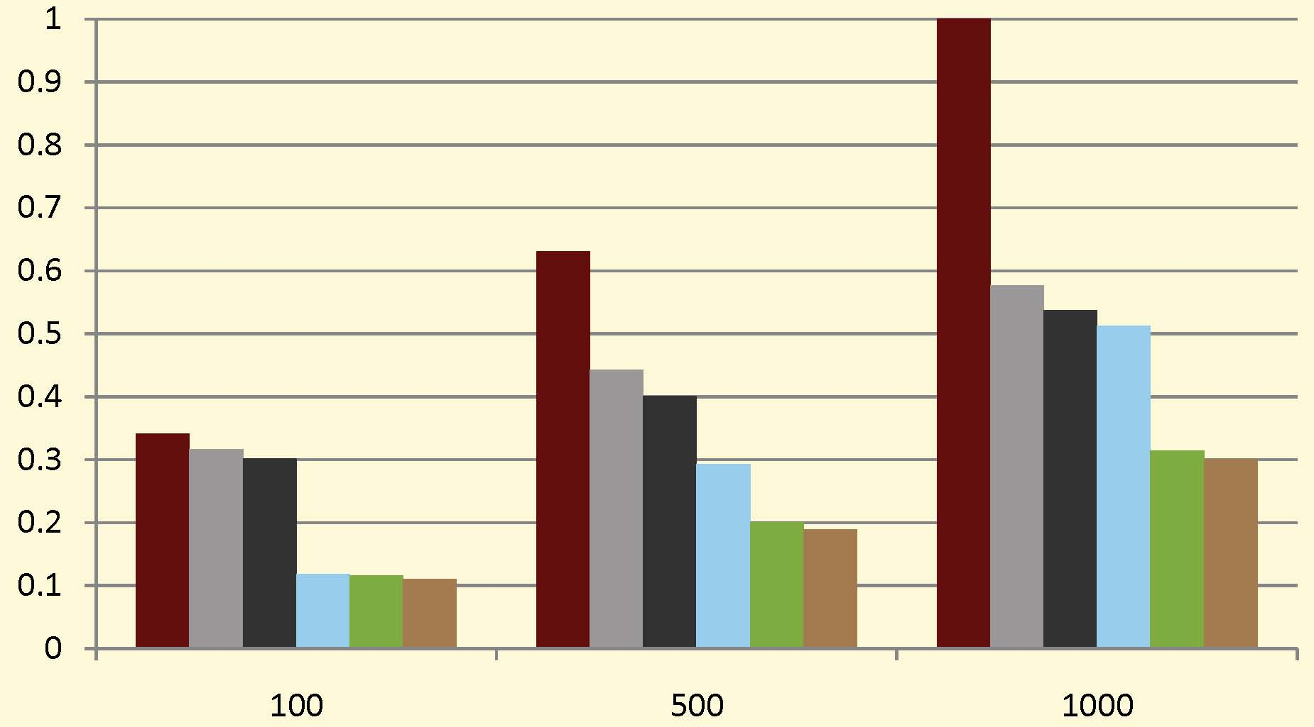
Variations on Memory Latency
(Normalized to Cache 1000 In-Order)

Slide 26
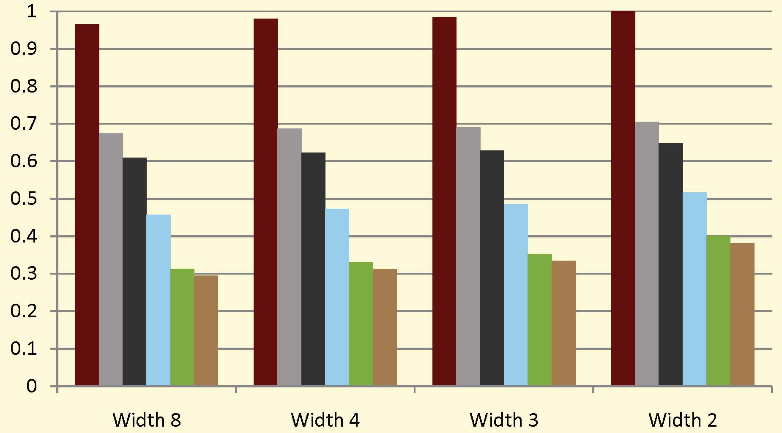
Variations on Stage Widths
(Normalized to Width 2 In-Order)

