Slide 1
SIMD
Single Instruction Multiple Data

Slide 2
SIMD: Motivation Contd.
Recall:
Part of architecture is understanding application needs
Many Apps:
for i = 0 to infinity
a(i) = b(i) + c
Same operation over many tuples of data
Mostly independent across iterations

Slide 3
Some things are naturally parallel

Slide 4
Sequential Execution Model / SISD
int a[N]; // N is large
for (i =0; i < N; i++)
a[i] = a[i] * fade;
Flow of control / Thread
One instruction at the time
Optimizations possible at the machine level
time

Slide 5
Data Parallel Execution Model / SIMD
int a[N]; // N is large
for all elements do in parallel
a[i] = a[i] * fade;
time
This has been tried before: ILLIAC III, UIUC, 1966
http://ieeexplore.ieee.org/xpls/abs_all.jsp?arnumber=4038028&tag=1
http://ed-thelen.org/comp-hist/vs-illiac-iv.html

Slide 6
SIMD Processing
SCALAR
(1 operation)
SIMD
(N operations)
r2
r2
r2
r2
r2
r1
r2
r1
r1
r1
r1
r1
+
+
+
+
+
+
r3
r3
r3
r3
r3
r3
add r3, r1, r2
add r3, r1, r2

Slide 7
TIME
C1
C2
C3
C4
C5
C6
C7
C8
C9
C10
fetch
decode
rf
exec
wb
exec
wb
exec
wb
fetch
decode
rf
exec
wb
exec
wb
exec
wb

Slide 8
TIME
C1
C2
C3
C4
C5
C6
C7
C8
C9
C10
fetch
decode
rf
exec
wb
exec
wb
exec
wb
fetch
decode
rf
exec
wb
exec
wb
exec
wb
fetch
decode
rf
exec
wb
exec
wb
exec
wb

Slide 9
SIMD Architecture
CU
μCU
regs
PE
PE
PE
ALU
MEM
MEM
MEM
Replicate Datapath, not the control
All PEs work in tandem
CU orchestrates operations

Slide 10
Multimedia extensions
SIMD in “modern” CPUs

Slide 11
MMX: Basics
Multimedia applications are becoming popular
Are current ISAs a good match for them?
Methodology:
Consider a number of “typical” applications
Can we do better?
Cost vs. performance vs. utility tradeoffs
Net Result: Intel’s MMX
Can also be viewed as an attempt to maintain market share
If people are going to use these kind of applications we better support them

Slide 12
Multimedia Applications
Most multimedia apps have lots of parallelism:
for I = here to infinity
out[I] = in_a[I] * in_b[I]
At runtime:
out[0] = in_a[0] * in_b[0]
out[1] = in_a[1] * in_b[1]
out[2] = in_a[2] * in_b[2]
out[3] = in_a[3] * in_b[3]
…..
Also, work on short integers:
in_a[i] is 0 to 256 for example (color)
or, 0 to 64k (16-bit audio)

Slide 13
Observations
32-bit registers are wasted
only using part of them and we know
ALUs underutilized and we know
Instruction specification is inefficient
even though we know that a lot of the same operations will be performed still we have to specify each of the individually
Instruction bandwidth
Discovering Parallelism
Memory Ports?
Could read four elements of an array with one 32-bit load
Same for stores
The hardware will have a hard time discovering this
Coalescing and dependences

Slide 14
MMX Contd.
Can do better than traditional ISA
new data types
new instructions
Pack data in 64-bit words
bytes
“words” (16 bits)
“double words” (32 bits)
Operate on packed data like short vectors
SIMD
First used in Livermore S-1 (> 20 years)

Slide 15
MMX:Example
Up to 8 operations (64bit) go in parallel
Potential improvement: 8x
In practice less but still good
Besides another reason to think your machine
is obsolete

Slide 16
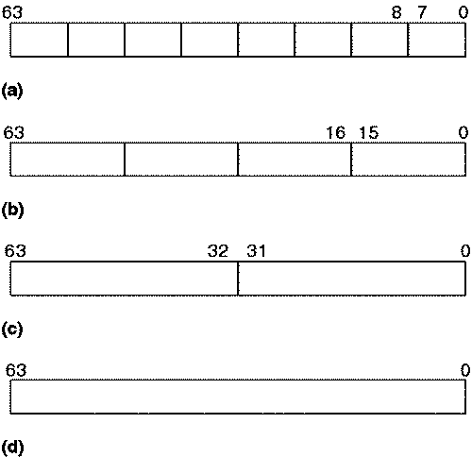
Data Types

Slide 18
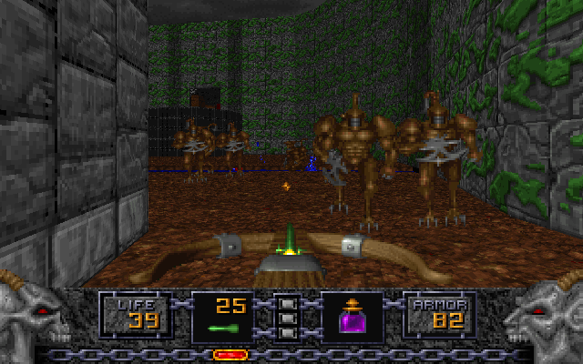

Slide 19
Vector Processors
SCALAR
(1 operation)
VECTOR
(N operations)
r1
r2
v1
v2
+
+
r3
v3
vector
length
add r3, r1, r2
vadd.vv v3, v1, v2
Scalar processors operate on single numbers (scalars)
Vector processors operate on vectors of numbers
Linear sequences of numbers
Does not say that they have to be done in parallel
From. Christos Kozyrakis, Stanford

Slide 20
a[i] = a[i] + 10
b[i] = b[i] * a[i]
c[i] = c[i] + b[i]
TIME
C1
C2
C3
C4
C5
C6
C7
C8
C9
C10
fetch
decode
rf
exec
wb
a[i] = a[i] + 10
rf
exec
wb
rf
exec
wb
fetch
decode
rf
exec
wb
b[i] = b[i] * a[i]
rf
exec
wb
rf
exec
wb
fetch
decode
rf
exec
wb
c[i] = c[i] + b[i]
rf
exec
wb
rf
exec
wb

Slide 21
Example of Simple Vector Processor

Slide 22
What’s in a Vector Processor
A scalar processor (e.g., a MIPS processor)
Scalar register file (32 registers)
Scalar functional units (arithmetic, load/store, etc)
A vector register file (a 2D register array)
Each register is an array of elements
E.g., 32 registers with 32 64-bit elements per register
MVL = maximum vector length = max # of elements per register
A set for vector functional units
Integer, FP, load/store, etc
Some times vector and scalar units are combined (share ALUs)

Slide 23
Vector Code Example
Y[0:63] = Y[0:63] + a * X[0:63]
LD R0, a
VLD V1, 0(Rx) V1 = X[]
VLD V2, 0(Ry) V2 = Y[]
VMUL.SV V3, R0, V1 V3 = X[]*a
VADD.VV V4, V2, V3 V4 = Y[]+V3
VST V4, 0(Ry) store in Y[]

Slide 24
Modern Multimedia Instruction Extensions
AVX → Vector extension
256 bit registers
8 32b floating-point
4 64b floating-point
Many new instructions

