Slide 1
Insertion Policies
Adaptive Insertion Policies for High-Performance Caching
Moinuddin K. Qureshi Yale N. Patt
Aamer Jaleel Simon C. Steely Jr. Joel Emer

Slide 2
Dead on Arrival (DoA) Lines
DoA Lines: Lines unused between insertion and eviction
(%) DoA Lines
For the 1MB 16-way L2, 60% of lines are DoA
➔ Ineffective use of cache space

Slide 3
Working Set > Cache Size Example
for (j = 0; j < M; j++)
for (i = 0; i < LARGE_N; i++)
a[i] = a[i] x 10;
Cache
a[]

Slide 4
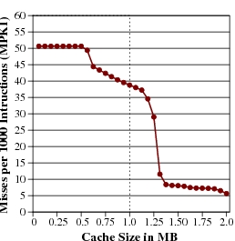
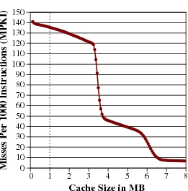
Why DoA Lines ?
Streaming data ➔ Never reused. L2 caches don’t help.
Working set of application greater than cache size
art
mcf
Misses per 1000 instructions
Misses per 1000 instructions
Cache size in MB
Cache size in MB
Soln: if working set > cache size, retain some working set

Slide 5
Working Set > Cache Size Example
for (j = 0; j < M; j++)
for (i = 0; i < LARGE_N; i++)
a[i] = a[i] x 10;
Cache
a[]
Keep this in the cache

Slide 6
Cache Insertion Policy
Two components of cache replacement:
Victim Selection: Which line to replace for incoming line? (E.g. LRU, Random, FIFO, LFU)
Insertion Policy: Where is incoming line placed in replacement list? (E.g. insert incoming line at MRU position)
Simple changes to insertion policy can greatly improve cache performance for memory-intensive workloads

Slide 7
LRU-Insertion Policy (LIP)
MRU
LRU
a
b
c
d
e
f
g
h
Reference to ‘i’ with traditional LRU policy:
i
a
b
c
d
e
f
g
Reference to ‘i’ with LIP:
a
b
c
d
e
f
g
i
Choose victim. Do NOT promote to MRU
Lines do not enter non-LRU positions unless reused

Slide 8
How it works for our example?
for (j = 0; j < M; j++)
for (i = 0; i < LARGE_N; i++)
a[i] = a[i] x 10;
Cache
a[]
Keep this in the cache
Assume Cache is empty
First set of accesses will fill
In all ways,
Thrashing will occur only on the
last way of each set

Slide 9
What about a change in working set?
First this
Followed by this
b[]
Cache
a[]
Keep this in the cache
Keep this in the cache
a[] will occupy all N-1 sets and will not leave. b[] does not stand a chance.

Slide 10
Bimodal-Insertion Policy (BIP)
Think two streaming working sets
Back to back
LIP does not age older lines
Infrequently insert lines in MRU position
Let ε = Bimodal throttle parameter
if ( rand() < ε ) Insert at MRU position; else Insert at LRU position;
For small ε , BIP retains thrashing protection of LIP while responding to changes in working set

Slide 11
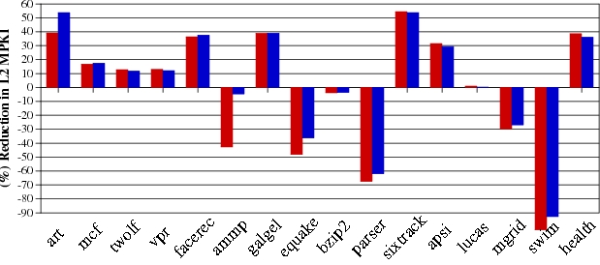
Results for LIP and BIP
LIP
BIP(ε=1/32)
(%) Reduction in L2 MPKI
Changes to insertion policy increases misses for LRU-friendly workloads

Slide 12
Bigger Lesson
Interesting programs run for a long time
Billions of instructions per second
Several orders of magnitude larger than your cache size
Don’t have to rush to do the “right thing” immediately
Event “infrequent” changes will eventually affect the whole cache

Slide 13
Dynamic-Insertion Policy (DIP)
Two types of workloads: LRU-friendly or BIP-friendly
DIP can be implemented by:
Monitor both policies (LRU and BIP)
Choose the best-performing policy
Apply the best policy to the cache
Need a cost-effective implementation ➔ “Set Dueling”

Slide 14
DIP via “Set Dueling”
Divide the cache in three:
Dedicated LRU sets
Dedicated BIP sets
Follower sets (winner of LRU,BIP)
n-bit saturating counter
misses to LRU-sets: counter++
misses to BIP-set: counter--
Counter decides policy for Follower sets:
MSB = 0, Use LRU
MSB = 1, Use BIP
LRU-sets
miss
+
n-bit cntr
BIP-sets
–
miss
Follower Sets
MSB = 0?
YES
No
Use LRU
Use BIP
monitor ➔ choose ➔ apply
(using a single counter)

Slide 15
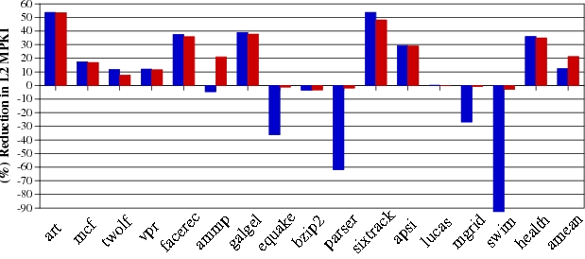
Results for DIP
BIP
DIP (32 dedicated sets)
(%) Reduction in L2 MPKI
DIP reduces average MPKI by 21% and requires < two bytes storage overhead

