Slide 1
The Memory Bus
Interfacing with Memory and I/O Devices

Slide 2
“Memory” Operations
CPU
MEMORY
DEVICE
LOAD.DATATYPE ADDRESS → VALUE
STORE.DATATYPE ADDRESS, VALUE
For our simple processor: DATATYPE = BYTE

Slide 3
How to Read from Memory
CPU
MEM
R0
0x00
R1
___
2
0x10
___
R2
0x10
R3
0xFF
1
Read from address 0x10 --- CPU executes:
SUB R1 R1 # R2 = 0
ORI 0x10 # R1 = 0x10
LOAD R2 (R1)
  Read from Mem[0x10]

Slide 4
Our Memory Interface Thus Far
8
8
ALU1
IRload
RaSel
ABLD
ALUop
IR6-7
RFWrite
0
8
3
0
2
8
8
ALUoutLD
2
reg1
data1
A
1
AddrSel
MemRead
MemWrite
1
1
ALU2
ALUout
0
IR
IR5-4
2
reg2
RF
8
8
ALU
8
ADDR
data2
B
000
PC
1
8
8
regw
dataw
8
8
Memory
1
001
8
Imm4
4
8
SE
010
Data_in
Data_out
Imm5
5
8
FlagWrite
N
Z
8
PCwrite
MDR
ZE
011
Imm3
ZE
100
RegIn
MDRload

Slide 5
Our Processor’s Memory Interface
8
Address A7-A0
ADDRESS
8
DataOut Do7-Do0
MemRead
MemWrite
DATA
8
DataIn Di7-Di0
8
ADDR
Processor
Memory
To Memory and Devices
MemRead
8
Data_in
Data_out
8
CONTROL`
MemWrite
CLK

Slide 6
LOAD 0x10 in Time
Initial state: Not reading or writing
8
Address A7-A0
Arbitrary
8
DataOut Do7-Do0
Don’t care
8
DataIn Di7-Di0
Processor
MemRead
0
0
MemWrite
CLK
We are here

Slide 7
LOAD 0x10 in Time
CYCLE 3 of LOAD @ Just after the clock edge
8
Address A7-A0
0x10
8
DataOut Do7-Do0
8
DataIn Di7-Di0
We expect memory to return the value here
Processor
MemRead
1
0
MemWrite
CLK
We are here

Slide 8
LOAD 0x10 in Time
CYCLE 3 of LOAD @ after Memory had enough time to read
8
Address A7-A0
0x10
8
DataOut Do7-Do0
8
DataIn Di7-Di0
0xAA # value from memory
Processor
MemRead
1
0
MemWrite
CLK
We are here

Slide 9
LOAD 0x10 in Time
End of CYCLE 3 of LOAD @ the rising edge
CPU latches the value in MDR
8
Address A7-A0
0x10
8
DataOut Do7-Do0
8
DataIn Di7-Di0
0xAA # value from memory
Processor
MemRead
1
0
MemWrite
CLK
We are here

Slide 10
What if Memory is slower?
Adding an ACK signal: Goes to Control
8
Address A7-A0
0x10
8
DataOut Do7-Do0
8
DataIn Di7-Di0
0xAA # value from memory
Processor
MemRead
1
0
MemWrite
ACK
0 from memory
CLK
We are here

Slide 11
What if Memory is slower?
@ the next rising edge: memory not ready ACK = 0
8
Address A7-A0
0x10
8
DataOut Do7-Do0
8
DataIn Di7-Di0
0xAA # value from memory
Processor
MemRead
1
0
MemWrite
ACK
0 from memory
CLK
We are here

Slide 12
What if Memory is slower?
One more cycle : memory is ready ACK = 1
8
Address A7-A0
0x10
8
DataOut Do7-Do0
8
DataIn Di7-Di0
0xAA # value from memory
Processor
MemRead
1
0
MemWrite
ACK
1 from memory
CLK
We are here

Slide 13
How to accommodate the ACK?
PCWrite = 1
AddrSel = 1
MemRead = 1
MemWrite = 0
IRLoad = 1
RaSel = X
MDRload = X
ABLoad = X
ALU1 = 0
ALU2 = 001
ALUOp= 000
ALUOutWrite = X
RFWrite = 0
RegIn = X
FlagWrite = 0
PCWrite = 0
AddrSel = X
MemRead = 0
MemWrite = 0
IRLoad = 0
RaSel = 0
MDRload = X
ABLoad = 1
ALU1 = X
ALU2 = XXX
ALUop = XXX
ALUoutWrite = X
RFWrite = 0
RegIn = X
FlagWrite =0
BPZ
LOAD
STORE
ORI
PCWrite = 0
AddrSel = X
MemRead = 0
MemWrite = 0
IRLoad = 0
RaSel = 1
MDRload = X
ABLoad = 1
ALU1 = X
ALU2 = XXX
ALUop = XXX
ALUOutWrite = X
RFWrite = 0
RegIn = X
FlagWrite = 0
PCWrite = 0
AddrSel = 0
MemRead = 1
MemWrite = 0
IRLoad = 0
RaSel = 0
MDRload = 1
ABLoad = 0
ALU1 = X
ALU2 = XXX
ALUop = XXX
ALUOutWrite = X
RFWrite = 0
RegIn = X
FlagWrite = 0
PCWrite = 0
AddrSel = 0
MemRead = 0
MemWrite = 1
IRLoad = 0
RaSel = 0
MDRload = X
ABLoad = 0
ALU1 = X
ALU2 = XXX
ALUop = XXX
ALUOutWrite = X
RFWrite = 0
RegIn = X
FlagWrite = 0
PCWrite = ‘N
AddrSel = X
MemRead = 0
MemWrite = 0
IRLoad = 0
RaSel = X
MDRload = X
ABLoad = X
ALU1 = 0
ALU2 = 010
ALUop = 000
ALUOutWrite = X
RFWrite = 0
RegIn = X
FlagWrite = 0
BZ
ADD, SUB or NAND
SHIFT
PCWrite = Z
AddrSel = X
MemRead = 0
MemWrite = 0
IRLoad = 0
RaSel = X
MDRload = X
ABLoad = X
ALU1 = 0
ALU2 = 010
ALUop = 000
ALUOutWrite = X
RFWrite = 0
RegIn = X
FlagWrite = 0
PCWrite = 0
AddrSel = X
MemRead = 0
MemWrite = 0
IRLoad = 0
RaSel = X
MDRload = X
ABLoad = 0
ALU1 = 1
ALU2 = 000
ALUop = oper.
ALUOutWrite = 1
RFWrite = 0
RegIn = X
FlagWrite = 1
PCWrite = 0
AddrSel = X
MemRead = 0
MemWrite = 0
IRLoad = 0
RaSel = X
MDRload = X
ABLoad = 0
ALU1 = 1
ALU2 = 010
ALUop = SHIFT
ALUOutWrite = 1
RFWrite = 0
RegIn = X
FlagWrite = 1
BNZ
PCWrite = 0
AddrSel = X
MemRead = 0
MemWrite = 0
IRLoad = 0
RaSel = X
MDRload = X
ABLoad = 0
ALU1 = 1
ALU2 = 011
ALUop = OR
ALUOutWrite = 1
RFWrite = 0
RegIn = X
FlagWrite =1
PCWrite = 0
AddrSel = X
MemRead = 0
MemWrite = 0
IRLoad = 0
RaSel = 0
MDRload = X
ABLoad = X
ALU1 = X
ALU2 =XXX
ALUop = XXX
ALUOutWrite = X
RFWrite = 1
RegIn = 1
FlagWrite = 0
PCWrite = Z’
AddrSel = X
MemRead = 0
MemWrite = 0
IRLoad = 0
RaSel = X
MDRload = X
ABLoad = X
ALU1 = 0
ALU2 = 010
ALUop = 000
ALUOutWrite = X
RFWrite = 0
RegIn = X
FlagWrite = 0
PCWrite = 0
AddrSel = X
MemRead = 0
MemWrite = 0
IRLoad = 0
RaSel = 0
MDRload = X
ABLoad = X
ALU1 = X
ALU2 = XXX
ALUop = XXX
ALUOutWrite = 0
RFWrite = 1
RegIn = 0
FlagWrite = 0
PCWrite = 0
AddrSel = X
MemRead = 0
MemWrite = 0
IRLoad = 0
RaSel = 1
MDRload = X
ABLoad = X
ALU1 = X
ALU2 =XXX
ALUop = XXX
ALUOutWrite = 1
RFWrite = 1
RegIn = 0
FlagWrite = 0

Slide 14
PCWrite = 0
AddrSel = X
MemRead = 0
MemWrite = 0
IRLoad = 0
RaSel = 0
MDRload = X
ABLoad = 1
ALU1 = X
ALU2 = XXX
ALUop = XXX
ALUoutWrite = X
RFWrite = 0
RegIn = X
FlagWrite =0
LOAD
!ACK
PCWrite = 0
AddrSel = 0
MemRead = 1
MemWrite = 0
IRLoad = 0
RaSel = 0
MDRload = 1
ABLoad = 0
ALU1 = X
ALU2 = XXX
ALUop = XXX
ALUOutWrite = X
RFWrite = 0
RegIn = X
FlagWrite = 0
ACK
PCWrite = 0
AddrSel = X
MemRead = 0
MemWrite = 0
IRLoad = 0
RaSel = 0
MDRload = X
ABLoad = X
ALU1 = X
ALU2 =XXX
ALUop = XXX
ALUOutWrite = X
RFWrite = 1
RegIn = 1
FlagWrite = 0

Slide 15
Let’s Interface with a memory device

Slide 16
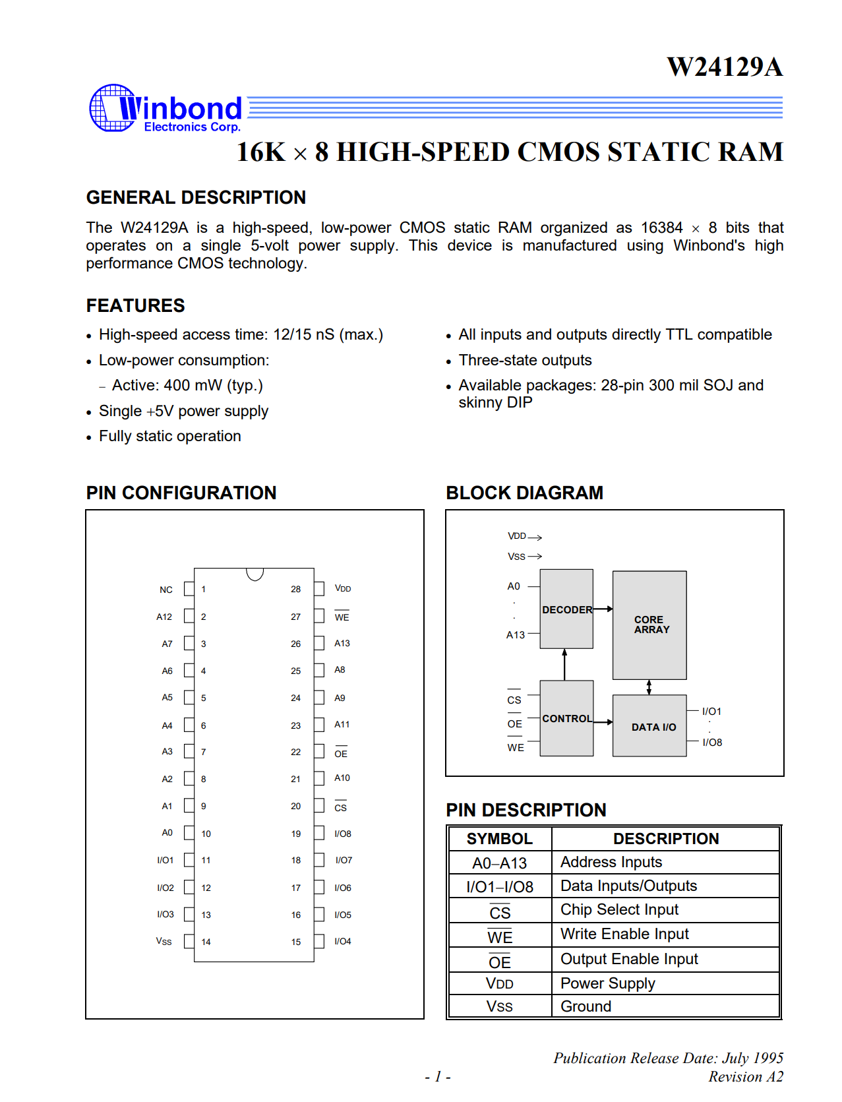
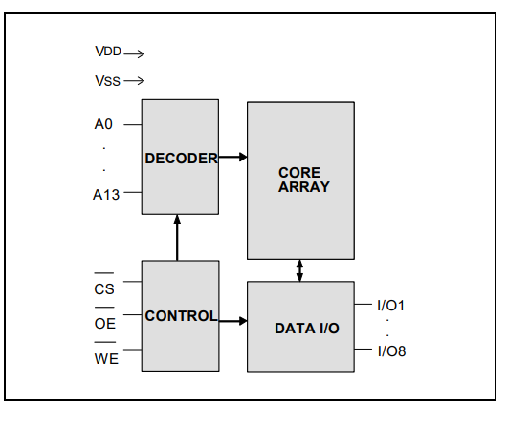
An Example Memory Device (chip)
16K rows x 8 bits/row
A13-A0: row select
I/O1-I/O8: data in/out
!CS: chip select
!OE: output enable (reading)
!WE: write enable (writing)

Slide 17
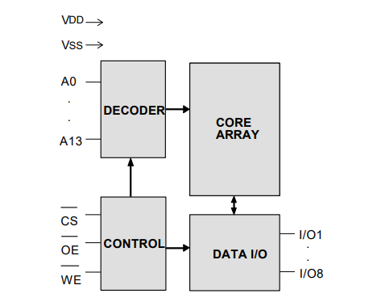
How To Read: Step #1: CPU “says”
16K rows x 8 bits/row
A13-A0: row select
I/O1-I/O8: data in/out
!CS: chip select
!OE: output enable (reading)
!WE: write enable (writing)
Executes:
LOAD R1 (R2)
CPU
MEMORY
LOAD 0x10
Address
0x10
Control
I am talking to you 0
I am not writing 0
I am reading 1

Slide 18
For our simple system let’s assume the memory had only 256 bytes
256 rows x 8 bits per row
Address pins are: A7-A0

Slide 19
How To Read: Step #1: CPU “says”
16K rows x 8 bits/row
A13-A0: row select
I/O1-I/O8: data in/out
!CS: chip select
!OE: output enable (reading)
!WE: write enable (writing)
Executes:
LOAD R1 (R2)
CPU
MEMORY
LOAD 0x10
Address
0x10
A7
Control
I am talking to you 0
I am not writing 0
I am reading 1

Slide 20
The Two Sides
8
Address A7-A0
Address
8
DataOut Do7-Do0
Data
8
DataIn Di7-Di0
Processor
MemRead
MemWrite
Control
ACK
CLK
8
Address A6-A0
Address
8
I/O7-I/O0
Data
Memory
!OE
!WE
Control
!CS

Slide 21
Control Signals
8
Address A7-A0
Address
8
DataOut Do7-Do0
Data
8
DataIn Di7-Di0
Processor
MemRead
MemWrite
ACK
CLK
Address
Address A7-A0
8
I/O7-I/O0
8
Data
Memory
!OE
Control
!WE
!CS

Slide 22
Control Signals & Address
8
Address A7-A0
Address
8
DataOut Do7-Do0
Data
8
DataIn Di7-Di0
Processor
MemRead
MemWrite
ACK
CLK
Address
Address A7-A0
8
I/O7-I/O0
8
Data
Memory
!OE
Control
!WE
!CS

Slide 23
ACK: Memory responds within the clock cycle
8
Address A7-A0
Address
8
DataOut Do7-Do0
Data
8
DataIn Di7-Di0
Processor
MemRead
MemWrite
ACK
CLK
Address
Address A7-A0
8
I/O7-I/O0
8
Data
Memory
!OE
Control
!WE
!CS

Slide 24
Multiplexing the Data Connections
8
Address A7-A0
8
8
DataOut Do7-Do0
DataIn Di7-Di0
8
8
Processor
MemRead
MemWrite
ACK
CLK
8
I/O7-I/O0
8
Memory
!OE
Control
!WE
!CS

Slide 25
Reading Data
8
X
Address A7-A0
8
8
DataOut Do7-Do0
DataIn Di7-Di0
8
8
Processor
MemRead
1
MemWrite
0
ACK
CLK
8
I/O7-I/O0
8
Memory
!OE
Control
!WE
!CS

Slide 26
Writing Data
8
Address A7-A0
8
8
DataOut Do7-Do0
DataIn Di7-Di0
8
8
Processor
MemRead
0
MemWrite
1
ACK
CLK
8
I/O7-I/O0
8
Memory
!OE
Control
!WE
!CS

Slide 27
Let’s Execute a Program
.text
I1: sub r1 r1 ← assume it’s @ pc= 0x2
I2: ori 0x10
I3: load r2 (r1)
I4: store r0 (r1)
I5: bnz I4
Load 0x2 → fetch I1
Load 0x3 → fetch I2
Load 0x4 → fetch I3
Load 0x10 → read mem[0x10]
Load 0x5 → fetch I4
Store 0x10, 0x1 → store mem[0x10] (assumes r0 = 0x1)
Load 0x5 → fetch I4
Load 0x5 → fetch I4
…

Slide 28
Load 0x2 → fetch I1 / Cycle Starts
8
Address A7-A0
8
8
DataOut Do7-Do0
0
DataIn Di7-Di0
8
8
????? -- not ready yet
Processor
MemRead
1
MemWrite
0
ACK
1
0
CLK
0x02
8
I/O7-I/O0
8
Memory
0
!OE
!WE
1
Control
0
We are here
!CS

Slide 29
Load 0x2 → fetch I1 / Cycle ends
8
Address A7-A0
8
8
DataOut Do7-Do0
0
DataIn Di7-Di0
8
8
0x56 = Sub R1 R1
Processor
MemRead
1
MemWrite
0
ACK
1
0
CLK
0x02
8
I/O7-I/O0
8
Memory
0
!OE
!WE
1
Control
0
We are here
!CS

Slide 30
Store 0x10, 0x1 Cycle Starts
8
Address A7-A0
8
8
DataOut Do7-Do0
0
DataIn Di7-Di0
8
8
????? -- not ready yet
Processor
MemRead
1
MemWrite
0
ACK
1
0
CLK
0x02
8
I/O7-I/O0
8
Memory
1
!OE
!WE
0
Control
0
We are here
!CS

Slide 31
Store 0x10, 0x1 Cycle Ends
8
Address A7-A0
8
DataOut Do7-Do0
0x1
8
1
DataIn Di7-Di0
8
8
0x1
Processor
MemRead
0
MemWrite
1
ACK
1
0
CLK
0x10
8
I/O7-I/O0
8
Memory
1
!OE
!WE
0
Control
0
We are here
!CS

Slide 32
Making Room for Devices
Let’s Connect a 128 row x 8b Memory

Slide 33
Map to Addresses 0x00 to 0x7F
8
Address A7-A0
8
8
DataOut Do7-Do0
DataIn Di7-Di0
8
8
Processor
MemRead
MemWrite
ACK
CLK
8
A7
8
I/O7-I/O0
Memory
Activate !CS only if in 0x00-0x7F
A7 = 0
!OE
Control
!WE
!CS

Slide 34
Let’s Introduce a write-only register at 0x80

Slide 35
Map Address 0x80
8
Address A7-A0
8
8
DataOut Do7-Do0
DataIn Di7-Di0
8
Processor
MemRead
MemWrite
ACK
CLK
A7 = 1
A6-A0 = 0…0
Write Enable @ 0x80
Activate only if CPU is Accessing 0x80 AND is doing a write
First

Slide 36
Write Enable & Data In
8
Address A7-A0
8
8
DataOut Do7-Do0
DataIn Di7-Di0
8
Processor
register
MemRead
8
MemWrite
ACK
Data in
CLK
A7
Write Enable
A0
CLK
Activate only if CPU is Accessing 0x80 AND is doing a write
First

Slide 37
Ack
8
Address A7-A0
8
8
DataOut Do7-Do0
DataIn Di7-Di0
8
Processor
register
MemRead
8
MemWrite
ACK
Data in
1
CLK
A7
Write Enable
A0
CLK
Set ACK only if we are being accessed
Do not assert a voltage otherwise – This will allow some other device
to do so

Slide 38
Ack – MUX based
8
Address A7-A0
8
8
DataOut Do7-Do0
DataIn Di7-Di0
8
Processor
register
MemRead
8
MemWrite
ACK
0
ACK from
others
1
1
CLK
A7
Write Enable
A0
CLK
Pass our ACK only if we are being accessed
Otherwise pass the ACK from other devices/memory

Slide 39
Let’s make it read/write register at 0x80

Slide 40
Read/Write Register @ 0x80
8
Address A7-A0
8
8
DataOut Do7-Do0
DataIn Di7-Di0
8
Processor
Read Enable
register
MemRead
8
MemWrite
ACK
0
ACK from
others
CLK
1
1
A7
Write Enable
A0
CLK
Pass our ACK only if we are being accessed
Address = 0x80 and (MemRead OR MemWrite)

