Slide 1


What the Fork:
A Study of Inefficient and Efficient Forking Practices in Social Coding
Shurui Zhou, Bogdan Vasilescu, Christian Kästner
ej
@shuishuiblue

Slide 2
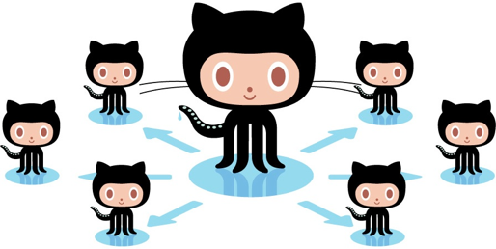

Fork-based Development

Slide 3
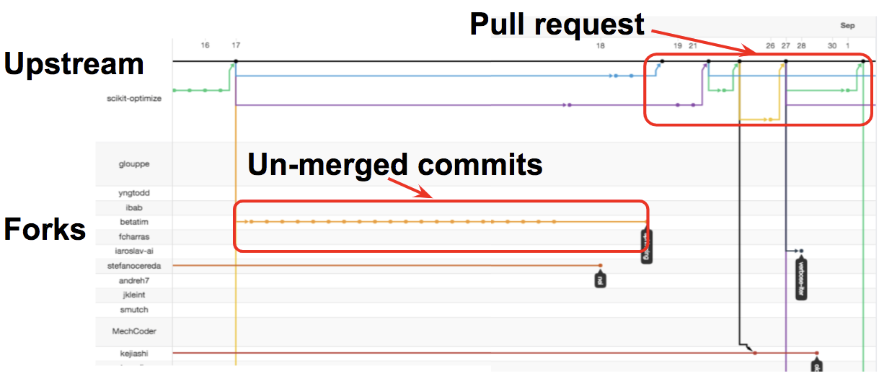
Fork-based Development is Popular
#Forks | #GitHub Projects
>50 | 61704
>500 | 4787
>1,000 | 2236
>5,000 | 198
>10,000 | 72
>100,000 | 2
[GHTorrent 2019-06]
GitHub Network View

Slide 4
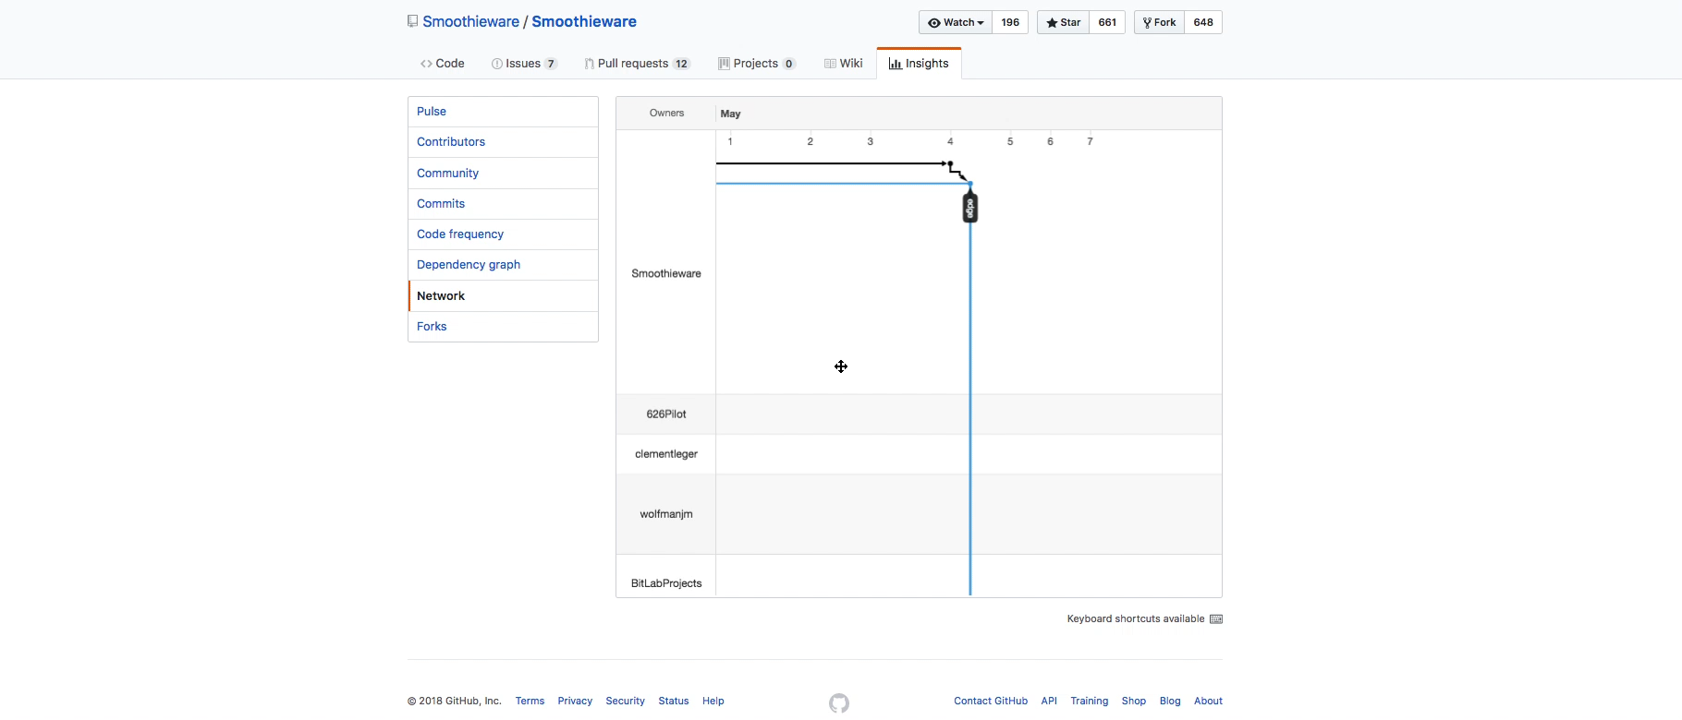
Network View - Lack of an overview

Slide 5
Problems Inefficiency
Lost Contribution
Rejected PRs
Lack of an overview
Redundant Development
[Zhou et al. ICSE'18]
Fragmented Community
Notes:
3'

Slide 6
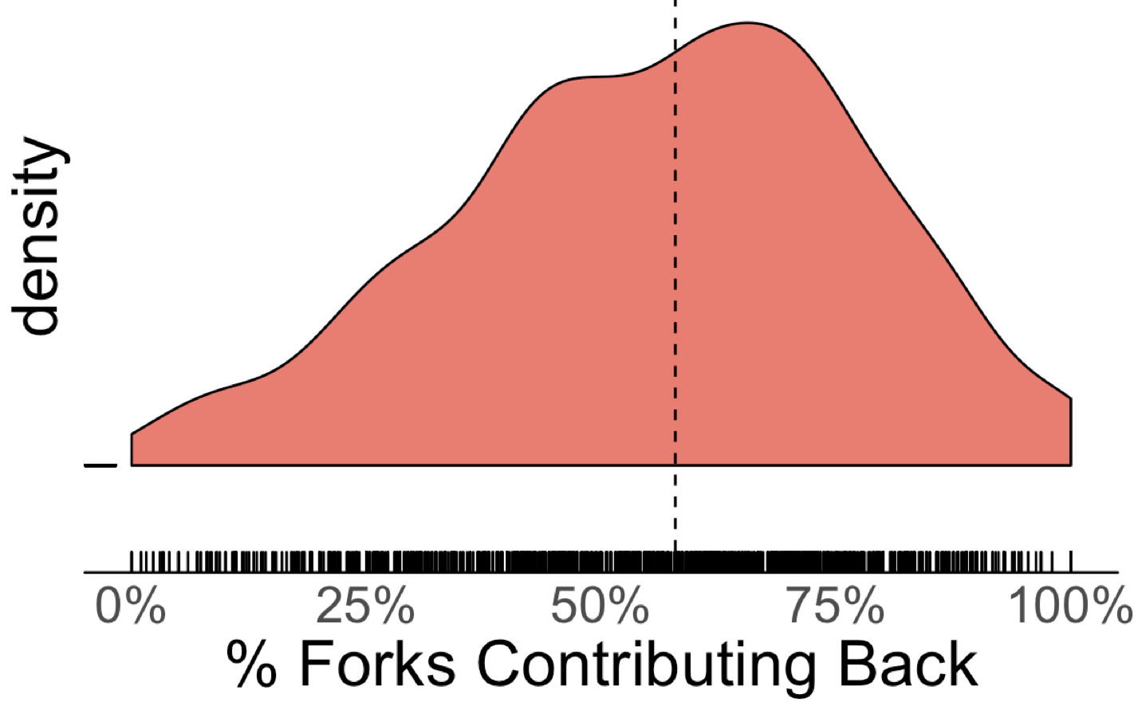
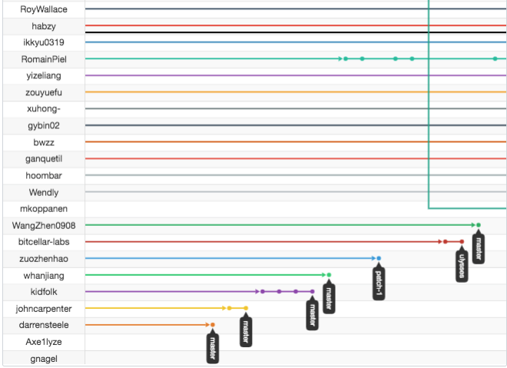
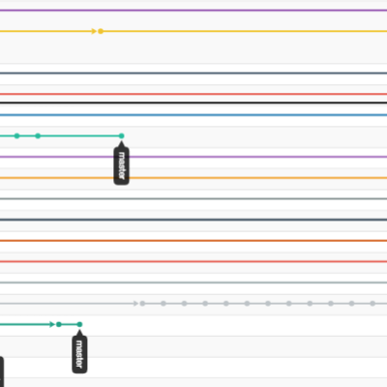
Lost Contribution
Only 14% of all forks of nine popular JavaScript projects on GitHub contained changes that were integrated back [Fung et al. 2012]
Notes:
The problem is still common today

Slide 7
Problems Inefficiency
Lost Contribution
Rejected PRs
Lack of an overview
Redundant Development
Fragmented Community

Slide 8

Rejected Pull Requests
- Demotivating [Steinmacher et al. ICSE'18]
- Misalignment with maintainers’
vision of the project

Slide 9





People Follow Different Processes
VS

Slide 10
People Follow Different Processes
“To a large extent the features are driven by bitcoin improvement proposals, so if I would be looking for a feature, I would go for these proposals”
--Bitcoin developer

Slide 11
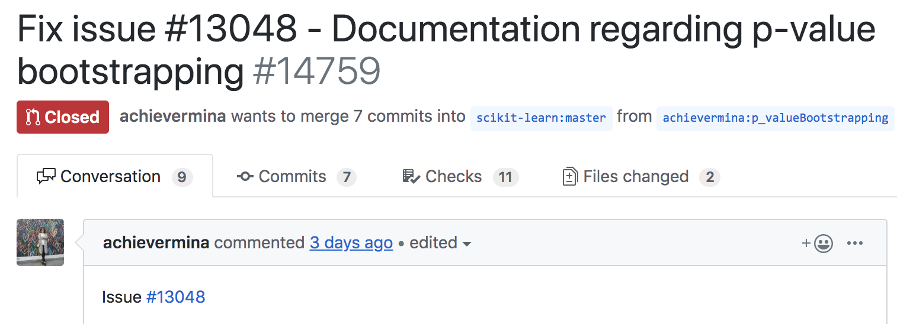
People Follow Different Processes

Slide 12
People Follow Different Processes
VS
- Project proposal
- Resolve issues on
the issue tracker
- Open for any contribution

Slide 13
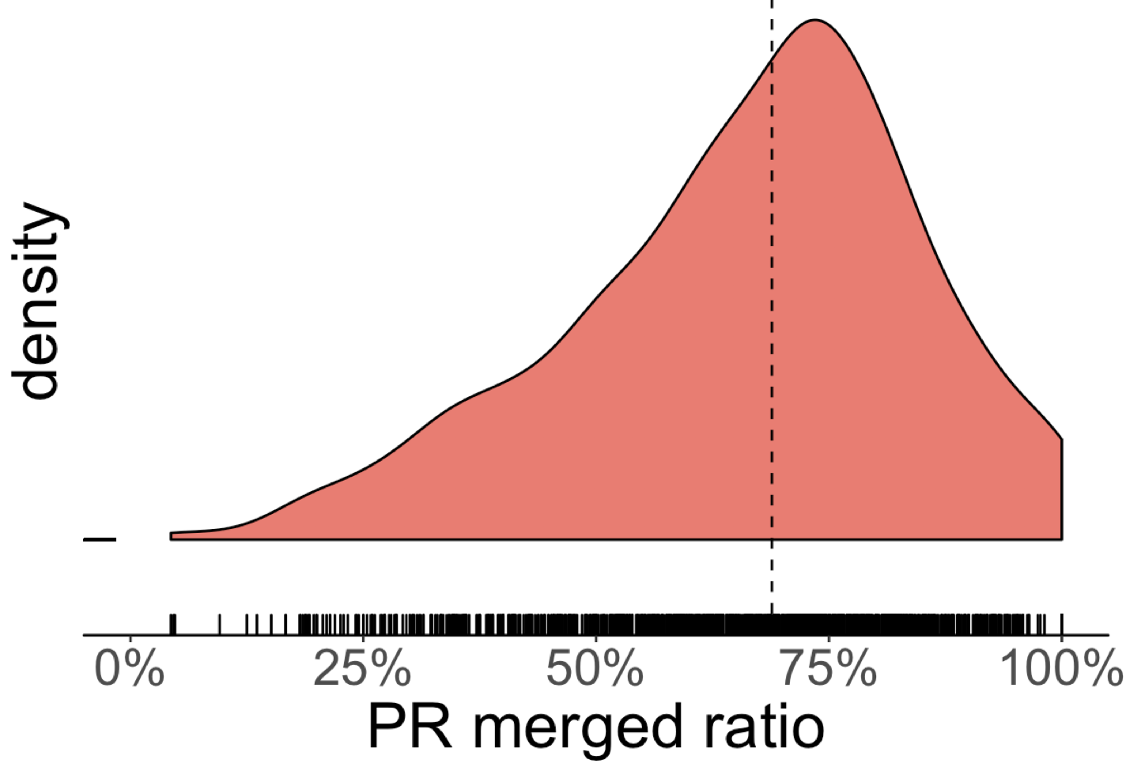
Rejected Pull Requests
- Demotivating
- Misalignment with maintainers’
vision of the project

Slide 14
Problems Inefficiency
Lost Contribution
Rejected PRs
Lack of an overview
Redundant Development
Fragmented Community
Notes:
3'

Slide 15
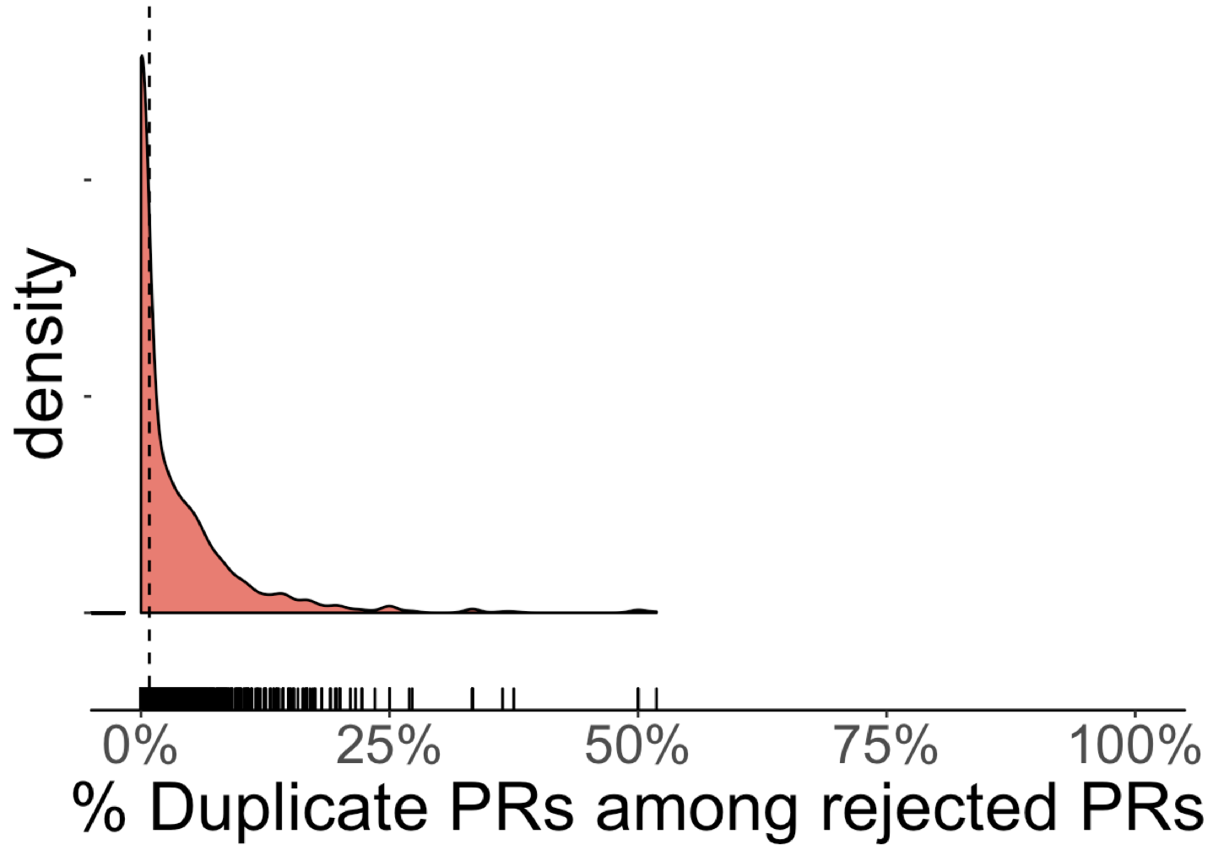
Redundant Development
23% un-merged PRs were rejected due to redundant dev. [Gousios et al. ICSE'14]
Cost of Reviewing [Li et al. MSR'18]
De-motivate developers [Steinmacher et al. ICSE'18]
Detecting duplicate dev. [Zhou et al. SANER'19]

Slide 16
Problems Inefficiency
Lost Contribution
Rejected PRs
Lack of an overview
Redundant Development
Fragmented Community
Notes:
3'

Slide 17


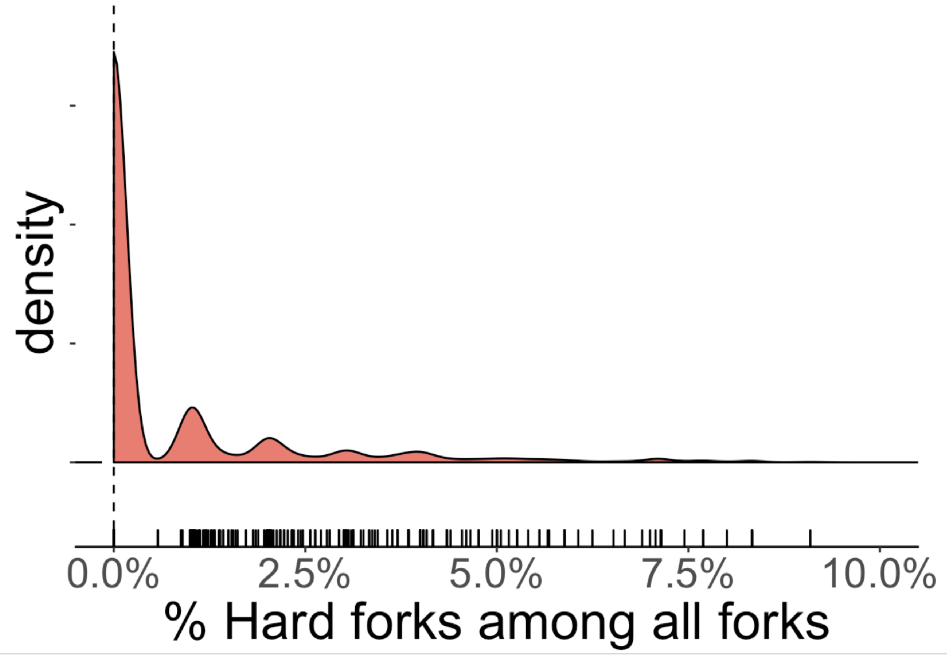

Communities Fragmentation (Hard Fork)

Slide 18
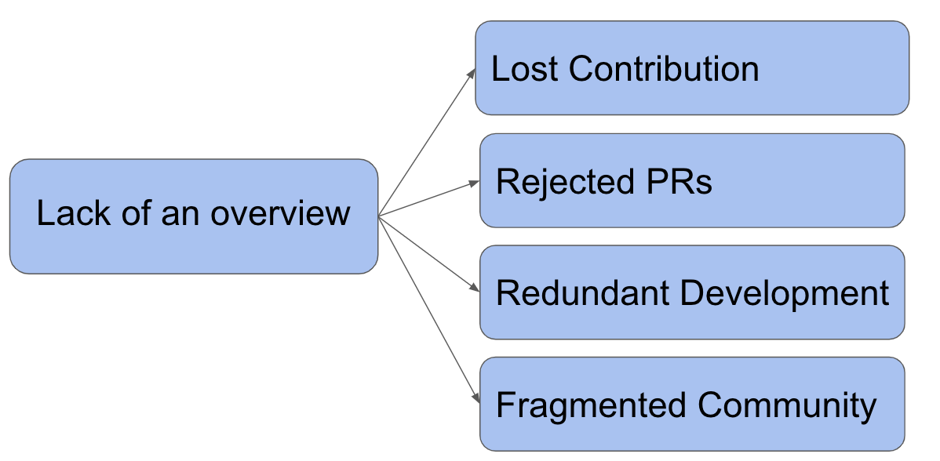
RQ: What characteristics and practices of a project associate with efficient forking practices?

Slide 19
Research Method
Interviewing Stakeholders
Deriving Hypotheses
Literature Search
Sampling
Quant.
Test Hypotheses
Inefficiencies
Practices
Context Factors
Modeling

Slide 20
Coordination Mechanism Affects Forking Practices
VS
- Project proposal
- Resolve issues on
the issue tracker
- Open for any contribution

Slide 21
Coordination Mechanism Affects Forking Practices
Centralization makes it easier to coordinate the divisions’ product types but more difficult to take advantage of the divisions’ private information. [Brandts et al. 2018]

Slide 22
Deriving Hypotheses
Centralized mgmt ➔ Larger portion of merged PRs
Centralized mgmt ➔ Larger portion of contributing forks
(6 more in the paper)

Slide 23
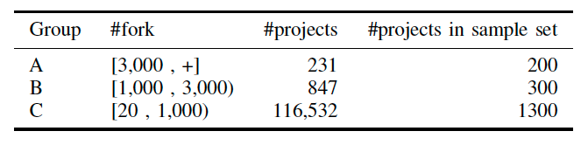
Test Hypotheses
Sampling
Quantifying
Inefficiencies
Practices
Context Factors
Modeling

Slide 24
Operationalization - Centralized Management
Number of PRs referring to an Existing Issue
Measure:
All the PRs
Notes:
+formula

Slide 25
Centralized Mgmt → More Merged PRs (R² = 27%)
Ratio Merged PRs
Plus controls for:
SubmitterPriorExpr
SubmitterSocialConn.
PR w/ test
+
+
Modularity
Centralized Mgmt
(6% of deviance explained)
(4% of deviance explained)
Notes:
+ design measure for detectinhg merge pr

Slide 26
Centralized Mgmt → More Contributing Forks (R² = 17%)
Ratio contributing forks
Plus controls for:
NumForks
Size
ProjectAge
+
+
Modularity
Centralized Mgmt
(1% of deviance explained)
(18% of deviance explained)

Slide 27
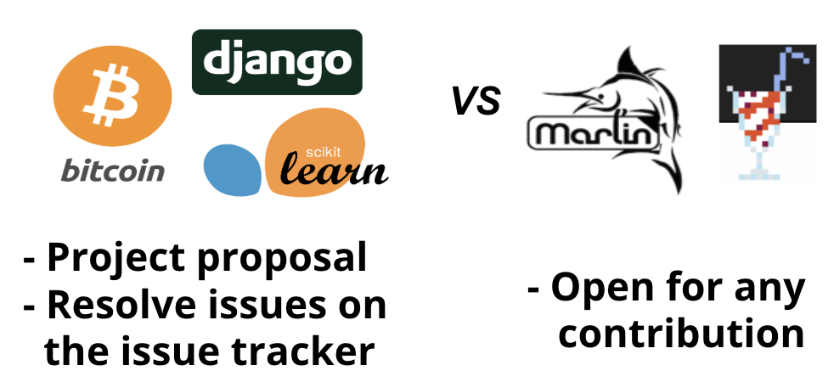
Evidence-based Intervention
For practitioners:
Coordinating planned changes through an issue tracker
Trade-offs?

Slide 28
Trade-off: Centralized Mgmt
Community Fragmentation
-
+
Plus controls for:
NumFork
Size
Centralized Mgmt
(12% of variance explained)
PR Merge Ratio
(35% of variance explained)

Slide 29
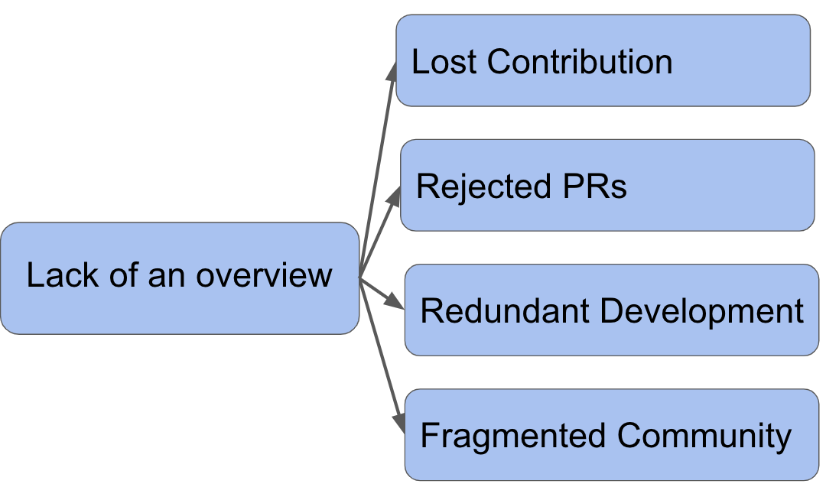
RQ: What characteristics and practices of a project associate with efficient forking practices?
- Coordination
- Modularity
Notes:
in the paper, there is also a discussion about modularity

Slide 30
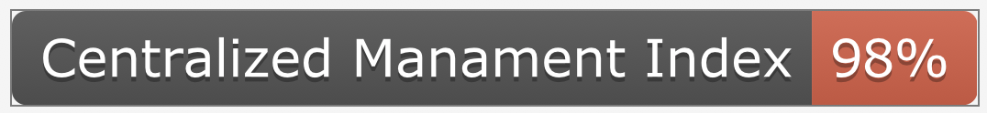

Opportunities to Design Further Interventions
Tooling to navigate and understand changes in forks
Making practices transparent
Cost of community fragmentation
Notes:
+ badge shields.io

Slide 31

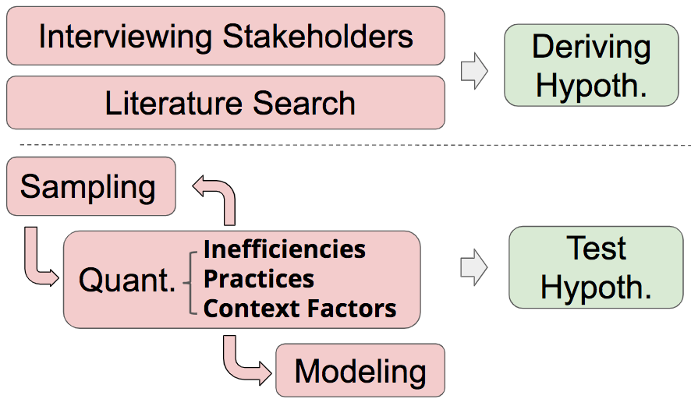

A Study of Inefficient and Efficient
Forking Practices in Social Coding
Lost Contribution
Rejected PRs
Lack of an overview
Redundant Development
Fragmented Community
- Evidence-based Suggestions
- Further research/tooling directions

