Slide 1
Identifying Features
in Forks
Shurui Zhou, Ştefan Stănciulescu, Olaf Leßenich
Yingfei Xiong, Andrzej Wąsowski, Christian Kästner

Slide 2
Fork-based Development
#Forks | #Github Projects
>50 | 61704
>500 | 4787
>1,000 | 2236
>5,000 | 198
>10,000 | 72
>100,000 | 2
Notes:
Table ++

Slide 3
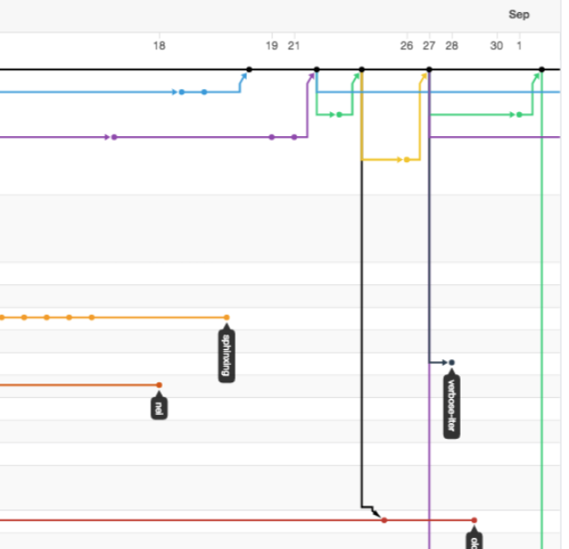
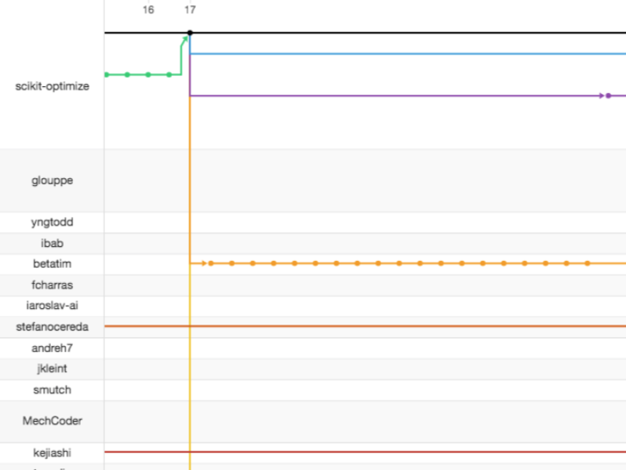
Network View of Forks
Pull Request
Upstream
Un-merged commits
Forks
Notes:
There are so many, you cannot find it..

Slide 4
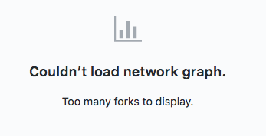
Problem: lack of an overview
Notes:
Ajust the length
https://github.com/isaacs/github/issues/702
https://github.com/isaacs/github/issues/562
https://github.com/isaacs/github/issues/24

Slide 5
Problem: Redundant Development
27 % of unmerged pull requests were rejected due to duplicate development. [Gousios et al. 2014]
Notes:
Consistent size

Slide 6
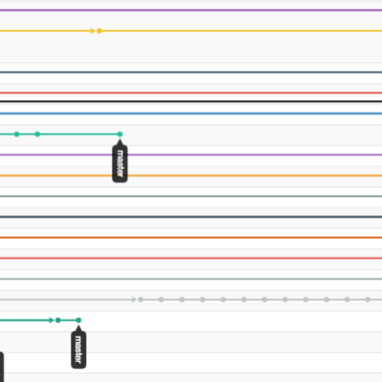
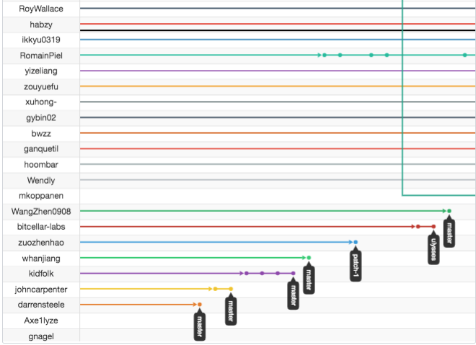
Problem: Lost Contribution
Only 14% of all forks of nine popular JavaScript projects on GitHub contained changes that were integrated back [Fung et al. 2012]

Slide 7
Problem: Suboptimal forking point
Requirement
Existing forks
?
?
Notes:
Different from redundant dev

Slide 8
Goal: a Better Overview of forks
Which are the active forks?
What kind of code changes have been made in forks?
What features were implemented in forks?
commits?
Notes:
Recap the problem
Unawarenesss of,,
showcase...

Slide 9
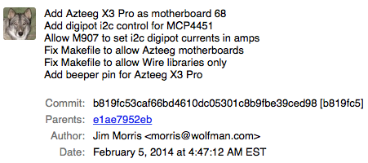
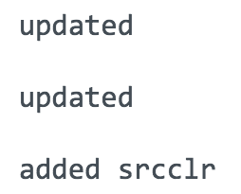
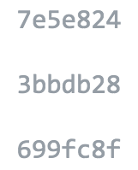
Challenges
Commit message is not reliable
Tangled and scattered code changes

Slide 10
Goal: a Better Overview of forks
Summarizing each fork that has un-merged code changes
Identifying cohesive code clusters (features) in forks
Notes:
Define a feature...

Slide 11
INFOX (IdeNtifying Features in fOrKS)
Summary Table for each fork
Mapping between feature to code changes
Feature List | LOC
Feature 1 | 23
Feature 2 | 100
Feature 3 | 66
Notes:
Here is what we’ve done : screenshot

Slide 12
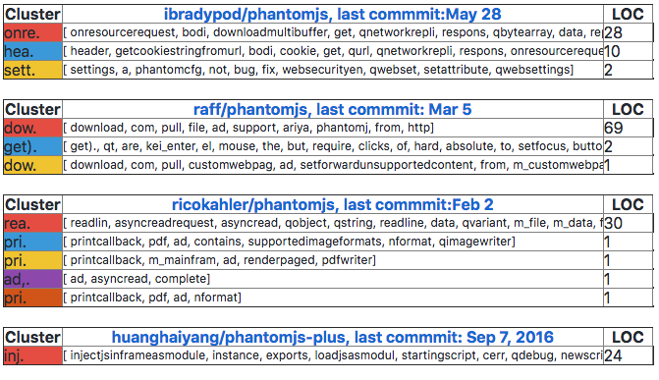
INFOX (IdeNtifying Features in fOrKS)
Notes:
Too many words, highlight some of
Explain columns, how to read…
keywods

Slide 13
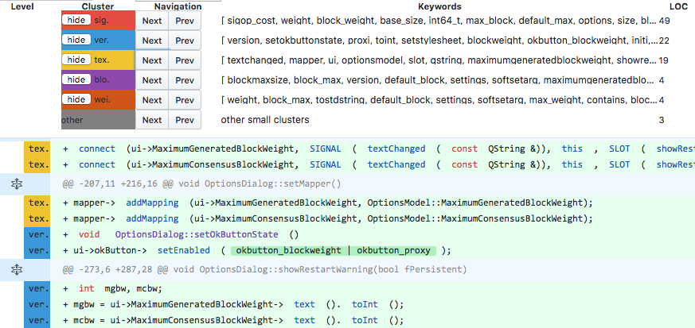
INFOX (IdeNtifying Features in fOrKS)
Notes:
+quotes

Slide 14
INFOX (IdeNtifying Features in fOrKS)
Dependency graph for code changes
(static analysis)
Clustering features
(community detection)
Labeling features
(NLP)

Slide 15
INFOX (IdeNtifying Features in fOrKS)
Dependency graph for Code changes
(Static analysis)
Clustering features
(Community detection)
Labeling features
(NLP)

Slide 16
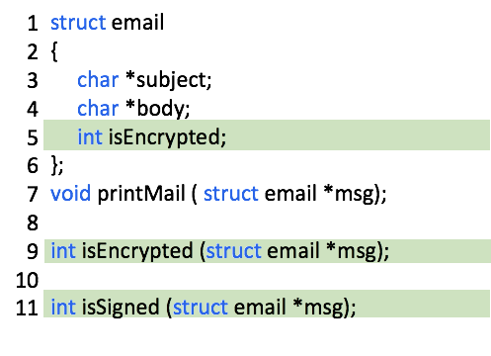
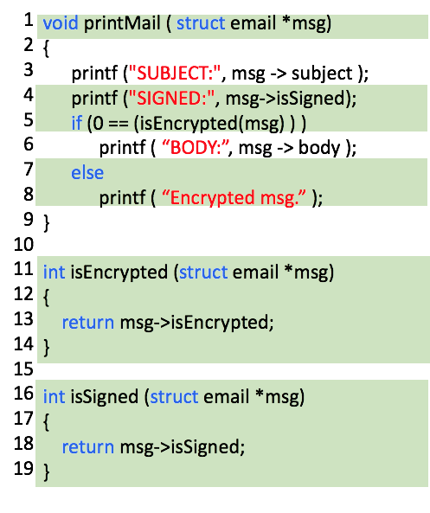
Dependency graph
Email System
Encryption
Signature
Nodes: Lines of code
Edges: Dependency relation

Slide 17
Dependency graph
3 Dependencies

Slide 18
Dependency graph
3 Dependencies

Slide 19
Dependency graph
3 Dependencies

Slide 20
Dependency graph
3 Dependencies

Slide 21
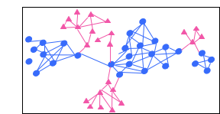
upstream
Dependency
graph
fork
diff
Clustering
features
Labeling
Features

Slide 22
Dependency
graph
2 features
Encryption
Signature
Clustering
features
Labeling
Features

Slide 23
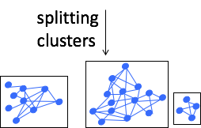
Dependency
graph
Splitting
Clustering
features
Joining
Labeling
Features

Slide 24
Dependency
graph
commit message
code
comment
Clustering
features
TF-IDF, N-Gram
Labeling
Features
Cluster 1 | isSigned, Signature
Cluster 2 | Encryption, Decryption

Slide 25
Output of INFOX

Slide 26
Evaluation
Effectiveness: (Quantitative Study)
To what extent do identified clusters
correspond to features?
Ground truth?

Slide 27
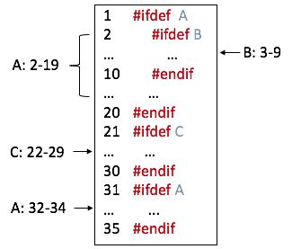
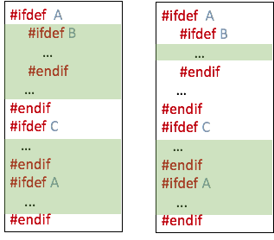
Effectiveness
Using ifdef as Ground Truth
Test cases
Ground truth
A: 2-19, 32-34
B: 3-9
C: 22-29
A and C
A and B
Notes:
Ifdef --- real examples

Slide 28
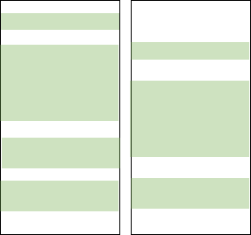
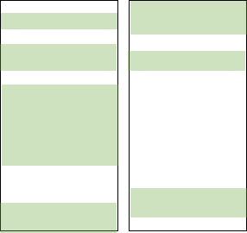
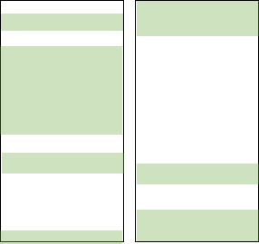
Effectiveness
Using ifdef as Ground Truth
Test cases
Ground truth
A: 2-19, 32-34
B: 3-9
C: 22-29
INFOX assigned features with 90% accuracy.

Slide 29
Effectiveness
Interview developers
Participants generally agreed that INFOX could identify correct clusters at certain splitting or joining steps

Slide 30
Evaluation
Usefulness: (Human-subject study)
Can INFOX help developers to gain a better
overview of repository forks?

Slide 31
Usefulness: (Human-subject study)
Sent out an 81 email to candidate developers
Interviewed 11 developers from 7 different projects

Slide 32
Interesting and Reusable Contribution
P5: “If it is only exists in this fork, then I want to somehow get this fork into my fork.”

Slide 33
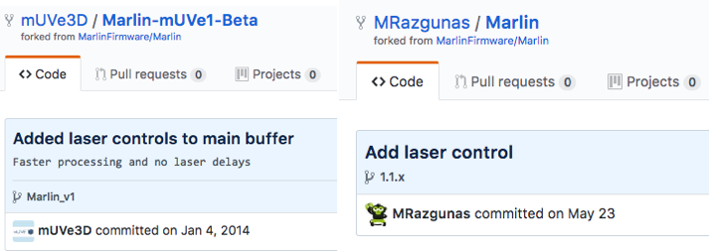
Redundant Development
P3: “It does look like somebody did a very simple one-function [...] system. I think they should use our code, there is great reason to use it.”
P3

Slide 34
Better Overview
“It is going to make it a lot easier to find the things you are looking for as a programmer.”
“I see all the differences for all the forks. Basically it is the same thing I am doing through GitHub, (but) only it is summarized in the same place, I don’t have to jump and open 50 tabs to do it.”

Slide 35
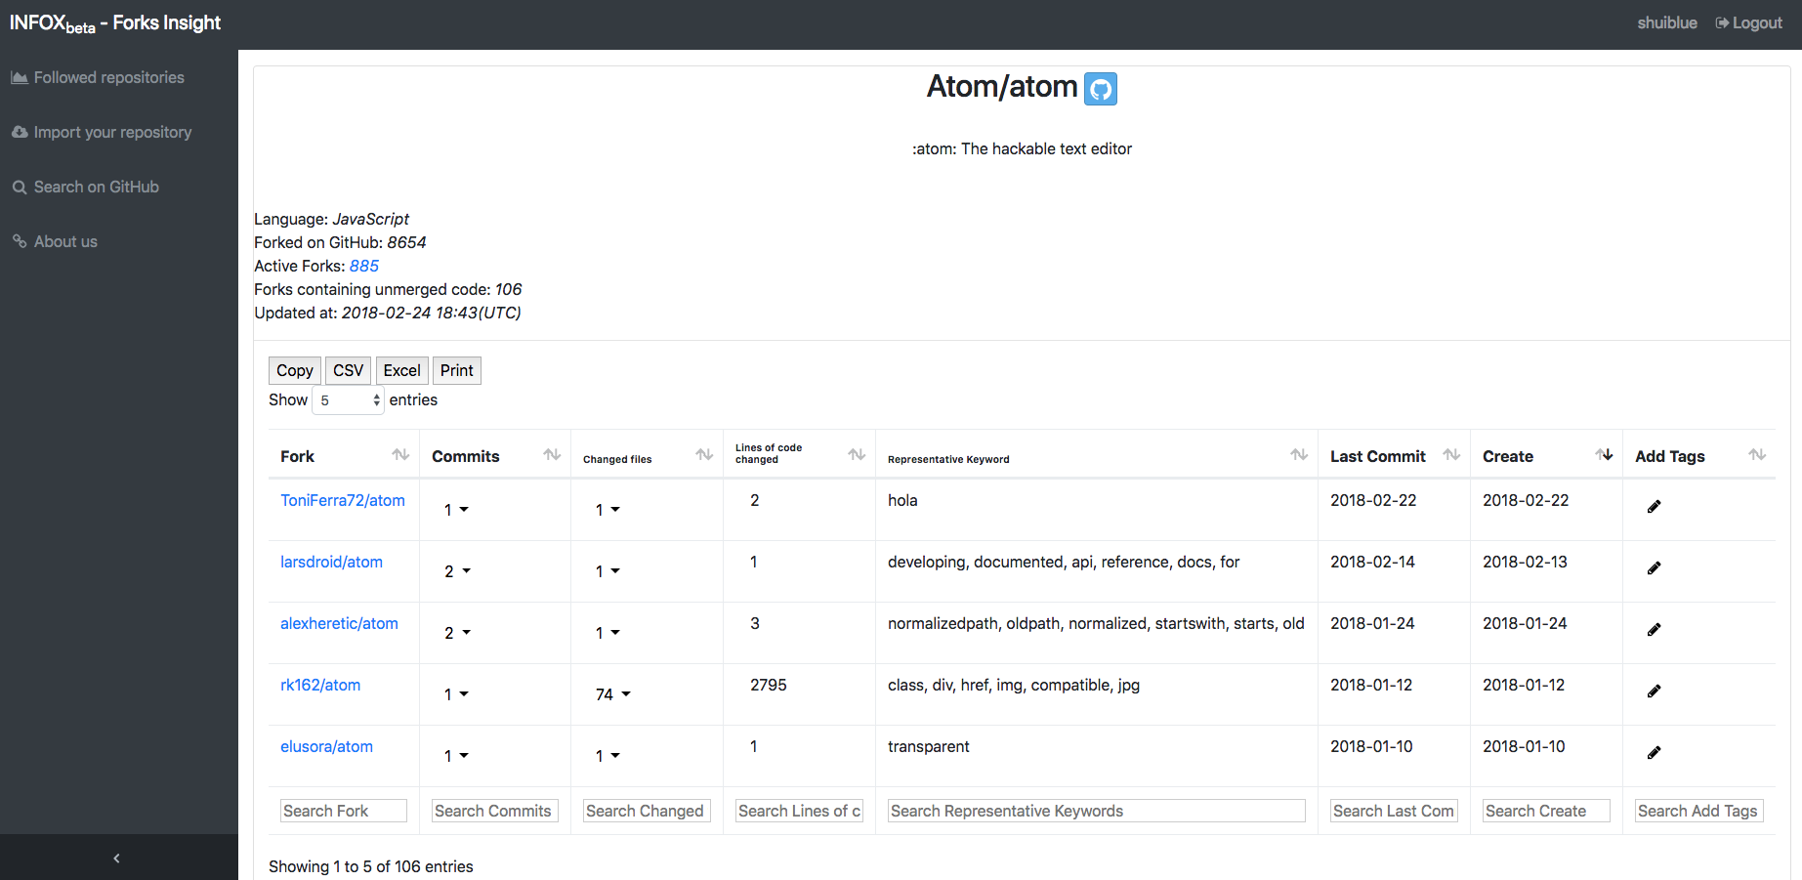
http://forks-insight.com/

Slide 36
@shuishuiblue
INFOX
forks-insight.com
Dependency
graph
Improving Transparency
Solving Problems
Redundant development
Lost contribution
Suboptimal starting point
Clustering
features
Labeling
Features
Notes:
Previous of solution earlier

