Slide 1


Identifying Redundancies in Fork-Based Development
Luyao Ren, Shurui Zhou, Christian Kästner, Andrzej Wąsowski

Slide 2
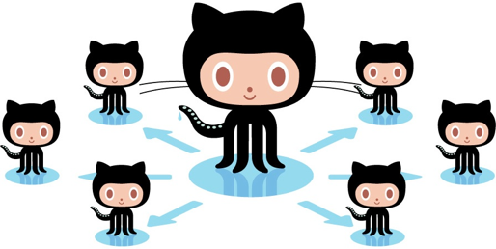
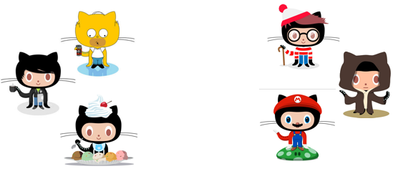
Fork-Based Development
#Forks | #Github Projects
>50 | 61704
>500 | 4787
>1,000 | 2236
>5,000 | 198
>10,000 | 72
>100,000 | 2
[GHTorrent 2018-03]

Slide 3
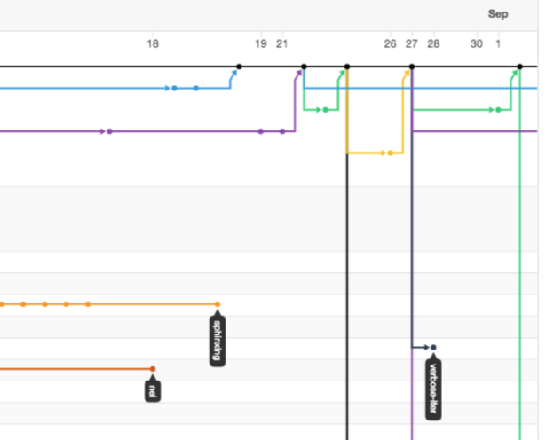
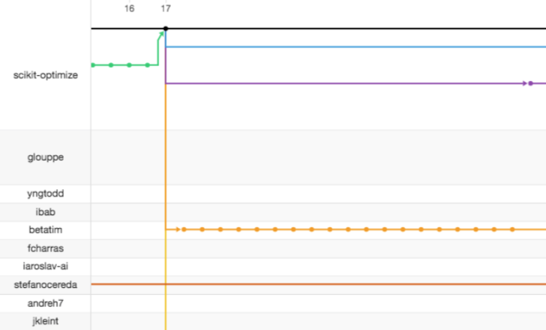
Fork-based Development
Pull request
Un-merged commits

Slide 4
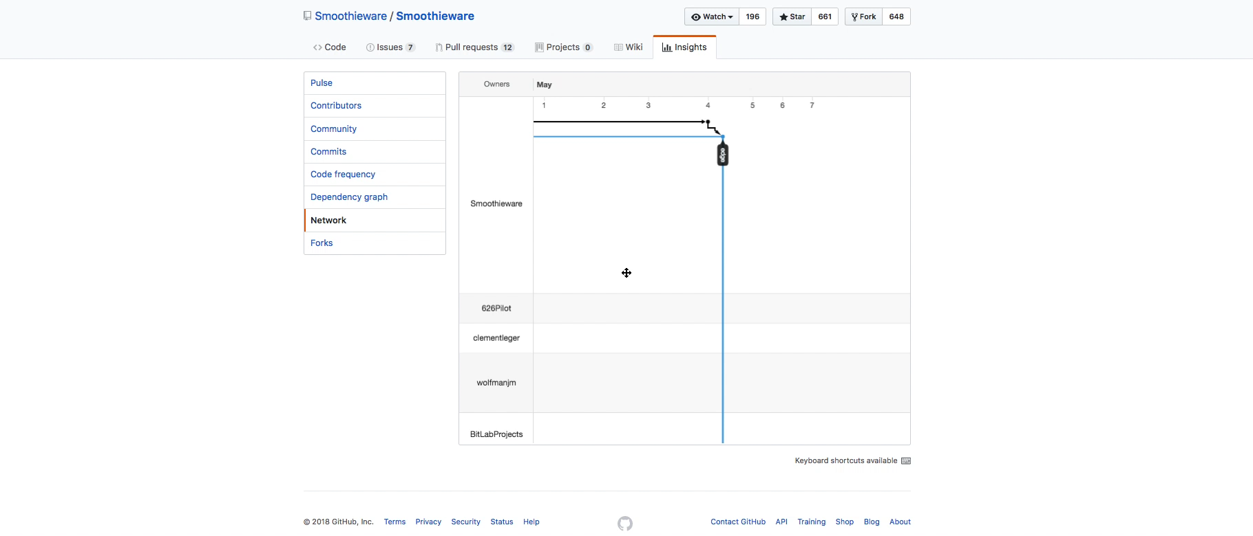

Slide 5

Lack of Overview

Slide 6
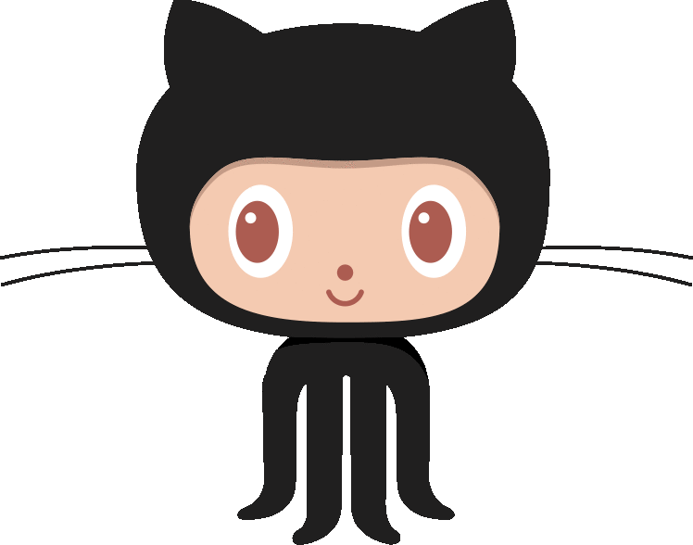






Redundant Development

Slide 7
Redundant Development - Industry
“ ...before we noticed that the same functionality was implemented twice within the same project, basically they haven’t realized that. They implemented the same features. Because it was not visible” [Berger et al. 2014]

Slide 8

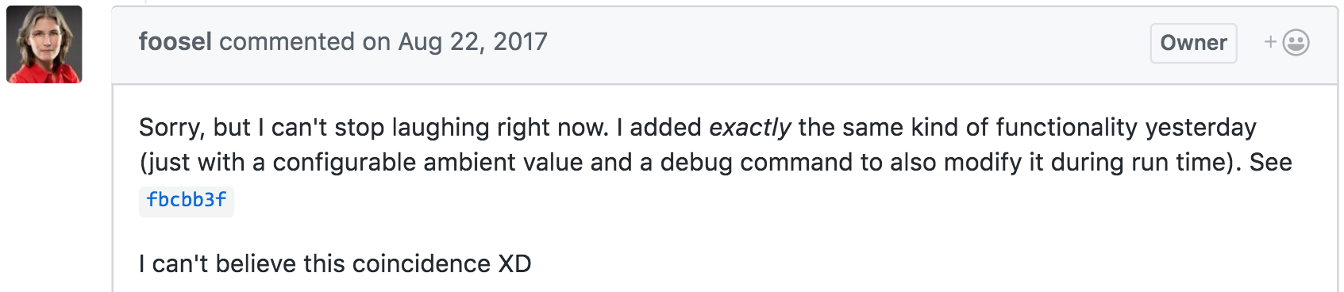
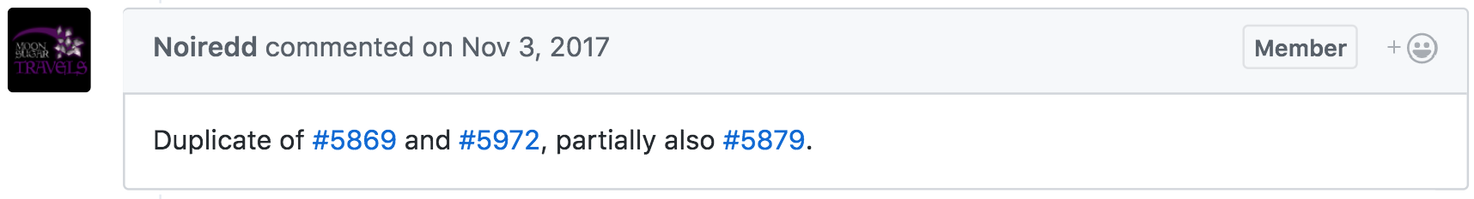
Duplicate Pull Requests

Slide 9
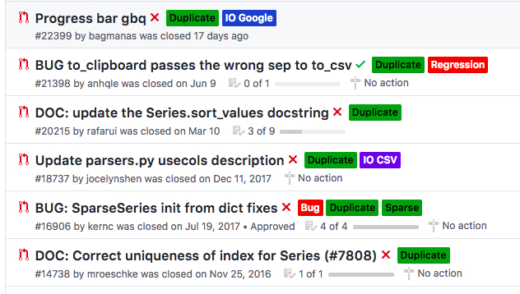
Duplicate Pull Requests
23% of un-merged pull requests were rejected due to redundant development. [Gousios et al. 2014]

Slide 10

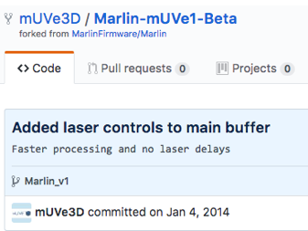
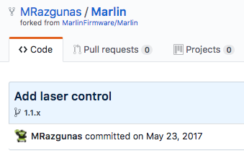

Redundant Feature Implementation
P3: “It does look like somebody did a very simple one-function. I think they should use our code, there is great reason to use it.” [Zhou et al. 2018]
P3

Slide 11
Cost / Waste
For maintainer:
- Maintenance effort
Before a duplicate PR is identified:
2.6 reviewers
5.2 review comments [Li et al. 2018]
For developers:
- De-motivate developers [Steinmacher et al. 2018]
11
Notes:
+collaboration, dup PR has values, rather than demotive, notice early, getting feedback from machine less embarrassing.

Slide 12

Goal -- Help Maintainers Detect Duplicate PRs
For new PR, immediately check existing potentially redundant PRs
Decrease workload
Notify maintainers and PR submitter
Hi, we have found there is a pull request: #14578 which might be duplicate to this one.
DupChanges-bot

Slide 13
Goal -- Help Developers detect Duplicate Changes Early
Monitoring each fork
Detecting redundancy as early as possible
Comparing commits with other forks/PRs
Encouraging collaboration
Hi, we have found fork: shuiblue/3D-printer has implemented the similar functionality as you did in branch dev, commit 52sdfsdf. We hope you could double check and avoid redundant development. :D
DupChanges-bot

Slide 14
Method
Manually analyze duplicate PRs
Developing clues as indicators
Operationalization
ML predicting redundancies
Notes:
3rd --> operationalization

Slide 15
Method
Manually analyze duplicate PRs
Developing clues as indicators
Operationalization
ML predicting redundancies
Notes:
3rd --> operationalization

Slide 16
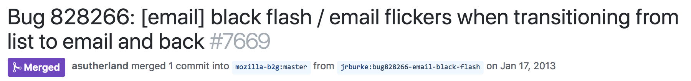
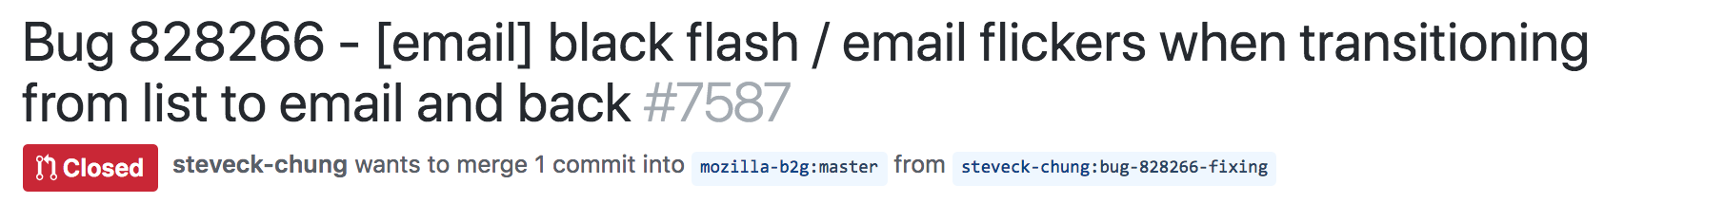
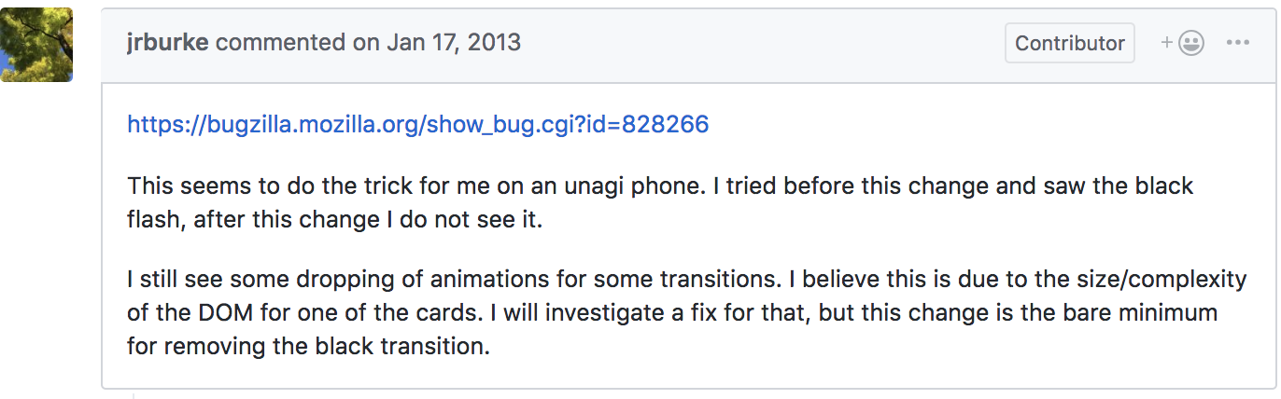
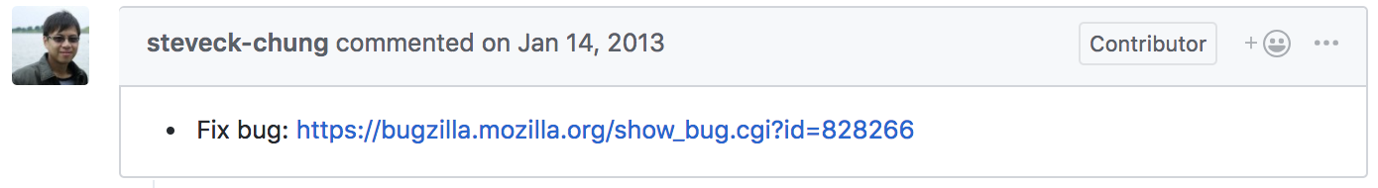
Developing Clues - Case 1
Similar title, different code (mozilla-b2g/gaia)

Slide 17
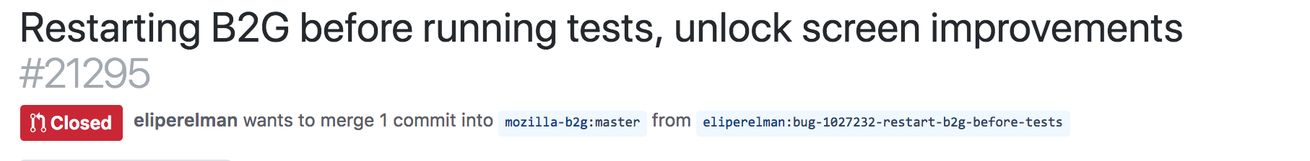
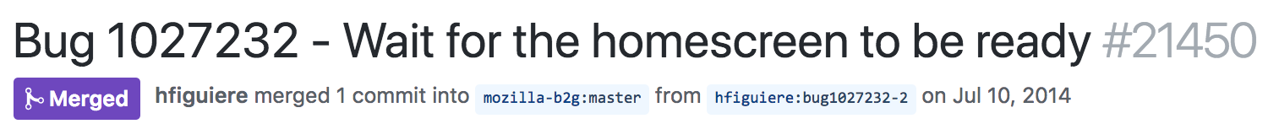
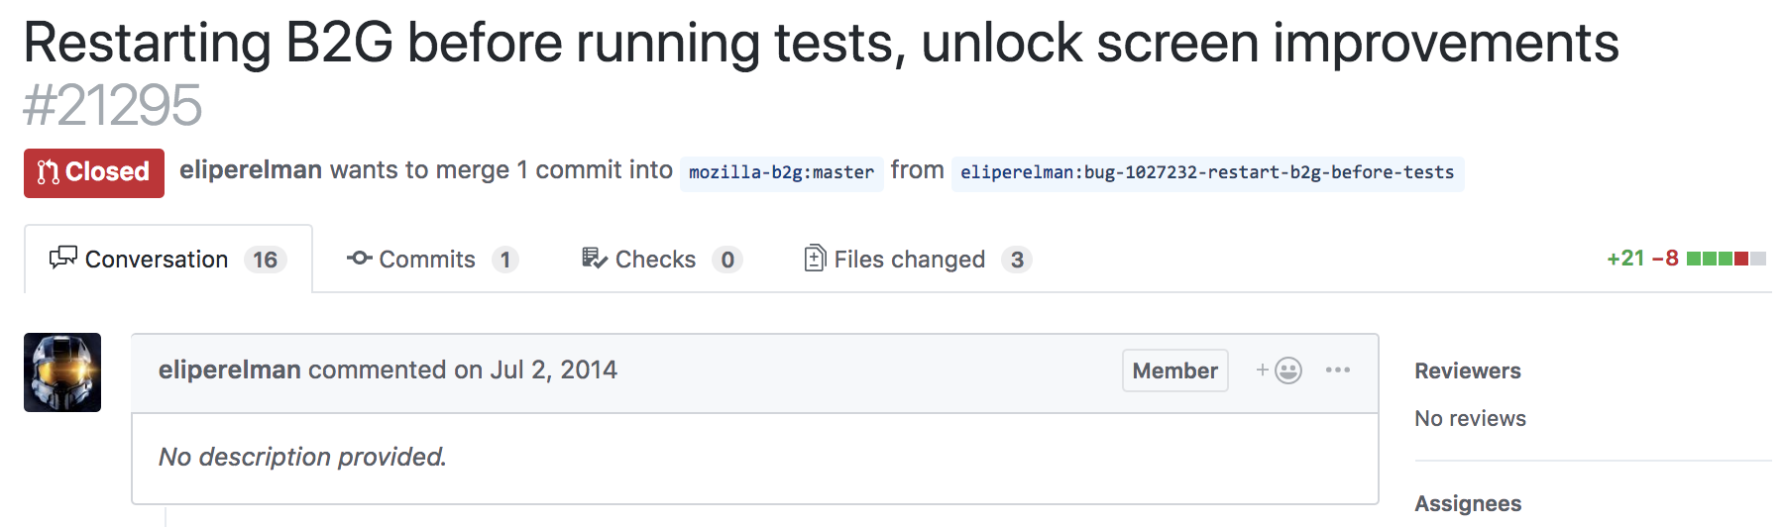
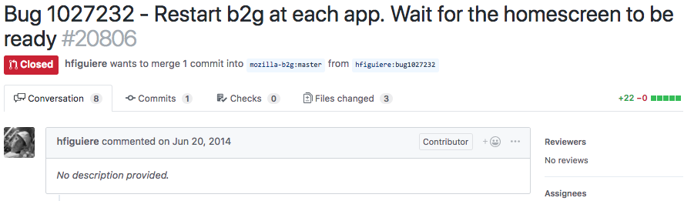
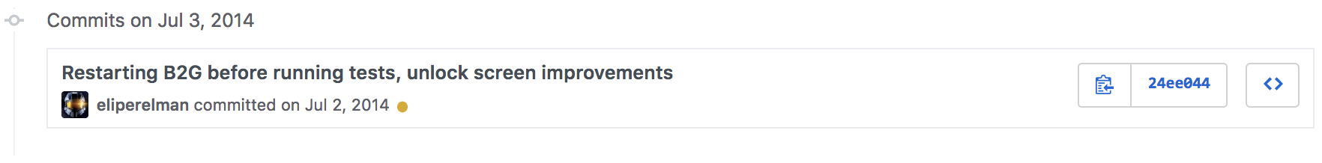
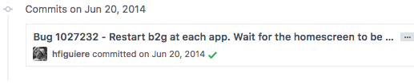
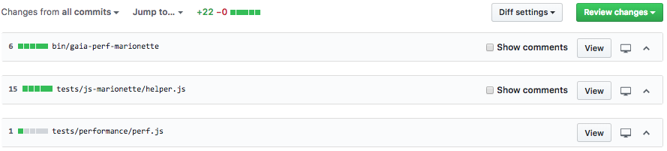
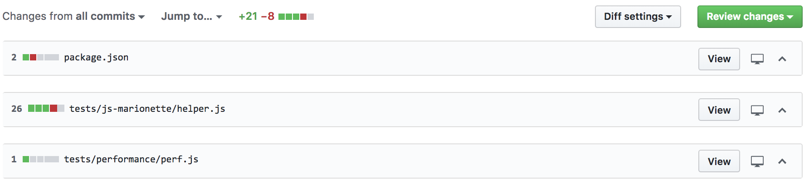
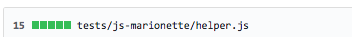
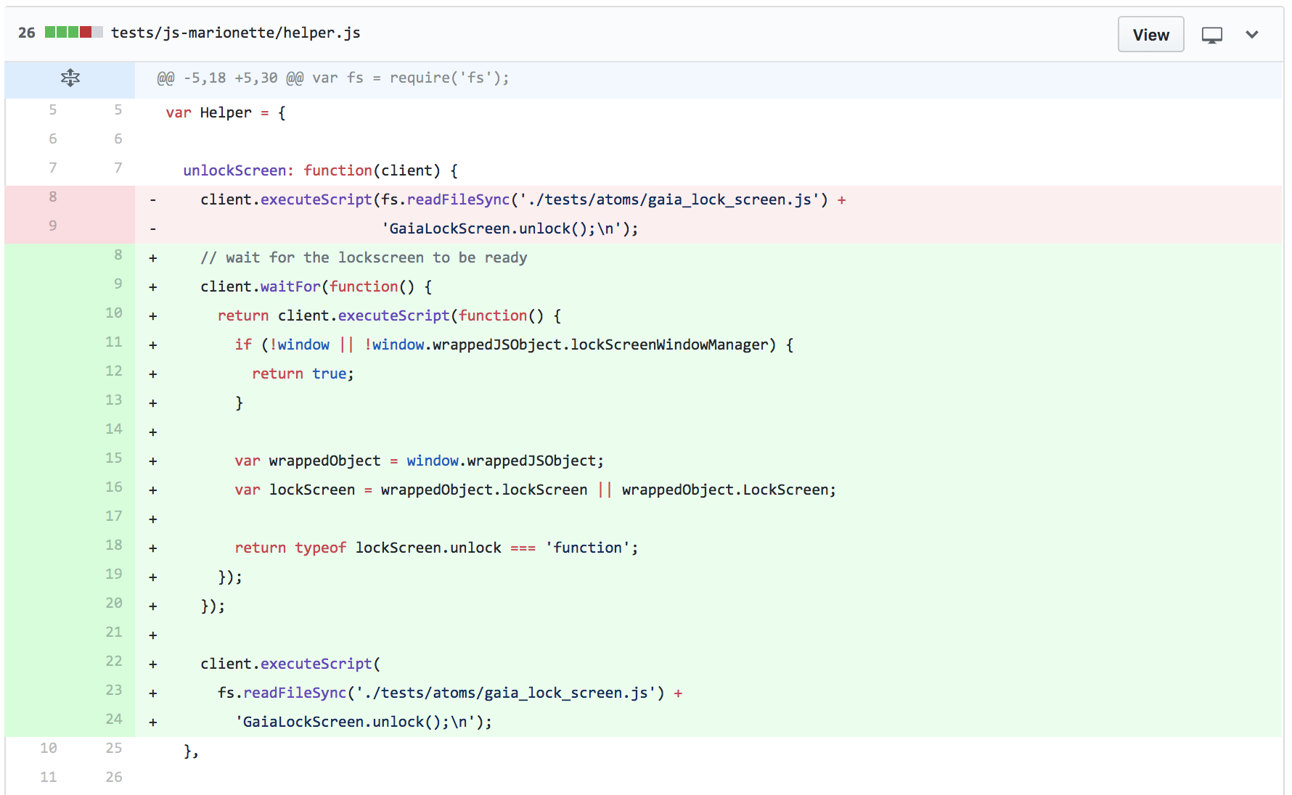
Developing Clues - Case 2
Different title, similar code (mozilla-b2g/gaia)

Slide 18
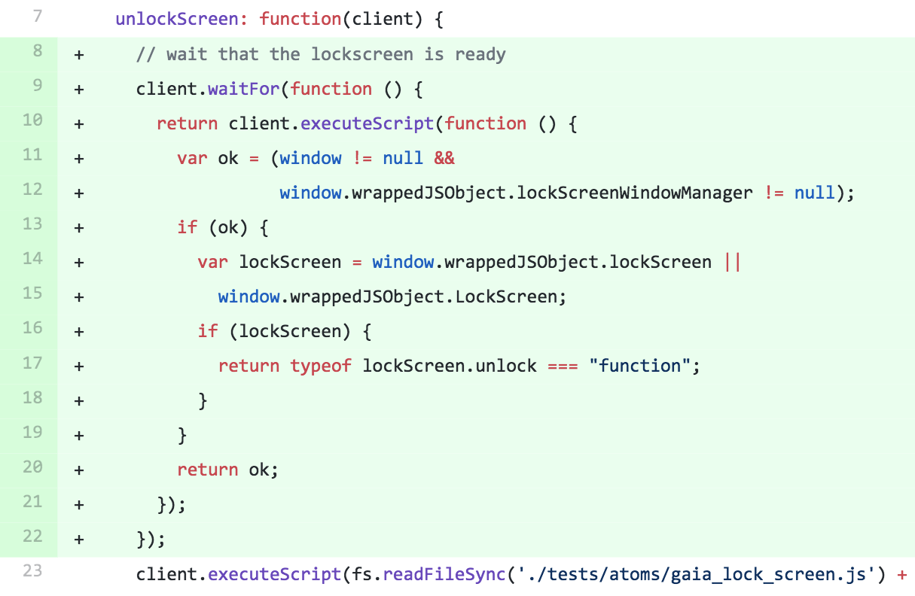
Developing Clues - Case 2
Different title, similar code (mozilla-b2g/gaia)

Slide 19
Developing Clues - Case 2
Different title, similar code (mozilla-b2g/gaia)

Slide 20
Developing Clues
Code change description
Patch content
A list of changed files
Code change location
Reference to issue tracker

Slide 21
Method
Manually analyze duplicate PRs
Developing clues as indicators
Operationalization
ML predicting redundancies
Notes:
3rd --> operationalization

Slide 22
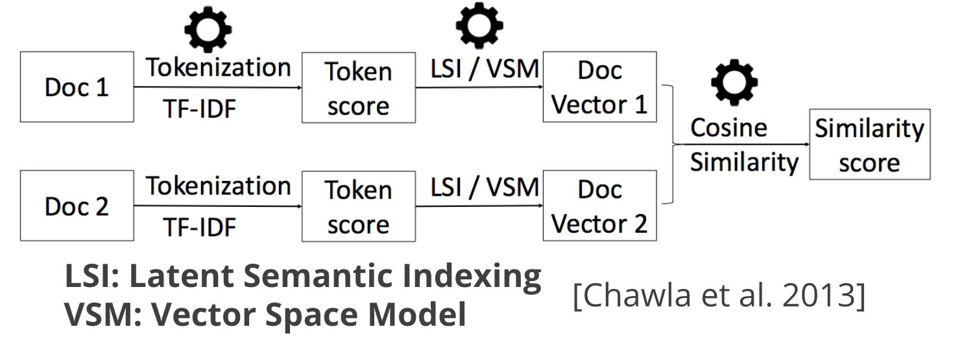
Calculating Similarity for Clues
Code change description
Patch content
A list of changed files
Code change location
Reference to issue tracker

Slide 23
Calculating Similarity for Clues
Code change description
Patch content
A list of changed files
Code change location
Reference to issue tracker
Similarity of two sets:
Jaccard Similarity Coefficient

Slide 24
Features for Training the Classifier
Clue | Feature for Classifier | Value
Change description | Title similarity | [0,1]
 | Description similarity | [0,1]
Patch content | Patch content similarity | [0,1]
 | Patch content similarity on overlapping changed files | [0,1]
Changed files list | Changed files similarity | [0,1]
 | #Overlapping changed files | N
Location of code changes | Location similarity | [0,1]
 | Location similarity on overlapping changed files | [0,1]
Reference to issue tracker | Reference to issue tracker | {-1, 0, 1}

Slide 25
Method
Manually analyze duplicate PRs
Developing clues as indicators
Operationalization
ML predicting redundancies
Notes:
3rd --> operationalization

Slide 26
Method
Manually analyze duplicate PRs
Developing clues as indicators
Operationalization
ML predicting redundancies
Notes:
3rd --> operationalization

Slide 27
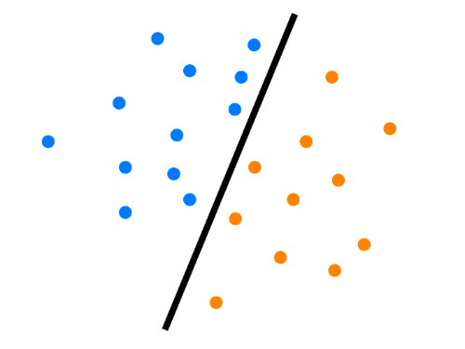





Predicting duplicate code changes using ML
List of Features
Positive
Model (AdaBoost)
Negative
Threshold
Similarity Score
Live data

Slide 28
Experiment Setup
Experiment Setup
DupPR dataset [Li et al. 2018]:
2323 pairs of duplicate PRs from 26 repos
Positive
Sample
 | #Repos | #Pairs of duplicate PRs
Training | 12 | 1174
Testing | 14 | 1149

Slide 29
Experiment Setup
Randomly sampled merged PRs from corresponding repos
Positive: Negative = 1:40
Negative
Sample

Slide 30
Evaluation
RQ1: How accurate is our approach to help maintainers identify redundant contributions?
RQ2: How much effort could our approach save for developers in terms of commits?

Slide 31
RQ1: Helping Maintainers to Find Duplicate PRs
PR History | Our result | Ground Truth | Dup PR Found | Warning Correctness
... | ... | ...
Timeline
Notes:
We simulate the PR history…

Slide 32


RQ1: Helping Maintainers to Find Duplicate PRs
PR History | Our result | Ground Truth | Dup PR Found | Warning Correctness
... | ... | ...
10 | 9 | 9
PR History | Our result | Ground Truth | Dup PR Found | Warning Correctness
... | ... | ...
10 | 9 | 9
11 | - | -
PR History | Our result | Ground Truth | Dup PR Found | Warning Correctness
... | ... | ...
10 | 9 | 9
11 | -
12 | - | 8
13 | 12
PR History | Our result | Ground Truth | Dup PR Found | Warning Correctness
... | ... | ...
10 | 9 | 9
11 | - | -
12 | - | 8

Slide 33
RQ1: Helping Maintainers to Find Duplicate PRs
PR History | Our result | Ground Truth | Dup PR Found | Warning Correctness
... | ... | ...
10 | 9 | 9
11 | -
12 | - | 8
13 | 12

Slide 34
RQ1: Helping Maintainers to Find Duplicate PRs
PR History | Our result | Ground Truth | Dup PR Found | Warning Correctness
... | ... | ...
10 | 9 | 9
11 | -
12 | - | 8
13 | 12
Notes:
For example, for PR 10, we found it is duplicate with PR 9, and in the ground truth data set, our result is correct. So, we found the Duplicate PR and the warning we sent out is correct.

Slide 35
RQ1: Helping Maintainers to Find Duplicate PRs
PR History | Our result | Ground Truth | Dup PR Found | Warning Correctness
... | ... | ...
10 | 9 | 9
11 | -
12 | - | 8
13 | 12

Slide 36
RQ1: Helping Maintainers to Find Duplicate PRs
PR History | Our result | Ground Truth | Dup PR Found | Warning Correctness
... | ... | ...
10 | 9 | 9
11 | -
12 | - | 8
13 | 12

Slide 37
RQ1: Helping Maintainers to Find Duplicate PRs
PR History | Our result | Ground Truth | Dup PR Found | Warning Correctness
... | ... | ...
10 | 9 | 9
11 | -
12 | - | 8
13 | 12
Recall: 50%
Notes:
With this running example. We get the recall fifty percent,

Slide 38
RQ1: Helping Maintainers to Find Duplicate PRs
PR History | Our result | Ground Truth | Dup PR Found | Warning Correctness
... | ... | ...
10 | 9 | 9
11 | -
12 | - | 8
13 | 12
Precision: 50%

Slide 39
RQ1: Helping Maintainers to Find Duplicate PRs
PR History | Our result | Ground Truth | Dup PR Found | Warning Correctness
... | ... | ...
10 | 9 | 9
11 | -
12 | - | 8
13 | 12
?
?
Problem: the ground truth data is incomplete
Notes:
But here is a problem.

Slide 40
RQ1: Helping Maintainers to Find Duplicate PRs
PR History | Our result | DupPR | Manual checking | Dup PR Found | Warning Correctness
... | ... | ...
10 | 9 | 9
11 | -
12 | - | 7
13 | 6
14 | 2

Slide 41
RQ1: Helping Maintainers to Find Duplicate PRs
PR History | Our result | DupPR | Manual checking | Dup PR Found | Warning Correctness
... | ... | ...
10 | 9 | 9
11 | -
12 | - | 7
13 | 6 |  | 6
14 | 2
?
?
Notes:
For example , if we detect PR 6 is duplicate with PR13, but GROUND truth data doesn’t have this duplicate PR pair. Then we need to manually check the correctness.

Slide 42
RQ1: Helping Maintainers to Find Duplicate PRs
PR History | Our result | DupPR | Manual checking | Dup PR Found | Warning Correctness
... | ... | ...
10 | 9 | 9
11 | - |  | -
12 | - | 7
13 | 6
14 | 2
?
Notes:
However, for this case, if we didn’t find the duplication, and the ground truth does not have the record either, this is unrealistic for us to manually compare this PR with all the existing PRs to check the duplication. So we trust the ground truth as this case. And we noticed that this will affect our precision.

Slide 43
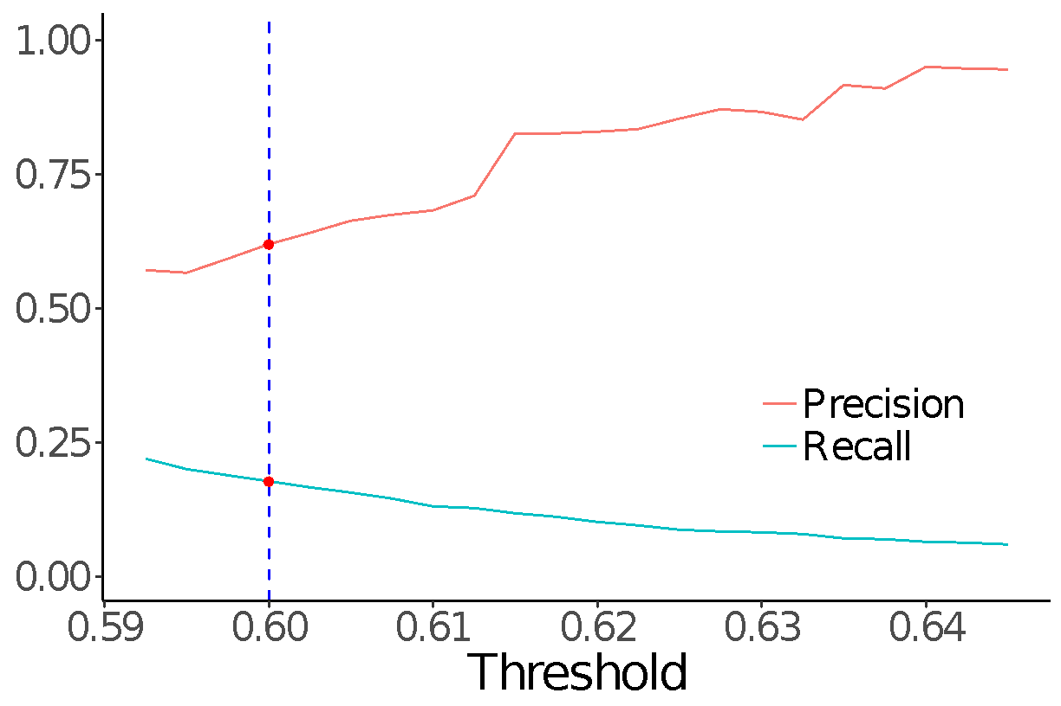
RQ1: Helping Maintainers to Find Duplicate PRs
Randomly sample 400
PRs from each project
Precision 55-82%
Recall 10-25%
Notes:
explain we want a high recall
there is a room for improvement, but fairly decent result\
We argue that within a reasonable
threshold range of 0.5925–0.62, our approach achieved 57-
83% precision and 10-22% recall. After some experiments,
we pick a reasonable default threshold of 0.6175, where our
approach achieves 83% precision and 11% recall

Slide 44
RQ2: Helping Developers to Find Duplicate Code
Changes Early
Filter out PR has only 1 commit
Simulate commit history of PRs
PR1
PR2

Slide 45
RQ2: Helping Developers to Find Duplicate Code
Changes Early
Filter out PR has only 1 commit
Simulate commit history of PRs
PR1
PR2
Timestamp

Slide 46
RQ2: Helping Developers to Find Duplicate Code
Changes Early
Filter out PR has only 1 commit
Simulate commit history of PRs
PR1
PR2
Timestamp

Slide 47
RQ2: Helping Developers to Find Duplicate Code
Changes Early
Filter out PR has only 1 commit
Simulate commit history of PRs
PR1
PR2
Timestamp

Slide 48
RQ2: Helping Developers to Find Duplicate Code
Changes Early
Filter out PR has only 1 commit
Simulate commit history of PRs
PR1
PR2
Timestamp

Slide 49
RQ2: Helping Developers to Find Duplicate Code
Changes Early
Filter out PR has only 1 commit
Simulate commit history of PRs
PR1
PR2
Timestamp
Notes:
We can save for PR1 2 commits. OR save 3 commits for PR2.

Slide 50
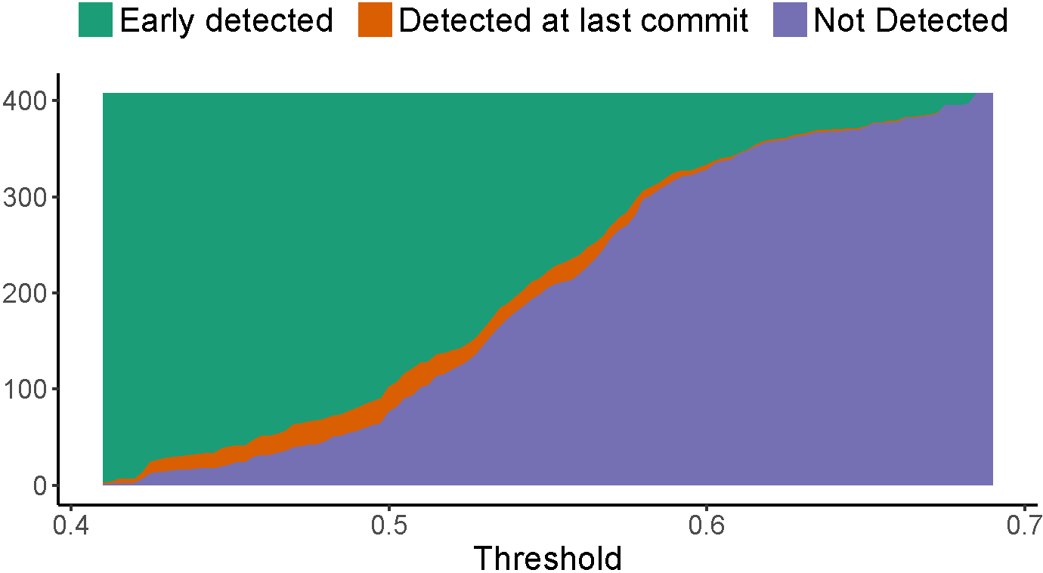
RQ2: Helping Developers to Find Duplicate Code
Changes Early
RQ2: helping developers to find duplicate code changes early
Recall 46 - 71%
0.07–0.5% false positive rate
Save 1.9 - 3.0 commits per PR
Notes:
Here I am showing you one of the results, within the same threshold range, we could save 1.9-3 commits per PR/
The takeaway message is our result could detect the duplication early.
I am not going to explain the detail, if you are interested please read the paper or I am happy to talk offline.

Slide 51
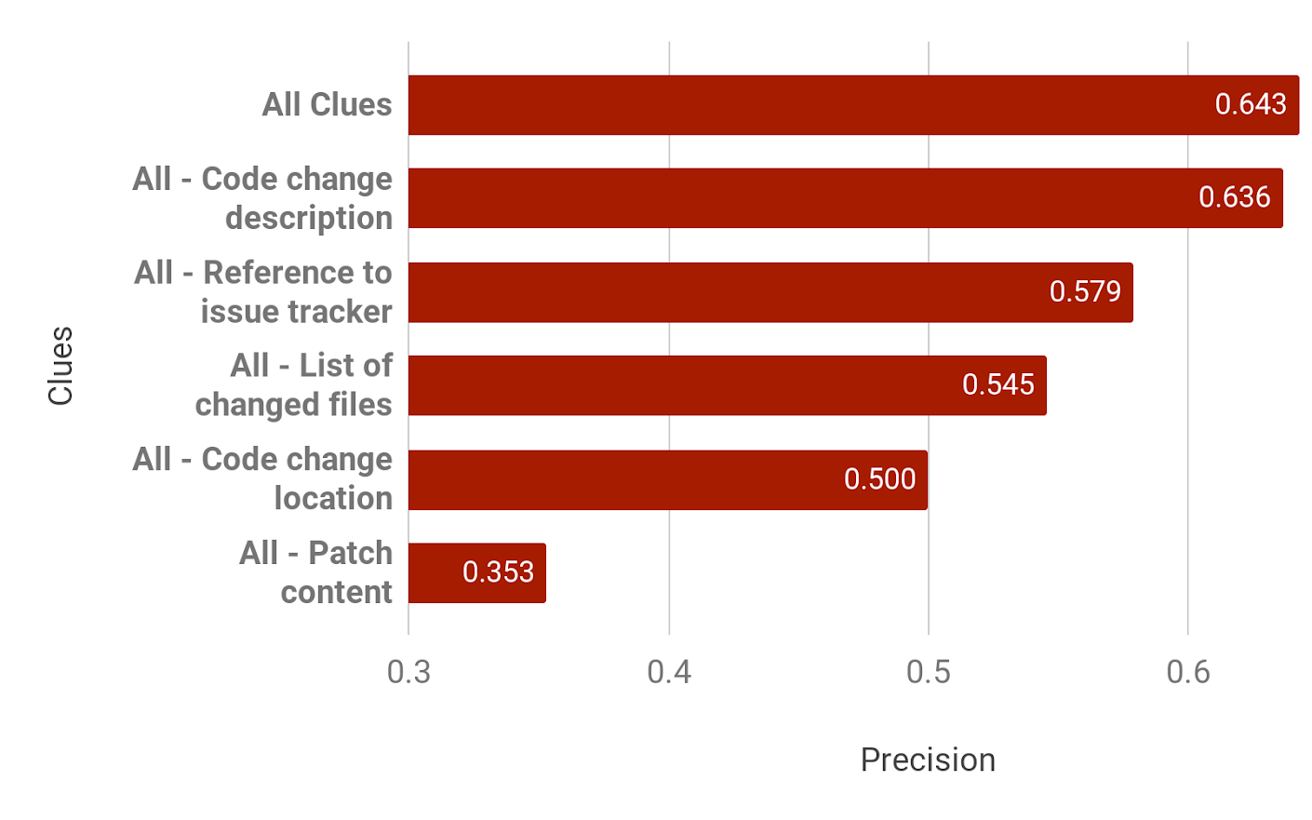
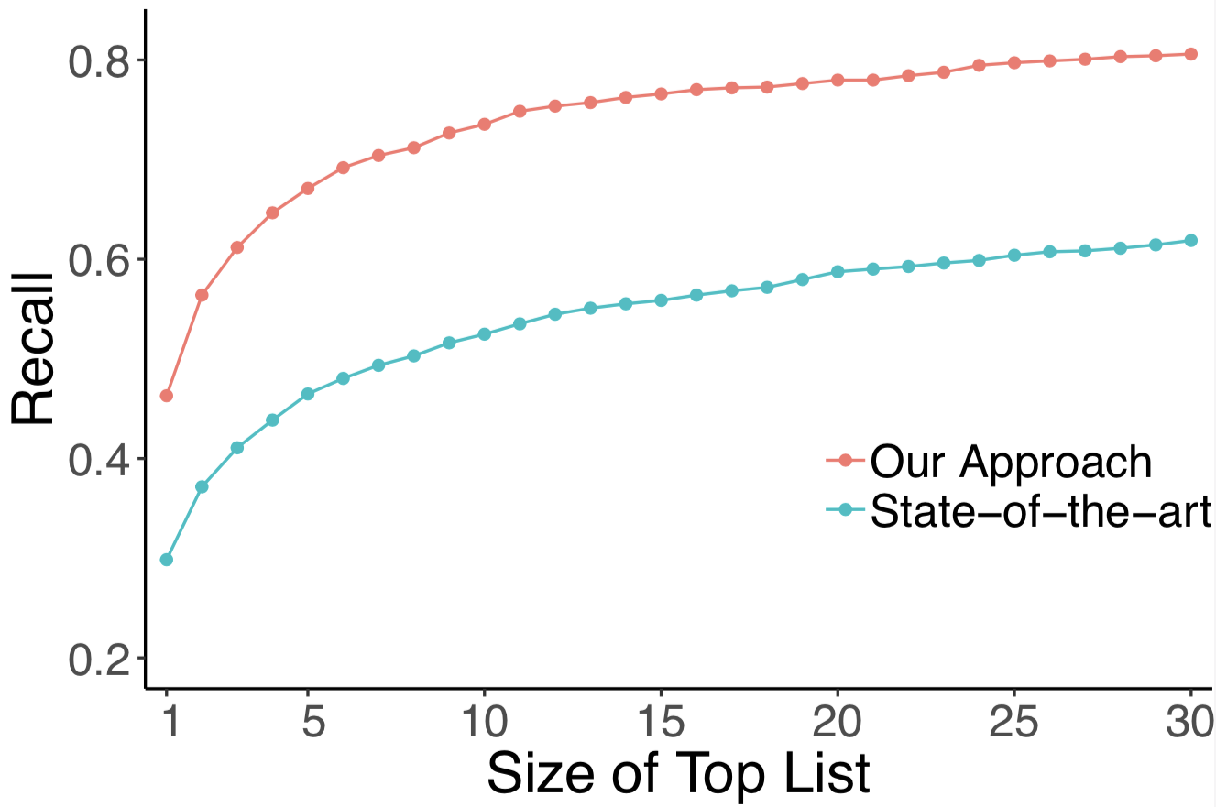
In the Paper: Comparing to State-of-the-Art & Sensitive Analysis
Outperform 16-21% Recall
[Li et al. 2017]
Notes:
The result shows that …
We also did sensitive analysis of rerunning our experiment by removing one clue at a time. And result shows that patch content is the most important clue in our approach.

Slide 52
Future Work - Tooling
Monitor bot for duplication PR/commits in fork
Firehouse user study
Live detection in IDE

Slide 53
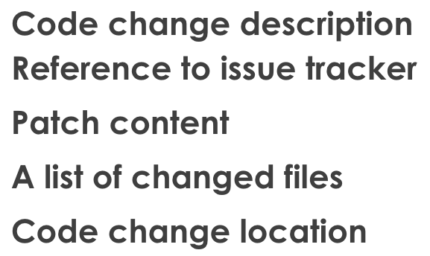
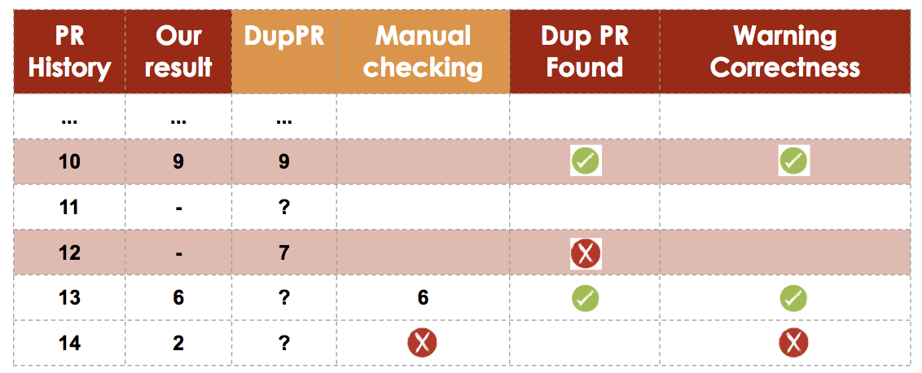
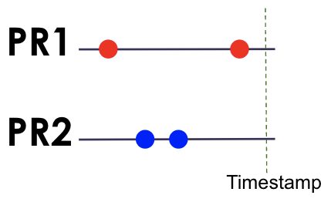
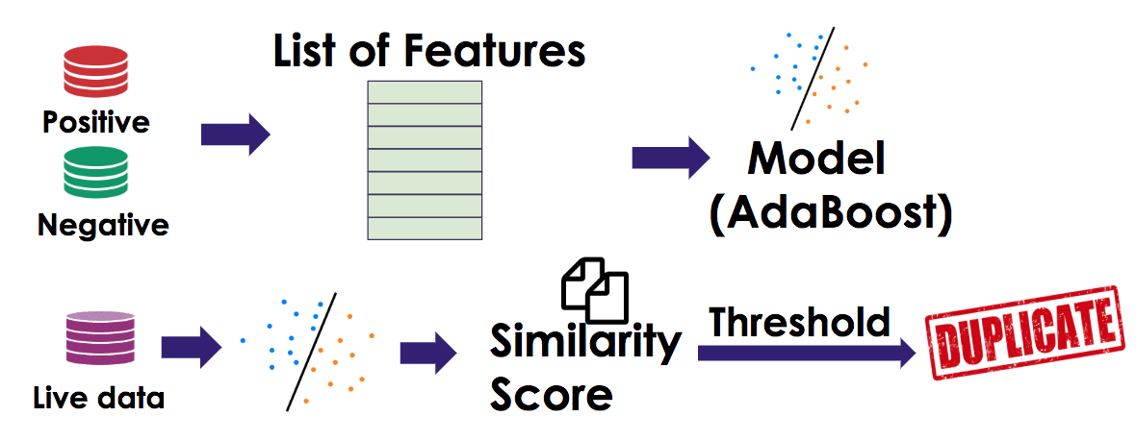
Identifying Redundancies in Fork-Based Development
RQ1:
For maintainer, decrease reviewing workload
RQ2:
For developer, save development effort
Clues
Precision 55%-82%
Recall 10%-25%
Recall 46% - 71%
0.07–0.5% false positive rate
Save 1.9 - 3.0 commits per PR
Notes:
To summarize.
We manually developed 5 clues to train ML model to predict redundant development.
And we evaluate the effectiveness of our approach from both maintainer and developers’ perspectives. And the result is promising.
Next step we will build a bot to test the usefulness.

