Slide 1
Octavo: An FPGA-Centric Processor Architecture
Charles Eric LaForest
J. Gregory Steffan
ECE, University of Toronto
FPGA 2012, February 24

Slide 2
Easier FPGA Programming
We focus on overlay architectures
  Nios, MicroBlaze, Vector Processors
    These inherited their architectures from ASICs
  Easy to use with existing software tools
  Performance penalty
  ASIC architectures poor fit to FPGA hardware!
ASIC ≠ FPGA
  ASIC: transistors, poly, vias, metal layers
  FPGA: LUTs, BRAMs, DSP Blocks, routing
    Fixed widths, depths, other discretizations
FPGA-centric processor design?

Slide 3
How do FPGAs Want to Compute?
Hardware (Stratix IV) | Width (bits) | Fmax (MHz)
DSP Blocks | 36 | 480
Block RAMs | 36 | 550
ALUTs | 1 | 800
Nios II/f | 32 | 230
What processor architecture best fits the underlying FPGA?

Slide 4
Research Goals
Assume threaded data parallelism
Run at maximum FPGA frequency
Have high performance
Never stall
Aim for simple, minimal ISA
Match architecture to underlying FPGA

Slide 5
Result: Octavo
10 stages, 8 threads, 550 MHz
Family of designs
  Word width (8 to 72 bits)
  Memory depth (2 to 32k words)
  Pipeline depth (8 to 16 stages)
Snapshot of work-in-progress

Slide 6
Designing Octavo

Slide 7
High-Level View of Octavo
Unified registers and RAM

Slide 8
Octavo vs. Classic RISC
All memories unified (no loads/stores)
How to pipeline Octavo?

Slide 9
Design For Speed:
Self-Loop Characterization

Slide 10
Self-Loop Characterization
Connect module outputs to inputs
  Accounts for the FPGA interconnect
Pipeline loop paths to absorb delays
Pointed to other limits than raw delay
  Minimum clock pulse widths
    DSP Blocks: 480 MHz
    BRAMs: 550 MHz
We measured some surprising delays…

Slide 11
BRAM Self-Loop Characterization
398 MHz
(routing!)
656 MHz
531 MHz
710 MHz
  Must connect BRAMs using registers

Slide 12
Building Octavo: Memory

Slide 13
Building Octavo: Memory

Slide 14
Memory
Instruction
ALU
Result
Replicated “scratchpad” memories with I/O
while still exceeding 550 MHz limit.

Slide 15
Building Octavo: ALU

Slide 16
Building Octavo: ALU
Fully pipelined (4 stages)
  Never stalls

Slide 17
Building Octavo: ALU
Multiplication
  Uses DSP Blocks
  Must overcome their 480 MHz limit…

Slide 18
Building Octavo: Multiplier
One multiplier is wide enough but too slow
Two multipliers working at half-speed
  Send data to both multipliers in alternation
480 MHz
600 MHz

Slide 19
Octavo: Putting It All Together

Slide 20
Octavo
0
1
2
3
4
5
6
7
8
9
Pipeline
  10 stages
    Actually 8 stages with one exception (more later)
  No result forwarding or pipeline interlocks
  Scalar, Single-Issue, In-Order, Multi-Threaded

Slide 21
Octavo
0
1
2
3
4
5
6
7
8
9
I
Instruction Memory
  Indexed by current thread PC
  Provides a 3-operand instruction
  On-chip BRAMs only

Slide 22
Octavo
0
1
2
3
4
5
6
7
8
9
I
A/B
A/B
A and B Memories
  Receive operand addresses from instruction
  Provide data operands to ALU and Controller
    Some addresses map to I/O ports
  On-chip BRAMs only

Slide 23
Octavo
0
1
2
3
4
5
6
7
8
9
I
A/B
A/B
Pipeline Registers
  Avoid an odd number of stages
  Separate BRAMs for best speed
    Predicted by BRAM self-loop characterization
    Unusual but essential design constraint

Slide 24
Octavo
0
1
2
3
4
5
6
7
8
9
I
CTL0
CTL1
A/B
A/B
Controller
  Receives opcode, source/destination operands
  Decides branches
  Provides current PC of next thread to I memory

Slide 25
Octavo
0
1
2
3
4
5
6
7
8
9
I
CTL0
CTL1
A/B
A/B
ALU0
ALU1
ALU2
ALU3
ALU
  Receives opcode and data
  Writes result to all memories

Slide 26
Octavo
T0
T1
0
1
2
3
T6
4
T7
5
T2
6
T3
7
T4
8
T5
9
I
CTL0
CTL1
A/B
A/B
ALU0
ALU1
ALU2
ALU3
Longest mandatory loop: 8 stages
  Along A/B memories and ALU
  Fill with 8 threads to avoid stalls

Slide 27
Octavo
0
1
2
3
4
5
6
7
8
9
I
CTL0
CTL1
A/B
A/B
ALU0
ALU1
ALU2
ALU3
Special case longest loop: 10 stages
  Along instruction memory and ALU
  Does not affect most computations
    Adds a delay slot to subroutine and loop code

Slide 28
Results: Speed and Area

Slide 29
Experimental Framework
Quartus 10.1 targeting Stratix IV (fastest)
  Optimize and place for speed
  Average speed over 10 placement runs
Varied processor parameters:
  Word width
  Memory depth
  Pipeline depth
Measure Frequency, Area, and Density

Slide 30
Maximum Operating Frequency

Slide 31
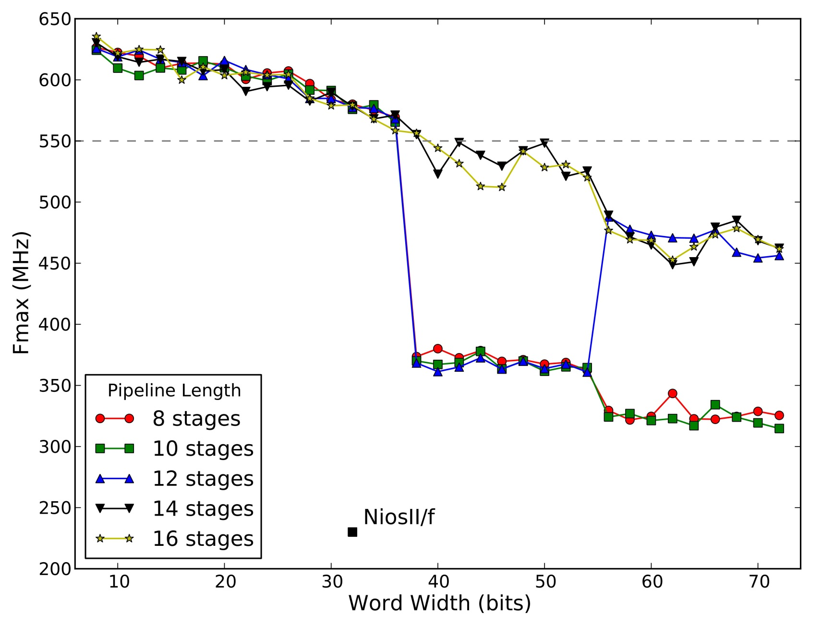
Maximum Operating Frequency
Timing Slack!
BRAM hard limit
Faster
Wider

Slide 32
Maximum Operating Frequency
550+ MHz
36 bits wide
230 MHz
32 bits wide
2.39x faster, but not a fair comparison

Slide 33
Maximum Operating Frequency
Multiplier CAD Anomaly!
(38 to 54 bits width)
Enough pipeline stages bury the inefficiency

Slide 34
Area Density

Slide 35
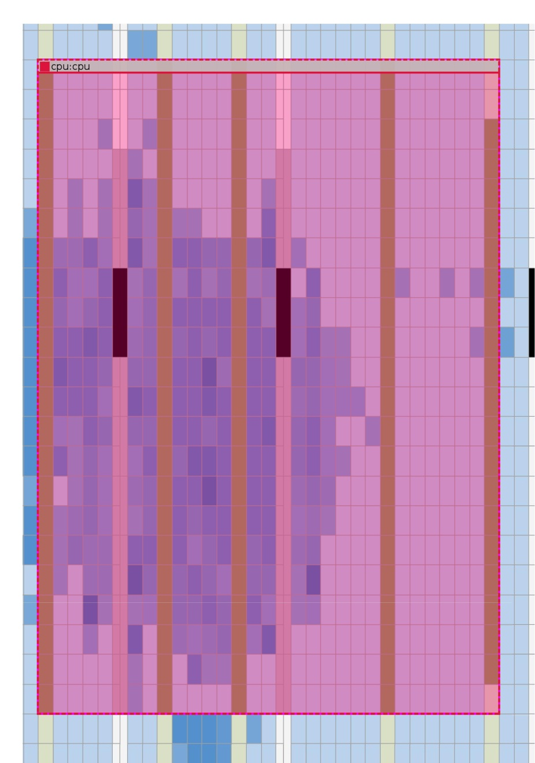
Area Density
67% used
(typical)
26% used
“Sweet spot”
72 bits, 1024 words
72 bits, 4096 words

Slide 36
Designing Octavo:
Lessons & Future Work

Slide 37
Lessons
Soft-processors can hit BRAM Fmax
  Octavo: 8 threads, 10 stages, 550 MHz
Self-loop characterization for modules
  Helps reason about their pipelining
  Shows true operating envelopes on FPGA
Octavo spans a large design space
  Significant range of widths, depths, stages
Consider FPGA-centric architecture!

Slide 38
Future Work

