Slide 1
Multi-ported Memories for FPGAs via XOR
Eric LaForest, Ming Liu, Emma Rapati, and Greg Steffan
ECE, University of Toronto

Slide 2
Multi-Ported Memories (MPM)
MPM: Memory with more than 2 ports
Many uses:
  register files
  queues/buffers
FPGA BRAMs:
  have only 2 ports
Building MPMs:
  multiple BRAMs
  logic elements (ALMs/LEs)
  clever combinations
…
…
Write Ports
Read Ports

Slide 3
Example: 2W/2R MPM
How can we build this?
Notes:
Assume we want to implement on an FPGA a memory with 2 write ports
(highlight write ports)‏
and two read ports.
(highlight read ports)‏
We will denote the number of ports as 2W/2R
(highlight 2W/2R)‏
There is no such device on an FPGA.
How do we implement it?
The obvious first solution is to use the most flexible component of FPGAs, the reconfigurable fabric, to build a memory with as many ports as we need.

Slide 4
2W/2R: Pure-ALMs/LEs
Scales very poorly with memory depth ☹
Notes:
And here's what the result looks like.
We have two write ports (highlight)‏
which feed into decoders and multiplexers (highlight)‏
which select the individual storage elements (highlight)‏
These elements are then multiplexed (highlight)‏
to some temporary registers (highlight)‏
which then hold the output values for the read ports (highlight)‏
It does what we want, which is to support two write and two reads at once.
(pause)‏
But there are a lot of problems with this solution.
There's a *lot* of implicit decoders.
One for each write port multiplexer (highlight), to figure out which element to mux to, and one for each *element* (highlight) as a write enable.
There's also a lot of multiplexing. Each read port has to be able to
read from any of all the storage element. That makes for some seriously
*wide* multiplexers (highlight). As wide as the entire memory depth.
Overall, the weakness of this solution is that it is fully-associative.
A lot of hardware has to be used to connect any write port to any storage
location, and any storage location to any read port. And it gets worse
the deeper the memory gets.

Slide 5
1W/2R: Replicated BRAMS
X
M₀
R₀
W₀
M₁
R₁
Fairly efficient ☺ Only one write port ☹
Notes:
The first one is replication.
We just connect a single write port to multiple duplicates of a memory. (highlight)‏
A write ends up copied in all the memories, and each duplicate can support an independent read.
(highlight)‏
But we're still stuck with only one write port.
(higlight)‏
(pause)‏

Slide 6
2W/2R Banked BRAMs
X
M₀
W₀
R₀
M₁
W₁
R₁
Multiple write ports ☺
Fragmented data ☹
Notes:
By keeping the write ports separate, we can now have multiple concurrent writes
(highlight)‏
and reads.
(highlight)‏
But now, we can only read a value from the same bank in which it was written.
(slide: highlight read and write ports in pair sequences)‏
And there's no way to know if multiple copies of a value exist, or which is the correct one. The data is fragmented and possibly inconsistent.

Slide 7
2W/2R “Multipumping”
W₀
R₀
M₀
W₁
R₁
No fragmentation ☺
Divides clock speed ☹
Notes:
Multipumping multiplexes the read and write ports of a simple dual ported memory, using temporary registers where needed.
It takes several cycles to perform all the reads and writes, although to the outside system they appear to occur within one system cycle.
Since the reads and writes occur in a sequence, we have to make sure writes don't overwrite values that haven't been read yet.
This usually means doing all the reads first
(slide: read arrows)‏
then all the writes
(slide: write arrows)‏
There are some performance and correctness implications to this read/write ordering which we will see later in the presentation and as future work.
(pause)‏
If instead the memory has true dual-ports, we can take advantage of that to do multipumping differently.

Slide 8
Review:
The Live Value Table (LVT) Approach
(FPGA’10)
Efficient Multi-Ported Memories for FPGAs, Eric LaForest and J. Gregory Steffan, International Symposium on Field-Programmable Gate Arrays, Monterey, CA, February, 2010.

Slide 9
LVT-Based MPM
LVT: remembers
which bank has
most recently-
written value
Bank for two
write ports,
replicate to
provide read
ports
LVT
Muxes
select bank
to read from
Notes:
Let's revisit our example of a memory with two write ports and two read ports.
Let's start implementing it with a single simple dual-port Block RAM, with one write port and one read port.

Slide 10
LVT-Based MPM
Many ALMs!
Significant
Multiplexing!
Punchline: LVT is a big freq win, but...
Notes:
We call this structure a Live Value Table, and it's the way we found to combine multiple 2-port Block RAMs into random-access memories with any number of ports.
(pause)‏

Slide 11
An XOR Approach

Slide 12
XOR
XOR basics:
  A ⊕ 0 = A
  B ⊕ B = 0
Implication:
  A ⊕ B ⊕ B = A
Can we exploit XOR to build better MPMs?
Intuition: avoid LVT-table, multiplexing

Slide 13
2W/2R XOR Design
R₀
Goal: a read is only an XOR operation

Slide 14
2W/2R XOR Design
A⊕OLD
A⊕OLD⊕OLD
R₀
=A
A⊕OLD
OLD
OLD
Focus on one location for now

Slide 15
2W/2R XOR Design
A
A⊕OLD
W₀
OLD
A⊕OLD
R₀
OLD
XOR new value with old value

Slide 16
2W/2R XOR Design
W₀
R₀
Support multiple locations, two write ports

Slide 17
2W/2R XOR Design
A
W₀
A⊕OLD1
OLD2
B
R₀
W₁
OLD1
B⊕OLD2
Most-recently-written bank holds new value XOR old(s)

Slide 18
2W/2R XOR Design
W₀
R₀
W₁
R₁
Add support for second read port---done! (almost)

Slide 19
2W/2R XOR Design
A
W₀
TOCK
R₀
W₁
TICK
R₁
Writing requires reading: hence 2 cycles to write!
Solution: need pipelining to avoid stalling

Slide 20
2W/2R XOR Design
A
W₀
Read?
R₀
W₁
TICK
R₁
What if read a location one cycle after written?
Solution: bypass with forwarding logic

Slide 21
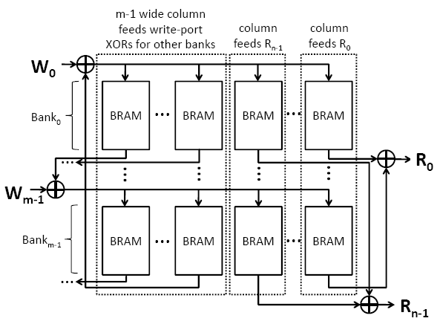
Generalized XOR Design

Slide 22
Generalized XOR Design

Slide 23
LVT vs XOR

Slide 24
Methodology
Use Quartus 10.0 to target Stratix IV
  Favor speed over area, optimize
  Average over 10 seeds to get Fmax
Measure area as Total Equivalent Area (TEA)
  Expresses area in a single unit (ALMs)‏
  1 M9K == 28.7ALMs **
Measure a large design space
  Depth: 32-8192 memory locations
  Ports: 2W/4R, 4W/8R, 8W/16R
** H. Wong, J. Rose and V. Betz, "Comparing FPGA vs. Custom CMOS and the Impact on Processor Microarchitecture," ACM Int. Symp.on FPGAs, 2011

Slide 25
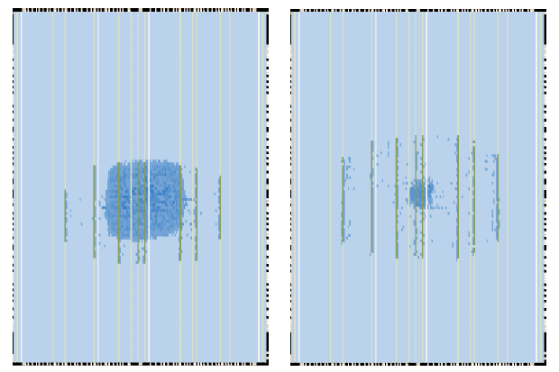
Example Layout: 8192-deep 2W/4R
LVT
XOR
Significant resource diversity!

Slide 26
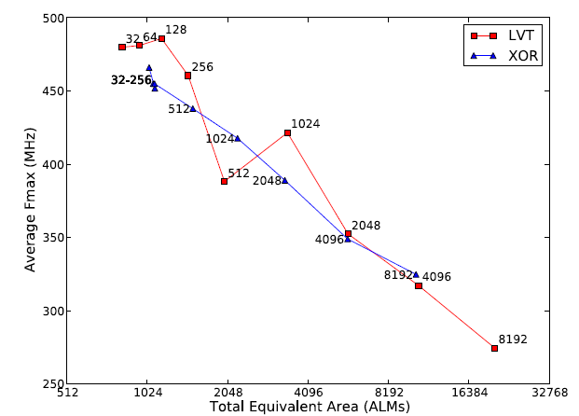
2W/4R
Faster
8192 XOR:
15% faster,
2x smaller
CAD anomaly
Smaller (log)
LVT better for small designs, XOR better for large

Slide 27
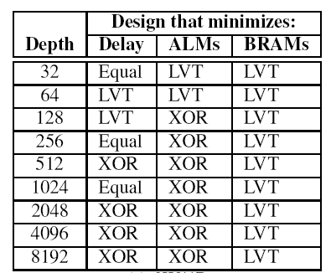
Navigating the Design Space (2W/4R)
Which is best? That depends...

Slide 28
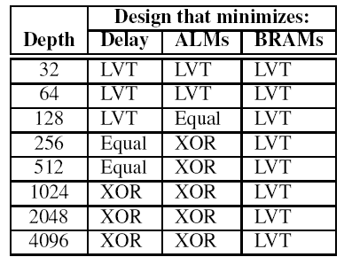
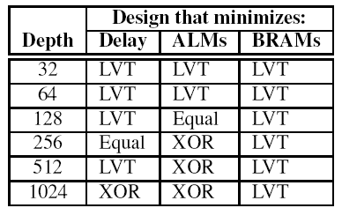
Summary
2W/4R
4W/8R
8W/16R
Use LVT when:
want to minimize BRAMs
building <= 128 depth
else use XOR, i.e. when:
>= 256 & spare BRAMS

Slide 29
Conclusions
Use LVT when
  building up to 128-entry designs
  you want to minimize BRAM usage
Use XOR when
  building 256-entry or larger designs
  you want to minimize ALM usage
Interesting Library/Generator?
  help the designer automatically navigate this space
Further work
  Exploring “true-dual-port” mode, stalls, power
  Results on other vendor’s FPGAs
Notes:
XOR approach is more stable
With increase of memory depth
XOR vs LVT depends on application of memory
i.e. need longer memory, is time or memory more important etc.
Best for each #w/#r ports
will vary with hardware and software characteristics
Multipumping implementations can be useful

