Slide 1
Operating Systems ECE344 A brief history of OS
Ding Yuan
ECE Dept., University of Toronto
http://www.eecg.toronto.edu/~yuan

Slide 2
Content of this lecture
The dark age (1945 – 55): no OS
Batch systems (1955 – 65)
Multiprogramming (1965 – 80)
PC (and mobile) era (1980 – present)

Slide 3
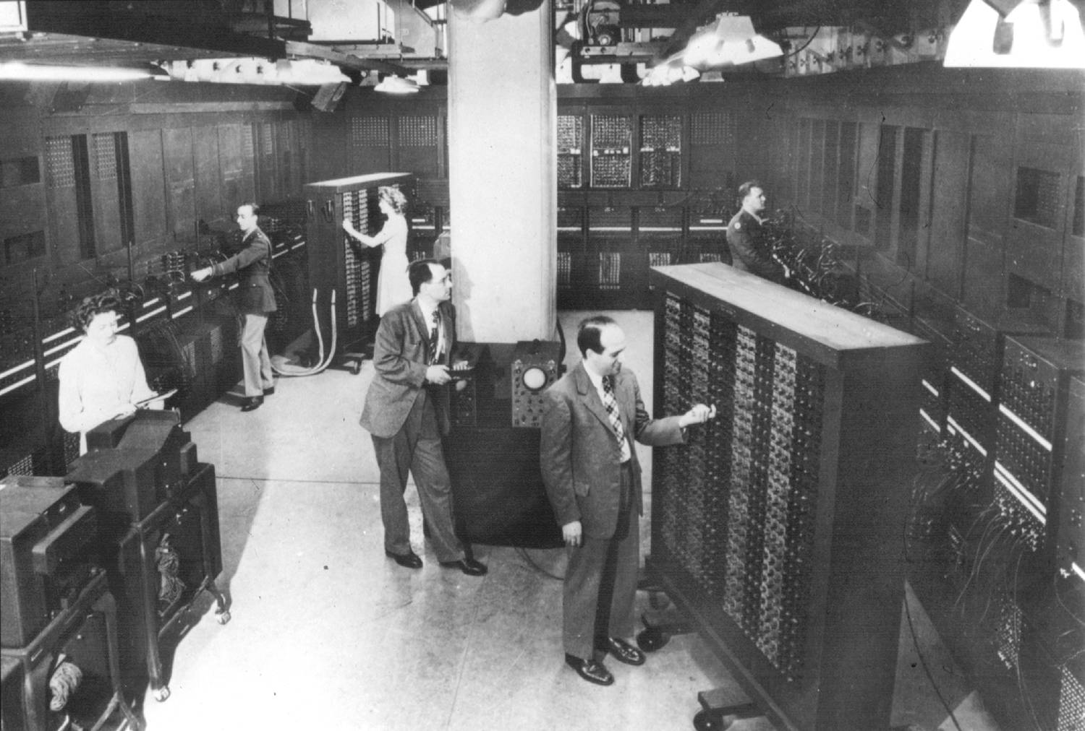
The dark age
ENIAC (1946): the first computer
Only a single group of people designed and used it
Protection and virtualization are not needed!
How to Allocate and Reclaim computation time?
Sign-up sheet on the wall!

Slide 4
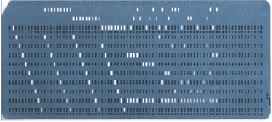
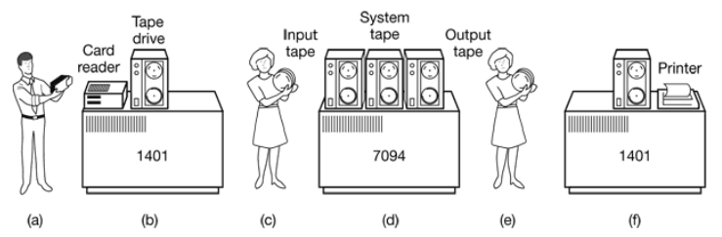
Batch systems (1955-65)
Background:
At that time, computers are used only to “compute” (instead of entertainments, etc.)
Users write program using “punch card”
Punch your program into cards
Bring the cards to computer operators
Come back after a day to get result

Slide 5
Batch systems (1955-65)
OS:
Read the first job from the tape
Run it
Write the output to another tape
Read the next job and repeat the process
Similar to the “sign-up sheet on the wall”, only now this process is automated

Slide 6
Multiprogramming (1965-80)
Problems with Batch systems?
Responsiveness
Do you want to wait for a day just to find out your program doesn’t compile?
Multiple users cannot concurrently access the computer
Efficiency
CPU is idle while the computer is doing I/O
Multiprogramming
Multiple tasks are performed during the same period of time
As if they are executed concurrently
Now multiple users can use the same machine simultaneously

Slide 7
MULTICS
MULTiplexed Information and Computing Service
Initiated by MIT, Bell Labs, and General Electric
Designed to support hundreds of users on a machine far less powerful than iPhone 5
People knew how to write small, efficient programs in those days
Technically successful, but not so much commercially
Bell Labs and GE dropped out before it was released

Slide 8
UNIX
Written by Ken Thompson and Dennis Ritchie from Bell Labs on PDP-11 (1971)
Project started because Ken wanted to play the “Space Travel” game without MULTICS
Originally named as “Unics” by Brian Kernighan
In 1973, Ritchie invented C programming language to ease the development of Unix

Slide 9
Linux
In 1991, Linus Torvalds, then a student of Univ. of Helsinki, wanted to learn OS
But at that time, no free, open-source OS is available
Decided to write his own OS and “open-source” it
Open-source is the key behind its popularity today

Slide 10
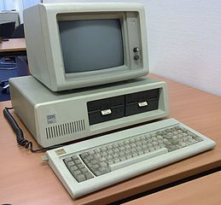
PC-era (1980-present)
IBM introduces PC in 1981, using Intel processors
Looking for an OS for its PC
At that time, an OS called CP/M is already working on Intel CPUs
Bill Gates initially suggested IBM to contract CP/M
CP/M founder refused to meet with IBM
IBM came back to Bill Gates, and he purchased an OS named DOS (Disk Operating System), modified it, and renamed it MS-DOS

Slide 11
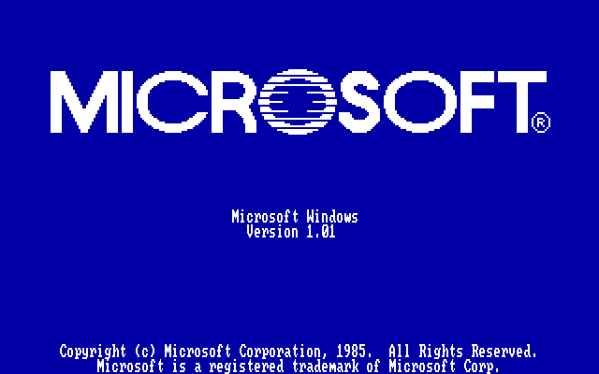
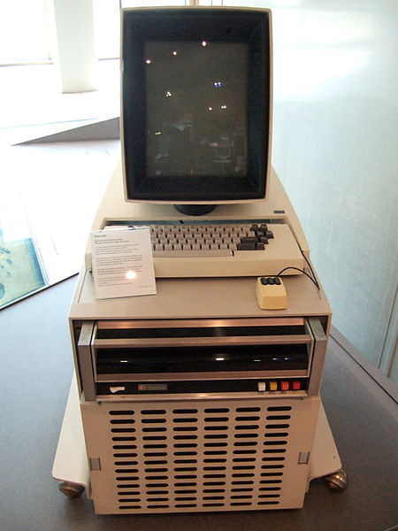
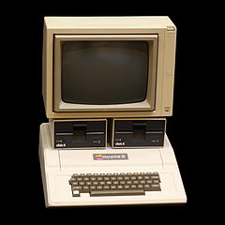
Graphical User Interface (GUI)
The interface of the early OSes is command-line
Researchers in Xerox-PARC built the first OS with graphic user interface
Steve Jobs visited PARC, saw the GUI, and used it in Apple’s Lisa (1983), later Macintosh (1984)
Microsoft introduced Windows in 1985

