Slide 1
Operating Systems ECE344
Lecture 13: Virtual Machines
Ding Yuan

Slide 2
Virtualization
“A technique for hiding the physical characteristics of computing resources from the way in which other systems, applications, or end users interact with those resources.”

Slide 3
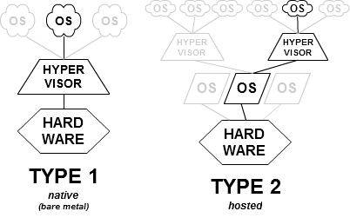
Virtual machine structures
Image source: https://en.wikipedia.org/wiki/Hypervisor

Slide 4
But why is it useful?
Resource consolidation & isolation
Cloud computing
Embedded systems
Testing
DevOps
Image source: https://en.wikipedia.org/wiki/Hypervisor

Slide 5
Old idea from the 1960s
IBM VM/370
Run different OS instances
Desirable when few machines is around
Popular research idea in 60s and 70s
Entire conferences on virtual machine monitor
Hardware/VMM/OS designed together
Interest died out in the 1980s and 1990s
Why?

Slide 6
A return to virtual machines
Disco: Stanford research project (SOSP’97)
By Edouard Bugnion, Scott Devine, and Mendel Rosenblum
Rosenblum is the author of log-structured file system
So OS developers won’t change their code for new hardware
Commercial VM for x86
VMware (later EMC, now Dell)
Connectix VirtualPC (now Microsoft)
Research virtual machines
Xen (SOSP’03)

Slide 7
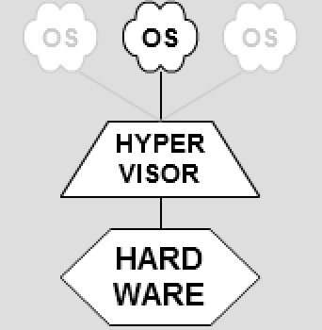
How do we virtualize?
Goal: virtualize a physical machine
Resources
CPU
Memory
Storage
Image source: https://en.wikipedia.org/wiki/Hypervisor

Slide 8
Virtualizing CPU
Translate?
Too slow
But more on this later…
Trap-and-emulate
H/W support (kernel + user mode)
Guest OS in user mode
Trap into hypervisor on privileged inst.
Modern CPUs have virtualization support
3 modes: kernel, supervisor, user
Image source: https://en.wikipedia.org/wiki/Hypervisor

Slide 9
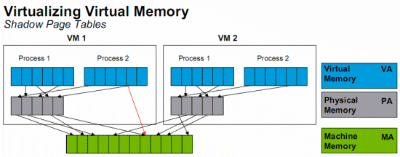
Virtualizing memory
Image source: http://www.anandtech.com/show/2480/10
Shadow page table:
isolate VM’s memory

Slide 10
MIPS implementation
What does TLB store?
VA -> MA
But how do we prevent one VM from accessing the other VM’s memory?
Trap on every TLB miss and TLB write
Image source: http://www.anandtech.com/show/2480/10
TLB

Slide 11
How about x86?
Hardware managed TLB
MMU performs page table lookup on TLB miss
What are the complications?
Hardware support for virtualization!
MMU can walk nested page table!
Image source: http://www.anandtech.com/show/2480/10
Page table

Slide 12
Virtualizing I/O
Trap-and-emulate on every hardware access
Too slow, so modify the device driver to use special “monitor call” (similar to syscall)

Slide 13
Binary translation
Used by VMware at one point
Imperfect hardware (x86) doesn’t allow perfect trap-and-emulate
popf (pop flags): might modify interrupt flag (IF) when executed in kernel mode, but suppress the attempt to modify IF when executed in user mode
Code segment selector (%cs) have two bits storing the kernel/user mode, can be read by user mode
No longer used today b/c of more powerful H/W support

