Slide 1
Operating Systems
ECE344
Introduction
Ding Yuan
ECE Dept., University of Toronto
http://www.eecg.toronto.edu/~yuan
slides courtesy: Ashvin Goel, Yuanyuan Zhou, Geoff Voelker

Slide 2
Content of this lecture
Course information (personnel, policy, prerequisite, agenda, etc.)
Why learning OS?
What is an OS? What does it do?
Summary

Slide 3
Goals of this course
Understand operating system concepts
How OS works, and more importantly, why?
Basis for future learning
Get hands dirty
  You will implement a real OS
Ready you for the real-world challenges!
  No one will help you to debug your program
  “My program crashes, why?” --- find out yourself!

Slide 4
Communications
Class web site
  Somewhere in the Internet, your job to find it
  Provides slides, agenda, grading policy, etc.
  All information regarding the labs
Piazza used for discussion
  Again, find it yourself
  Q/A & discussion with peers, TAs, prof
UoT Portal used for Grades only

Slide 5
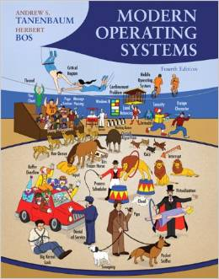
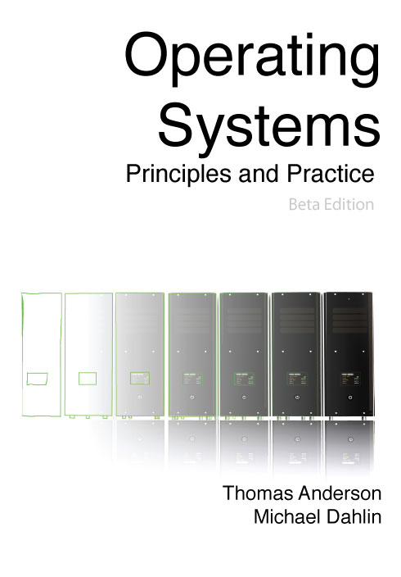
Suggested Textbooks
Modern Operating Systems, 4th Edition
(Main textbook)
Andrew S. Tanenbaum and Herbert Bos
Operating Systems: Principles and Practice
(Further reading)
Thomas Anderson, Michael Dahlin

Slide 6
Personnel
Instructor:
  Ding Yuan (yuan@eecg.toronto.edu)
  Office hour: 10 minutes after each lecture
  Homepage: http://www.eecg.toronto.edu/~yuan
TAs:
  David Lion, Shehbaz Jaffer, Jack Sun, Xu Zhao, Yongle Zhang

Slide 7
Prerequisite
Programming experiences (e.g., ECE244)
  You will be programming in C
Computer organizations (e.g., ECE243)
  What is an Instruction (e.g., load, store)?
  What is CPU? Memory? Registers?
  What is Stack? Stack pointer?
  What is Program Counter (PC)?

Slide 8
Course Contents
Overview of computer hardware
Threads and processes
Synchronization and concurrency
Scheduling
Memory Management, Virtual Memory
Disk Management and File Systems
Advanced topics

Slide 9
Lab Assignments
We will be using the OS161 teaching OS
  Uses a simple MIPS emulator (sys161)
  Initially, we provide a barebones OS
  You write a simple Unix-like OS by the end of the course!
  Runs on Linux machines in UG Workstation Labs
    Can also download and install on any Linux machine
It is hard!
Start your assignment early!

Slide 10
Practice sessions
Optional to attend
TA will be available in the first 1.5 hours of each lab session
  But they are there only to answer your question

Slide 11
Work in pairs
You will work in groups of 2 for the lab assignments
  Make sure you review your partner’s code
  Learn to coordinate and be efficient
  Form your group by January 13th, 11:59PM
  Send an email to Shehbaz Jaffer “shehbaz.jaffer@mail.utoronto.ca” with the subject “ECE344 group information”
  Include the names and UTorIDs of you and your partner

Slide 12
What to Expect From Lab Assignments
Building an OS is difficult
  Perhaps the hardest lab in your undergraduate study
  OS: one of the hardest programs to write & debug
Principles may sound easy, implementation is extremely hard
  The labs give specifications, not implementations
  “God (or devil) is in the detail”
  Hack into a large, unfamiliar code base and implement additional features
You will spend a lot of time on the lab assignments
  Allows for imagination
  Allows for errors and frustration
  Lab instructions ask that you design well, before you code
  Assume that you will do the design/coding outside lab hours
Notes:
12

Slide 13
But it is rewarding!
Solid understanding of how an OS works
  Appreciations on the implementation efforts that make things work
Solid technical capability
  Again: OS is one of the hardest programs to write and debug
  Quickly hack into unfamiliar code base

Slide 14
What to expect from lectures
Not only understand how, but more importantly, why
You are encouraged to speak up
  Ask questions, answer questions
  “The mediocre teacher tells. The good teacher explains. The superior teacher demonstrates. The great teacher inspires.”

Slide 15
Grading
Exams
  Mid-term - 25%
  Final - 45%
Assignments
  Labs - 30%
Policies
  No extensions to deadlines
  20% penalty per day submitted late

Slide 16
Exam
Midterm
  Covers first half of class
Final
  Covers second half of class + selected material from first part
Project-related knowledge may be included in the exams
  So do your project and do NOT copy!

Slide 17
Cheating policy
Academic integrity
Your work in this class must be your own – we have zero tolerance policy towards cheating of any kind and any student who cheats will get a failing grade in the course
Both the cheater and the student who aided the cheater will be held responsible for the cheating
We have tools to detect software plagiarism

Slide 18
How NotTo pass ECE344
Do not come to lecture
  It’s nice out, the slides are online, and material in the book anyway
  TRUTH: Lecture material is the basis for exams
  It is much more efficient to learn through discussion
Copy other people’s project
  It is cheating!
  How can you answer the questions in midterm or final exams?

Slide 19
How NotTo pass ECE344 (2)
Do not ask questions in lecture, office hours, or piazza
  It’s scary, I don’t want to embarrass myself
  TRUTH: asking questions is the best way to clarify lecture material at the time it is being presented
    “There is no such things as stupid question…”
Wait until the last couple of days to start a project
  The project cannot be done in the last few days
  Repeat: the project cannot be done in the last few days!

Slide 20
Before we start
Any questions?
Do you think this will be a hard class?

Slide 21

Final piazza post from student in 2015’s ECE344

Slide 22
Why learning OS?
Fulfill requirement?
Great programmers understand Operating System
  http://www.youtube.com/watch?v=-3Rt2_9d7Jg
    Which course is this?
    http://matt-welsh.blogspot.ca/2010/10/in-defense-of-mark-zuckerberg.html
  Software companies love OS students
OS is the foundation of all software! (and it’s hard to code!)
Academic research in OS is very influential
  What do Microsoft, Apple, VMware, or even Google sell?
Notes:
reflection on his experience interacting with Mark

Slide 23
What is an OS?
Anyone?
Give a few names of an OS?
  Desktops?
  Smart phones?

Slide 24
OS and hardware
The OS abstracts/controls/mediates access to hardware resources (what resources?)
  Computation (CPUs)
  Volatile storage (memory) and persistent storage (disk, etc.)
  Communication (network, modem, etc.)
  Input/output devices (keyboard, display, printer, etc.)

Slide 25
Benefits to Applications
Simpler
  no tweaking device registers
Device independent
  all disks look the same
Portable
  same program runs on Windows95/98/ME/NT/2000/XP/Vista/Windows 7/Windows 8/Windows 10
Worry less about interference from other applications

Slide 26
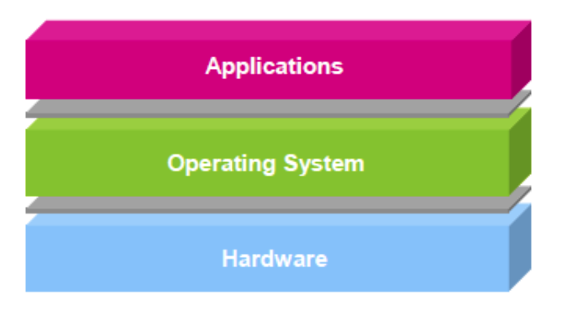
OS is…
Software layer between hardware and applications
The OS is “all the code that you didn’t have to write” to implement your application

Slide 27
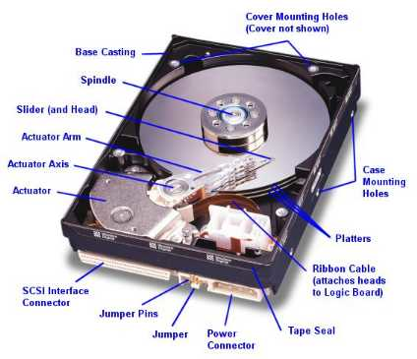

An example comparing life with/without OS
Life with an OS
file = open (“test.txt”, O_WRONLY);
write (file, “test”, 4);
close (file);
Life without an OS
Blocks, platter, track, and sector
Where is this file on disk? Which platter, track, and sectors?
Code needs to change on a different system

Slide 28
What does an OS do?
Resources
  Allocation
  Protection
  Reclamation
  Virtualization

Slide 29
What does an OS do?
Resources
  Allocation
  Protection
  Reclamation
  Virtualization
Finite resources
Competing demands
Examples:
  CPU
  Memory
  Disk
  Network
Government:
Limited budget, Land,
Natural resources

Slide 30
What does an OS do?
Resources
  Allocation
  Protection
  Reclamation
  Virtualization
You can’t hurt me,
I can’t hurt you.
Some degrees of
safety and security
Government:
Law and order

Slide 31
What does an OS do?
Resources
  Allocation
  Protection
  Reclamation
  Virtualization
The OS gives,
The OS takes away
Some times involun-
tarily
Government:
Income Tax

Slide 32
What does an OS do?
Resources
  Allocation
  Protection
  Reclamation
  Virtualization
Illusion of infinite, private resources
  Memory vs. disk
  Time-shared CPU
Government:
Social welfare and insurance

Slide 33
Why you want to learn OS?
Foundation to other software
  Databases, Browsers, Computational software, … …
OS is one of the hardest software piece to write & debug
  Directly talks to hardware (very ugly interfaces)
  Abstract into clean interfaces
  They are BIG
  Lines of code:
    Windows Vista (2006): 50M (XP + 10M)
    Linux 3.6: 15.9 M
    Android 4.0: > 1M

Slide 34
Why you want to learn OS?
Many OS concepts (e.g., protection, resource management) is needed in other places
  E.g., browser
OS is used everywhere
  Your car is running on Linux/Windows

Slide 35
Before the next class
Browse the course web
Start thinking about partners for project groups
See me up front if you have any questions
Let the fun (or grind) begin!

