Slide 1
Operating Systems
ECE344
Lecture 10: Scheduling
Ding Yuan

Slide 2
Scheduling Overview
In discussing process management and synchronization, we talked about context switching among processes/threads on the ready queue
But we have glossed over the details of exactly which thread is chosen from the ready queue
Making this decision is called scheduling
In this lecture, we’ll look at:
  The goals of scheduling
  Various well-known scheduling algorithms
  Standard Unix scheduling algorithm

Slide 3
Multiprogramming
In a multiprogramming system, we try to increase CPU utilization and job throughput by overlapping I/O and CPU activities
  Doing this requires a combination of mechanisms and policy
We have covered the mechanisms
  Context switching, how it happens
  Process queues and process states
Now we’ll look at the policies
  Which process (thread) to run, for how long, etc.
We’ll refer to schedulable entities as jobs (standard usage) – could be processes, threads, people, etc.

Slide 4
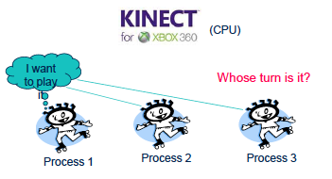
Scheduling
Deciding which process/thread should occupy the resource (CPU, disk, etc.)

Slide 5
When to schedule?
A new job starts
The running job exits
The running job is blocked
I/O interrupt (some processes will be ready)
Timer interrupt
  Every 10 milliseconds (Linux 2.4)
  Every 1 millisecond (Linux 2.6)
  Why is the change?

Slide 6
What are the scheduling objectives?
Anyone?

Slide 7
Scheduling Objectives
Fair (nobody cries)
Priority (lady first)
Efficiency (make best use of equipment)
Encourage good behavior (good boy/girl)
Support heavy load (degrade gracefully)
Adapt to different environment (interactive, real-time, multi-media, etc.)
Notes:
Can you see contradictions?

Slide 8
Performance Criteria
Throughput: # of jobs that complete in unit time
Turnaround time (also called elapse time)
  Amount of time to execute a particular process from the time it entered
Waiting time
  amount of time process has been waiting in ready queue
Meeting deadlines: avoid bad consequences

Slide 9
Different Systems, Different Focuses
Batch Systems (e.g., billing, accounts receivable, accounts payable, etc.)
  Max throughput, max CPU utilization
Interactive Systems (e.g., our PC)
  Min. response time
Real-time system (e.g., airplane)
  Priority, meeting deadlines
    Example: on airplane, Flight Control has strictly higher priority than Environmental Control

Slide 10


Program Behaviors Considered in Scheduling
Is it I/O bound? Example?
Is it CPU bound? Example?
Batch or interactive environment
Priority
Frequency of page fault
Frequency of I/O

Slide 11
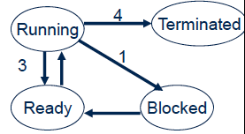
Preemptive vs. Non-preemptive
Non-preemptive scheduling
  The running process keeps the CPU until it voluntarily gives up the CPU
    Process exits
    Switch to blocked state
    1 and 4 only (no 3 unless
    calls yield)
Preemptive scheduling
  The running process can be interrupted and must release the CPU

Slide 12
Scheduling Algorithms
First Come First Serve (FCFS)
Short Job First (SJF)
Priority Scheduling
Round Robin
Multi-Queue & Multi-Level Feedback
Earliest Deadline First Scheduling
Batch
Systems
Interactive
Systems
Real-time
Systems

Slide 13
First Come First Serve (FCFS)
Also called first-in first-out (FIFO)
  Jobs are scheduled in order of arrival to ready queue
  “Real-world” scheduling of people in lines (e.g., supermarket)
  Typically non-preemptive (no context switching at market)
  Jobs treated equally, no starvation

Slide 14
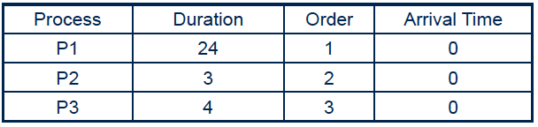
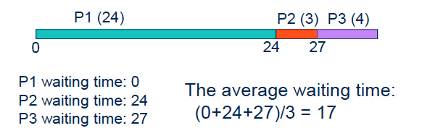
FCFS Example

Slide 15
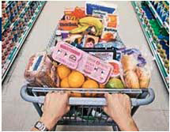
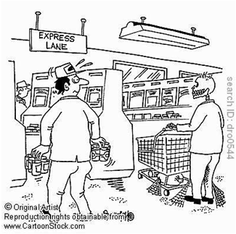
Problems with FCFS
Average waiting time can be large if small jobs wait behind long ones (high turnaround time)
  Non-preemptive
  You have a basket, but you’re stuck behind someone with a cart
Solution?
  Express lane (12 items or less)

Slide 16
Shortest Job First (SJF)
Shortest Job First (SJF)
  Choose the job with the smallest expected duration first
    Person with smallest number of items to buy
  Requirement: the job duration needs to be known in advance
  Used in Batch Systems
  Optimal for Average Waiting Time if all jobs are available simultaneously (provable). Why?
  Real life analogy?
    Express lane in supermarket
    Shortest important task first
    -- The 7 Habits of Highly Effective People

Slide 17
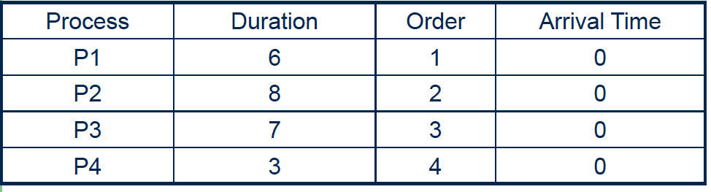
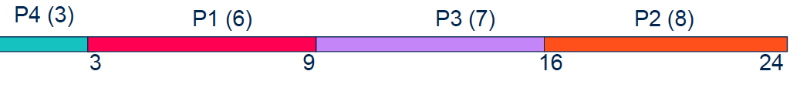
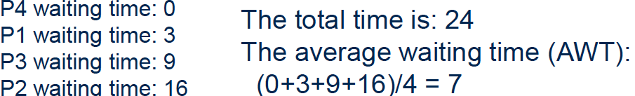
Non-preemptive SJF: Example
0

Slide 18


Comparing to FCFS
0

Slide 19

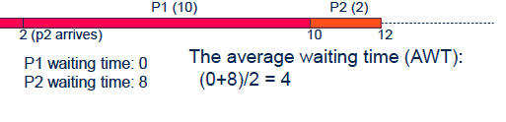
SJF is not always optimal
Is SJF optimal if not all the jobs are available simultaneously?
0

Slide 20
Preemptive SJF
Also called Shortest Remaining Time First
  Schedule the job with the shortest remaining time required to complete
Requirement: again, the duration needs to be known in advance

Slide 21


Preemptive SJF: Same Example

Slide 22

A Problem with SJF
Starvation
  In some condition, a job is waiting forever
  Example:
    Process A with duration of 1 hour, arrives at time 0
    But every 1 minute, a short process with duration of 2 minutes arrive
    Result of SJF: A never gets to run

Slide 23
Scheduling Algorithms
First Come First Serve (FCFS)
Short Job First (SJF)
Priority Scheduling
Round Robin
Multi-Queue & Multi-Level Feedback
Earliest Deadline First Scheduling
Batch
Systems
Interactive
Systems
Real-time
Systems

Slide 24
Priority Scheduling
Each job is assigned a priority
FCFS within each priority level
Select highest priority job over lower ones
Rationale: higher priority jobs are more mission-critical
  Example: DVD movie player vs. send email
Real life analogy?
  Boarding at airports
Problems:
  May not give the best AWT
  indefinite blocking or starving a process

Slide 25
Set Priority
Two approaches
  Static (for systems with well-known and regular application behaviors)
  Dynamic (otherwise)
Priority may be based on:
  Importance
  Percentage of CPU time used in last X hours
    Should a job have higher priority if it used more CPU in the past? Why?

Slide 26
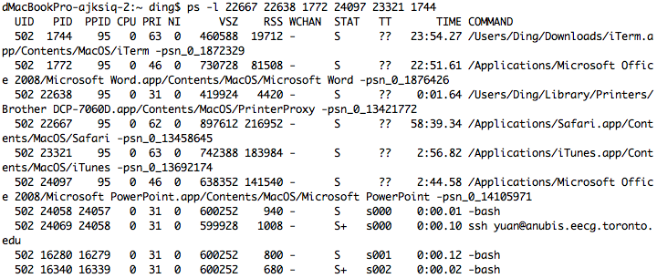
Priority in Unix

Slide 27
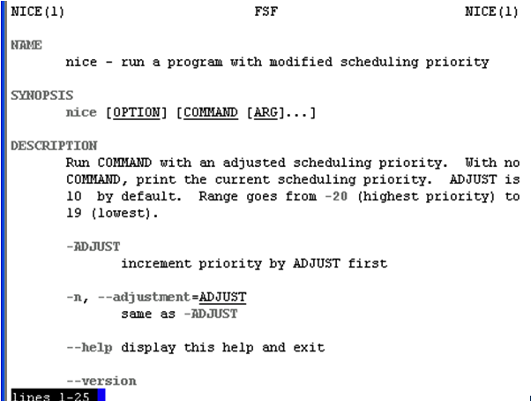
Nobody wants to Be “nice” on Unix

Slide 28




More on Priority Scheduling
For real-time (predictable) systems, priority is often used to isolate a process from those with lower priority. Priority inversion: high priority task is indirectly preempted by medium/low priority tasks
  A solution: priority inheritance
high priority job
medium priority job
low priority job

Slide 29
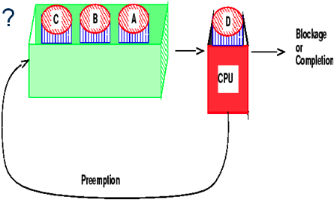
Round-robin
One of the oldest, simplest, most commonly used scheduling algorithm
Select process/thread from ready queue in a round-robin fashion (take turns)
Real life analogy?
Problem:
Do not consider priority
Context switch overhead

Slide 30
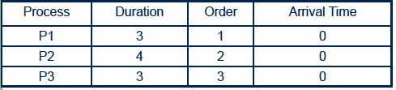
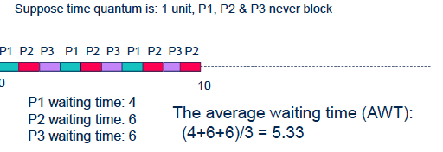
Round-Robin: example

Slide 31
Time Quantum
Time slice too large
  FIFO behavior
  Poor response time
Time slice too small
  Too many context switches (overheads)
  Inefficient CPU utilization
Heuristics: 70-80% of jobs block within time-slice
Typical time-slice: 5 – 100 ms
  Wait: isn’t timer-interrupt frequency 1ms on Linux 2.6?

Slide 32
Combining Algorithms
Scheduling algorithms can be combined
  Have multiple queues
  Use a different algorithm among queues
  Move processes among queues
Example: Multiple-level feedback queues (MLFQ)
  Multiple queues representing different job types
    Interactive, CPU-bound, batch, etc.
  Queues have priorities
  Jobs can move among queues based upon execution history
    Feedback: switch from interactive to CPU-bound behavior

Slide 33
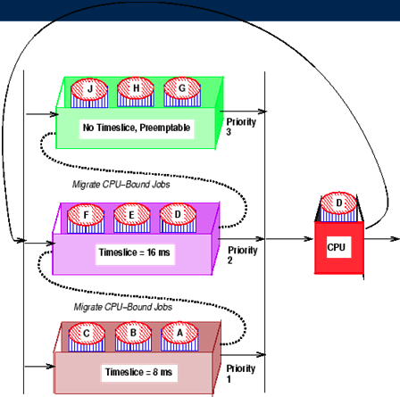
Example

Slide 34
Unix Scheduler
The Unix scheduler uses a MLFQ
  ~170 priority levels
Priority scheduling across queues, RR within a queue
  The process with the highest priority always runs
  Processes with the same priority are scheduled RR
Processes dynamically change priority
  Increases over time if process blocks before end of quantum
  Decreases over time if process uses entire quantum

Slide 35
Unix Scheduler
priority value = nice + base + (recent CPU usage/2)
The lower the value, the higher the priority
nice --- static priority [-20, 20], default 0
base --- a constant (60 in Unix)
recent CPU usage is also called CPU decay = (last value + CPU count used by this process) / 2

Slide 36
Process A
Process B
Process C
priority
recent CPU
priority
recent CPU
priority
recent CPU
60
0
1
..
60
60
0
60
0
timer int.
Context
switch
75
30
60
0
1
..
60
60
0
Context
switch
67.5
15
75
30
60
0
1
..
60
Context
switch
63.75
7.5
8
9
..
67
67.5
15
75
30

Slide 37
Properties
How will it treat processes that have been waiting for a long time?
How about a process that do not finish quantum before giving up the CPU (voluntarily or blocked)?

Slide 38
Motivation of Unix Scheduler
The idea behind the Unix scheduler is to reward interactive processes over CPU hogs
Interactive processes (shell, editor, etc.) typically run using short CPU bursts
  They do not finish quantum before waiting for more input
Want to minimize response time
  Time from keystroke (putting process on ready queue) to executing keystroke handler (process running)
  Don’t want editor to wait until CPU hog finishes quantum
This policy delays execution of CPU-bound jobs
  But that’s ok

Slide 39
Scheduling Algorithms
First Come First Serve (FCFS)
Short Job First (SJF)
Priority Scheduling
Round Robin
Multi-Queue & Multi-Level Feedback
Earliest Deadline First Scheduling
Batch
Systems
Interactive
Systems
Real-time
Systems

Slide 40
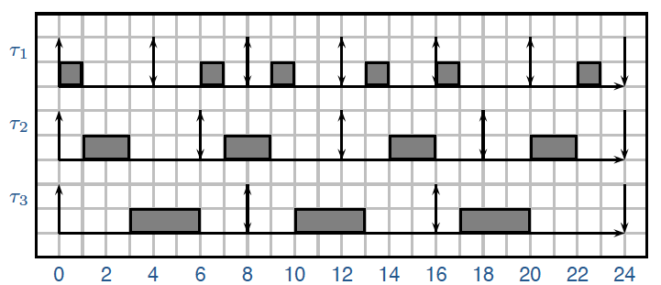
Earlieas Deadline First (EDF)
Each job has an arrival time and a deadline to finish
  Real life analogy?
Always pick the job with the earliest deadline to run
Optimal algorithm (provable): if the jobs can be scheduled (by any algorithm) to all meet the deadline, EDF is one of such schedules

Slide 41
Scheduling Summary
Scheduler (dispatcher) is the module that gets invoked when a context switch needs to happen
Scheduling algorithm determines which process runs, where processes are placed on queues
Many potential goals of scheduling algorithms
  Utilization, throughput, wait time, response time, etc.
Various algorithms to meet these goals
  FCFS/FIFO, SJF, Priority, RR
Can combine algorithms
  Multiple-level feedback queues
  Unix example

Slide 42
Scheduling problems in “big data analytics”
Hadoop MapReduce
  Users run computation jobs
  In nature it is a batch system
    FCFS, SJF
  But also needs to consider for fairness and priority among multiple users
  Further complicated by
    sharing the computing cluster with other jobs
    some jobs may have deadlines
  Lots of interesting problems!

