Slide 1
Operating Systems ECE344 Introduction
Ding Yuan
ECE Dept., University of Toronto
http://www.eecg.toronto.edu/~yuan
slides courtesy: Ashvin Goel, Yuanyuan Zhou, Geoff Voelker

Slide 2
Content of this lecture
Course information (personnel, policy, prerequisite, agenda, etc.)
Why learning OS?
What is an OS? What does it do?
Summary

Slide 3
Goals of this course
Understand operating system concepts
How OS works, and more importantly, why?
Basis for future learning
Get hands dirty
You will implement a real OS
Ready you for the real-world challenges!
No one will help you to debug your program
“My program crashes, why?” --- find out yourself!

Slide 4
Communications
Class web site
Somewhere in the Internet, your job to find it
Provides slides, agenda, grading policy, etc.
All information regarding the labs
Piazza used for discussion
Again, find it yourself
Q/A & discussion with peers, TAs, prof
UoT Portal used for Grades only

Slide 5
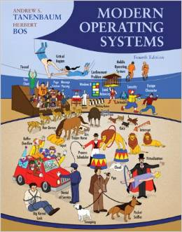
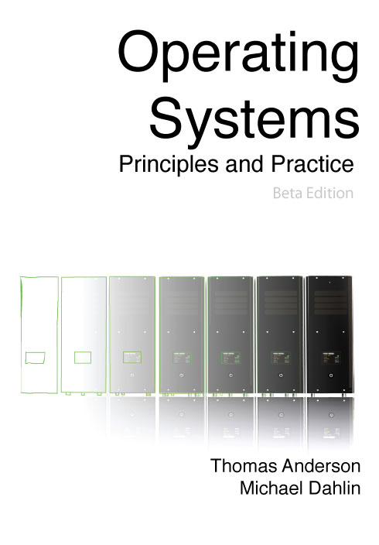
Suggested Textbooks
Modern Operating Systems, 4th Edition
(Main textbook)
Andrew S. Tanenbaum and Herbert Bos
Operating Systems: Principles and Practice
(Further reading)
Thomas Anderson, Michael Dahlin

Slide 6
Personnel
Instructor:
Ding Yuan (yuan@eecg.toronto.edu)
Office hour: 10 minutes after each lecture
Homepage: http://www.eecg.toronto.edu/~yuan
TAs:
David Lion, Mike Qin, Xu Zhao, Yongle Zhang

Slide 7
Prerequisite
Programming experiences (e.g., ECE244)
You will be programming in C
Computer organizations (e.g., ECE243)
What is an Instruction (e.g., load, store)?
What is CPU? Memory? Registers?
What is Stack? Stack pointer?
What is Program Counter (PC)?

Slide 8
Course Contents
Overview of computer hardware
Threads and processes
Synchronization and concurrency
Scheduling
Memory Management, Virtual Memory
Disk Management and File Systems
Advanced topics

Slide 9
Grading
Exams
Mid-term - 25%
Final - 45%
Assignments
Labs - 30%
Policies
No extensions to deadlines
20% penalty per day submitted late

Slide 10
Lab Assignments
We will be using the OS161 teaching OS
Uses a simple MIPS emulator (sys161)
Initially, we provide a barebones OS
You write a simple Unix-like OS by the end of the course!
Runs on Linux machines in UG Workstation Labs
Can also download and install on any Linux machine
It is hard!
Start your assignment early!

Slide 11
Work in pairs (or individually)
You can either work in groups of 2 or individually for the lab assignments
If you work in groups of 2
Make sure you review your partner’s code
Learn to coordinate and be efficient
If your partner drop the course, you can either (1) work individually or (2) pair with another “widower”
Do not allow a group of more than 2
If you work individually
You get 20% bonus on top your existing lab marks
E.g., if you got 20 lab marks for all labs, your final lab mark -> 24
Form your group by January 12th
Send an email to Mike Qin “dai.qin@mail.utoronto.ca” with the subject “ECE344 group information”
Include the names and UTorIDs of you and your partner (or just yourself)

Slide 12
Practice sessions
Optional to attend
TA will be available in the first 1.5 hours of each lab session
But they are there only to answer your question

Slide 13
What to Expect From Lab Assignments
Building an OS is difficult
Perhaps the hardest lab in your undergraduate study
OS: one of the hardest programs to write & debug
Principles may sound easy, implementation is extremely hard
The labs give specifications, not implementations
“God (or devil) is in the detail”
Hack into a large, unfamiliar code base and implement additional features
You will spend a lot of time on the lab assignments
Allows for imagination
Allows for errors and frustration
Lab instructions ask that you design well, before you code
Assume that you will do the design/coding outside lab hours
Notes:
13

Slide 14
But it is rewarding!
Solid understanding of how an OS works
Appreciations on the implementation efforts that make things work
Solid technical capability
Again: OS is one of the hardest programs to write and debug
Quickly hack into unfamiliar code base

Slide 15
What to expect from lectures
Not only understand how, but more importantly, why
You are encouraged to speak up
Ask questions, answer questions
“The mediocre teacher tells. The good teacher explains. The superior teacher demonstrates. The great teacher inspires.”

Slide 16
Exam
Midterm
Covers first half of class
Final
Covers second half of class + selected material from first part
Project-related knowledge may be included in the exams
So do your project and do NOT copy!

Slide 17
Cheating policy
Academic integrity
Your work in this class must be your own – we have zero tolerance policy towards cheating of any kind and any student who cheats will get a failing grade in the course
Both the cheater and the student who aided the cheater will be held responsible for the cheating
We have tools to detect software plagiarism

Slide 18
How NotTo pass ECE344
Do not come to lecture
It’s nice out, the slides are online, and material in the book anyway
TRUTH: Lecture material is the basis for exams
It is much more efficient to learn through discussion
Copy other people’s project
It is cheating!
How can you answer the questions in midterm or final exams?

Slide 19
How NotTo pass ECE344 (2)
Do not ask questions in lecture, office hours, or piazza
It’s scary, I don’t want to embarrass myself
TRUTH: asking questions is the best way to clarify lecture material at the time it is being presented
“There is no such things as stupid question…”
Wait until the last couple of days to start a project
The project cannot be done in the last few days
Repeat: the project cannot be done in the last few days!

Slide 20
Before we start
Any questions?
Do you think this will be a hard class?

Slide 21

Final piazza post from student in 2015’s ECE344

Slide 22
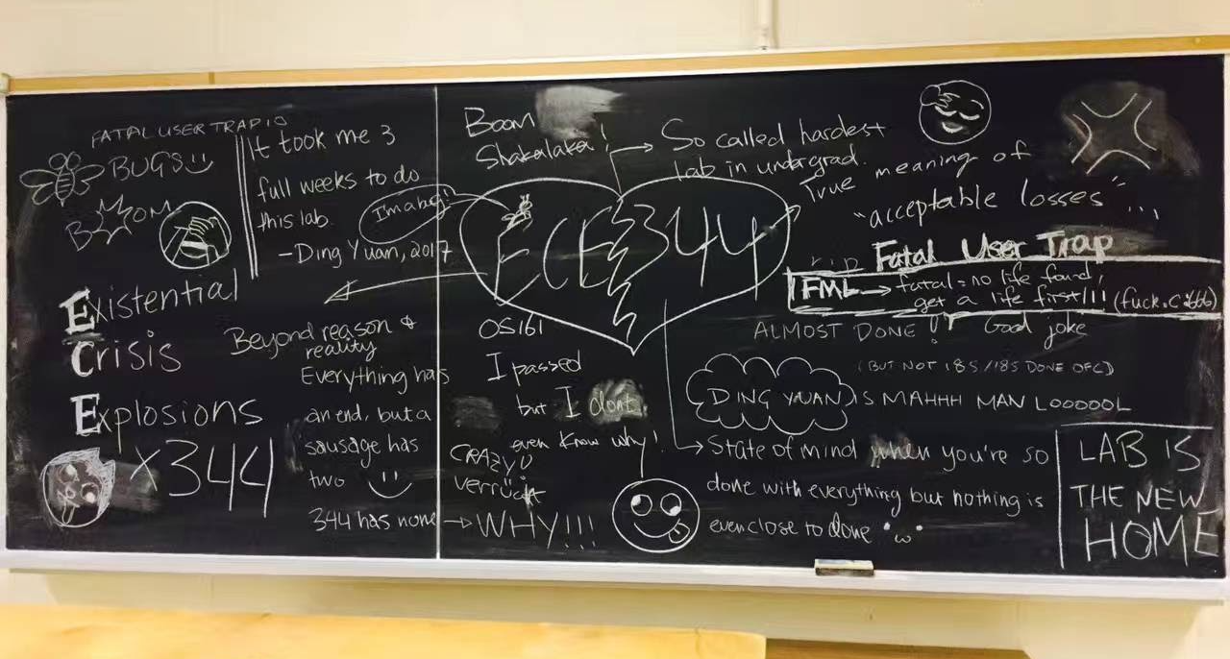
Board in GB251 on the due day of the last lab (2017)

Slide 23
Why learning OS?
Fulfill requirement?
Great programmers understand Operating System
http://www.youtube.com/watch?v=-3Rt2_9d7Jg
Which course is this?
http://matt-welsh.blogspot.ca/2010/10/in-defense-of-mark-zuckerberg.html
Software companies love OS students
OS is the foundation of all software! (and it’s hard to code!)
Academic research in OS is very influential
What do Microsoft, Apple, VMware, or even Google sell?
Notes:
reflection on his experience interacting with Mark

Slide 24
What is an OS?
Anyone?
Give a few names of an OS?
Desktops?
Smart phones?

Slide 25
OS and hardware
The OS abstracts/controls/mediates access to hardware resources (what resources?)
Computation (CPUs)
Volatile storage (memory) and persistent storage (disk, etc.)
Communication (network, modem, etc.)
Input/output devices (keyboard, display, printer, etc.)

Slide 26
Benefits to Applications
Simpler
no tweaking device registers
Device independent
all disks look the same
Portable
same program runs on Windows95/98/ME/NT/2000/XP/Vista/Windows 7/Windows 8/Windows 10
Worry less about interference from other applications

Slide 27
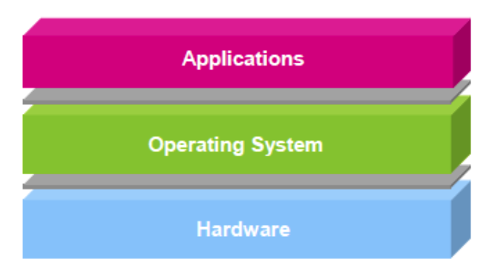
OS is…
Software layer between hardware and applications
The OS is “all the code that you didn’t have to write” to implement your application

Slide 28
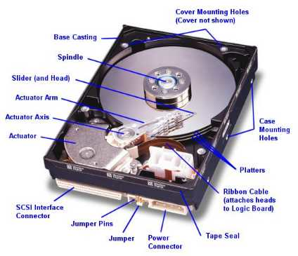

An example comparing life with/without OS
Life with an OS
file = open (“test.txt”, O_WRONLY);
write (file, “test”, 4);
close (file);
Life without an OS
Blocks, platter, track, and sector
Where is this file on disk? Which platter, track, and sectors?
Code needs to change on a different system

Slide 29
What does an OS do?
Resources
Allocation
Protection
Reclamation
Virtualization

Slide 30
What does an OS do?
Resources
Allocation
Protection
Reclamation
Virtualization
Finite resources
Competing demands
Examples:
CPU
Memory
Disk
Network
Government:
Limited budget, Land,
Natural resources

Slide 31
What does an OS do?
Resources
Allocation
Protection
Reclamation
Virtualization
You can’t hurt me,
I can’t hurt you.
Some degrees of
safety and security
Government:
Law and order

Slide 32
What does an OS do?
Resources
Allocation
Protection
Reclamation
Virtualization
The OS gives,
The OS takes away
Some times involun-
tarily
Government:
Income Tax

Slide 33
What does an OS do?
Resources
Allocation
Protection
Reclamation
Virtualization
Illusion of infinite, private resources
Memory vs. disk
Time-shared CPU
Government:
Social welfare and insurance

Slide 34
Why you want to learn OS?
Foundation to other software
Databases, Browsers, Computational software, … …
OS is one of the hardest software piece to write & debug
Directly talks to hardware (very ugly interfaces)
Abstract into clean interfaces
They are BIG
Lines of code:
Windows Vista (2006): 50M (XP + 10M)
Linux 3.6: 15.9 M
Android 4.0: > 1M

Slide 35
Why you want to learn OS?
Many OS concepts (e.g., protection, resource management) is needed in other places
E.g., browser
OS is used everywhere
Your car is running on Linux/Windows

Slide 36
Before the next class
Browse the course web
Start thinking about partners for project groups
See me up front if you have any questions
Let the fun (or grind) begin!

