Slide 1
Operating Systems ECE344
Lecture 4: Threads
Ding Yuan

Slide 2
Processes
Recall that a process includes many things
An address space (defining all the code and data pages)
OS resources (e.g., open files) and accounting information
Execution state (PC, SP, regs, etc.)
Creating a new process is costly because of all of the data structures that must be allocated and initialized
Recall struct proc in Solaris
…which does not even include page tables, perhaps TLB flushing, etc.
Communicating between processes is costly because most communication goes through the OS
Overhead of system calls and copying data

Slide 3
Parallel Programs
To execute these programs we need to
Create several processes that execute in parallel
Cause each to map to the same address space to share data
They are all part of the same computation
Have the OS schedule these processes in parallel
This situation is very inefficient
Space: PCB, page tables, etc.
Time: create data structures, fork and copy addr space, etc.
Solutions: possible to have more efficient, yet cooperative “processes”?

Slide 4
Rethinking Processes
What is similar in these cooperating processes?
They all share the same code and data (address space)
They all share the same privileges
They all share the same resources (files, sockets, etc.)
What don’t they share?
Each has its own execution state: PC, SP, and registers
Key idea: Why don’t we separate the concept of a process from its execution state?
Process: address space, privileges, resources, etc.
Execution state: PC, SP, registers
Exec state also called thread of control, or thread

Slide 5
Threads
Modern OSes (Mac, Windows, modern Unix) separate the concepts of processes and threads
The thread defines a sequential execution stream within a process (PC, SP, registers)
The process defines the address space and general process attributes (everything but threads of execution)
A thread is bound to a single process
Processes, however, can have multiple threads
Threads become the unit of scheduling
Processes are now the containers in which threads execute

Slide 6
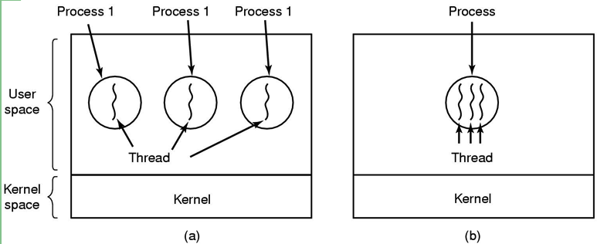
Threads: lightweight processes
execution
environment (resource)
(a) Three processes each with one thread
(b) One process with three threads

Slide 7
The thread model
Shared information
Processor info: parent process, time, etc
Memory: segments, page table, and stats, etc
I/O and file: communication ports, directories and file descriptors, etc
Private state
Registers
Program counter
Execution stack
State (ready, running and blocked)
Why?
Each thread execute separately

Slide 8
Threads in a Process
Stack (T1)
Thread 1
Thread 2
Stack (T2)
Stack (T3)
Thread 3
Heap
Static Data
PC (T3)
PC (T2)
Code
PC (T1)

Slide 9
Threads: Concurrent Servers
Using fork() to create new processes to handle requests in parallel is overkill for such a simple task
Recall our forking Web server:
while (1) {
int sock = accept();
if ((child_pid = fork()) == 0) {
Handle client request
Exit
} else {
Close socket
}
}

Slide 10
Threads: Concurrent Servers
Instead, we can create a new thread for each request
web_server() {
while (1) {
int sock = accept();
thread_create(handle_request, sock);
}
}
handle_request(int sock) {
Process request
close(sock);
}

Slide 11
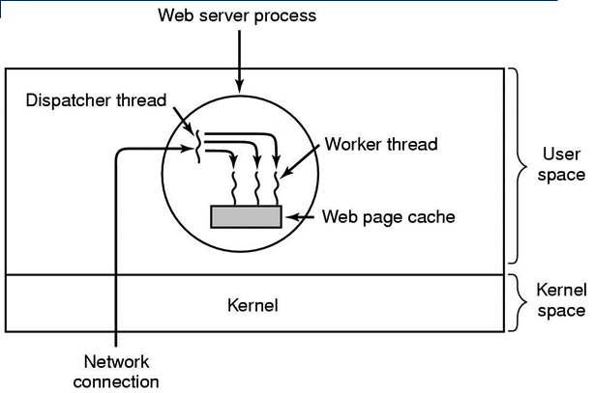
Thread usage: web server

Slide 12
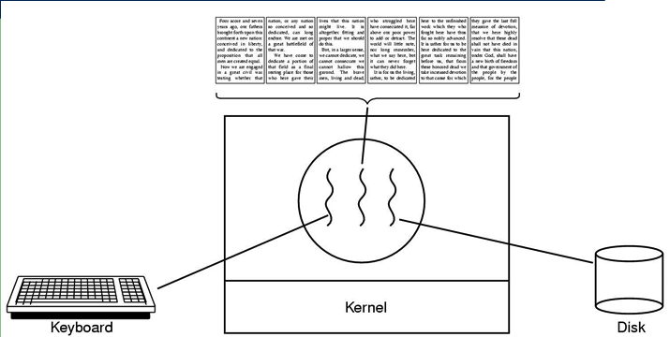
Thread usage: word processor
A thread can wait for I/O, while the other threads can still running.
What if it is single-threaded?

Slide 13
Kernel-Level Threads
We have taken the execution aspect of a process and separated it out into threads
To make concurrency cheaper
As such, the OS now manages threads and processes
All thread operations are implemented in the kernel
The OS schedules all of the threads in the system
OS-managed threads are called kernel-level threads or lightweight processes
Windows: threads
Solaris: lightweight processes (LWP)
POSIX Threads (pthreads): PTHREAD_SCOPE_SYSTEM

Slide 14
Kernel-level Thread Limitations
Kernel-level threads make concurrency much cheaper than processes
Much less state to allocate and initialize
However, for fine-grained concurrency, kernel-level threads still suffer from too much overhead
Thread operations still require system calls
Ideally, want thread operations to be as fast as a procedure call
For such fine-grained concurrency, need even “cheaper” threads

Slide 15
User-Level Threads
To make threads cheap and fast, they need to be implemented at user level
Kernel-level threads are managed by the OS
User-level threads are managed entirely by the run-time system (user-level library)
User-level threads are small and fast
A thread is simply represented by a PC, registers, stack, and small thread control block (TCB)
Creating a new thread, switching between threads, and synchronizing threads are done via procedure call
No kernel involvement
User-level thread operations 100x faster than kernel threads
pthreads: PTHREAD_SCOPE_PROCESS

Slide 16
User-level Thread Limitations
But, user-level threads are not a perfect solution
As with everything else, they are a tradeoff
User-level threads are invisible to the OS
They are not well integrated with the OS
As a result, the OS can make poor decisions
Scheduling a process with idle threads
Blocking a process whose thread initiated an I/O, even though the process has other threads that can execute
Solving this requires communication between the kernel and the user-level thread manager

Slide 17
Kernel- vs. User-level Threads
Kernel-level threads
Integrated with OS (informed scheduling)
Slow to create, manipulate, synchronize
User-level threads
Fast to create, manipulate, synchronize
Not integrated with OS (uninformed scheduling)
Understanding the differences between kernel- and user-level threads is important
For programming (correctness, performance)
For test-taking
Notes:
user thread: lots of thread create/delete activities, not much I/O

Slide 18
Kernel- and User-level Threads
Or use both kernel- and user-level threads
Can associate a user-level thread with a kernel-level thread
Or, multiplex user-level threads on top of kernel-level threads
Java Virtual Machine (JVM)
Java threads are user-level threads
On older Unix, only one “kernel thread” per process
Multiplex all Java threads on this one kernel thread
On Windows NT, modern Unix
Can multiplex Java threads on multiple kernel threads
Can have more Java threads than kernel threads

Slide 19
Implementing Threads
Implementing threads has a number of issues
Interface
Context switch
Preemptive vs. Non-preemptive
What do they mean?
Scheduling
Synchronization (next lecture)
Focus on user-level threads
Kernel-level threads are similar to original process management and implementation in the OS

Slide 20
Sample Thread Interface
thread_create(procedure_t, arg)
Create a new thread of control
Start executing procedure_t
thread_yield()
Voluntarily give up the processor
thread_exit()
Terminate the calling thread; also thread_destroy
thread_join(target_thread)
Suspend the execution of calling thread until target_thread terminates

Slide 21
Thread Scheduling
For user-level thread: scheduling occurs entirely in user-space
The thread scheduler determines when a thread runs
It uses queues to keep track of what threads are doing
Just like the OS and processes
But it is implemented at user-level in a library
Run queue: Threads currently running (usually one)
Ready queue: Threads ready to run
Are there wait queues?

Slide 22
Non-Preemptive Scheduling
Threads voluntarily give up the CPU with thread_yield
What is the output of running these two threads?
Ping Thread
Pong Thread
while (1) {
printf(“ping\n”);
thread_yield();
}
while (1) {
printf(“pong\n”);
thread_yield();
}

Slide 23
thread_yield()
Wait a second. How does thread_yield() work?
The semantics of thread_yield are that it gives up the CPU to another thread
In other words, it context switches to another thread
So what does it mean for thread_yield to return?
It means that another thread called thread_yield!
Execution trace of ping/pong
printf(“ping\n”);
thread_yield();
printf(“pong\n”);
thread_yield();
…

Slide 24
Implementing thread_yield()
The magic step is invoking context_switch()
Why do we need to call append_to_queue()?
thread_yield() {
thread_t old_thread = current_thread;
current_thread = get_next_thread();
append_to_queue(ready_queue, old_thread);
context_switch(old_thread, current_thread);
return;
}
As old thread
As new thread

Slide 25
Thread Context Switch
The context switch routine does all of the magic
Saves context of the currently running thread (old_thread)
Push all machine state onto its stack
Restores context of the next thread
Pop all machine state from the next thread’s stack
The next thread becomes the current thread
Return to caller as new thread
This is all done in assembly language
See arch/mips/mips/switch.S in OS161 (kernel thread implementation)

Slide 26
Wait a minute
Non-preemptive threads have to voluntarily give up CPU
Only voluntary calls to thread_yield(), or thread_exit() causes a context switch
What if one thread never release the CPU (never calls thread_yield())?
We need preemptive user-level thread scheduling

Slide 27
Preemptive Scheduling
Preemptive scheduling causes an involuntary context switch
Need to regain control of processor asynchronously
How?
Use timer interrupt
Timer interrupt handler forces current thread to “call” thread_yield
How?

Slide 28
Process vs. threads
Multithreading is only an option for “cooperative tasks”
Trust and sharing
Process
Strong isolation but poor performance
Thread
Good performance but share too much
Example: web browsers
Safari: multithreading (no longer the case in the latest version)
one webpage can crash entire Safari
Google Chrome: each tab has its own process

Slide 29
Threads Summary
The operating system as a large multithreaded program
Each process executes as a thread within the OS
Multithreading is also very useful for applications
Efficient multithreading requires fast primitives
Processes are too heavyweight
Solution is to separate threads from processes
Kernel-level threads much better, but still significant overhead
User-level threads even better, but not well integrated with OS
Now, how do we get our threads to correctly cooperate with each other?
Synchronization…

