Slide 1
Operating Systems ECE344
Lecture 9: Page Replacement
Ding Yuan

Slide 2
Review
For a memory access instruction
Does it use a virtual address or physical address?
What can happen?
Best case
What if you are unlucky?
Demand paging
What is it?
Page fault
What is it?
Why does it happen?
Who handles it?
How costly is it?

Slide 3
Demand Paging Algorithm
Algorithm NEVER brings a page into main memory until it is needed
Page fault
Check if a valid virtual memory addr. Kill proc. if not.
If valid address, check if it’s cached in memory already (perhaps by other processes). If so, skip to 7.
How can this be possible?
Find a free page frame. If no free page available, choose one to evict (which one? focus of this lecture)
If the victim page is dirty, write it out to disk first
Suspend user process, map address into disk block and fetch disk block into page frame
When disk read finished, add vm mapping for page frame
If necessary, restart process.

Slide 4
Demand Paging (detail)
Some
Pages are evicted to disk when memory is full
Pages loaded from disk when referenced again
References to evicted pages cause a TLB miss
PTE was invalid, causes fault
OS allocates a page frame, reads page from disk
When I/O completes, the OS fills in PTE, marks it valid, and restarts faulting process
Dirty vs. clean pages
Actually, only dirty pages (modified) need to be written to disk
Clean pages do not – but you need to know where on disk to read them from again

Slide 5
Issue: Eviction
Hopefully, kick out a less-useful page
Goal: kick out the page that’s least useful
Problem: how do you determine utility?
Kick out pages that aren’t likely to be used again
Heuristic: temporal locality exists

Slide 6
Page Replacement Strategies
The Principle of Optimality
Replace the page that will not be used again the farthest time in the future
Random replacement
Choose a page randomly
FIFO – First In First Out
Replace the page that has been in memory the longest
LRU – Least Recently Used
Replace the page that has not been used for the longest time
NRU – Not Recently Used
An approximation to LRU

Slide 7
Belady’s Algorithm
Known as the optimal page replacement algorithm because it has the lowest fault rate for any page reference sequence
Idea: Replace the page that will not be used for the longest time in the future
Problem: Have to predict the future!
Why is Belady’s useful then? Use it as a yardstick
Compare implementations of page replacement algorithms with the optimal to gauge room for improvement
If optimal is not much better, then algorithm is pretty good
If optimal is much better, then algorithm could use some work
Random replacement is often the lower bound

Slide 8
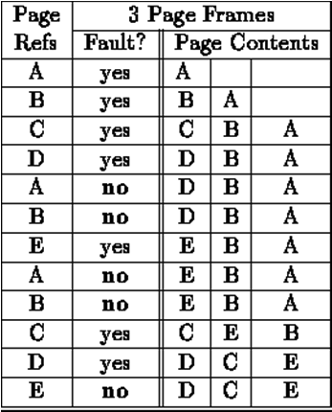
Optimal Example
12 references, 7 faults
Miss rate: 7/12
Hit rate: 5/12

Slide 9
First-In First-Out (FIFO)
FIFO is an obvious algorithm and simple to implement
Maintain a list of pages in order in which they were paged in
On replacement, evict the one brought in longest time ago
Why might this be good?
Maybe the one brought in the longest ago is not being used
Why might this be bad?
Then again, maybe it’s not
We don’t have any info to say one way or the other
FIFO suffers from “Belady’s Anomaly”
The fault rate might actually increase when the algorithm is given more memory (very bad)

Slide 10
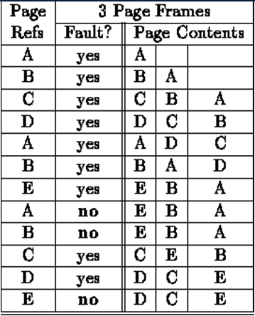
FIFO
12 references, 9 faults
Miss rate: 9/12
Hit rate: 3/12

Slide 11
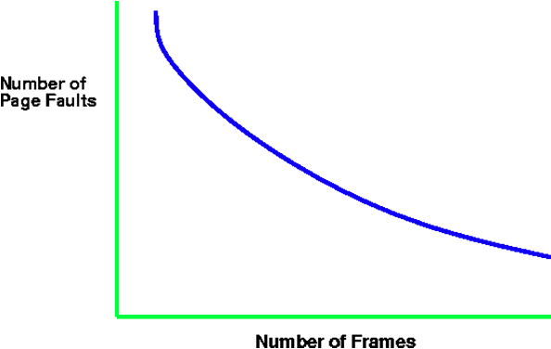
Intuitive Paging Behavior with Increasing Number of Page Frames

Slide 12
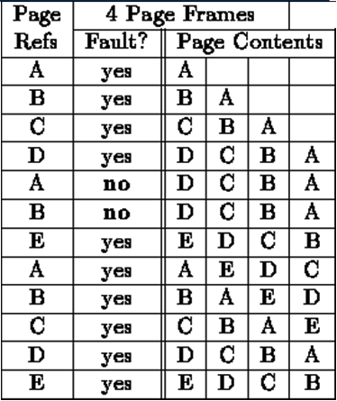
Belady’s Anomaly (for FIFO)
12 references, 10 faults
1
2
3
4
5
6
7
8
9
10
11
12
Notes:
why? because FIFO does not consider the recency of each entry, but only when it was first introduced
The 8th reference: won’t be a fault if only 3 frames.

Slide 13
Least Recently Used (LRU)
LRU uses reference information to make a more informed replacement decision
Idea: We can’t predict the future, but we can make a guess based upon past experience
On replacement, evict the page that has not been used for the longest time in the past (Belady’s: future)
When does LRU do well? When does LRU do poorly?
Implementation
To be perfect, need to time stamp every reference (or maintain a stack) – much too costly
So we need to approximate it

Slide 14
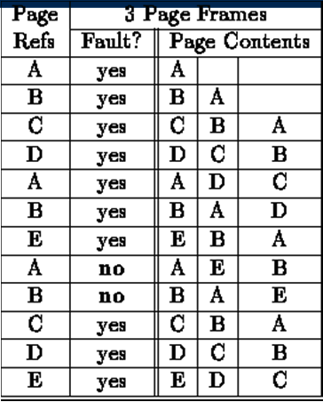
LRU
12 references,
10 faults
Evict A (Least Recent)
No Belady’s anomaly
why?
Evict B (Least Recent)
Notes:
Inclusive. If one more entry, the ones in smaller mem will still be in larger memory. the memory always keeps the last 3 most recently used unique pages. So when you have a miss, it’s not in the most recnelty used last N pages, definitely not in the most recently used last N-1 pages. Most recently used N pages.

Slide 15
Approximating LRU: NRU
NRU: Evict a page that is NOT recently used;
LRU: evict a page that is LEAST recently used
NRU Implementation: simpler than LRU
uses reference bit
a counter is kept per page
At regular intervals, for every page do:
if ref bit = 0, increment counter
if ref bit = 1, zero the counter
zero the reference bit
The counter will contain the number of intervals since the last reference to the page
The page with the largest counter is the least recently used
Notes:
To implement LRU: everytime u ref a page, need to set a timestamp. Why this algorithm is not LRU? Multiple pages with the same counter value.

Slide 16
LRU Clock
Used by Unix
Replace page that is “old enough”
Arrange all of physical page frames in a big circle (clock)
A clock hand is used to select a good LRU candidate
Sweep through the pages in circular order like a clock
If the ref bit is off, it hasn’t been used recently
What is the minimum “age” if ref bit is off?
If the ref bit is on, turn it off and go to next page
Arm moves quickly when pages are needed
Low overhead when plenty of memory

Slide 17
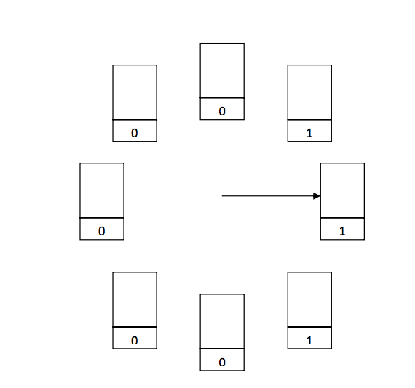
LRU Clock

Slide 18
LRU Clock
0

Slide 19
LRU Clock
0
0

Slide 20
LRU Clock
0
0
Victim page

Slide 21
Switching Gear
So far, all we have talked about is memory management for a single process
What about multiple processes?
If we just use “demand paging” for each process, why do we care?

Slide 22
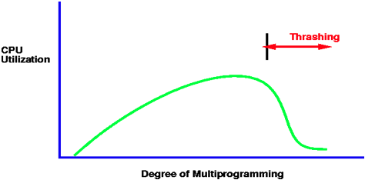
Thrashing and CPU utilization
As the page fault rate goes up, processes get suspended on page queues for the disk
The system may try to optimize performance by starting new jobs
But is it always good?
Starting new jobs will reduce the number of page frames available to each process, increasing the page fault requests
System throughput plunges

Slide 23
Fixed vs. Variable Space
In a multiprogramming system, we need a way to allocate memory to competing processes
Problem: How to determine how much memory to give to each process?
Fixed space algorithms
Each process is given a limit of pages it can use
When it reaches the limit, it replaces from its own pages
Local replacement
Some processes may do well while others suffer
Variable space algorithms
Process’ set of pages grows and shrinks dynamically
Global replacement
One process can ruin it for the rest

Slide 24
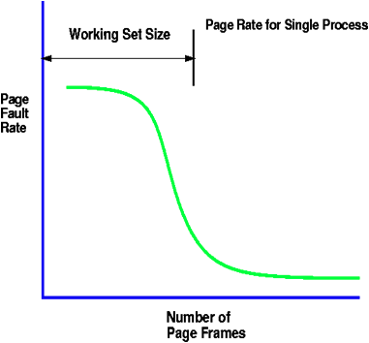
Working Set
The working set model assumes locality
The principle of locality states that a program clusters its access to data and text temporarily
As the number of page frames increases above some threshold, the page fault rate will drop dramatically

Slide 25
Working Set Model
A working set of a process is used to model the dynamic locality of its memory usage
Defined by Peter Denning in 60s
Definition
WS(t,w) = {pages P such that P was referenced in the time interval (t, t-w)}
t – time, w – working set window (measured in page refs)
A page is in the working set (WS) only if it was referenced in the last w references

Slide 26
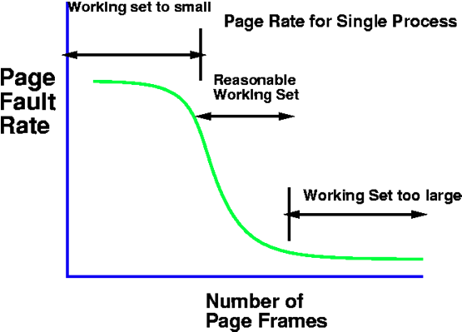
Working Set Size vs. Page Faults

Slide 27
Working Set Size
The working set size is the number of pages in the working set
The number of pages referenced in the interval (t, t-w)
The working set size changes with program locality
During periods of poor locality, you reference more pages
Within that period of time, the working set size is larger
Intuitively, want the working set to be the set of pages a process needs in memory to prevent heavy faulting
Each process has a parameter w that determines a working set with few faults
Denning: Don’t run a process unless working set is in memory

Slide 28
Working Set Problems
Problems
How do we determine w?
How do we know when the working set changes?
Too hard to answer
So, working set is not used in practice as a page replacement algorithm
However, it is still used as an abstraction
The intuition is still valid
When people ask, “How much memory does Firefox need?”, they are in effect asking for the size of Firefox’s working set

Slide 29
Page Fault Frequency (PFF)
Page Fault Frequency (PFF) is a variable space algorithm that uses a more ad-hoc approach
Monitor the fault rate for each process
If the fault rate is above a high threshold, give it more memory
So that it faults less
But not always (FIFO, Belady’s Anomaly)
If the fault rate is below a low threshold, take away memory
Should fault more
But not always
Hard to use PFF to distinguish between changes in locality and changes in size of working set

Slide 30
Summary
Page replacement algorithms
Belady’s – optimal replacement (minimum # of faults)
FIFO – replace page loaded furthest in past
LRU – replace page referenced furthest in past
Approximate using PTE reference bit
LRU Clock – replace page that is “old enough”
Working Set – keep the set of pages in memory that has minimal fault rate (the “working set”)
Page Fault Frequency – grow/shrink page set as a function of fault rate
Multiprogramming
Should a process replace its own page, or that of another?

