Slide 1
ECE 244
Programming Fundamentals
Lec. 12: variable scope
Ding Yuan
ECE Dept., University of Toronto
http://www.eecg.toronto.edu/~yuan

Slide 2
Four ways to hold data
Global variable
  Declared outside of any functions
Arguments
  Passed in on function calls
Local variables
  Declared inside of function or code block
Dynamic variable
  Allocated with “new” and have no name

Slide 3
How are they created and destroyed
 | Created | Destroyed
Global variable | start of program | end of program
Argument | start of function invocation | end of function execution
Local variable | start of code block {..} | end of code block
Dynamic variable | with new | with delete

Slide 4
Examples
int glob; // global variable
int foo(int x, int y) // x and y are arguments
{
int a = 5; // a is local variable
.. ..
}
int main()
{
int a = 3; // a is local variable; different from foo’s a
int b = 4;
..
foo(a,b);
}

Slide 5
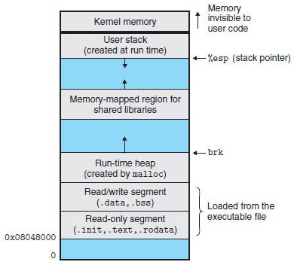
Memory layout
Local vars,
arguments
Dynamic vars
Global vars
Instructions

Slide 6
Call stack: layout before foo is called
int foo(int x, int y)
{
int a1 = 5;
x++;
.. ..
}
int main()
{
int a = 3;
int b = 4;
..
foo(a,b);
}
main’s stack
frame
SP
b = 4
a = 3

Slide 7
Call stack: layout after foo is called
int foo(int x, int y)
{
int a1 = 5;
x++;
.. ..
}
int main()
{
int a = 3;
int b = 4;
..
foo(a,b);
}
SP
a1 = 5
foo’s stack
frame
y = 4
x = 3 4
return addr.
main’s stack
frame
b = 4
a = 3

Slide 8
Call stack: layout after foo returned
int foo(int x, int y)
{
int a1 = 5;
x++;
.. ..
}
int main()
{
int a = 3;
int b = 4;
..
foo(a,b);
}
main’s stack
frame
SP
b = 4
a = 3

Slide 9
Call stack: pass pointers as arg.
int foo(int *x, int *y)
{
int a1 = 5;
*x++;
.. ..
}
int main()
{
int a = 3;
int b = 4;
..
foo(&a,&b);
}
Mem. addr
1100
1104
1108
1112
1116
1120
a1 = 5
foo’s stack
frame
y = 1116
x = 1120
return addr.
main’s stack
frame
b = 4
a = 3 4

