Slide 1
ECE 244 Programming Fundamentals Lec. 18: Quicksort
Ding Yuan
ECE Dept., University of Toronto
http://www.eecg.toronto.edu/~yuan

Slide 2
Sorting
Given a list, put elements in a certain order
One of the most commonly used algorithm; efficiency matters a lot!
Question: how to design an sorting algorithm?
6 3 9 8 5 2 7 1 4
1 2 3 4 5 6 7 8 9

Slide 3
Naïve alg.: bubble sort (slow)
https://en.wikipedia.org/wiki/Bubble_sort#/media/File:Bubble-sort-example-300px.gif
Complexity: n + n-1 + n-2 … + 1 = n(n-1)/2 = O(n^2)

Slide 4
Quicksort
Fastest general sorting algorithm used today
qsort in stdlib.h

Slide 5
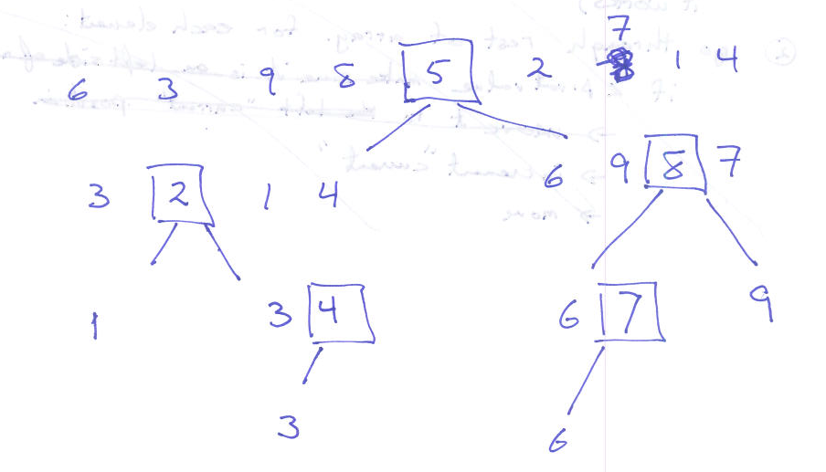
Idea
Pick a pivot value from an array
Move every value < pivot to the left of the pivot
Move every value >= pivot to the right of the pivot
Quicksort sub-array to the left of pivot
Quicksort sub-array to the right of pivot

Slide 6
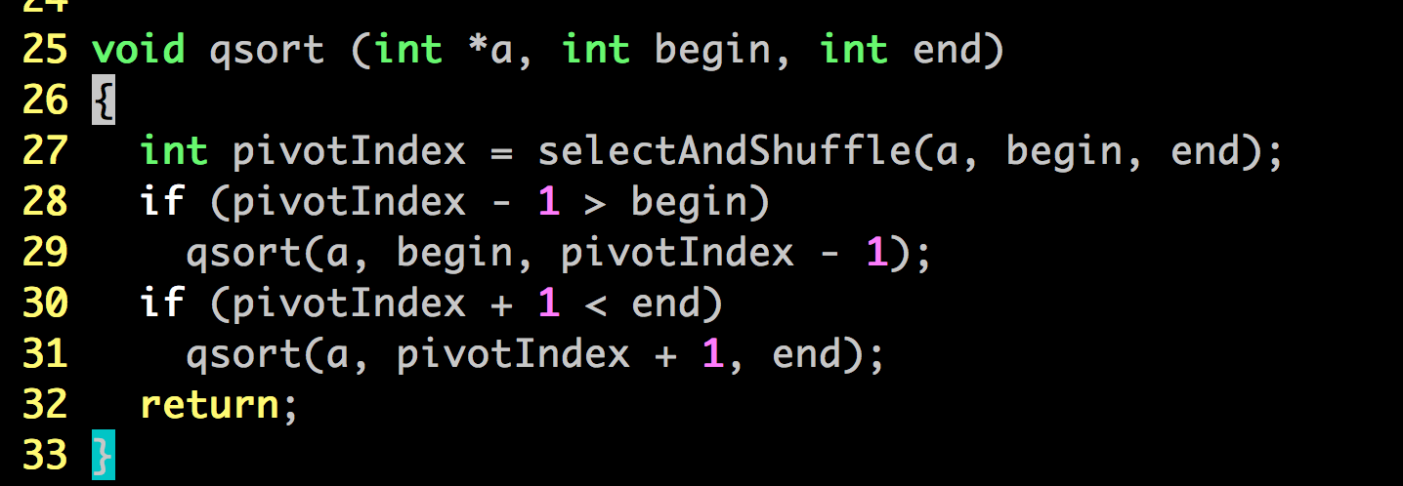
How do we implement it?
6 3 9 8 5 2 7 1 4
selectAndShuffle:
Pick the first element as pivot
Move elements > pivot to its right; elements < pivot to its left
Return the new index of pivot
selectAndShuffle
4 3 5 2 1 6 7 9 8

Slide 7
selectAndShuffle (int *a, int begin, int end)
How do you implement it? Think about it…
6 3 9 8 5 2 7 1 4
selectAndShuffle
4 3 5 2 1 6 7 9 8

Slide 8
Idea
If there are m elements that are < pivot, what is the index of pivot at the end?
Iterate through the array, find every element < pivot
Put the i-th element that is < pivot to the a[i]; how?
Swap!
Finally, swap the m-th element that is < pivot w/ pivot
6 3 9 8 5 2 7 1 4
selectAndShuffle
4 3 5 2 1 6 7 9 8

Slide 9
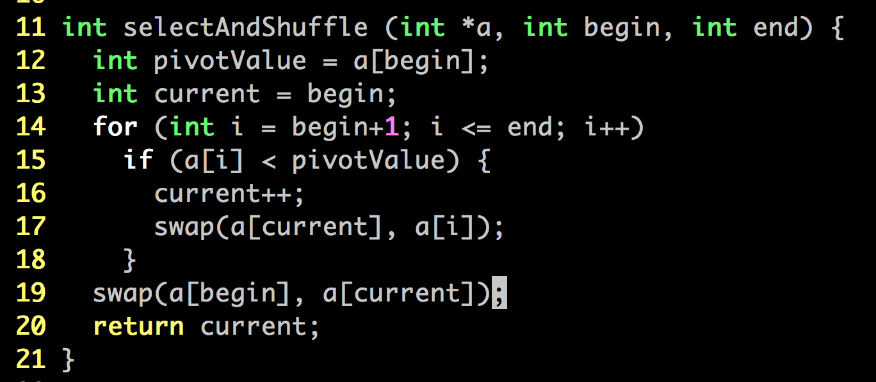
At the end of each iteration i current
6 3 9 8 5 2 7 1 4 - 0
6 3 9 8 5 2 7 1 4 1 1
6 3 9 8 5 2 7 1 4 2 1
6 3 9 8 5 2 7 1 4 3 1
6 3 9 8 5 2 7 1 4 4 2
6 3 5 8 9 2 7 1 4 5 3
6 3 5 2 9 8 7 1 4 6 3
6 3 5 2 9 8 7 1 4 7 4
6 3 5 2 1 8 7 9 4 8 5
6 3 5 2 1 4 7 9 8 9 5
4 3 5 2 1 6 7 9 8 - 5

Slide 10
After selectAndShuffl(a, 0, 8) returns 5
qsort(a, 0, 4)
qsort(a, 6, 8)
4 3 5 2 1 6 7 9 8
4 3 5 2 1
1 2 3 4 5
7 9 8
7 8 9

Slide 11
Complexity
n elements
~log₂(n)
Average performance: O(n log n)

Slide 12
Further considerations
How to choose a pivot point?
First? Last?
Commonly used is median of three
median (a[begin], a[middle], a[end])

Slide 13
Practice questions
Implement the median-of-three pivot value selection
Implement merge sort
Really advanced: parallelize qsort!

