Slide 1
ECE 244 Programming Fundamentals Lec. 20: Binary search tree
Ding Yuan
ECE Dept., University of Toronto
http://www.eecg.toronto.edu/~yuan

Slide 2
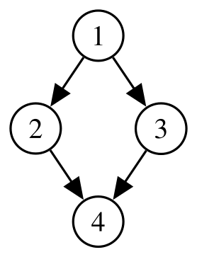
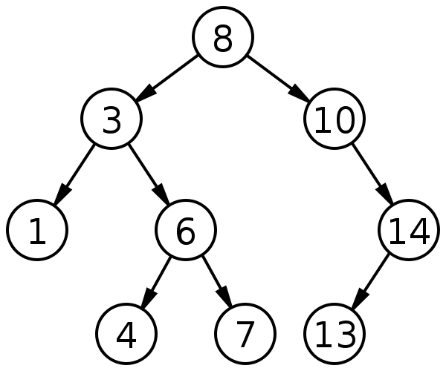
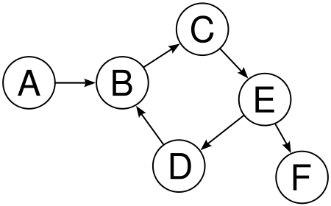
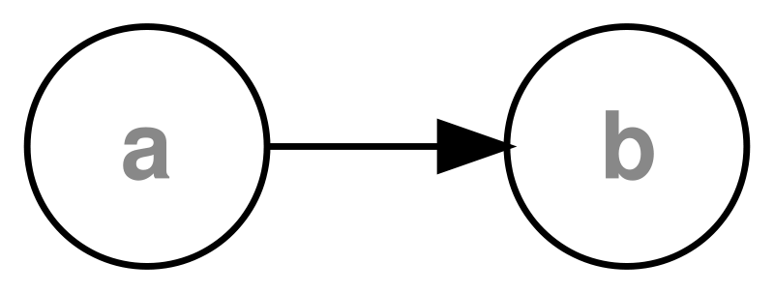
Tree
A data structure made up of nodes and edges
No cycle
Each node can have multiple children, but only one parent
One root
Is it a tree?

Slide 3
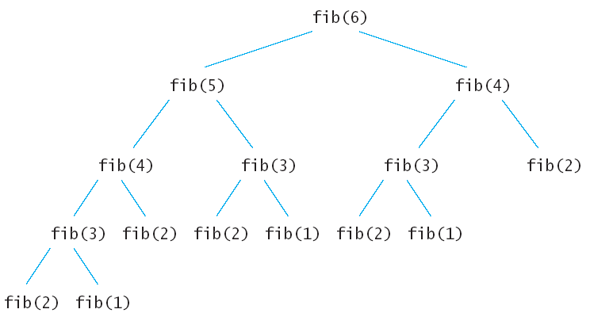
Tree is widely used
Function call tree
Hierarchical debugging
Directory and files (assume no links)

Slide 4
Binary search tree
Binary tree: each node has at most 2 children
Binary search tree: a binary tree s.t. for every node,
the nodes in the left subtree have values <= value of node
the nodes in the right subtree have values > value of node
Minimum value?
Leftmost node w/o a left child
Maximum value?
Right most node w/o a right child

Slide 5
Tree traversal
Visit every element of a tree
Three methods:
Pre-order: node, left subtree, right subtree
8, 3, 1, 6, 4, 7, 10, 14, 13
Post-order: left subtree, right subtree, node
1, 4, 7, 6, 3, 13, 14, 10, 8
In-order: left subtree, node, right subtree
1, 3, 4, 6, 7, 8, 10, 13, 14

Slide 6
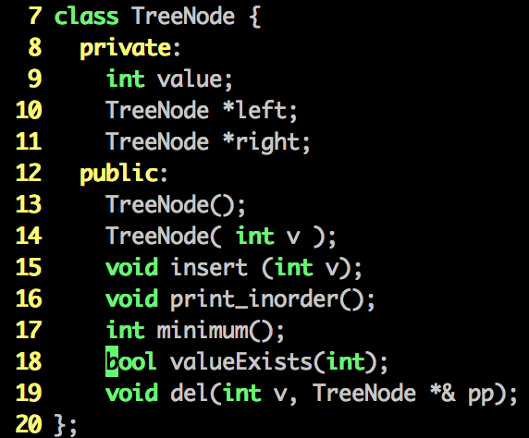
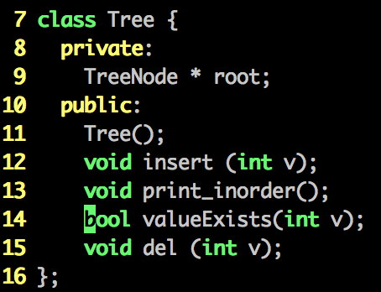
Let’s build a binary search tree

Slide 7
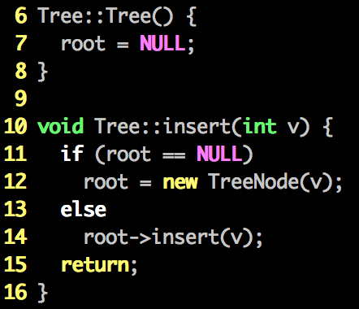
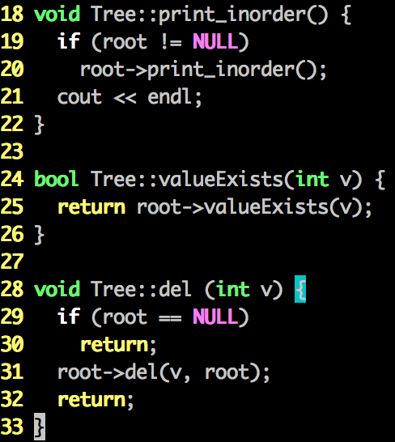
Methods in Tree class

Slide 8
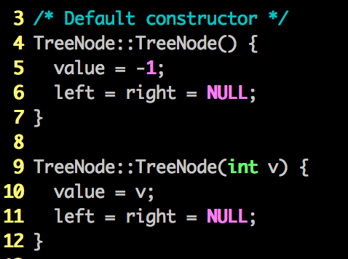
Constructors in TreeNode

Slide 9
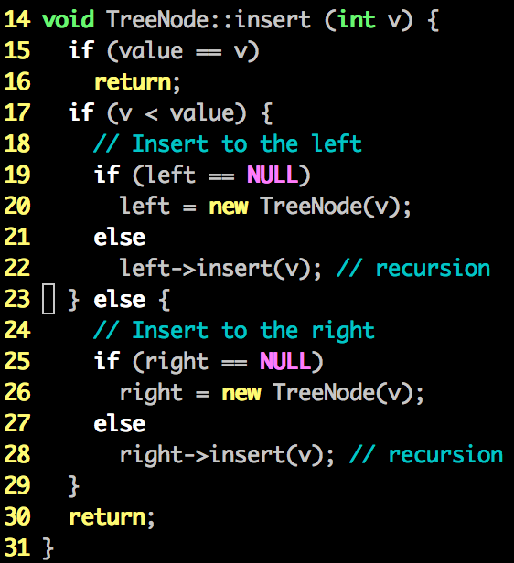
Insert

Slide 10
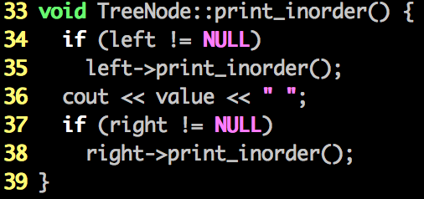
Traversal (in-order)

Slide 11
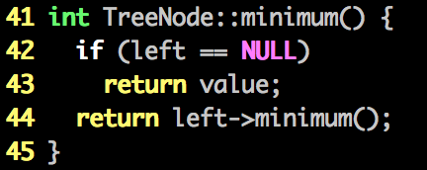
TreeNode::minimum()

Slide 12
TreeNode::del(int v, TreeNode *& pp)
How do we delete a node?
How do we delete 1? 4? 13?
How about 10?
E.g., a node w/ right child but w/o left child
How about 14?
E.g., a node w/ left child but w/o right child
How about 6, 3, 8?
Find the minimum m from the right subtree
Change the value to m
delete that node whose value is m

Slide 13
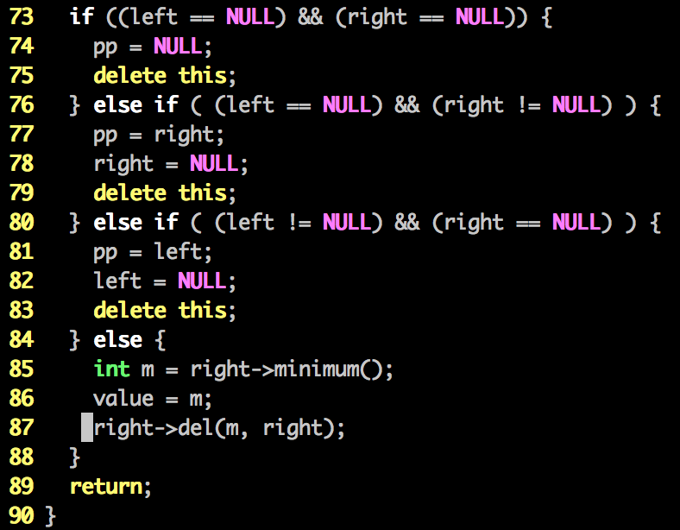

Slide 14
Practice homework
Implement binary search tree yourself
Add destructors
Add copy constructor, overload assignment operator

