Slide 1
ECE 244 Programming Fundamentals Lec.1: Introduction
Ding Yuan
ECE Dept., University of Toronto
http://www.eecg.toronto.edu/~yuan

Slide 2
Content of this lecture
Administration (personnel, policy, agenda, etc.)
Why ECE 244?

Slide 3
Administration

Slide 4
Who am I
Ding YUAN (call me Ding)
Research: operating system, software reliability and performance
Brief BIO:
Ph.D. University of Illinois (UIUC), 2012
Founder of YScope Inc.
Canada Research Chair in Systems Software
Technique invented used by Hadoop, Uber, Google, Huawei, etc.
Contributed hundreds of patches to open-source projects:
Linux kernel, Hadoop, Hbase, Cassandra, Hive, …

Slide 5
Recommended Textbook
Walter Savitch
“Problem Solving with C++”, 10th edition
Not necessary to have the latest edition (5,6,7,8th editions are also fine)

Slide 6
Communications
Class web site: https://www.eecg.utoronto.ca/~yuan/teaching/ece244/
Contains everything: lab handout, course info, etc.
We use Piazza for discussion (link is on class website)
Instructors will answer questions on Piazza board

Slide 7
Policies: Grading
Labs: 25%
Midterm: 30%
October 17, 6-8PM. Open-book (you can bring any book or printed materials; no page limit)
But no computer-aid
Final: 45%

Slide 8
Policies: Assignments
Work individually
You should be working on your own
Discussion is allowed, BUT should not look at others’ code
Don’t put assignment code on public repositories (e.g., GitHub)!
Handins
Electronic hand-ins only
Follow the submit procedure (as specified in lab handout)

Slide 9
Policies: Cheating
Cheating is a serious offence, will be punished harshly
0 grade for assignment, potential for official letter in file.
What is cheating?
Using someone else’s solution to finish your assignment to avoid having to understand/learn
Sharing code
Copying or retyping
What is NOT cheating?
Helping others use systems or tools.
Helping others with high-level design issues.
Helping others debug their code.
We do use cheater-beaters
Automatically compares your solutions with others

Slide 10
Tutorials
TUT01/02: WE 11-12, *MC252* only
TUT03/04: FR 15-16, *GB248* only
TUT05/06: FR 9-10, *GB119* only
To answer questions
Elaborate lab assignment
Review materials
No new material is covered in tutorials

Slide 11
Lab assignments
5 of them
Lab 1 is already released (due on 9/23)
Lab sessions
Room SF1012/SF1013
TAs on duty
Not mandatory to attend lab sessions (you can ssh into lab machines)
But if you do the labs on your own machine, you have to make sure they work on the lab machine environment

Slide 12
Tutorial & Labs start next week (9/12)

Slide 13
Office hour
10 minutes after each lecture, or by appointment

Slide 14
How NotTo pass ECE244
Do not come to lecture
It’s nice out, material in the book anyway
TRUTH: Lecture material is the basis for exams (we will not follow text book closely)
It is much more efficient to learn through discussion
Copy other people’s project
It is cheating!
How can you answer the questions in midterm or final exams?

Slide 15
How NotTo pass ECE244 (2)
Do not ask questions in lecture, office hours, or discussion board
It’s scary, I don’t want to embarrass myself
TRUTH: asking questions is the best way to clarify lecture material at the time it is being presented
“There is no such things as stupid question…”
Wait until the last couple of days to start a project
The project cannot be done in the last few days

Slide 16
Before we start
Any questions?

Slide 17
Why ECE 244?

Slide 18
Why software?
Programming is FUN!
Software innovation is highly influential and exciting
World’s largest companies are founded by programmers
Microsoft, Apple, Google, Facebook, etc.
Software industry is growing growing growing
“The unemployment rate for software engineers in silicon valley is 0%”
Software is powering everything: including your car, watch, etc.

Slide 19
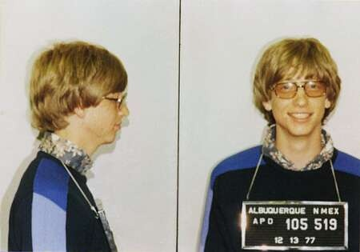
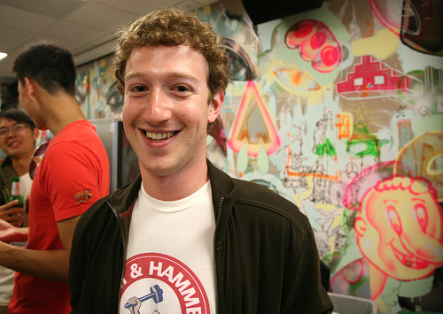
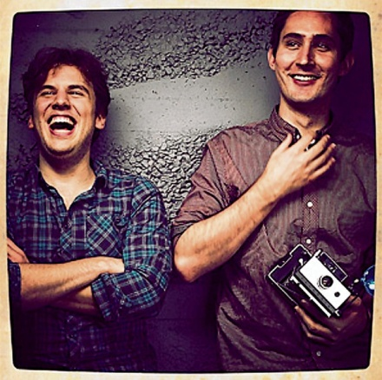
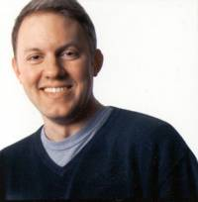
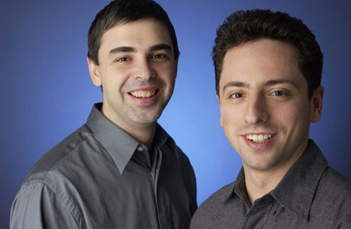
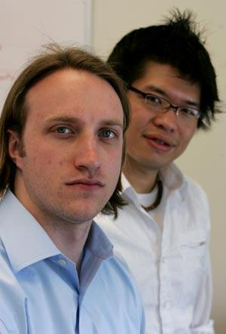
Start a Company in your 20’s!
Notes:
Instagram: Kevin Systrom, Mike Krieger
Marc Andreesen: netscape
Larry page
Youtube: Chad Hurley, Steve Chen

Slide 20
Why Take this Course?
(First step to) become a superstar programmer
Superstar programmers are increasingly in demand
A superstar programmer is worth 1000x normal – Bill Gates
How to become superstar programmer?
Practice + solid background

Slide 21
Goals of this course
Continues where APS105 left off
Teach more advanced programming techniques
Teach use of software tools and environment
First step towards a solid understanding of software

Slide 22
Why C/C++?
Why not Python? Javascript? Ruby?
Because C/C++ gives you more control (and it’s harder)!
It’s easy to learn other languages once you know C/C++, but not the other way
C was my first language
Up until now I have used over 20 languages, all others are easy to learn – they are influenced by C anyway
It is closer to how computer actually works
Best programmers are C/C++ experts!

Slide 23
Why C/C++? (cont.)
Why not Python? Javascript? Ruby?
Because C/C++ gives you more control (and it’s harder)!
It’s easy to learn other languages once you know C/C++, but not the other way
C was my first language
Up until now I have used over 20 languages, all others are easy to learn – they are influenced by C anyway
It is closer to how computer actually works
Best programmers are C/C++ experts!
Other languages are all implemented in C/C++!

Slide 24
C vs. C++
C++ is a superset of C
C is an extremely elegant language, C++ is not
“C++ I think is basically too big a language, although there's a reason for almost everything that's in it. When I write a C program of any size, I probably will wind-up using 75, 80, 90% of the language features. In other words, most of the language is useful in almost any kind of program. By contrast, if I write in C++ I probably don't use even 10% of the language, and in fact the other 90% I don't think I understand.”
--- Brian Kernighan, author of the “K&R C” book
This class will focus on C and the Object-Oriented aspects of C++

Slide 25
Topic of this course
Thorough understanding of C
In particular, pointers
Compilation
C++: OO-features
Class & objects
Inheritance
Templates
Problem solving
Data structures: linked list, tree, graphs, etc.
Recursions
Exception handling
Complexity analysis

Slide 26
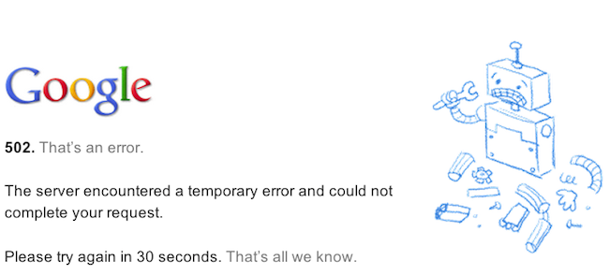
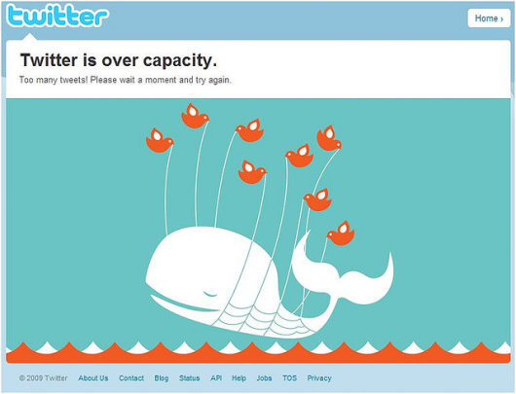
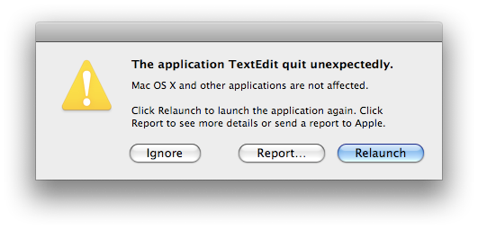
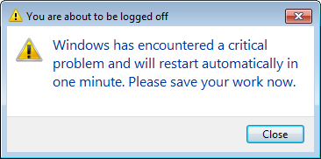
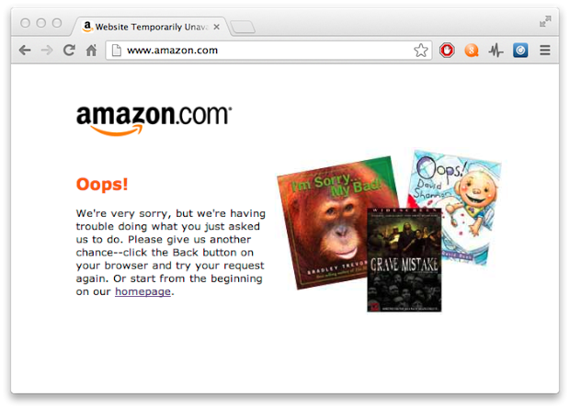
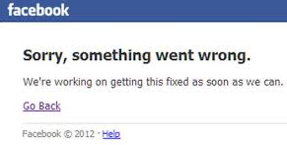
Warning: software is hard!

Slide 27
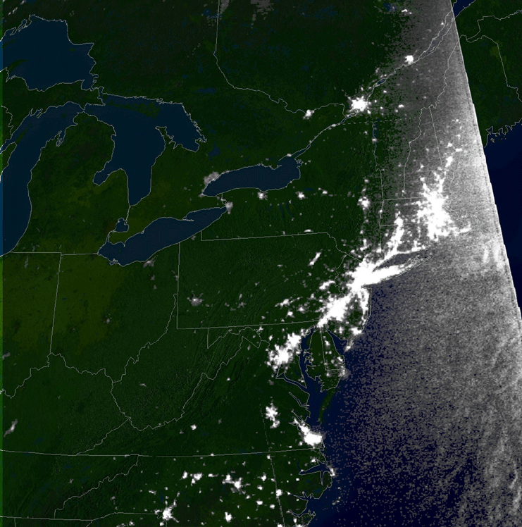
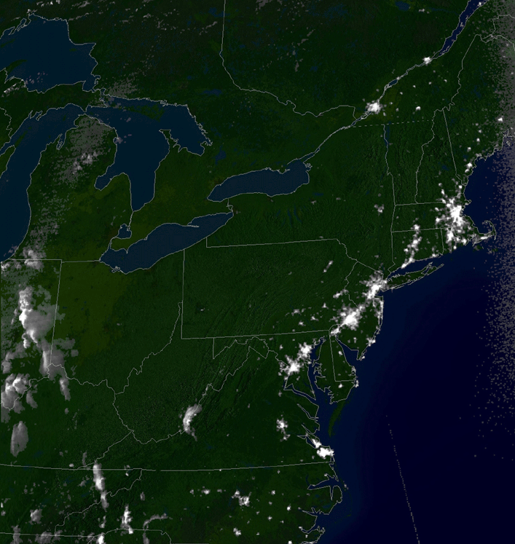
2003 Northeast blackout is caused by software bug
Notes:
10 Million in Ontario. diapers

