Slide 1
ECE 244 Programming Fundamentals Lec.22: Inheritance
Ding Yuan
ECE Dept., University of Toronto
http://www.eecg.toronto.edu/~yuan

Slide 2
What is inheritance?
Two classes, i.e., base class and derived class, share a lot of properties, yet the derived class has its own properties

Slide 3
Real-world examples
2004
2009
2012
2016

Slide 4
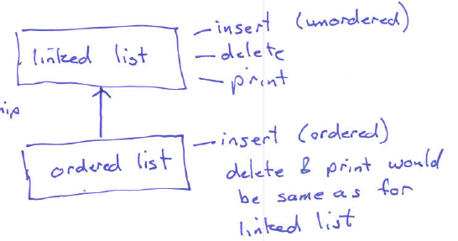
Key benefit/motivation
You want to reuse code (or features) from other classes
Example:
If you already implemented linked list, now you want to implement another class: ordered linked list
Can we reuse code?

Slide 5
Inheritance
A powerful mechanism to allow a class, say B, to “inherit” the content of another class, say A
Also called superclass/subclass
A derived class is always larger than the base class
Derived class receives all of the member variables and functions of the base class
Therefore in derived class, we can directly use the members of the base class
Can also extend/customize/override as needed
A: base class
B: derived class

Slide 6
Syntax
class DerivedClass : public BaseClass
{
/* Only list the inherited members if you wish
to change them, plus new members you’re adding. */
}
Example:
class OrderedList : public List {
void insert (int v); // redefine insert()
// value, next, delete(), print()… are all inherited,
// and you can use them as if they were defined in
// OrderedList
}

Slide 7
Usage of derived class
Once derived class is declared, you can use it just like any other class
E.g. void OrderedList::insert(int v) { … }
OrderedList *list = new OrderedList;

Slide 8
Data protection
Derived classes CANNOT access private members of base class
But these private members are inherited!
I.e., in this example, when you instantiate an object of Derived class, there will be memory allocated for “a”
class Base {
private:
int a;
.. ..
};
class Derived : public Base {
private:
..
};

Slide 9
Protected members
What if we want a member variable/function to be accessible to derived class, but inaccessible to outside?
C++ provides another access specifier: protected
class Base {
private:
protected:
int a;
.. ..
};
class Derived : public Base {
// Can access “a” as a member variable.
};

Slide 10
Overriding (i.e., redefining) vs. Overloading
Overloading: same function name, different parameter list
void foo (int v);
void foo (double d);
void foo (int i, int j);
Overriding: redefine a function in derived class
List::insert (int a);
OrderedList::insert (int a);
You can also redefine a member var, say “a”, w/ the same name in derived class
There will be two copies of “a” – one in base obj. and one in derived class obj.

