Slide 1
ECE 244 Programming Fundamentals Lec.23: Inheritance 2
Ding Yuan
ECE Dept., University of Toronto
http://www.eecg.toronto.edu/~yuan

Slide 2
True or False?
Derived class inherits all member variables from base class
Derived class can access private members of base class
Derived class can access protected members of base class
Derived class can add member vars and functions
Derived class can remove member vars and functions

Slide 3
Class Hierarchies
name
D.O.B.
addr.
Staff
wage
hours
Employee
salary
start date
Temporary
Secretary
Manager
level
report list
staff list
Consultant
TSecretary
expertise

Slide 4
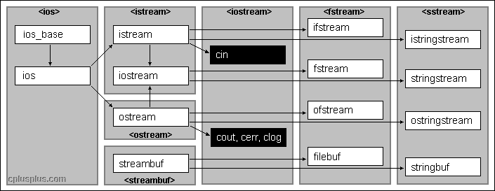
Another example

Slide 5
Mixing types
A Manager is an Employee, but an Employee is not a Manager.
Hence:
Why?
void g (Manager mm, Employee ee)
{
Employee *pe = &mm; // OK
Manager *pm = &ee; // Not OK!
..
}
Employee
Manager

Slide 6
Mixing types (cont.)
This can be very useful; for example, you can implement a linked list of Employees, and insert a manager – no problem at all
Example: C++ containers
void g (Manager mm, Employee ee)
{
vector<Employee> vec;
vec.push_back(ee);
vec.push_back(mm);
cout << “Size: “ << vec.size();
}
Employee
Manager

Slide 7
Inheritance vs. Membership
Why not:
How does this compare to inheritance?
“Is a” relationship vs. “has a”
class Manager
{
private:
Employee emp;
..
}

Slide 8
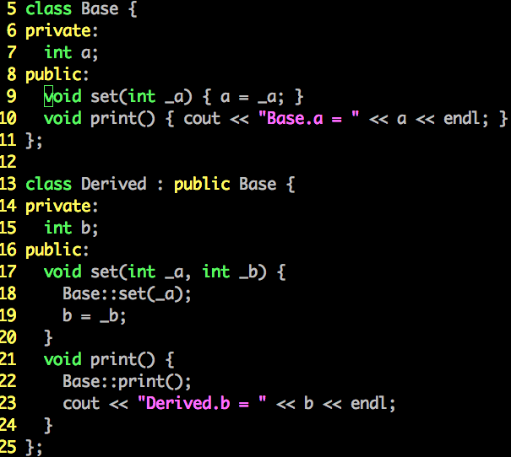
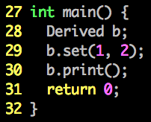
Accessing parent members

Slide 9
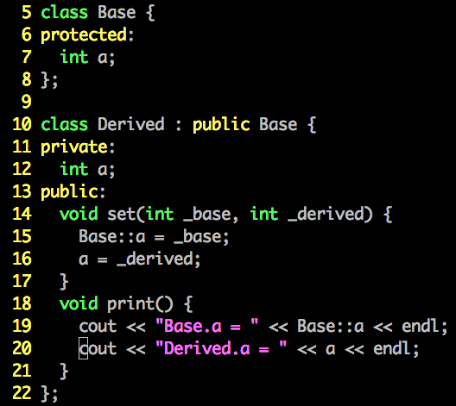
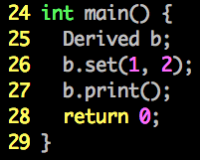
Accessing parent members (cont.)

Slide 10
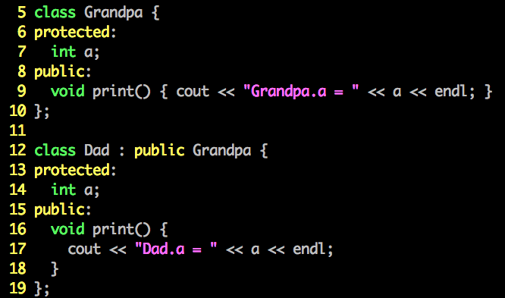
You can access predecessor’s members

Slide 11
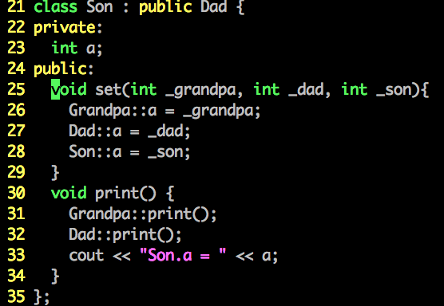
You can access predecessor’s members

Slide 12
Mixing types
A Manager is an Employee, but an Employee is not a Manager.
Hence:
Why?
void g (Manager mm, Employee ee)
{
Employee *pe = &mm; // OK
Manager *pm = &ee; // Not OK!
..
}
Employee
Manager

Slide 13
Mixing types (cont.)
This can be very useful; for example, you can implement a linked list of Employees, and insert a manager – no problem at all
Example: C++ containers
void g (Manager mm, Employee ee)
{
vector<Employee> vec;
vec.push_back(ee);
vec.push_back(mm);
cout << “Size: “ << vec.size();
}
Employee
Manager

Slide 14
Base/derived class in containers
When storing base *objects* into container (e.g., vector), cannot convert it back to derived class obj.
But you can convert pointers
vector<Employee> vec;
vec.push_back(manager);
vec[0].print_manager_level(); // ERROR
vector<Employee*> vec;
vec.push_back(&manager);
((Manager*)vec[0])->print_manager_level(); // OK

Slide 15
Inheritance vs. Membership
Why not:
How does this compare to inheritance?
“Is a” relationship vs. “has a”
class Manager
{
private:
Employee emp;
..
}

Slide 16
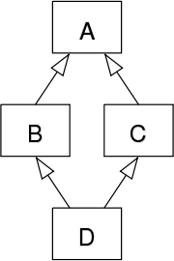
Avoid multiple inheritance
class Grandpa {
private:
char* name;
public:
char* getName () { return name; }
};
class Parent1 : public Grandpa { .. };
class Parent2 : public Grandpa { .. };
class Child : public Parent1, public Parent2 { .. };
int main () {
Child c;
c.getName();
.. ..
}
Diamond of Dread
- The code won’t compile
TWO copies of Grandpa’s members are created when creating a Child object
Compiler doesn’t know which “getName()” should be invoked

