Slide 1
ECE 244
Programming Fundamentals
Lec.24: Inheritance 3
Constructors
Ding Yuan
ECE Dept., University of Toronto
http://www.eecg.toronto.edu/~yuan

Slide 2
Recall
A public function f() in Base class is inherited by Derived class
  I.e., objects of class Derived have f() in its interface
Example:
class Base {
public:
void f() {..};
};
class Derived {
/* does not redefine f() */
}
Derived p;
p.f(); // Invoke Base::f(), no problem!

Slide 3
Functions not inherited
I.e., an object of Derived class does not have the following functions of Base in its interface
  But it does not mean that these functions, which are defined in Base, will not be invoked through a Derived object
  Huh? Subtle, so focus on understanding instead of terminology
Constructors
Destructor
Copy constructor
operator=

Slide 4
Constructors in Inheritance
Constructors are NOT inherited
  E.g., Base::Base(int) won’t be invoked by Derived d(3), if Derived::Derived(int) is not defined
If you don’t explicitly call a base constructor, the default base constructor is called when initializing a derived class object
You can explicitly call (non-default) base constructor using the following syntax:
  Derived::Derived(..) : Base(..) { .. }
Base constructor always called first!
Notes:
Q:

Slide 5
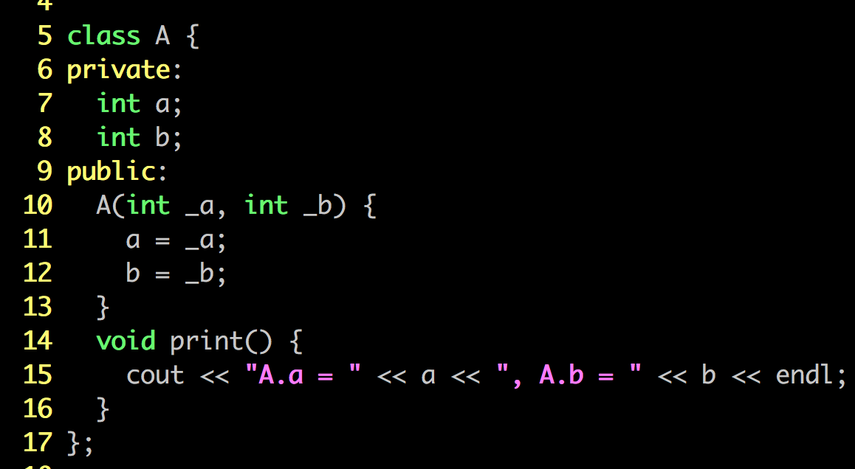
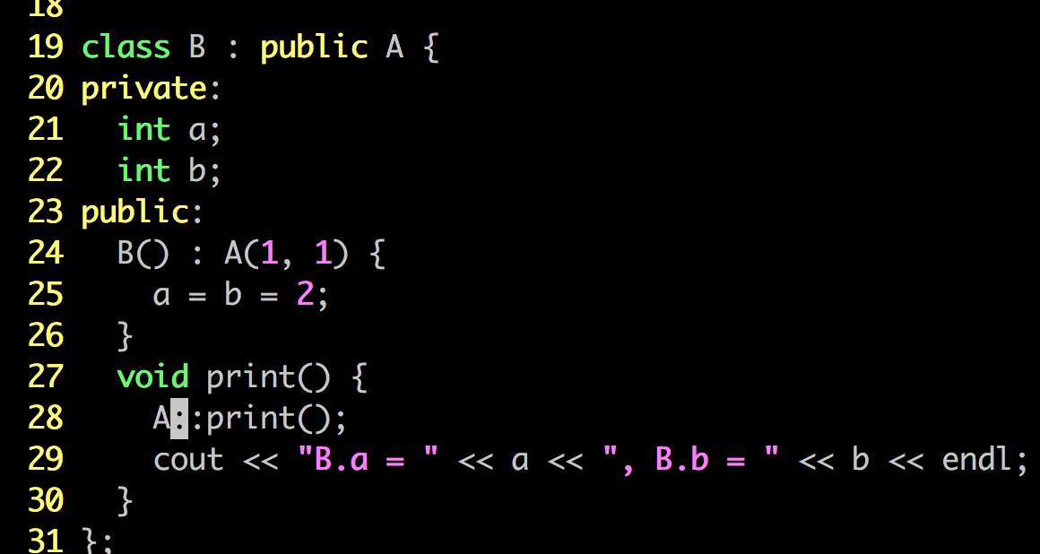

Slide 6
Aside: initialize member vars in Constructor w/ similar syntax
class Employee {
private:
string name;
int sin;
public:
Employee() : name (“”), sin(0) { /* deliberately left empty */ }
Employee(string n, int s) : name(n), sin(s) { /* empty */ }
};
.. ..
Manager::Manager(string n, int sin, int _level)
: Employee(n, sin), level(_level) { /* empty */ }

Slide 7
Order of constructor invocations
In this case, Staff() being invoked first, then Employee(), then Manager()
Staff
Employee
Manager

Slide 8
About default constructor
When there is a user declared constructor of any type, there is no compiler-generated default constructor

Slide 9
Destructors
Destructor of the base class is called automatically
But after derived class’s destructor
In this case, the order of destructor invocation: ~Manager(), ~Employee(), ~Staff()
  One way to remember: multiple levels of inheritance works like a stack
Staff
Employee
Manager

Slide 10
Inheritance & dynamic memory
Recall: whenever a class contains member vars that point to dynamic memory, we should manage memory and write our own code for:
  operator=
  copy constructor
This is no different with derived class
Base
Deep copy base class member variables
call base class copy function
deep copy extra member vars contained in derived class
Derived

Slide 11
Example
Base::Base (const Base & original) {
// Deep copy original into *this
}
Derived::Derived (const Derived & original) : Base(original)
{
// Deep copy extra Derived vars
}
You have to call Base(original) yourself
  If you don’t call it yourself, the default constructor of Base will be invoked – Error!!!
Notes:
Demo: copy_constructor.cc
Try remove the : Base (original)

Slide 12
Example: operator=
Base & Base::operator= (const Base & rhs) {
// Deep copy
}
Derived & Derived::operator= (const Derived & rhs)
{
Base::operator=(rhs);
// Deep copy any extra Derived variables
return (*this);
}

Slide 13
Revisit the terminology: “F is not inherited”
Where F = constructors/destructor/operator=/copy constructor
  Not in Derived class interface, but can still be invoked
  Examples:
class Base {
public:
Base (int) { .. }
};
class Derived {
/* No Derived(int) */
}
Derived p (10); // Compile error
class Base {
public:
Base () { .. }
};
class Derived {
}
Derived p; // Correct, and Base() is invoked!! – Base() is NOT in the interface of Derived, but it will be invoked!

