Slide 1
ECE 244 Programming Fundamentals Lec.2: Intro to C++
Ding Yuan
ECE Dept., University of Toronto
http://www.eecg.toronto.edu/~yuan

Slide 2
Content of this lecture
Computer hardware
Basic C++ program
Simple I/O
Strings in C++
Functions: formal versus actual parameter
Functions: pass-by-value vs. pass-by-reference

Slide 3
Why start with hardware?
Programs are fundamentally executed by hardware
Understand h/w can simplify your understanding of programming language
Great programmers need to understand hardware to write high performance code
But more of a topic in your future courses (e.g., “Operating Systems”, “Computer Systems Programming”, “Compiler”)

Slide 4
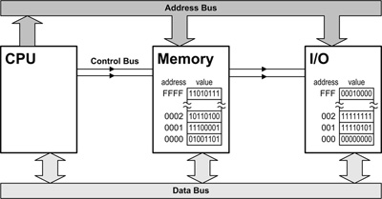
Inside a computer
push %ebp
mov %esp,%ebp
.. ..

Slide 5
C++ Fundamental Types
Integers
int (32 bits)
short (16 bits)
long int (>= 32 bits)
Real
float
double
long double
Logic: bool
void
Signed (default), or
Unsigned
Text
char (1 byte)
E.g., ‘A’, b’ (note single quote). Not “A”, which is a string

Slide 6
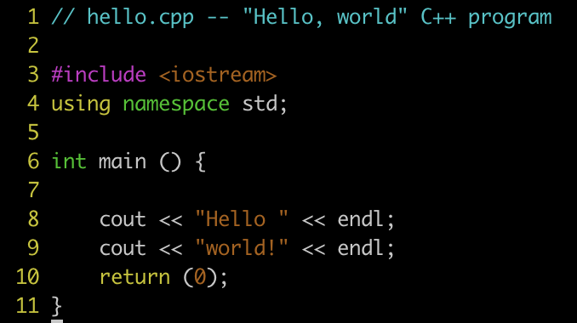
Basic C++ program
Demo
Notes:
cout: stream object

Slide 7
Functions
Where does C++ program start executing?
int main(int argc, char* argv[])
But you should define your own functions. Why?
Logical code grouping
Easier to understand & debug
Easier to reuse code (refactoring)

Slide 8
User-defined functions
[result type][function name]([param list])
Must have name
May take parameters
May return a result
May have local variables
Must be declared before used

Slide 9
User-defined functions examples
[result type][function name]([param list])
int foo (int x, char y)
double bar ()
void boring()

Slide 10
Function declaration vs. definition
#include <iostream>
using namespace std;
int main ()
{
boo();
return 0;
}
void boo()
{
cout << “Hello!” << endl;
return;
}
Problems?
Notes:
When you declare a variable, a function, or even a class all you are doing is saying: there is something with this name, and it has this type.

Slide 11
Correct programs
#include <iostream>
using namespace std;
void boo();
int main ()
{
boo();
return 0;
}
void boo()
{
cout << “Hello!” << endl;
return;
}
#include <iostream>
using namespace std;
void boo()
{
cout << “Hello!” << endl;
return;
}
int main ()
{
boo();
return 0;
}

Slide 12
Function declaration
Cannot always write programs so that functions are written before they are used
E.g., A() calls B() and B() calls A() – recursive program
Need to declare function prototype before definitions
[result type][function name]([list of param. types]);
int foo (int x, char y);
int foo (int, char);
int foo (int /* student number */,
char /* group */);

Slide 13
Function parameters
Formal vs. actual parameters
int bump (int mark) { /* mark is a formal param */
if (mark < 90) {
mark += 10;
}
return mark;
}
int main () {
for (int i = 0; i < STUDENTNUM; i++) {
int yourmark = marksheet[i];
cout << “Student ” << i << “’s mark is: ”
<< bump(yourmark) << endl;
/* yourmark is the actual param. */
}
}

Slide 14
Pass-by-value vs. pass-by-pointer
void bump_value (int mark){
if (mark < 90) {
mark += 10;
}
}
void bump_pointer(int* markPtr){
if (*markPtr < 90) {
*markPtr += 10;
}
}
int main () {
int yourmark = 72;
bump_value(yourmark);
cout << yourmark << endl;
bump_pointer(&yourmark);
cout << yourmark << endl;
bump_pointer(&yourmark);
cout << yourmark << endl;
}
markPtr
mark
yourmark
0x80
72
72
Memory:
addr.(0x): 60 61 62 63 64 65 66 67 .. .. 70 71 72 73 .. 80 81 82 83

Slide 15
Pass-by-reference: C++ reference
void bump_ref (int& mark){
if (mark < 90) {
mark += 10;
} else {
mark = 100;
}
}
int main () {
int yourmark = 72;
bump_ref(yourmark);
cout << yourmark << endl;
bump_ref(yourmark);
cout << yourmark << endl;
}
Reference is an “alias”, or alternate name, to an existing variable
mark in bump_ref() is an alias of yourmark
The primary use of reference: function formal parameter
So the function works on the original copy of the var.

Slide 16
Reference vs. Pointer
Reference is a safer, but less powerful, pointer
Why safer? Strict type checking by compiler
Cannot assign an ‘int’ variable to a ‘char&’ reference, but pointers can be type-casted to anything
Reference cannot be reassigned
What happens to this code?
It must be assigned at initialization
E.g., “int& a;” won’t compile
Reference cannot be assigned to NULL
Reference variables do NOT have separate memory allocation
1 int a = 0, b = 10;
2 int& ra = a;
3 cout << ra << endl;
4 ra = b;
5 cout << a <<endl;
Notes:
any occurrence of the reference name refers directly to the object it references

Slide 17
Things I assume you already know
Variable and types
char, short, float, double, long
Operators and expressions
Arithmetic: +, -, *, /, %
Relational: >, >=, <, <=, ==, !=
Logical: !, &&, ||
Increment/decrement: ++a, a++, --a, a--
Bitwise: &, |, ^, <<, >>, ~
Control-flow
if-else, else-if, switch, while, for, do-while, break, continue

