Slide 1
ECE 244 Programming Fundamentals Lec.3: Program Organization
Ding Yuan
ECE Dept., University of Toronto
http://www.eecg.toronto.edu/~yuan

Slide 2
Content of this lecture
Organizing C++ code into .h and .cc files
Use of #ifndef in .h files

Slide 3
Why multiple files?
First of all, technically you don’t HAVE to use multiple files
But it is a good practice
Just like you don’t put all statements in one line
Why multiple files?
Speed up compilation
Only compiles a .cc file when it is changed
Keep your code organized
Separate interface from implementation
E.g. function prototype from definition

Slide 4
Example: linked list
5
187
23
3
/* Always insert from the beginning, return the new head. */
Node* insert (Node* head, int value);
/* Search the list; if found, return the node.
* Return NULL if not found. */
Node* search (Node* head, int value);

Slide 5
The Files
linked_list.h
Header file: declarations of functions & data structures
insert.cc
Implementation of list_insert function
search.cc
Implementation of list_search function
main.cc
Implementation of main function

Slide 6
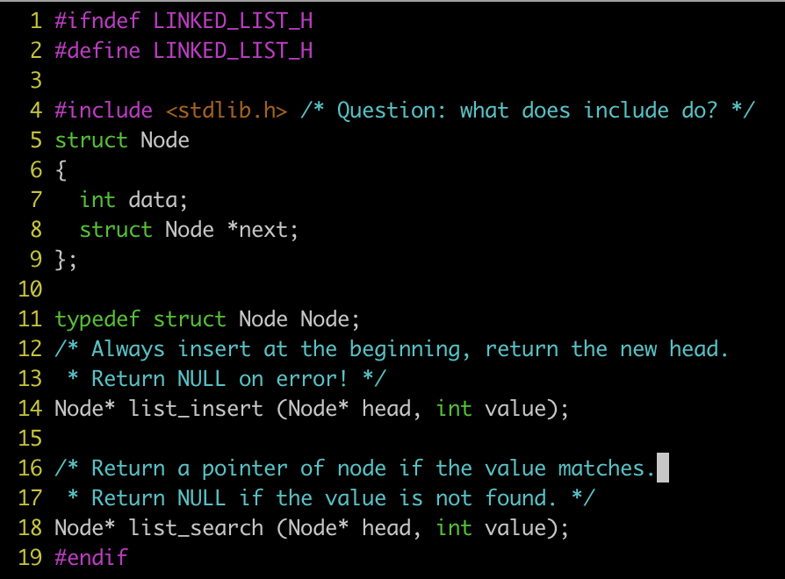
linked_list.h

Slide 7
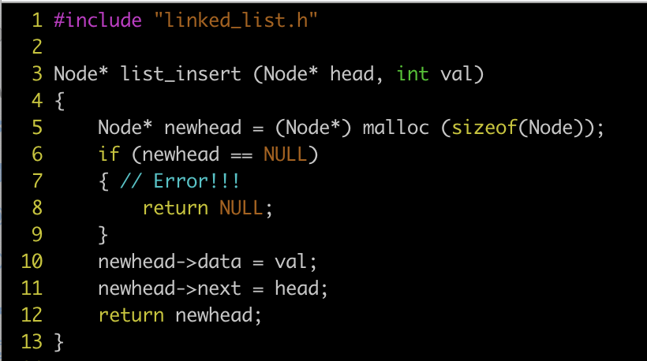
insert.cc

Slide 8
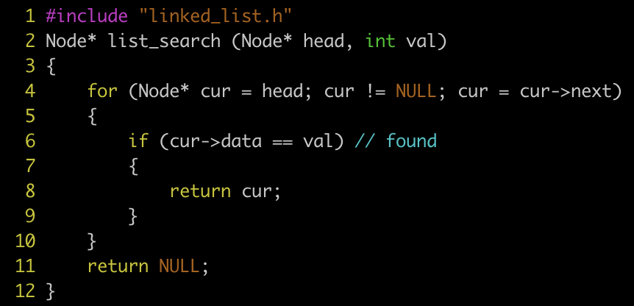
search.cc

Slide 9
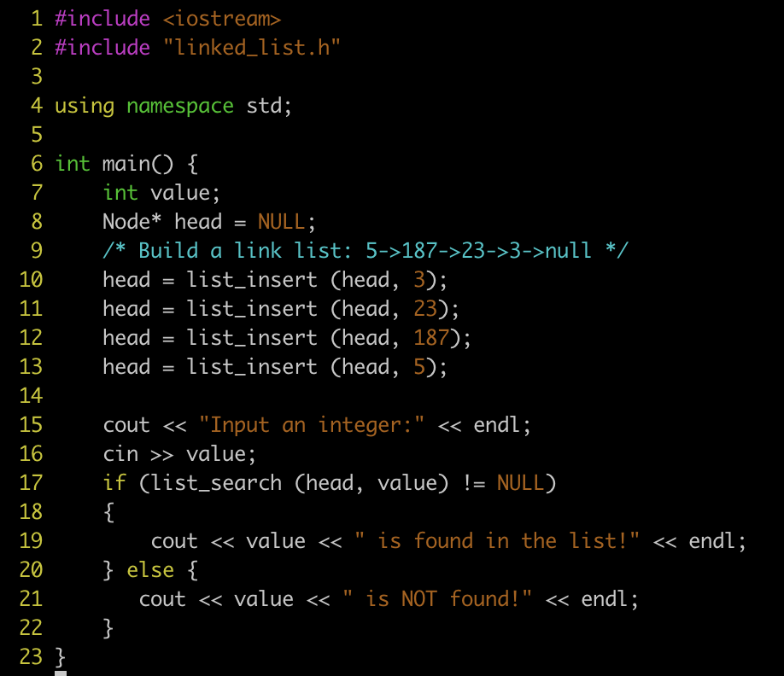
main.cc

Slide 10
Compilation
> g++ -c insert.cc –o insert.o
-c: compile source files without linking
Generates object file (insert.o)
> g++ -c search.cc –o search.o
> g++ -c main.cc –o main.o
> g++ insert.o search.o main.o –o linked_list
-This steps is linking: it links the 3 object files, and outputs an executable file linked_list

Slide 11
#include
What does #include “file” do?
Copy the content of file into the current file
It belongs to a class of instructions called pre-processor directives (more on this next lecture)
Can I include .cc file, instead of .h?
Yes, but it’s really bad practice; why?
What should go into .h file?
Prototypes instead of implementations!
E.g., Function declaration instead of definition, class interface instead of implementation (later in this course)
What is the difference between <> and “”?
E.g., #include <iostream> vs. #include “linked_list.h”
Can I include the same .h file multiple times?

Slide 12
#ifndef: include guard
Prevent the same .h file from being included multiple times!
Remember: always always always guard your header file!!
// b.h
#include “mystruct.h”
void bar();
// main.cpp
#include “a.h”
#include “b.h”
int main() {..}
// mystruct.h
struct A { };
// a.h
#include “mystruct.h”
void foo();

