Slide 1
ECE 244
Programming Fundamentals
Lec. 5: C++ I/O
Ding Yuan
ECE Dept., University of Toronto
http://www.eecg.toronto.edu/~yuan

Slide 2

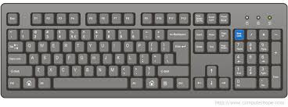
Standard input/output
#include <iostream>
using namespace std;
int main() {
int x;
cout << “Hello world!” << endl;
cin >> x;
}
output
input
Hello world!

Slide 3
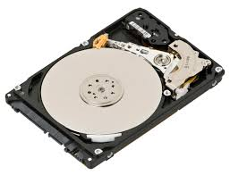
File input/output
program
file
file
Notes:
Example: powerpoint

Slide 4
File input
#include <fstream>
using namespace std;
ifstream inFile(“filename”);
or
ifstream inFile;
inFile.open (“filename”);
int a,b,c;
inFile >> a >> b >> c;
a = 1
b = 2
c = 3
1
2
3
“if” in “ifstream” stands for “input” and “file”

Slide 5
File output
#include <fstream>
using namespace std;
ofstream outFile(“filename”);
or
ofstream outFile;
outFile.open (“filename”);
int a = 6;
outFile << “a = “ << a << endl;
a = 6

Slide 6
Two ways to open a file for output
Open for writing (default)
  If the file already exists, it is first erased;
  Otherwise it is created
Open for append
  Use: outFile.open(“filename”, ios::app);
  Write adds to the end of the file

Slide 7
When opening file
inFile.open (“filename”); <- search in current directory
inFile.open (“dir/filename”); <- relative path
inFile.open (“../filename”); <- relative path
inFile.open (“/etc/passwd”); <- absolute path
Question: why do we need to open a file?

Slide 8
You open, you close!
When done reading/writing to a file, close it!
  inFile.close();
  outFile.close();

Slide 9
Buffering
Output will not be immediately written to file
  Instead, temporarily store the output in buffer; write out to file periodically in chunks
  Why buffering?
  To force output: outFile.flush();
  or outFile << endl;
outFile << “Hello \n”;
..
outFile << “Hello again!”;
Buffer:
Hello
Hello again!
Slow!
file
Notes:
how slow? rocket speed/snail speed = 150K

