Slide 1
ECE 244 Programming Fundamentals Lec. 8: Class constructors
Ding Yuan
ECE Dept., University of Toronto
http://www.eecg.toronto.edu/~yuan

Slide 2
Constructors
Special member functions whose job is to initialize data in object
Gets called automatically when object is instantiated
Never called directly by any function

Slide 3
Constructor (cont.)
// Time.h
class Time {
private:
int minute;
int second;
public:
Time();
.. ..
};
// time.cc
Time::Time()
{
second = minute = 0;
cout << “Time initialized” << endl;
}
Has the same name as the class
No return value – not even void
Must be public
Invoked when an object is instantiated
Which line will cause the constructor to be invoked?
Time t;
Time *p;
p = new Time;

Slide 4
Multiple constructors
Initialize objects in different ways
Multiple constructors!
Function overloading
Functions w/ same name
Must have different param. list
Different number of params, or
The same number of params but different types
Not just different variable names

Slide 5
Multiple constructors
class Time {
private:
int minute;
int second;
public:
Time(); // Default constructor
Time(int, int);// Overload func.
};
Time::Time()
{
second = minute = 0;
}
Time::Time(int _m, int _s)
{
minute = _m;
second = _s;
}
int main ()
{
Time t1(10,0);
Time t2;
Time *p = new Time(12,30);
}

Slide 6
Another example: linked list (using class this time)
5
187
23
3
/* Always insert from the beginning, return the new head. */
void insert (int value);
/* Search the list; if found, return the node.
* Return NULL if not found. */
Node* search (int value);

Slide 7
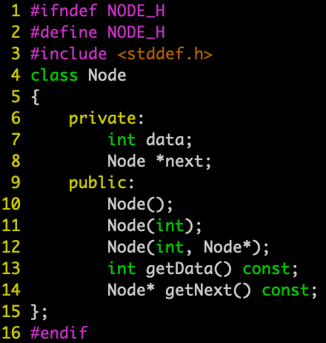
Node.h

Slide 8
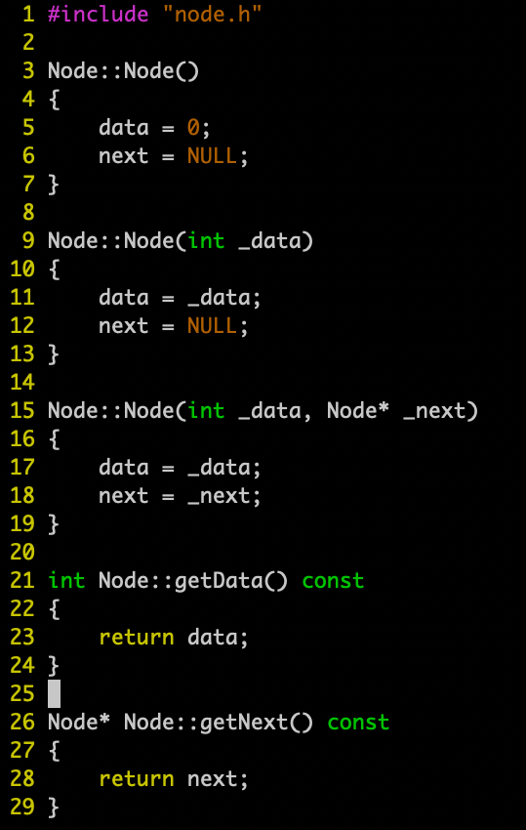
node.cc

Slide 9
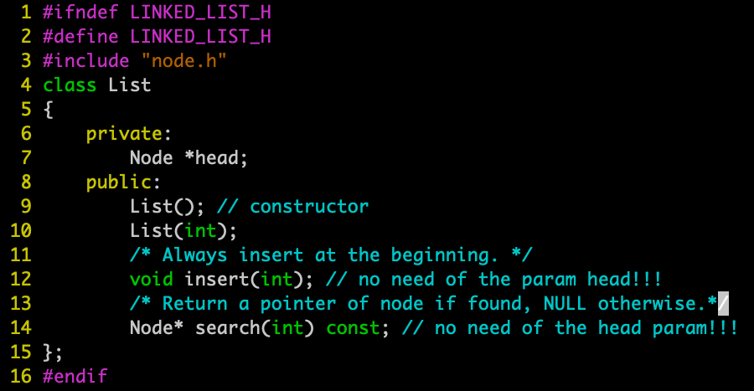
linked_list.h

Slide 10
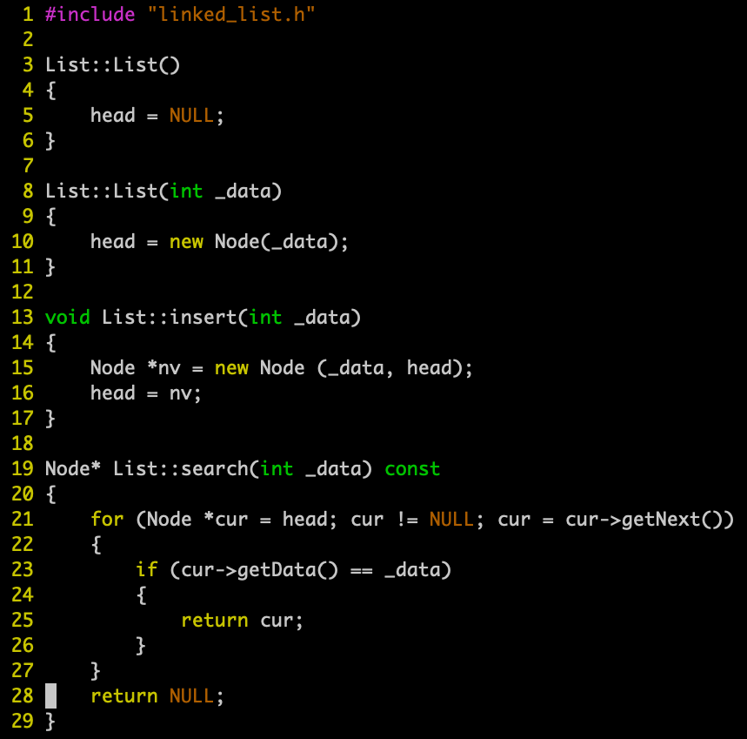
linked_list.cc

Slide 11
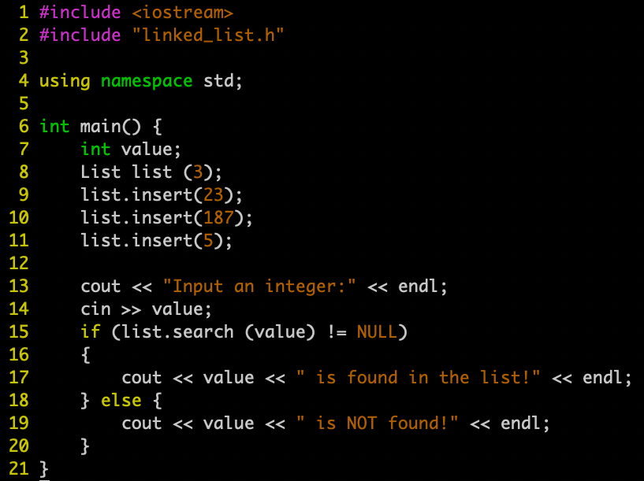
main.cc

