Slide 1
Operating Systems ECE344
Lecture 11: File System
Ding Yuan

Slide 2
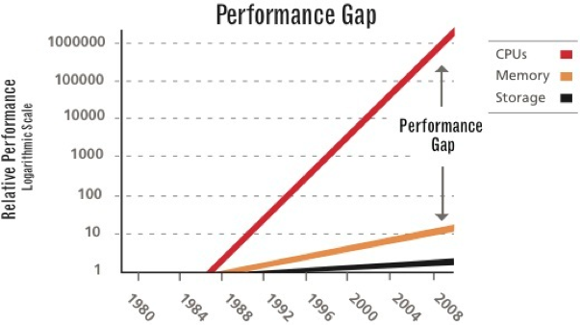
Big picture: performance gap

Slide 3
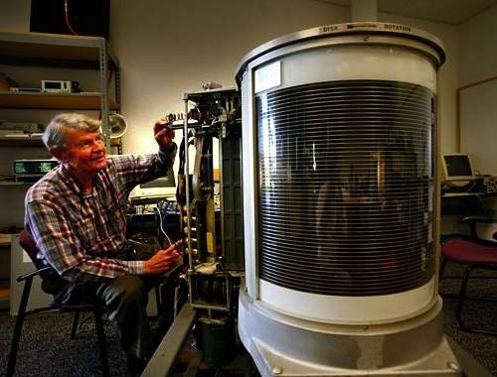
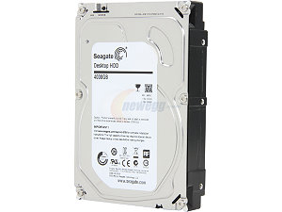
What problem are we solving?
Data storage & access
Super important
One of the fastest growing industry
Why?
Driven by technology
1956, IBM, 24 inches, 3.75MB, 1KB/sec, > $150,000
2015, Seagate, 3.5 inches, 5TB, 6Gb/sec, < $200

Slide 4
Storage
One of the fastest growing industry
Why?
Driven by technology
Driven by demand
Mainframe storage: IBM, Memorex
PC storage: Seagate, DEC, Quantum, etc.
Enterprise Storage: EMC, NetApp, etc.
Cloud Storage: Dropbox, Google Drive, etc.

Slide 5
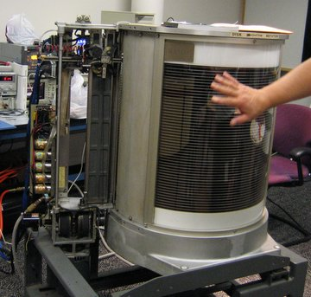
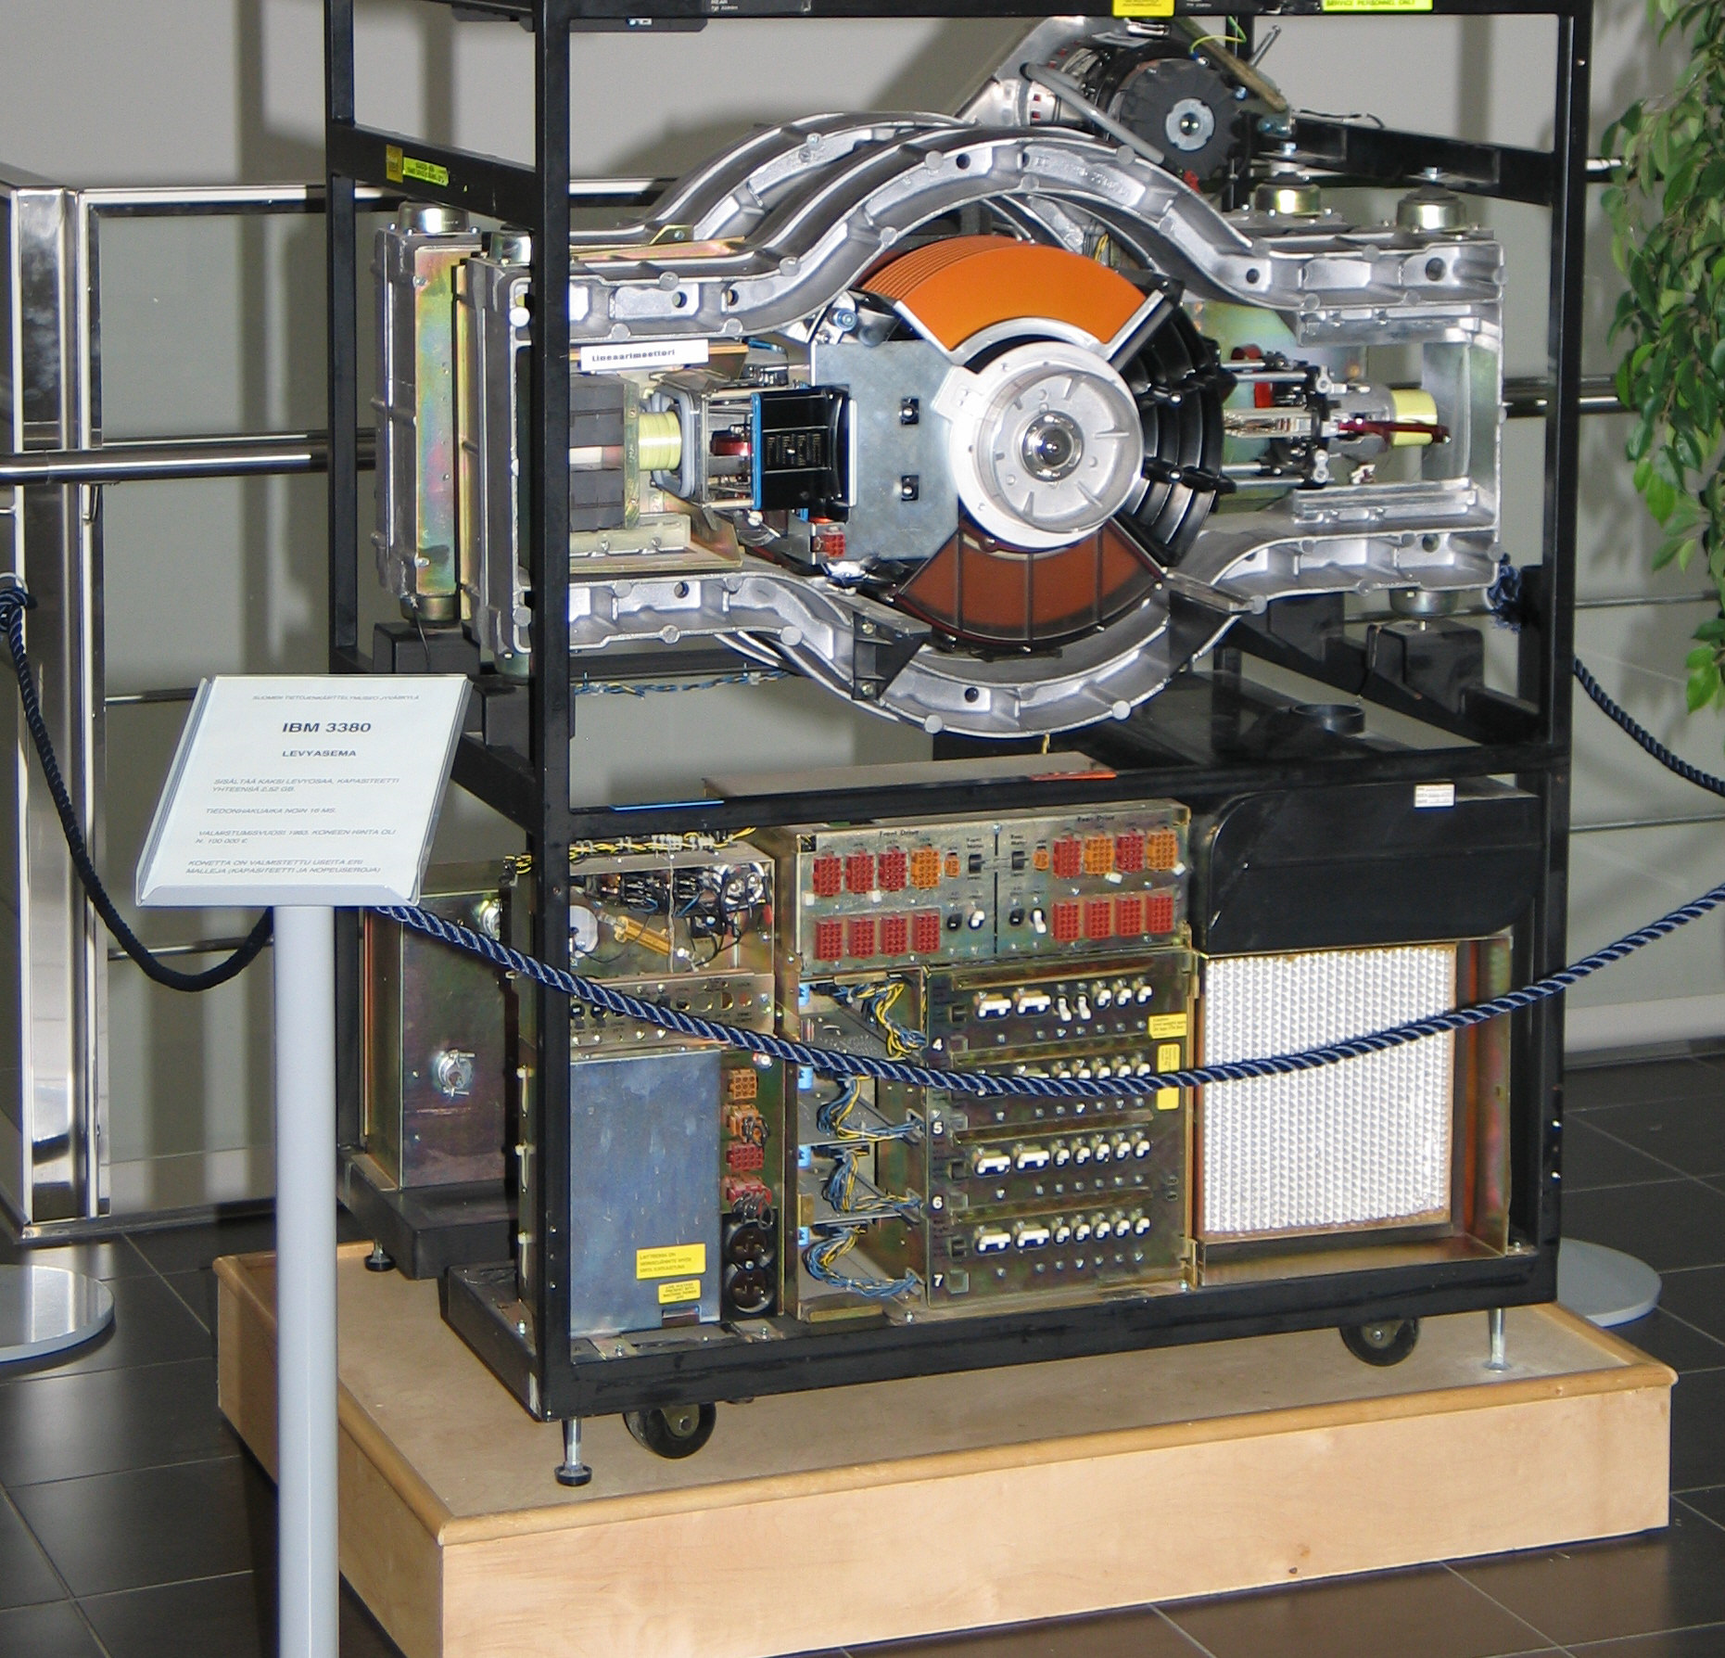
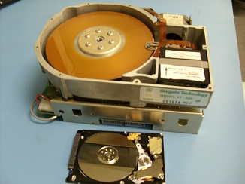
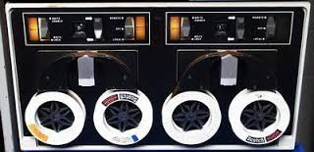
History of storage tech
1956: IBM 350, 24 inches,
3.75MB, 1KB/sec, > $150,000
1980: IBM 3380, first GB
disk (1.26G), > $100K
1980: ST-560, first 5.25
inch drive, 5MB, $1500
NextCom notebook 2006: first
laptop w/ SSD as storage
Tape (DECtape): primary storage for
main-frames and mini-computers (1950 ~ 70s)

Slide 6
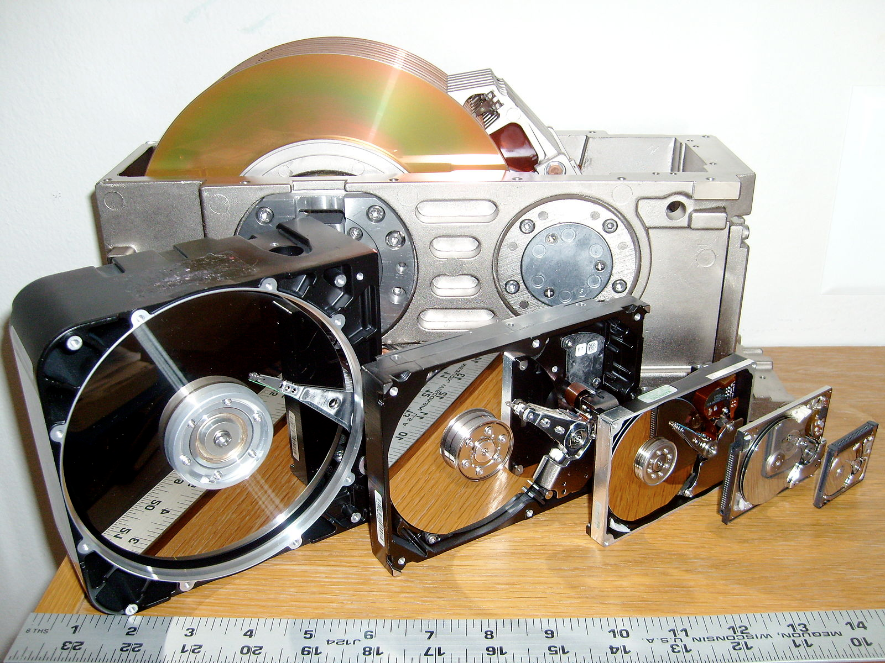
Image source: https://en.wikipedia.org/wiki/File:SixHardDriveFormFactors.jpg/

Slide 7
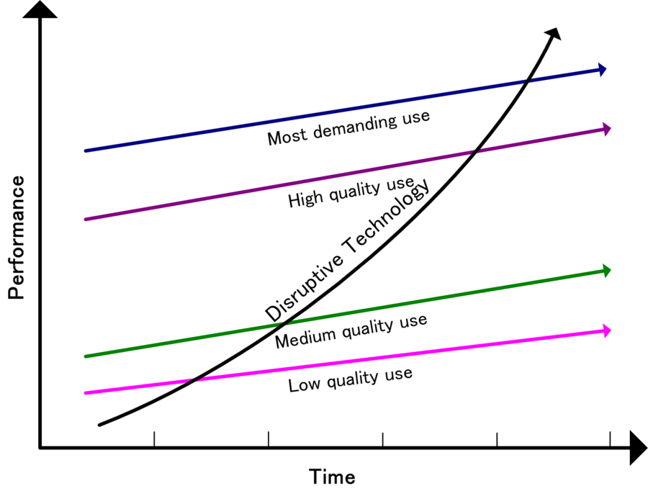
Storage Industry: The origin of “disruptive technology”
Image source: https://en.wikipedia.org/wiki/Disruptive_innovation
Image source: amazon.ca

Slide 8
File Systems
First we’ll discuss properties of physical disks
Structure
Performance
Scheduling
Then we’ll discuss how we build file systems on them
Files
Directories
Sharing
Protection
File System Layouts
File Buffer Cache
Read Ahead
Finally, we will discuss SSD

Slide 9
Disks and the OS
Disks are messy physical devices
Errors, bad blocks, missed seeks, etc.
The job of the OS is to hide this mess from higher level software
Low-level device control (initiate a disk read, etc.)
Higher-level abstractions (files, databases, etc.)

Slide 10
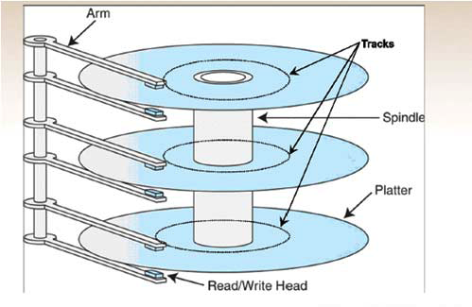
How hard disk work?
http://www.youtube.com/watch?v=kdmLvl1n82U
https://youtu.be/9eMWG3fwiEU?t=11
Disk components
Platters
Surfaces
Tracks
Cylinders
Sectors
Arm
Heads

Slide 11
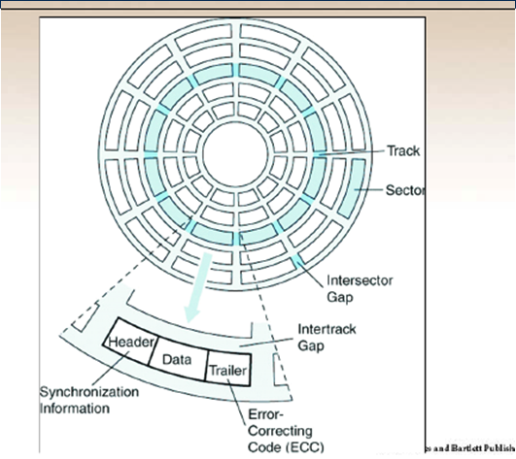
Another View of Disk

Slide 12
Disk Interaction
Specifying disk requests requires a lot of info:
Cylinder #, surface #, sector #, transfer size…
Older disks required the OS to specify all of this
The OS needed to know all disk parameters
Modern disks are more complicated
Not all sectors are the same size, sectors are remapped, etc.
Current disks provide a higher-level interface (SCSI)
The disk exports its data as a logical array of blocks [0…N]
Disk maps logical blocks to cylinder/surface/track/sector
Only need to specify the logical block # to read/write
But now the disk parameters are hidden from the OS

Slide 13
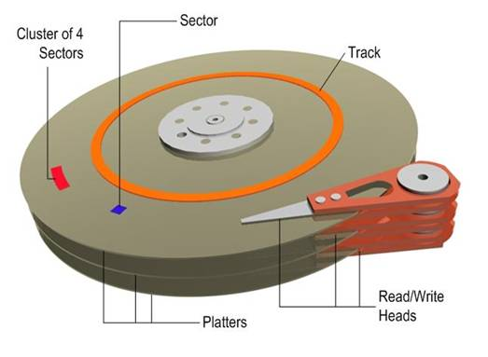
Disk Performance
Random disk access is SLOW!
Access data sequentially: only suffer one seek and rotational delay
Data
Rotational delay
Seek
Random disk access: suffers one seek and rotational delay every time!

Slide 14
Disk Performance
Disk request performance depends upon three steps
Seek – moving the disk arm to the correct cylinder
Depends on how fast disk arm can move (increasing very slowly)
Rotation – waiting for the sector to rotate under the head
Depends on rotation rate of disk (increasing, but slowly)
Transfer – transferring data from surface into disk controller electronics, sending it back to the host
Depends on density (increasing quickly)
When the OS uses the disk, it tries to minimize the cost of all of these steps
Particularly seeks and rotation

Slide 15
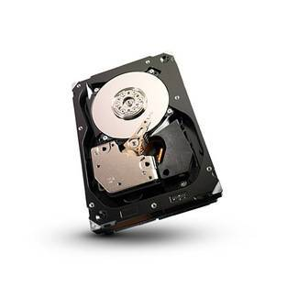
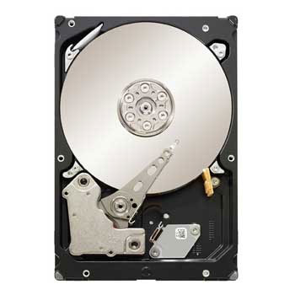
Disks: 2016
Seagate Cheetah 3.5" (server)
capacity: 300 - 600 GB
rotational speed: 15,000 RPM
sequential read performance: 122 MB/s - 204 MB/s
seek time (average): 3.4 ms
Seagate Barracuda 3.5" (desktop)
capacity: 250 GB – 4TB
rotational speed: 7,200 RPM
sequential read performance: 125 MB/s - 146 MB/s
seek time (average): 8.5 ms
Notes:
checked – still the same
HDD data transfer rate depends upon the rotational speed of the platters and the data recording density. Because heat and vibration limit rotational speed, advancing density becomes the main method to improve sequential transfer rates. Higher speeds require a more powerful spindle motor, which creates more heat. While areal density advances by increasing both the number of tracks across the disk and the number of sectors per track, only the latter increases the data transfer rate for a given rpm. Since data transfer rate performance only tracks one of the two components of areal density, its performance improves at a lower rate

Slide 16
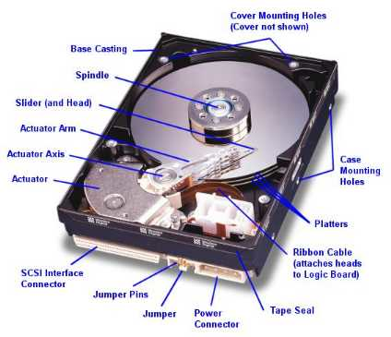
But do you directly program on “disk”?
Life with an OS
file = open (“test.txt”, O_WRONLY);
write (file, “test”, 4);
close (file);
Life without an OS
Where is this file on disk? Which platter, track, and sectors?
Code needs to change on a different system

Slide 17
File Systems
File systems
Implement an abstraction (files) for secondary storage
Organize files logically (directories)
Permit sharing of data between processes, people, and machines
Protect data from unwanted access (security)
Notes:
But do you directly program with disk block? you don’t!

Slide 18
Files
A file is data with some properties
Contents, size, owner, last read/write time, protection, etc.
A file can also have a type
Understood by other parts of the OS or runtime libraries
Executable, dll, souce, object, text, etc.
Understood by the file system
Block/character device, directory, link, etc.
A file’s type can be encoded in its name or contents
Windows encodes type in name
.com, .exe, .bat, .dll, .jpg, etc.
Unix encodes type in contents
Magic numbers, initial characters (e.g., #! for shell scripts)

Slide 19
Basic File Operations
Unix
creat(name)
open(name, how)
read(fd, buf, len)
write(fd, buf, len)
sync(fd)
seek(fd, pos)
close(fd)
unlink(name)
Windows
CreateFile(name, CREATE)
CreateFile(name, OPEN)
ReadFile(handle, …)
WriteFile(handle, …)
FlushFileBuffers(handle, …)
SetFilePointer(handle, …)
CloseHandle(handle, …)
DeleteFile(name)
CopyFile(name)
MoveFile(name)
Notes:
open: transfer Access control list to capability based security model

Slide 20
Directories
Directories serve two purposes
For users, they provide a structured way to organize files
For the file system, they provide a convenient naming interface that allows the implementation to separate logical file organization from physical file placement on the disk
Most file systems support multi-level directories
Naming hierarchies (/, /usr, /usr/local/, …)
Most file systems support the notion of a current directory
Relative names specified with respect to current directory
Absolute names start from the root of directory tree

Slide 21
Directory Internals
A directory is a list of entries
<name, location>
Name is just the name of the file or directory
Location depends upon how file is represented on disk
List is usually unordered (effectively random)
Entries usually sorted by program that reads directory
Directories typically stored in files

Slide 22
Basic Directory Operations
Unix
Directories implemented in files
Use file ops to create dirs
C runtime library provides a higher-level abstraction for reading directories
opendir(name)
readdir(DIR)
seekdir(DIR)
closedir(DIR)
NT
Explicit dir operations
CreateDirectory(name)
RemoveDirectory(name)
Very different method for reading directory entries
FindFirstFile(pattern)
FindNextFile()

Slide 23
Path Name Translation
Let’s say you want to open “/one/two/three”
What does the file system do?
Open directory “/” (well known, can always find)
Search for the entry “one”, get location of “one” (in dir entry)
Open directory “one”, search for “two”, get location of “two”
Open directory “two”, search for “three”, get location of “three”
Open file “three”
Systems spend a lot of time walking directory paths
This is why open is separate from read/write
OS will cache prefix lookups for performance
/a/b, /a/bb, /a/bbb, etc., all share “/a” prefix
Notes:
/one/two/three --- like virtual addr

Slide 24
File System Layout
How do file systems use the disk to store files?
File systems define a block size (e.g., 4KB)
Disk space is allocated in granularity of blocks
A “Master Block” determines location of root directory
Always at a well-known disk location
Often replicated across disk for reliability
A free map determines which blocks are free, allocated
Usually a bitmap, one bit per block on the disk
Also stored on disk, cached in memory for performance
Remaining disk blocks used to store files (and dirs)
There are many ways to do this
Notes:
What is in the “Master Block”?
swap space, where on disk? beginning.

Slide 25
Disk Layout Strategies
Files span multiple disk blocks
How do you find all of the blocks for a file?
1. Contiguous allocation
Fast, simplifies directory access
Inflexible, causes fragmentation, needs compaction
2. Linked structure
Each block points to the next, directory points to the first
Good for sequential access, bad for all others
3. Indexed structure (indirection, hierarchy)
An “index block” contains pointers to many other blocks
Handles random better, still good for sequential
May need multiple index blocks (linked together)
Notes:
Key question: how do we find files?

Slide 26
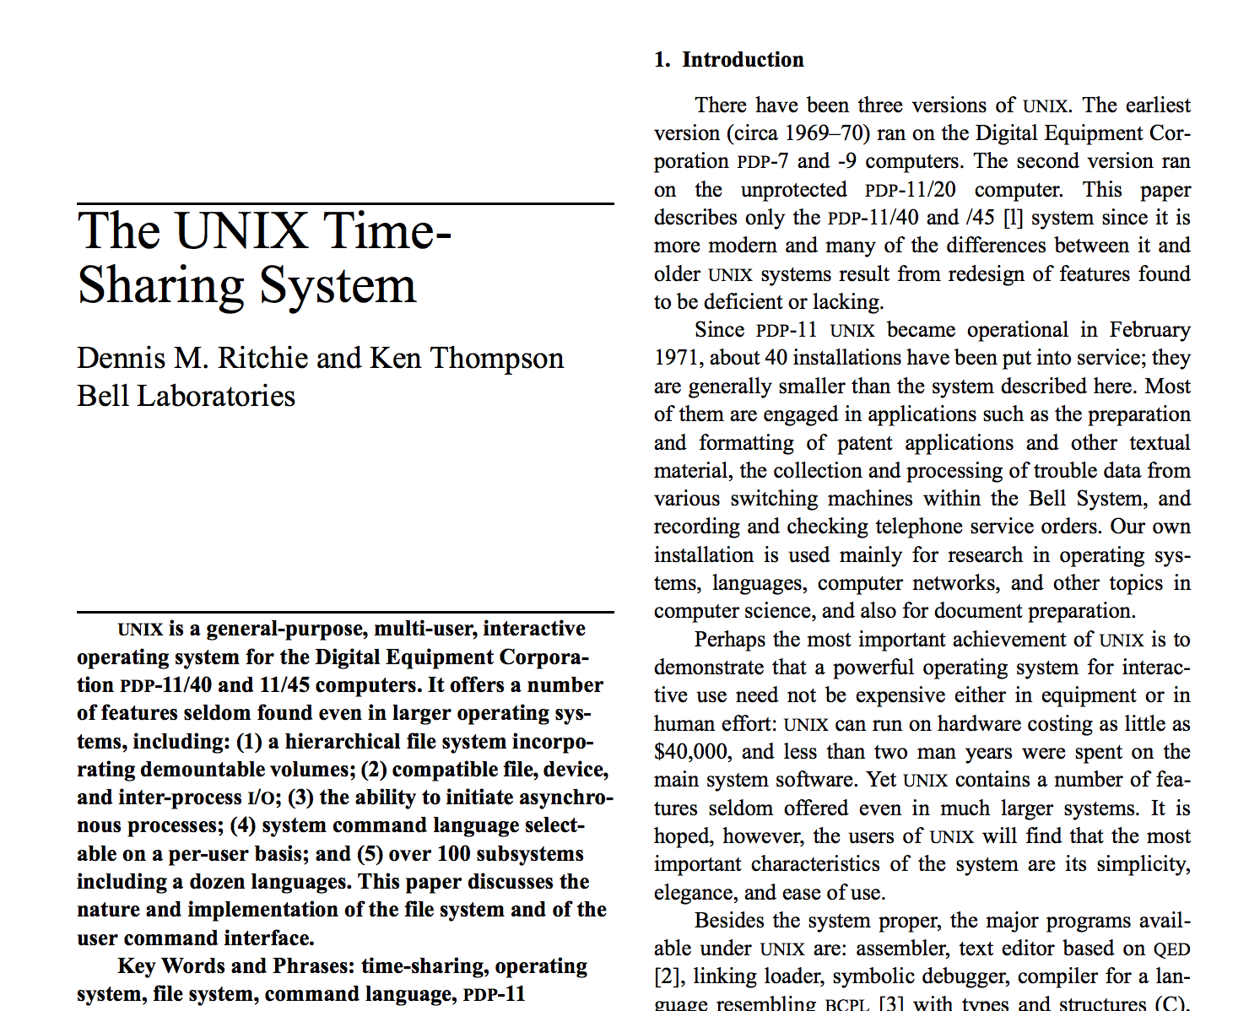
Logical layout: inode (index node)

Slide 27
Unix Inodes
Unix inodes implement an indexed structure for files
Also store metadata info (protection, timestamps, length, ref count…)
Each inode contains 15 block pointers
First 12 are direct blocks (e.g., 4 KB blocks)
Then single, double, and triple indirect
(Metadata)
0
1
…
…
12
(1)
13
(2)
14
(3)
…
…
Notes:
Draw a graph: /bin/bash
stat / --- all info in inode are there

Slide 28
Unix Inodes and Path Search
Unix Inodes are not directories
Inodes describe where on the disk the blocks for a file are placed
Directories are files, so inodes also describe where the blocks for directories are placed on the disk
Directory entries map file names to inodes
To open “/one”, use Master Block to find inode for “/” on disk
Open “/”, look for entry for “one”
This entry gives the inode number for the inode for “one”
Read the inode for “one” into memory
The inode says where first data block is on disk
Read that block into memory to access the data in the file
Notes:
Inodes describe where to find a file on disk
Dir describes what are the files and subdirectories in the current dir!

Slide 29
Example: read /bin/ls
/bin/ls
inode of /
inode of /bin
usr 2783
bin 3512
.. ..
inode of /bin/ls
cd 5193
ls 5728
.. ..
…
instructions
of ls.. ..
instructions
of ls.. ..

Slide 30
Sharing Files btw. Directories
Links (or hard links)
ln source_file target_dir
Simply create another link from target_dir to the inode of source_file (the inode is not duplicated)
Now two directories have links to source_file
What if we remove one?
Now you understand why the system call to remove a file is named “unlink”?

Slide 31
File Buffer Cache
Applications exhibit significant locality for reading and writing files
Idea: Cache file blocks in memory to capture locality
This is called the file buffer cache
Cache is system wide, used and shared by all processes
Reading from the cache makes a disk perform like memory
Even a 4 MB cache can be very effective
Issues
The file buffer cache competes with VM (tradeoff here)
Like VM, it has limited size
Need replacement algorithms again (LRU usually used)

Slide 32
Caching Writes
On a write, some applications assume that data makes it through the buffer cache and onto the disk
As a result, writes are often slow even with caching
Several ways to compensate for this
“write-behind”
Maintain a queue of uncommitted blocks
Periodically flush the queue to disk
Unreliable
Battery backed-up RAM (NVRAM)
As with write-behind, but maintain queue in NVRAM
Expensive

Slide 33
Performance Issues
Original Unix FS had two placement problems:
1. Data blocks allocated randomly in aging file systems
Blocks for the same file allocated sequentially when FS is new
As FS “ages” and fills, need to allocate into blocks freed up when other files are deleted
Problem: Deleted files essentially randomly placed
So, blocks for new files become scattered across the disk
2. Inodes allocated far from blocks
All inodes at beginning of disk, far from data
Traversing file name paths, manipulating files, directories requires going back and forth from inodes to data blocks
Both of these problems generate many long seeks
Notes:
Draw a pic on the blackboard.

Slide 34
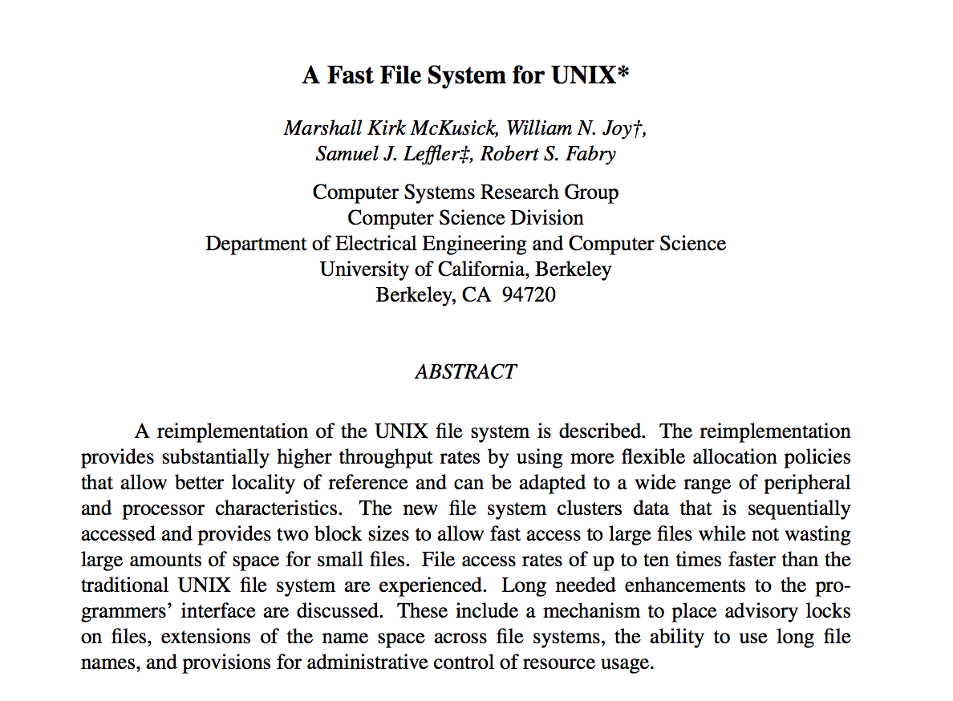
FreeBSD Fast File System

Slide 35
Fast File System
BSD FFS addressed these problems using the notion of a cylinder group
Disk partitioned into groups of cylinders
Data blocks in same file allocated in same cylinder
Files in same directory allocated in same cylinder
Inodes for files allocated in same cylinder as file data blocks
Free space requirement
To be able to allocate according to cylinder groups, the disk must have free space scattered across cylinders
10% of the disk is reserved just for this purpose
Notes:
Recall: cylinder: all the tracks on every single surface that have the same distance to the center of the disk.
Cylinder group: a group of cylinders that are adjuscent to each other --- short seek time.

