Slide 1
Operating Systems ECE344
Lecture 13: Log Structured FS
Ding Yuan

Slide 2
Fundamental Limitation with HD
Mechanical
Cannot be made too fast
Latency in milliseconds

Slide 3
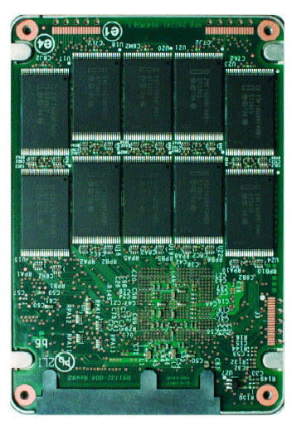
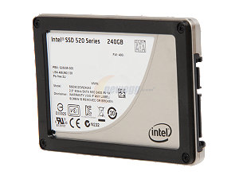
Solid-State Drive (SSD)
Nonvolatile memory
This gives the device the “solid-state” name
Most common media: NAND Flash memory (Floating-gate transistors)

Slide 4
SSD
Latest (2025)
Capacity: >100 TB (server grade)
Sequential R/W: 13-14GB/s
Latency: < 100 us
500-100,000 Program/Erase Cycles
Intel 520 Cherryville (2013)
Capacity: 240 GB
Compare to HD: TB
Sequential R/W: 550/520 MB/s
Compare to HD: 122 MB/s
Latency
Read: 0.04 ms
Write: 0.2 ms
Compare to HD: tens of ms
$1/GB
Compare to HD: 0.06/GB

Slide 5
Limitations of SSD
Random write performance
For write, need to first erase a large of pages (32-64 pages), and reprogram
Burnout
Each cell has limited erase/program cycles
Range from 500 – 100,000 writes

Slide 6
How do SSD’s characteristics impact FS design?
Characteristics of SSD
No mechanical components --- data location won’t make difference
Random write performance is BAD
Limited “write” cycles for each cell
Optimizations on data location are no longer useful
Avoid random writes!
Spread the writes across the entire SSD

Slide 7
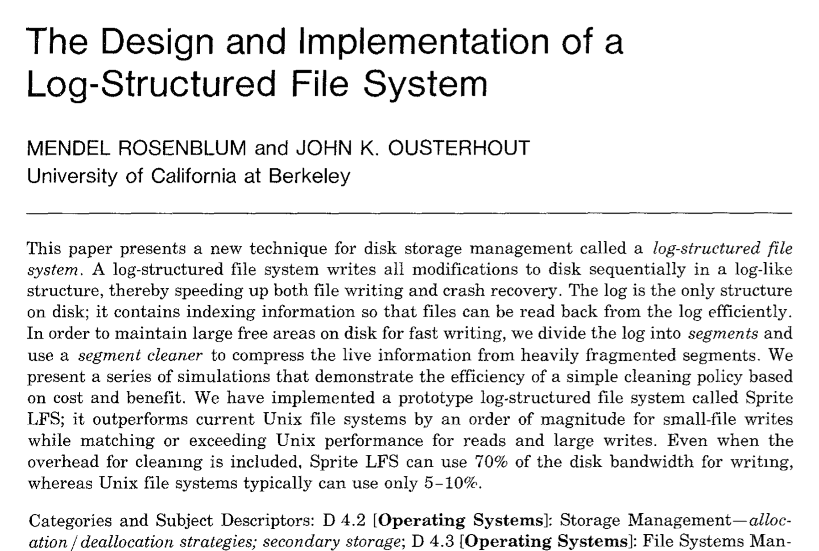
Notes:
Don’t clap.
Emphasize by *slow*
Put a pause after each word --- when I speak fast, some words become inaudible
And also speak up on every word…
Transition --- go slow on them!
How Sim---ple testing, pause, don’t strike!
Java specific;
Abort on over-catch;
These systems are reliable’
debug the scripts, get rid of unnecessary words.
Embarrasingly simple tool
top-down vs. bottom-up?
Bad practice --- really conservative.
FP?
In this talk I will describe a thorough analysis of hundreds of real-world failures in distributed system which
gave us three findings:
numbers? say #? or majority, vast majority?
Too many numbers!!
top-down vs. bottom-up --- not clear
code review.
connections btw. the components. emphasize on this in summary.
Unexpected fun in this project

Slide 8
Log-structured File System
New physical layout
Logical organization remains the same, i.e., inode
Motivations
I/O traffic dominated by writes
Reads are cached by memory
Sequential access is faster than random access on H.D.

Slide 9
Core Ideas
Treat hard drive like a log
Append only
No in-place update
Buffer multiple small writes into a single large write
What about read? Who cares, cached anyway ☺

Slide 10
Unix Inodes
Unix inodes implement an indexed structure for files
Each file or directory has one inode
Also store metadata info (protection, timestamps, length, ref count…)
Each inode contains 15 block pointers
First 12 are direct blocks (e.g., 4 KB blocks)
Then single, double, and triple indirect
(Metadata)
0
1
…
…
12
(1)
13
(2)
14
(3)
…
…

Slide 11
Example: read /var/log/syslog
inode 2: /
inode 3512: /var
usr 2783
var 3512
.. ..
inode 5193:
/var/log
inode 6264:
/var/log/syslog
log 5193
lib 5728
.. ..
…
syslog 6264
dmesg 2832
.. ..
data content
(first 4 KB)
.. ..
data content
(2nd 4 KB)
.. ..

Slide 12
Example: create a file dir1/file1
Assume dir1 already exists
inode 45: dir1/
inode 45: dir1/
Before
After
inode 86: dir1/file1
file0 83
.. ..
file0 83
file1 86
.. ..
2
2 5
.. ..
…
7
…
8
inode # | disk addr
45 | 1 4
86 | 6
.. ..
inode # | disk addr
45 | 1
garbage
disk
addr. : 0 1 2 3 4 5 6 7 8 9
disk
addr. : 0 1 2 3 4 5 6 7 8 9

Slide 13
Garbage Collection
Can quickly run out of disk space
Constantly collect garbage
But GC is very complicated and can cause significant perf. degradation (up to 40%)
Similar to GC pause in today’s runtimes (e.g., JVM)
Before GC
After GC
segment
segment
segment
segment
disk
addr. : 0 1 2 3 4 5 6 7 8 9
disk
addr. : 0 1 2 3 4 5 6 7 8 9
garbage
in-use
free

Slide 14
Checkpoint & Rollback
Very easy b/c there is no in-place update!
Each inode map is a snapshot!
inode 45: dir1/
Before
After
inode 86: dir1/file1
file0 83
.. ..
file0 83
file1 86
.. ..
2
2 5
.. ..
…
7
…
8
inode # | disk addr
45 | 1 4
86 | 6
.. ..
inode # | disk addr
45 | 1
disk
addr. : 0 1 2 3 4 5 6 7 8 9
disk
addr. : 0 1 2 3 4 5 6 7 8 9

Slide 15
SSD:Desirable features from file systems
Characteristics of SSD
No mechanical components --- data location won’t make difference
Random write performance is BAD
On every write, a large segment needs to be reprogrammed anyway
Limited “write” cycles for each cell
Optimizations on data location are no longer useful
Avoid random writes!
GC is “free”!!!
Spread the writes across the entire SSD

Slide 16
Log-structured File System on SSD
Many popular Flash File Systems are log-structured File System
Linux JFFS/JFFS2/YAFFS/LogFS…
Vendors implement log-structured FS in their firmware!

