Slide 1
Operating Systems
ECE344
Lecture 2: Architectural (hardware) Support for Operating Systems
Ding Yuan

Slide 2
Content of this lecture
Review of introduction
Hardware overview
A peek at Unix
Hardware (architecture) support
Summary

Slide 3
Review
What are the two main responsibilities of OS?
  Manage hardware resources
  Provide a clean set of interface to programs
Managing resources:
  Allocation
  Protection
  Reclamation
  Virtualization
Questions?

Slide 4
Why Start With Hardware?
Operating system functionality fundamentally depends upon hardware
  Key goal of an OS is to manage hardware
  If done well, applications can be oblivious to HW details
Hardware support can greatly simplify – or complicate – OS tasks
  Early PC operating systems (DOS, MacOS) lacked virtual memory in part because the hardware did not support it

Slide 5
So what is inside a computer
An abstract overview
  http://www.youtube.com/watch?v=Q2hmuqS8bwM&feature=related
An introduction with a real computer
  http://www.youtube.com/watch?v=VWzX4MEYOBk

Slide 6
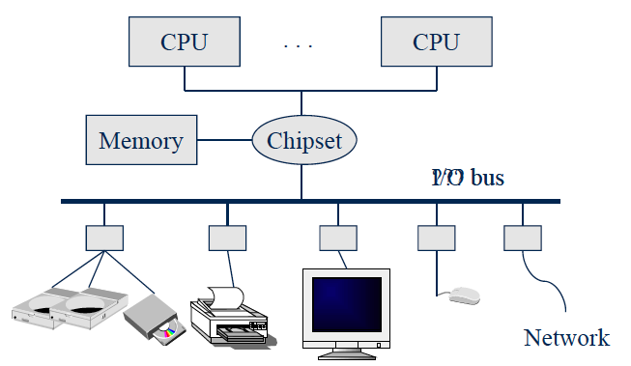
A Typical Computer from a Hardware Point of View
OS
Apps
Data
OS
Apps
Data

Slide 7
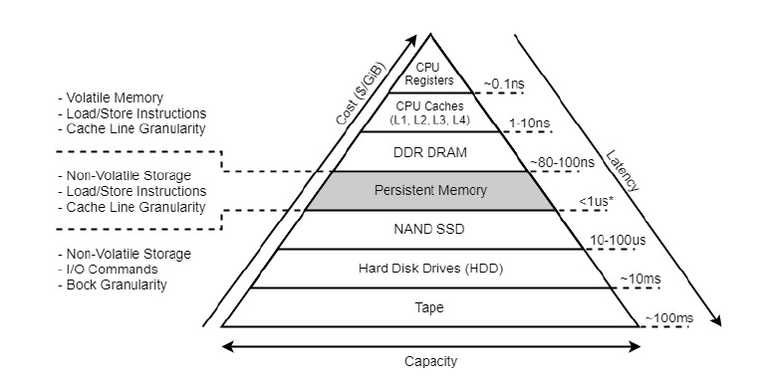
Memory-storage Hierarchy
-9
1 nanosecond = 10 second
Notes:
memory – disk: 100 thousand times
facebook front page

Slide 8
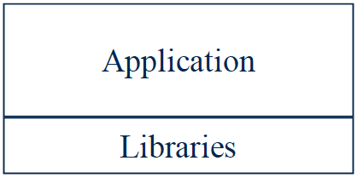
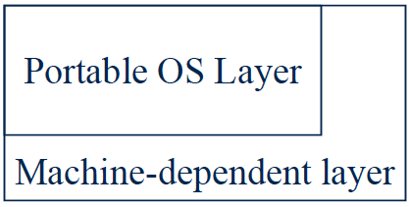
A peek into Unix structure
Written by programmer
Compiled by programmer
Uses library calls (e.g., printf)

Slide 9
A peek into Unix structure
Example: stdio.h
Written by elves
Uses system calls
Defined in headers
Input to linker (compiler)
Invoked like functions
May be “resolved” when
program is loaded.

Slide 10
A peek into Unix structure
System calls (read, open..)
All “high-level” code

Slide 11
A peek into Unix structure
Bootstrap
System initialization
Interrupt and exception
I/O device driver
Memory management
Kernel/user mode switching
Processor management

Slide 12
A peek into Unix structure
Cannot execute “protected_instruction”, e.g., directly access I/O device
User mode
Kernel mode
Some systems do not have clear user-kernel boundary
User/kernel mode is supported by hardware (why?)
Notes:
Explain why protection is needed.

Slide 13

Why hardware has to support User/Kernel mode?
Imaginary OS code (software-only solution)
if ([PC] != protected_instruction)
execute(PC);
else
switch_to_kernel_mode();
Does it work?

Slide 14
Why hardware has to support User/Kernel mode?
Application’s code:
lw $t0, 4($gp)
mult $t0, $t0, $t0
lw $t1, 4($gp)
ori $t2, $zero, 3
mult $t1, $t1, $t2
add $t2, $t0, $t1
sw $t2, 0($gp)
OS: check if next instruction
is protected instruction.

Slide 15
Why hardware has to support User/Kernel mode?
Application’s code:
lw $t0, 4($gp)
mult $t0, $t0, $t0
lw $t1, 4($gp)
ori $t2, $zero, 3
mult $t1, $t1, $t2
add $t2, $t0, $t1
sw $t2, 0($gp)
OS: check if next instruction
is protected instruction.
Performance overhead is too big: OS needs to check every instruction of the application!
  Simulators

Slide 16
Why hardware has to support User/Kernel mode?
OS: set-up the environment;
load the application
Application’s code:
lw $t0, 4($gp)
mult $t0, $t0, $t0
lw $t1, 4($gp)
ori $t2, $zero, 3
mult $t1, $t1, $t2
add $t2, $t0, $t1
sw $t2, 0($gp)
Instead, what we really want is
to give the CPU entirely to the application
  Bare-metal execution
Any problems?
Return to OS after termination;
OS: schedule next application to
execute..
How can OS check if application
executes protected instruction?
  How can OS know it will ever run again?

Slide 17
Why hardware has to support User/Kernel mode?
Give the CPU to the user application
  Why: Performance and efficiency
  OS will not be executing
Without hardware’s help, OS loses control of the machine!
  Analogy: give the car key to someone, how do you know if he will return the car?
This is the most fundamental reason why OS will need hardware support --- not only for user/kernel mode
Questions?

Slide 18
Hardware Features for OS
Features that directly support the OS include
  Protection (kernel/user mode)
    Protected instructions
  Memory protection
  System calls
  Interrupts and exceptions
  Timer (clock)
  I/O control and operation
  Synchronization

Slide 19
Types of Hardware Support
Manipulating privileged machine state
  Protected instructions
  Manipulate device registers, TLB entries, etc.
Generating and handling “events”
  Interrupts, exceptions, system calls, etc.
  Respond to external events
  CPU requires software intervention to handle fault or trap
Mechanisms to handle concurrency
  Interrupts, atomic instructions

Slide 20
Protected Instructions
A subset of instructions of every CPU is restricted to use only by the OS
  Known as protected (privileged) instructions
Only the operating system can
  Directly access I/O devices (disks, printers, etc.)
    Security, fairness (why?)
  Manipulate memory management state
    Page table pointers, page protection, TLB management, etc.
  Manipulate protected control registers
    Kernel mode, interrupt level
  Halt instruction (why?)
Notes:
HLT: put the CPU to sleep until the next interrupt is fired.

Slide 21
OS Protection
Hardware must support (at least) two modes of operation: kernel mode and user mode
  Mode is indicated by a status bit in a protected control register
  User programs execute in user mode
  OS executes in kernel mode (OS == “kernel”)
Protected instructions only execute in kernel mode
  CPU checks mode bit when protected instruction executes
  Setting mode bit must be a protected instruction
  Attempts to execute in user mode are detected and prevented
    x86: General Protection Fault

Slide 22
Memory Protection
OS must be able to protect programs from each other
OS must protect itself from user programs
We need hardware support
  Again: once OS gives the CPU to the user programs, OS loses control

Slide 23
Memory Protection
Memory management hardware provides memory protection mechanisms
  Base and limit registers
  Page table pointers, page protection, TLB
  Virtual memory
  Segmentation
Manipulating memory management hardware uses protected (privileged) operations

Slide 24
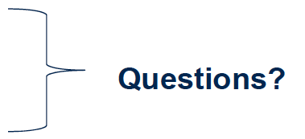
Hardware Features for OS
Features that directly support the OS include
  Protection (kernel/user mode)
    Protected instructions
  Memory protection
  System calls
  Interrupts and exceptions
  Timer (clock)
  I/O control and operation
  Synchronization

Slide 25
Events
After the OS has booted, all entry to the kernel happens as the result of an event
  event immediately stops current execution
  changes mode to kernel mode, event handler is called
An event is an “unnatural” change in control flow
  Events immediately stop current execution
  Changes mode, context (machine state), or both
The kernel defines a handler for each event type
  Event handlers always execute in kernel mode
  The specific types of events are defined by the machine
  In effect, the operating system is one big event handler

Slide 26
OS Control Flow
When the processor receives an event of a given type, it
  transfers control to handler within the OS
  handler saves program state (PC, registers, etc.)
  handler functionality is invoked
  handler restores program state, returns to program
Notes:
What defines an execution? Or execution context? That’s the key question students need to understand as background.

Slide 27
Categorizing Events
Two kinds of events, interrupts and exceptions
Exceptions are caused by executing instructions
  CPU requires software intervention to handle a fault or trap
Interrupts are caused by an external event
  Device finishes I/O, timer expires, etc.
Two reasons for events, unexpected and deliberate
Unexpected events are, well, unexpected
  What is an example?
Deliberate events are scheduled by OS or application
  Why would this be useful?

Slide 28
Categorizing Events
This gives us a convenient table:
  Terms may be used slightly differently by various OSes, CPU architectures…
    No need to “memorize” all the terms
  Software interrupt – a.k.a. async system trap (AST), async or deferred procedure call (APC or DPC)
Will cover faults, system calls, and interrupts next
 | Unexpected | Deliberate
Exceptions (sync) | fault | syscall trap software interrupt
Interrupts (async) | interrupt

Slide 29
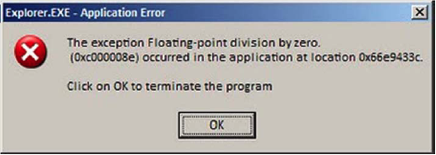
Faults

Slide 30
Faults
Hardware detects and reports “exceptional” conditions
  Page fault, divide by zero, unaligned access
Upon exception, hardware “faults” (verb)
  Must save state (PC, registers, mode, etc.) so that the faulting process can be restarted
Fault exceptions are a performance optimization
  Could detect faults by inserting extra instructions into code (at a significant performance penalty)

Slide 31
Handling Faults
Some faults are handled by “fixing” the exceptional condition and returning to the faulting context
  Page faults cause the OS to place the missing page into memory
  Fault handler resets PC of faulting context to re-execute instruction that caused the page fault
Some faults are handled by notifying the process
  Fault handler changes the saved context to transfer control to a user-mode handler on return from fault
  Handler must be registered with OS
  Unix signals
    SIGSEGV, SIGALRM, SIGTERM, etc.

Slide 32
Handling Faults
The kernel may handle unrecoverable faults by killing the user process
  Program faults with no registered handler
  Halt process, write process state to file, destroy process
  In Unix, the default action for many signals (e.g., SIGSEGV)
What about faults in the kernel?
  Dereference NULL, divide by zero, undefined instruction
  These faults considered fatal, operating system crashes
  Unix panic, Windows “Blue screen of death”
    Kernel is halted, state dumped to a core file, machine locked up

Slide 33
System Calls
For a user program to do something “privileged” (e.g., I/O) it must call an OS procedure
  Known as crossing the protection boundary, or a protected procedure call
Hardware provides a system call instruction that:
  Causes an exception, which vectors to a kernel handler
  Passes a parameter determining the system routine to call
  Saves caller state (PC, registers, etc.) so it can be restored
  Returning from system call restores this state
Requires hardware support to:
  Restore saved state, reset mode, resume execution

Slide 34
System Call Functions
Process control
  Create process, allocate memory
File management
  Create, read, delete file
Device management
  Open device, read/write device, mount device
Information maintenance
  Get time
Programmers generally do not use system calls directly
  They use runtime libraries (e.g., stdio.h)
  Why?

Slide 35
Function call
main () {
foo (10);
}
Compile
main: mov edi, 0xA
call foo
.. ..
foo: .. ..
ret

Slide 36
System call
open: ;Linux convention:
;parameters via registers.
mov eax, 5 ; syscall number for open
mov ebx, path ; ebx: first parameter
mov ecx, flags ; ecx: 2nd parameter
mov edx, mode ; edx: 3rd parameter
int 80h
open (path, flags, mode);
open: ; FreeBSD convention:
; parameters via stacks.
push dword mode
push dword flags
push dword path
mov eax, 5
push dword eax ; syscall number
int 80h
add esp, byte 16
More information:
http://www.int80h.org

Slide 37
Directly using system call?
Write assembly code
  Hard
Poor portability
  write different version for different architecture
  write different version for different OSes
Application programmers use library
  Libraries written by elves

Slide 38
System Call
Firefox: open()
Trap to kernel mode, save state
User mode
Kernel mode
Restore state, return to user level, resume execution
Trap handler
open read handler in vector table
open() kernel routine

Slide 39
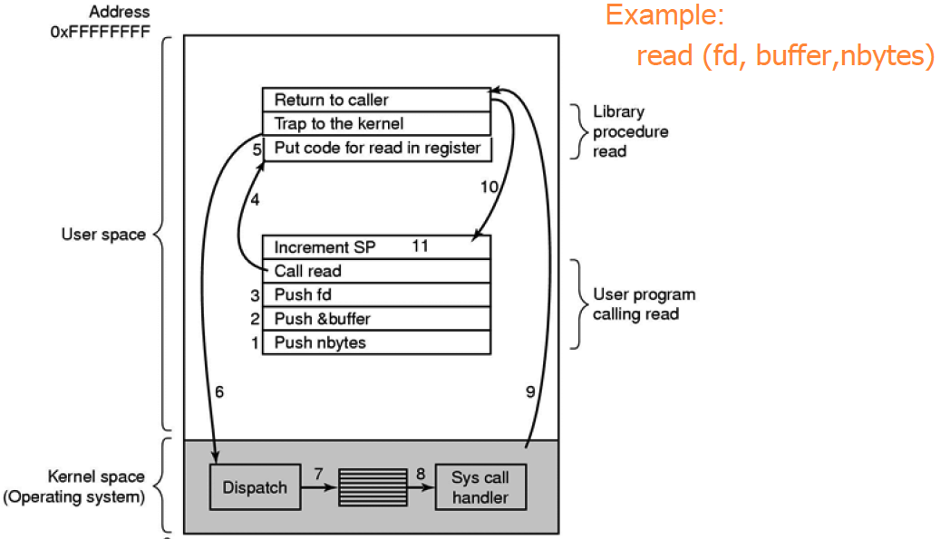
Steps in making a syscall

Slide 40
System Call Issues
What would happen if the kernel did not save state?
Why must the kernel verify arguments?
Why is a table of system calls in the kernel necessary?

Slide 41
Interrupts
Interrupts signal asynchronous events
  I/O hardware interrupts
  Hardware timers
Two flavors of interrupts
  Precise: CPU transfers control only on instruction boundaries
  Imprecise: CPU transfers control in the middle of instruction execution
    What the heck does that mean?
  OS designers like precise interrupts, CPU designers like imprecise interrupts
    Why?

Slide 42
Interrupt Illustrated
User Mode
Mode bit = 1
User
process
Resume process
Kernel Mode
Mode bit = 0
Return
Mode bit = 1
Suspend user process
Execute OS’s interrupt handler
Save user process’s state
Execute device driver
Restore
state
Clear
interrupt
Device
Raise
Interrupt

Slide 43
How to find interrupt handler?
Hardware maps interrupt type to interrupt number
OS sets up Interrupt Descriptor Table (IDT) at boot
  Also called interrupt vector
  IDT is in memory
  Each entry is an interrupt handler
  OS lets hardware know IDT base
Hardware finds handler using interrupt number as index into IDT
  handler = IDT[intr_number]

Slide 44
Timer
The timer is critical for an operating system
It is the fallback mechanism by which the OS reclaims control over the machine
  Timer is set to generate an interrupt after a period of time
    Setting timer is a privileged instruction
  When timer expires, generates an interrupt
  Handled by kernel, which controls resumption context
    Basis for OS scheduler (more later…)
Prevents infinite loops
  OS can always regain control from erroneous or malicious programs that try to hog CPU
Also used for time-based functions (e.g., sleep())

Slide 45
I/O Control
I/O issues
  Initiating an I/O
  Completing an I/O
Initiating an I/O
  Special instructions
  Memory-mapped I/O
    Device registers mapped into address space
    Writing to address sends data to I/O device

Slide 46
I/O Completion
Interrupts are the basis for asynchronous I/O
  OS initiates I/O
  Device operates independently of rest of machine
  Device sends an interrupt signal to CPU when done
  OS maintains a vector table containing a list of addresses of kernel routines to handle various events
  CPU looks up kernel address indexed by interrupt number, context switches to routine

Slide 47
I/O Example
1. Ethernet receives packet, writes packet into memory
2. Ethernet signals an interrupt
3. CPU stops current operation, switches to kernel mode, saves machine state (PC, mode, etc.) on kernel stack
4. CPU reads address from vector table indexed by interrupt number, branches to address (Ethernet device driver)
5. Ethernet device driver processes packet (reads device registers to find packet in memory)
6. Upon completion, restores saved state from stack

Slide 48
Interrupt Questions
Interrupts halt the execution of a process and transfer control (execution) to the operating system
  Can the OS be interrupted? (Consider why there might be different IRQ levels)
Interrupts are used by devices to have the OS do stuff
  What is an alternative approach to using interrupts?
  What are the drawbacks of that approach?

Slide 49
Alternative approach
Polling
Problems?
Analogy:
  Polling: keeps checking the email every 30 seconds
  Interrupt: when email arrives, give me a ring
while (Ethernet_card_queue_is_empty)
;
// Ethernet card received packets.
handle_packets();

Slide 50
Summary
Protection
  User/kernel modes
  Protected instructions
System calls
  Used by user-level processes to access OS functions
  Access what is “in” the OS
Exceptions
  Unexpected event during execution (e.g., divide by zero)
Interrupts
  Timer, I/O

Slide 51
Summary (2)
After the OS has booted, all entry to the kernel happens as the result of an event
  event immediately stops current execution
  changes mode to kernel mode, event handler is called
When the processor receives an event of a given type, it
  transfers control to handler within the OS
  handler saves program state (PC, registers, etc.)
  handler functionality is invoked
  handler restores program state, returns to program

Slide 52
Architecture Trends Impact OS Design
Processor
  Single core to multi-core
    OS must better handle concurrency
Network
  Isolation to dial-up to LAN to WAN
    OS must devote more efforts to communications
  Disconnected to wired to wireless
    OS must manage connectivity more
  Isolated to shared to attacked
    OS must provide more security/protection
Mobile/battery-operated
  OS must pay attention to energy consumption

Slide 53
May you live in Interesting Times
Multicores
Smart phones
Tapes→disks→flash memory→..
3G, 4G, 5G.
Cloud
Wearable computers
Virtual reality
Motion capturing device
..

