Slide 1
ECE 454 Computer Systems Programming Introduction
Ding Yuan
ECE Dept., University of Toronto
http://www.eecg.toronto.edu/~yuan
slides courtesy: Greg Steffan

Slide 2
Content of this lecture
Administration (personnel, policy, agenda, etc.)
Why ECE 454?
Overview of the course

Slide 3
Administration

Slide 4
Personnel
Instructor:
Ding Yuan (yuan@eecg.toronto.edu)
Office hour: the 10 minutes after each lecture
Office: Sandford Fleming 2002E
Homepage: http://www.eecg.toronto.edu/~yuan
(Michael Stumm will take over later)
Teaching Assistants:
Arnamoy Bhattacharyya, Seyed Jokar Jandaghi, Yu Luo, Ishita Ray, Hao Wang

Slide 5
Recommended Textbook
Textbook is not required
The relevant contents will be covered in the slides
Google & Wikipedia can tell you all
I will post some online resources in Piazza
Randal E. Bryant and David R. O’Hallaron,
“Computer Systems: A Programmer’s Perspective”, 3rd edition, Prentice Hall 2015.

Slide 6
Communications
Class web site
http://www.eecg.toronto.edu/~yuan/teaching/ece454/
Provides slides, agenda, grading policy, etc.
All information regarding to the labs
Piazza (see the class web site) used for discussion
Q/A & discussion with peers, TAs, prof
Quercus is only used for Grades

Slide 7
Policies: Grading
Exams (65%)
Midterm (25%): TBD
Final (40%)
Closed book
Homework (35%)
5 homeworks (varying % each)

Slide 8
Policies: Assignments
Work groups
You can work in groups of two for all labs (or individually)
You can change groups for each assignment (if you want)
No extensions for group changes mid-assignment
Don’t put assignment code on Internet!
Handins
Electronic hand-ins only
Follow the submit procedure (as specified in lab handout)

Slide 9
Policies: Cheating
Cheating is a serious offence, will be punished harshly
0 grade for assignment, potential for official letter in file.
What is cheating?
Using someone else’s solution to finish your assignment to avoid having to understand/learn
Sharing code with a non-group-member
Copying or retyping
What is NOT cheating?
Helping others use systems or tools.
Helping others with high-level design issues.
We do use cheater-beaters
Automatically compares your solutions with others

Slide 10
How NotTo pass ECE454
Do not come to lecture
It’s nice out, the slides are online, and material in the book anyway
TRUTH: Lecture material is the basis for exams
It is much more efficient to learn through discussion
Copy other people’s project
It is cheating!
How can you answer the questions in midterm or final exams?

Slide 11
How NotTo pass ECE454 (2)
Do not ask questions in lecture, office hours, or piazza
It’s scary, I don’t want to embarrass myself
TRUTH: asking questions is the best way to clarify lecture material at the time it is being presented
“There is no such things as stupid question…”
Wait until the last couple of days to start a project
The project cannot be done in the last few days

Slide 12
Before we start
Any questions?

Slide 13
Why ECE 454?

Slide 14
Why Take this Course?
Become a superstar programmer
Most engineering jobs involve programming
Superstar programmers are increasingly in demand
A superstar programmer is worth 1000x normal – Bill Gates

Slide 15
Why Take this Course?
Better understanding of software/hardware interaction
Important whether you are a software or hardware type
Considering a programming job or grad school
Jobs and Entrepreneurial Opportunities
Computing is at the heart of most interesting ventures
Notes:
this class is teaching you how to write fast software, but we will spend a significant amount of time talking about hw. --- you have to know your hw to write the fastest program

Slide 16
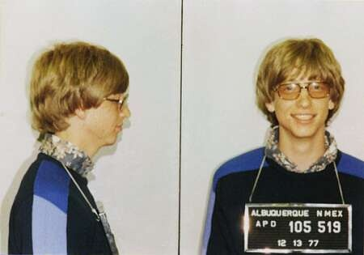
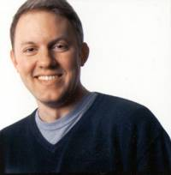
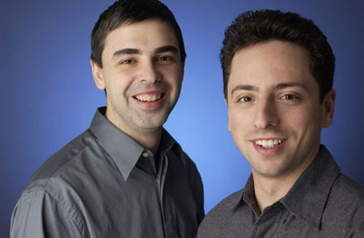
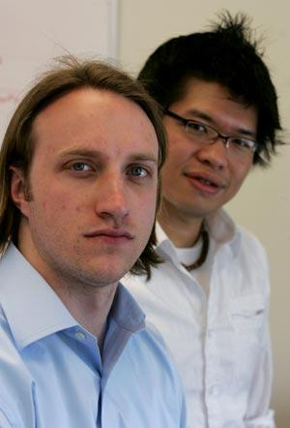
Start a Company in your 20’s!
Notes:
Instagram: Kevin Systrom, Mike Krieger
Marc Andreesen: netscape
Larry page
Youtube: Chad Hurley, Steve Chen

Slide 17
What Good Programmers Care About
Readability
Debugability
Reliability
Maintainability
Scalability
Efficiency
Productivity (choice of language, practice)
Performance (systems understanding)
ECE 454
Notes:
Perl vs. Python. Perl is more efficient. Larry Wall falls asleep and hits Larry Wall's forehead on the keyboard.
Upon waking Larry Wall decides that the string of characters on Larry Wall's monitor isn't random but an example program in a programming language that God wants His prophet, Larry Wall, to design. Perl is born.

Slide 18
Let’s be more concrete
Suppose you’re building
The “homepage” feature
void display_homepage (user) {
friendlist = get_friendlist (user);
foreach (friend in friendlist) {
update = get_update_status (friend);
display (update);
}
}
How can I double the speed?
Easy: TAKE ECE 454!!!

Slide 19
Pre 2005
To improve the performance, just buy a new computer

Slide 20
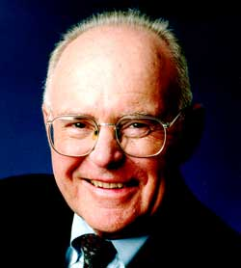
Recent Intel Processors
Year
Processor
Chip
Frequency
# Transistors
“Moore’s Law”
The number of transistors per chip seems to be doubling every 18 months!
1993
Pentium
66MHz
3.1 million
1997
pentium II
300MHz
7.5 million
1999
Pentium III
450MHz
28 million
Gordon Moore, 1965
2000
Pentium IV
1.5GHz
42 million

Slide 21
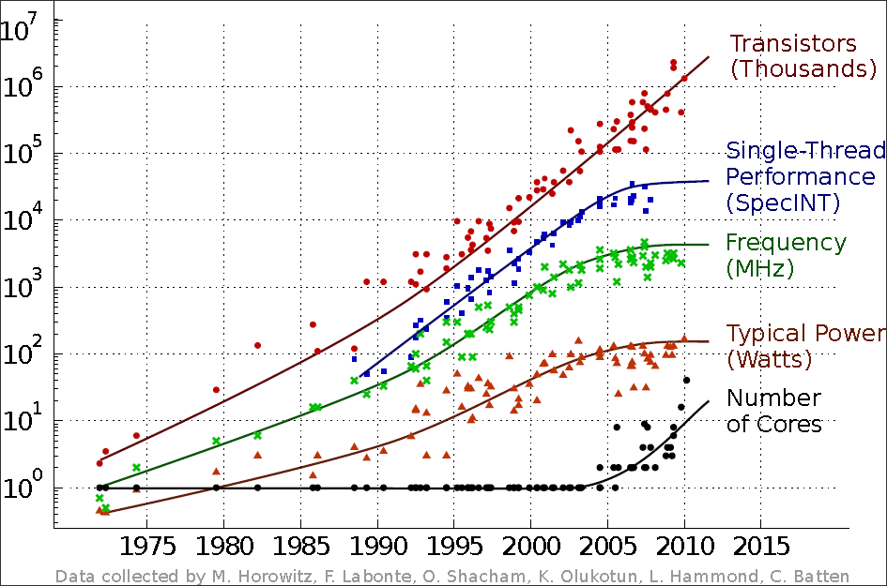
Increases in Transistors vs. Clock Freq.
Notes:
While it seems that Moore’s law will continue, providing billions of transistors on a chip,
we have already seen the end of frequency scaling due to power and other limitations

Slide 22
A Multicore Present and Future
C
C
C
C
C
C
C
P
P
P
P
PentiumIV
Core2 Duo
Core 2 Quad
P
P
P
C
C
C
C
P
C
C
C
C
C
C
C
C
C
C
C
C
P
C
C
C
C
P
P
P
C
C
C
C
8-core
16-core
☞ 2x cores every 1-2yrs: 1000 cores by 2020!?
Notes:
Two years ago I asked an audience how many people owned a dual-core desktop or laptop, and there were almost no hands.
So I’ll try again today: how many people have a dual core?
Apple A6 – processor of its iphone 5, has 2 cores
How many people have a quad-core?
By the end of the year Intel and AMD will have released 8-core processor chips; SUN has had an 8-core out for a while now.
In fact, the trend is for the number of processor cores to continue doubling each technology generation.
This means that we could be approaching 1k cores by 2020 if trends continue!
Sounds great---so what’s the catch?

Slide 23
Only One Sequential Program to Run?
void display_homepage (user) {
friendlist = get_friendlist (user);
foreach (friend in friendlist) {
update = get_update_status (friend);
display (update);
}
}
Time
P
C
C
C
C
P
C
C
C
C
C
C
P
C
C
C
C
P
P
C
C
C
C
one core idle
16-core
15 cores idle!

Slide 24
Improving Execution Time
Single Program:
Exec.
Time

C
C
C
C
C
need parallel threads to reduce execution time

Slide 25
void display_homepage (user) {
friendlist = get_friendlist (user);
foreach (friend in friendlist) {
pthread_create(fetch_and_display, friend);
}
}
void fetch_and_display (friend) {
update = get_update_status (friend);
display (update);
}
fetch_and
_display
fetch_and
_display
fetch_and
_display
fetch_and
_display
C
C
C
C

Slide 26
Punch line: We Must Parallelize All Software!
☞ You will learn it in ECE 454

Slide 27
But…
So far we only discussed CPU
But is it true that faster CPU -> faster program?
The same program may run slower on a faster CPU. Why?
void display_homepage (user) {
friendlist = get_friendlist (user);
foreach (friend in friendlist) {
update = get_update_status (friend);
display (update);
}
}
Notes:
can you think of any reason?

Slide 28
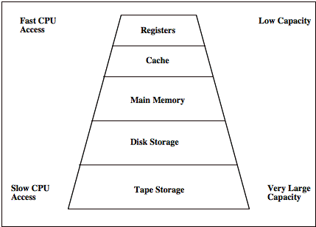
Storage hierarchy
Your program needs to access data. That takes time!

Slide 29
Numbers everyone should know
L1 cache reference 0.5 ns* (L1 cache size: < 10 KB)
Branch mispredict 5 ns
L2 cache reference 7 ns (L2 cache size: hundreds KB)
Mutex lock/unlock 100 ns
Main memory reference 100 ns (mem size: GBs)
Send 2K bytes over 1 Gbps network 20,000 ns
Read 1 MB sequentially from memory 250,000 ns
Round trip within same datacenter 500,000 ns
Flash drive read 40,000 ns
Disk seek 10,000,000 ns (10 milliseconds)
Read 1 MB sequentially from network 10,000,000 ns
Read 1 MB sequentially from disk 30,000,000 ns
Send packet Cal.->Netherlands->Cal. 150,000,000 ns
*1 ns = 1/1,000,000,000 second
For a 2.7 GHz CPU (my laptop), 1 cycle = 0.37 ns
Data from Jeff Dean
Notes:
L3: several MB, 20 ns

Slide 30
Performance optimization is about finding the bottleneck
If you can avoid unnecessary disk I/O
---> your program could be 100,000 times faster
Have you heard of Facebook’s memcached?
If you allocate your memory in a smart way
---> your data can fit entirely in cache
and your program could be another 100 times faster
You will learn this in lab assignments

Slide 31
Back to the Facebook example
void display_homepage (user) {
friendlist = get_friendlist (user);
foreach (friend in friendlist) {
pthread_create(fetch_and_display, friend);
}
}
void fetch_and_display (friend) {
update = get_update_status (friend);
display (update);
}
Challenge: the data rows are too BIG!
100 Petabytes = 100,000 x my laptop

Slide 32
Back to the Facebook example
void display_homepage (user) {
friendlist = get_friendlist (user);
updates = MULTI_GET (“updates”, friendlist);
display (updates);
}
MULTI_GET
Optimization 1: parallelization
server
server
server
server
Opt. 2: Store in
memory instead
of hard disk
memory
memory
memory
memory
FriendA
FriendB
FriendC

Slide 33
Course Content

Slide 34
Course Breakdown
Module 1: Code Measurement and Optimization
Module 2: Memory Management and Optimization
Module 3A: Multi-core parallelization
Module 3B: Multi-machine parallelization

Slide 35
1) Code Measurement and Optimization
Topics
Finding the bottleneck!
code optimization principles
measuring time on a computer and profiling
Understanding and using an optimizing compiler
Assignments
HW1: Compiler optimization and program profiling
basic performance profiling, finding the bottleneck.

Slide 36
2) Memory Management and Opt.
Topics
Memory hierarchy
Caches and Locality
Virtual Memory
Note: all involve aspects of software, hardware, and OS
Assignments
HW2: Optimizing Memory Performance
profiling, measurement, locality enhancements for cache performance
HW3: Writing your own memory allocator package
understanding dynamic memory allocation (malloc)

Slide 37
3) Parallelization
Topics
A: Parallel/multicore architectures (high-level understanding)
Threads and threaded programming
Synchronization and performance
B: Parallel on multiple machines
Big data & cloud computing
Assignments
HW4: Threads and Synchronization Methods
Understanding synchronization and performance
HW5: Parallelizing a program
Parallelizing and optimizing a program for multicore performance

Slide 38
A big picture
Topic 1: code
optimization
C
C
Core
Cache
Cache
Cache
Topic 3A: multi-
core parallelization
Topic 2: mem.
management
Memory
Memory
Topic 3B: parallelization
using the cloud

Slide 39
Homework Schedule
HW1: 2 weeks 5%
HW2: 2 weeks 7%
HW3: 4 weeks 9%
HW4: 1.5 weeks 7%
HW5: 2 weeks 7%
35% total

Slide 40
The bigger picture
Optimization is not the ONLY goal!
Readability
Debugability
Reliability
Maintainability
Scalability
Efficiency
More important than performance!!!!
Premature optimization is the root of all evil!
– Donald Knuth

Slide 41
Example 1
Premature optimization causing bugs
cp /proc/cpuinfo .
Created an empty file!!! (Demo)
bool copy_reg (.. ) {
if (src.st_size != 0) {
/* Copy the file content */
}
else {
/* skip the copy if the file size = 0 */
}
}
Premature optimization!!!
Notes:
ug137:~/ece454/demo/cpuinfo_cp/coreutils-6.0/src
or on baker:teaching/ece454

Slide 42
Example 2
Optimization might reduce readability
int count (unsigned x) {
int sum = x;
while (x != 0) {
x = x >> 1;
sum = sum – x;
}
return sum;
}
int count (unsigned x) {
int sum, i;
sum = x;
for (i = 1; i < 31; i++) {
x = rotatel(x, 1);
sum = sum + x;
}
return -sum;
}
They’re both to count the number of ‘1’ bits in ‘x’.
How could someone else maintain this code?

Slide 43
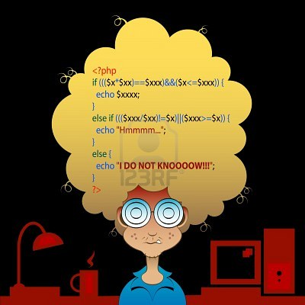
/*
* When I wrote this, only God and
* I understood what I was doing.
* Now, only God knows
*/

Slide 44
But how do I know if my optimization is “premature”?
Hard to answer…
“Make it work; Make it right; Make it Fast” --- Butler Lampson
Purpose of my program?
-- e.g., will it have a long lifetime or it’s a one-time thing (e.g., hackathon or ACM programming contest)
Am I optimizing for the bottleneck?
-- e.g., if the program is doing a lot of I/O, there is no point to optimize for “count the number of bits in an integer”
Am I optimizing for the common case or special case?
-- e.g., the “cp” bug was optimizing for a special case…
What’s the price I pay? e.g., reduced readability, increase program size, etc.

Slide 45
Again, “Premature optimization is the root of all evils”
If you are only going to remember one thing from ECE 454, this is it!
And let the fun begin!

