Slide 1
ECE 454 Computer Systems Programming CPU Architecture
Ding Yuan
ECE Dept., University of Toronto
http://www.eecg.toronto.edu/~yuan

Slide 2
Content
Examine the tricks CPU plays to make life efficient
History of CPU architecture
Modern CPU Architecture basics
UG machines
More details are covered in ECE 552
Notes:
We will tell you what tricks does the cpu play to make your program fast; but we won’t go into details on how the cpu implements each of these tricks.
ECE552

Slide 3
Before we start…
Hey, isn’t the CPU speed merely driven by transistor density?
Transistor density increase → clock cycle increase → faster CPU
A faster CPU requires
Faster clock cycle
smaller Cycles Per Instruction (CPI)
CPI is the focus of this lecture!
True
True, but
there is more…

Slide 4
In the Beginning…
1961:
First commercially-available integrated circuits
By Fairchild Semiconductor and Texas Instruments
1965:
Gordon Moore's observation: (director of Fairchild research)
number of transistors on chips was doubling annually

Slide 5
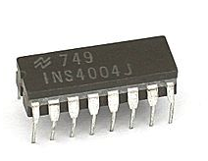
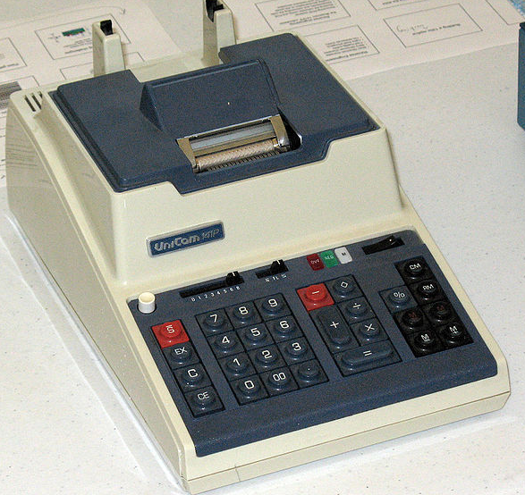
1971: Intel Releases the 4004
First commercially available, stand-alone microprocessor
4 chips: CPU, ROM, RAM, I/O register,
108KHz; 2300 transistors
4-bit processor for use in calculators

Slide 6
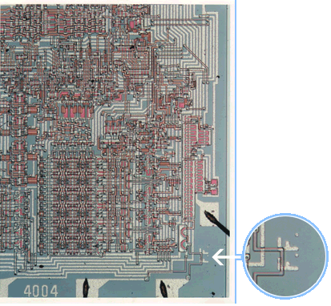
Designed by Federico Faggin

Slide 7
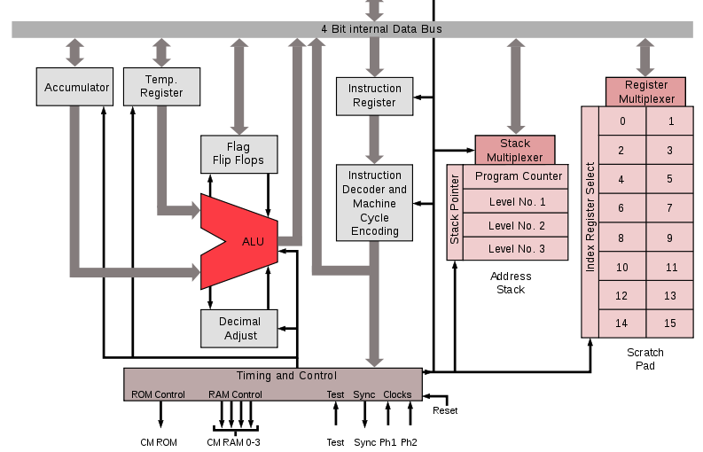
Intel 4004 (first microprocessor)
3 Stack registers (what does this mean)?
4-bit processor, but 4KB memory (how)?
No Virtual Memory support
No Interrupt
No pipeline

Slide 8
The 1970’s (Intel): Increased Integration
1971: 108KHz; 2300 trans.;
4-bit processor for use in calculators
1972: 500KHz; 3500 trans.; 20 support chips
8-bit general-purpose processor
1974: 2MHz; 6k trans.; 6 support chips
16-bit addr space, 8-bit registers, used in ‘Altair’
1978: 10MHz; 29k trans.;
Full 16-bit processor, start of x86
4004
8008
8080
8086

Slide 9
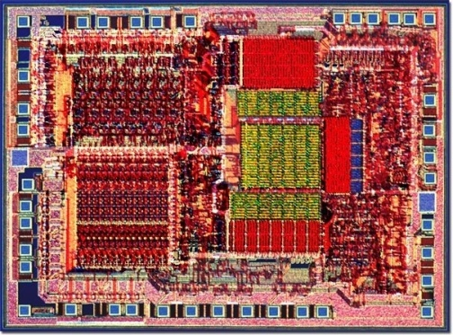
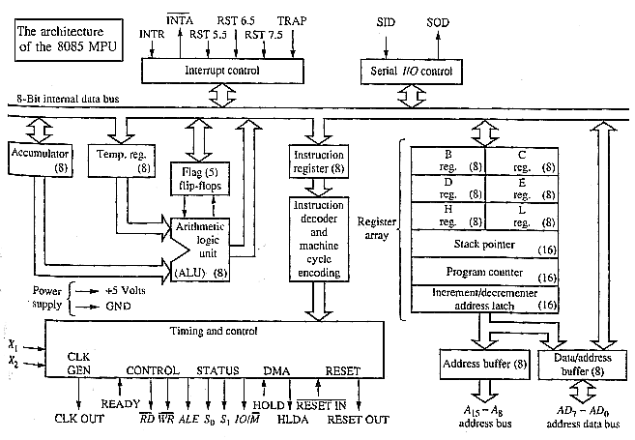
Intel 8085

Slide 10
The 1980’s: RISC and Pipelining
1980: Patterson (Berkeley) coins term RISC
1982: Makes RISC-I pipelined processors (only 32 instructions)
1981: Hennessy (Stanford) develops MIPS
1984: Forms MIPS computers
RISC Design Simplifies Implementation
Small number of instruction formats
Simple instruction processing
RISC Leads Naturally to Pipelined Implementation
Partition activities into stages
Each stage simple computation

Slide 11
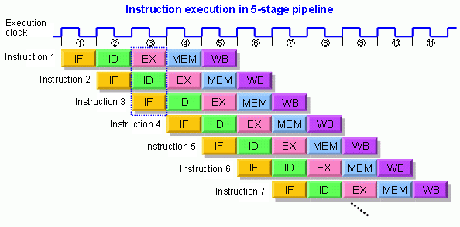
RISC pipeline
Reduce CPI from 5 → 1 (ideally)

Slide 12
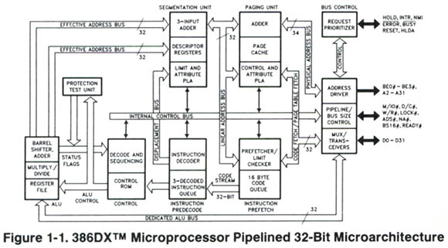
1985: Pipelining: Intel 386
33MHz, 32-bit processor, cache → KBs

Slide 13
Pipelines and Branch Prediction
BNEZ R3, L1
Which instr. should we fetch here?
Must wait/stall fetching until branch direction known?
Solutions?

Slide 14
Pipelines and Branch Prediction
Wait/stall?
Pipeline:
Insts fetched
Branch directions computed
How bad is the problem? (isn’t it just one cycle?)
Branch instructions: 15% - 25%
Pipeline deeper: branch not resolved until much later
Cycles are smaller
More functionality btw. fetch & decode
Misprediction penalty larger!
Multiple instruction issue (superscalar)
Flushing & refetching more instructions
Object-oriented programming
More indirect branches which are harder to predict by compiler

Slide 15
Branch Prediction: solution
Solution: predict branch directions:
Intuition: predict the future based on history
Use a table to remember outcomes of previous branches
BP is important: 30K bits is the standard size
of prediction tables on Intel P4!

Slide 16
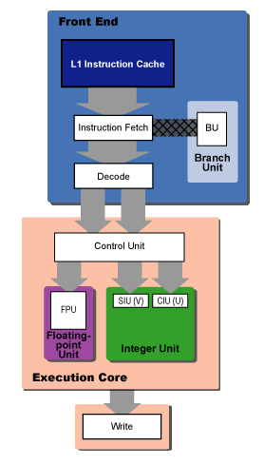
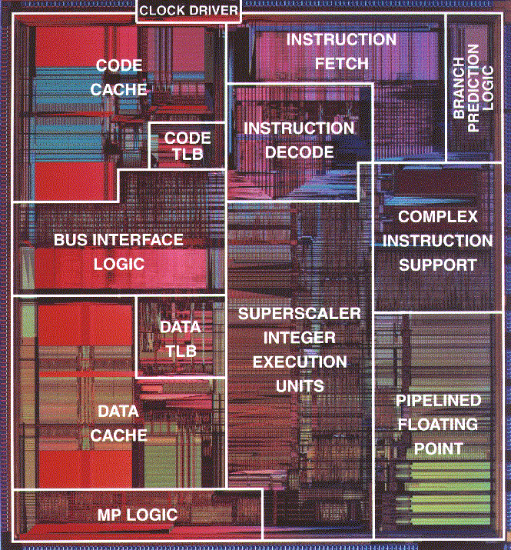
1993: Intel Pentium

Slide 17
What do we have so far
CPI:
Pipeline: reduce CPI from n to 1 (ideal case)
Branch instruction will cause stalls: effective CPI > 1
Branch prediction
But can we reduce CPI to <1?

Slide 18
Instruction-Level Parallelism
1
1
1
2
instructions
2
3
4
5
2
3
3
6
4
Execution
Time
4
7
8
application
5
9
5
6
6
7
7
8
8
9
9
single-issue
superscalar

Slide 19
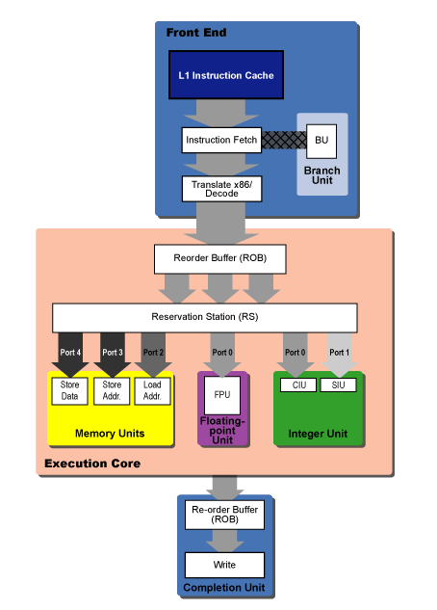
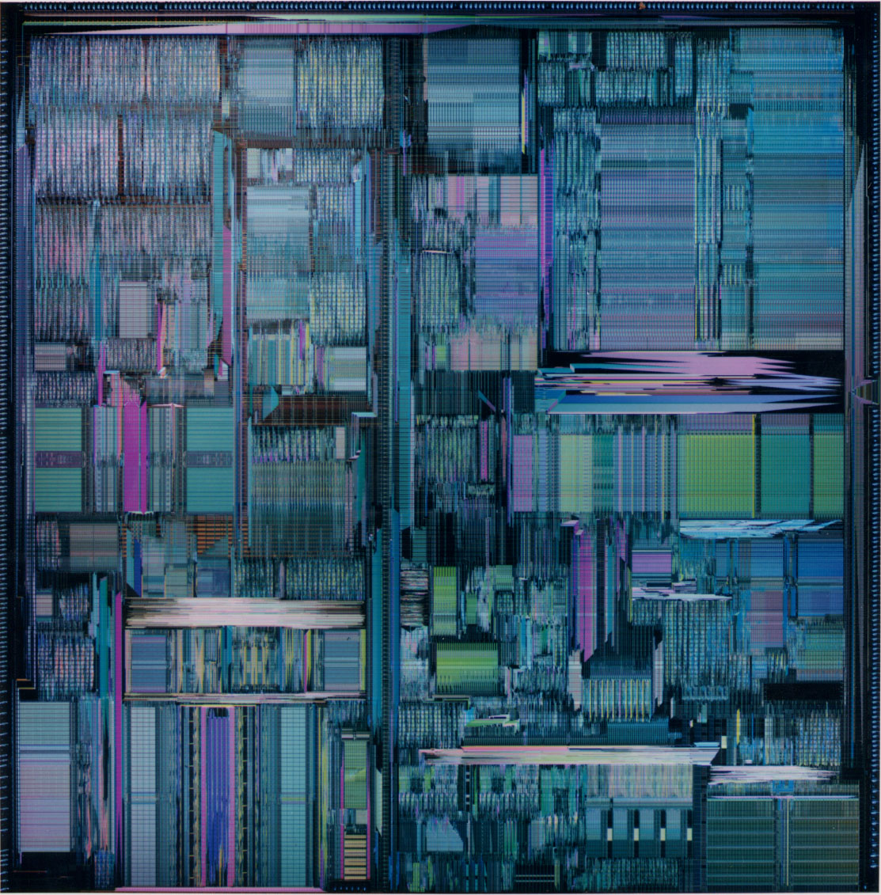
1995: Intel PentiumPro

Slide 20
Data hazard: obstacle to perfect pipeline
DIV F0, F2, F4 // F0 = F2/F4
ADD F10, F0, F8 // F10 = F0 + F8
SUB F12, F8, F14 // F12 = F8 – F14
DIV F0,F2,F4
STALL: Waiting for F0 to be written
STALL: Waiting for F0 to be written
ADD F10,F0,F8
SUB F12,F8,F14
Necessary?

Slide 21
Out-of-order execution: solving data-hazard
DIV F0, F2, F4 // F0 = F2/F4
ADD F10, F0, F8 // F10 = F0 + F8
SUB F12, F8, F14 // F12 = F8 – F14
DIV F0,F2,F4
SUB F12,F8,F14
☞
Not wait (as
long as it’s
safe)
STALL: Waiting for F0 to be written
ADD F10,F0,F8

Slide 22
Out-of-Order exe. to mask cache miss delay
IN-ORDER:
OUT-OF-ORDER:
inst1
inst1
inst2
load (misses cache)
inst3
inst2
inst4
inst3
Cache miss latency
load (misses cache)
inst4
inst5 (must wait for load value)
Cache miss latency
inst6
inst5 (must wait for load value)
inst6

Slide 23
Out-of-order execution
In practice, much more complicated
Detect dependency
Introduce additional hazard
e.g., what if I write to a register too early?

Slide 24
Instruction-Level Parallelism
1
1
1
2
1
2
6
instructions
2
3
4
5
3
4
5
2
3
3
6
7
8
4
Execution
Time
4
7
8
9
application
5
9
5
6
6
7
7
8
8
9
9
out-of-order
single-issue
superscalar
super-scalar

Slide 25
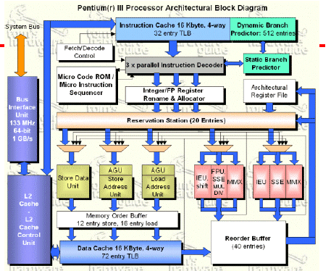
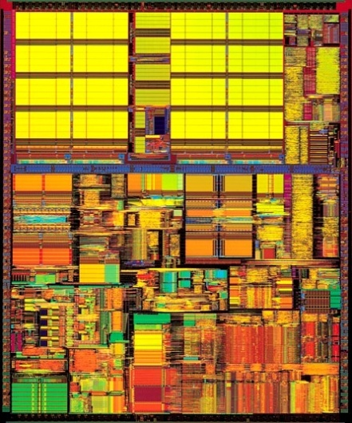
1999: Pentium III

Slide 26
Deep Pipelines
Pentium III’s Pipeline: 10 stages
Pentium IV’s Pipeline (deep pipeline):
TC nxt IP
TC fetch
Drv
Alloc
Rename
Que
Sch
Sch
Sch
Disp
Disp
RF
RF
Ex
Flgs
BrCk
Drv
Notes:
http://www.hardwaresecrets.com/article/Inside-Pentium-4-Architecture/235/2

Slide 27
The Limits of Instruction-Level Parallelism
1
2
6
1
2
6
Execution
Time
3
4
5
3
4
5
7
8
7
8
9
9
out-of-order
wider OOO
super-scalar
super-scalar
diminishing returns for wider superscalar

Slide 28
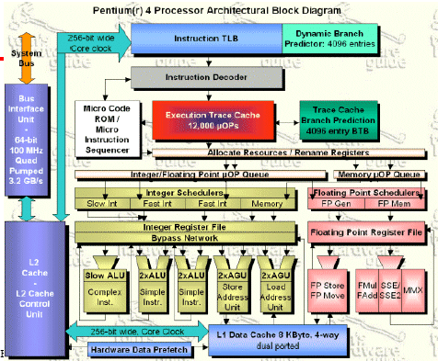
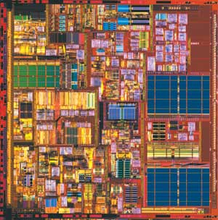
2000: Pentium IV

Slide 29
Multithreading The “Old Fashioned” Way
1
1
1
2
6
2
2
3
4
5
3
3
Execution
Time
7
8
4
4
9
Application 1
Application 2
1
6
5
5
2
6
6
3
4
5
7
7
7
8
8
8
9
9
9
Fast context
switching

Slide 30
Simultaneous Multithreading (SMT) (aka Hyperthreading)
1
2
6
1
2
1
3
4
5
2
6
6
Execution
Time
Execution
Time
7
8
3
3
5
9
4
4
5
1
2
6
7
8
7
3
4
5
9
8
7
8
9
9
Fast context
hyperthreading
switching
SMT: 20-30% faster than context switching

Slide 31
Putting it all together: Intel
Year
Processor
Tech.
CPI
1971
4004
no pipeline
n
1985
386
pipeline
close to 1
branch prediction
closer to 1
1993
Pentium
Superscalar
< 1
1995
PentiumPro
Out-of-Order exe.
<< 1
1999
Pentium III
Deep pipeline
shorter cycle
2000
Pentium IV
SMT
<<<1

Slide 32
32-bit to 64-bit Computing
Why 64 bit?
32b addr space: 4GB; 64b addr space: 18M * 1TB
Benefits large databases and media processing
OS’s and counters
64bit counter will not overflow (if doing ++)
Math and Cryptography
Better performance for large/precise value math
Drawbacks:
Pointers now take 64 bits instead of 32
Ie., code size increases
unlikely to go to 128bit

Slide 33
Optional materials (not covered in lectures)

Slide 34
Branch Prediction: solution
Solution: predict branch directions: branch prediction
Intuition: predict the future based on history
Local prediction for each branch (only based on your own history)
Problem?

Slide 35
Branch Prediction: solution
if (a == 2)
a = 0;
if (b == 2)
b = 0;
if (a != b)
.. ..
Only depends on the history
of itself?
Global predictor
Intuition: predict based on the both the global and local history
(m, n) prediction (2-D table)
An m-bit vector storing the global branch history (all executed branches)
The value of this m-bit vector will index into an n-bit vector – local history
BP is important: 30K bits is the standard size
of prediction tables on Intel P4!

